Slide 1
Porting to .NET Core

Slide 2
When Should You Port To .NET Core
Need .NET Core Features (e.g. Cross-Platform)
New Project
Able to Upgrade Individual Component / Service

Slide 3
When Shouldn’t You Port To .NET Core
Working Code, No Compelling Business Reason
Need Features Not In .NET Core (Pretty Few Now)

Slide 4
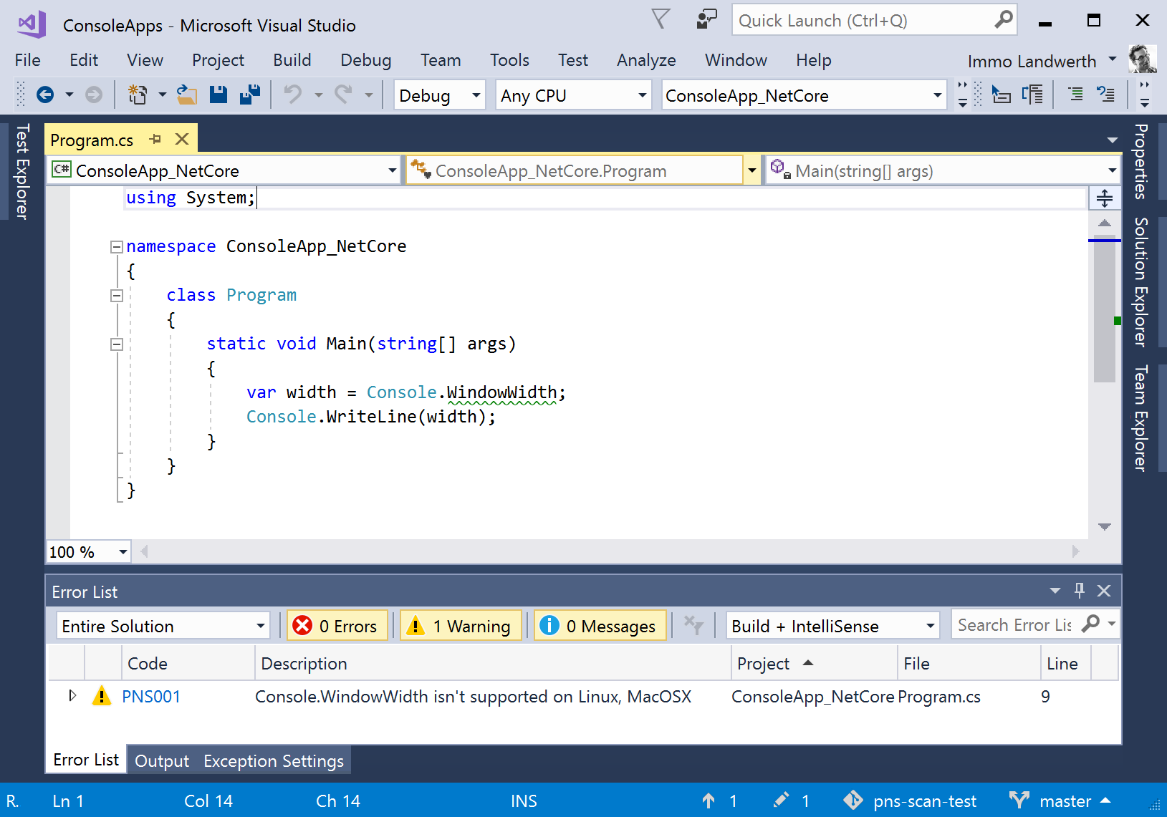
Platform-Compat Analyzer

Slide 5
Demo: Porting a Library

Slide 6
Demo: Porting an ASP.NET MVC 5 Application

