Slide 1
ASP.NET Core
Notes:
Agenda
- Introduce .NET Core
- Development
- Deployment
- .NET CLI

Slide 2



Visual Studio for Mac
The IDE loved by millions, now on the Mac
Build apps, games, and services for mobile, web, and cloud
Productivity for teams across PC and Mac
An IDE natively designed for the Mac
Notes:
Visual Studio for Mac brings the IDE loved by millions to the Mac. It offers developers an integrated environment to build, debug, test, and deploy apps, games, and services for mobile, web, and cloud. Teams across PC and Mac can share code seamlessly by relying on the same solutions and projects. This is al offered in an IDE that is natively designed for the Mac and feels right at home for any Mac user.

Slide 3
Create web apps with powerful tooling
Visual Studio web development
Same powerful web editor tools from Visual Studio on Windows
Full support for ASP.NET Core, HTML5, and CSS3
Built-in support for publishing to Azure
Notes:
CONTEXT : Native applications, may not be suitable for all the apps in a companies mobile strategy. They may prefer to develop some of these new apps as pure web apps, or hybrid apps for mobile devices, rather than going through the native route.
Visual Studio for Mac provides the same powerful web editor tools you know and love from Visual Studio on Windows.
With full support for ASP.NET Core, HTML5, and CSS3, you can build highly interactive JavaScript-based apps for consumers, LOB, and enterprise.
With built-in support for publication of your web apps to Azure, scaling through the cloud couldn’t be easier.

Slide 4



ASP.NET Core in a Nutshell
Web
Forms
MVC
Web API
ASP.NET Core MVC
ASP.NET 4.6
(System.Web)
ASP.NET Core 1.0
(Microsoft.AspNetCore)
.NET Framework
.NET Core
Platform for .NET applications on Windows
Cross-platform, modular libraries & runtime optimized for server and cloud workloads

Slide 5
ASP.NET Core features
Hosting
Kestrel, Startup
Middleware
Routing, authentication, static files, diagnostics, error handling, session, CORS, localization, custom
Dependency Injection
Configuration
Logging
Application frameworks
MVC, Identity, SignalR (future)

Slide 6
Middleware

Slide 7
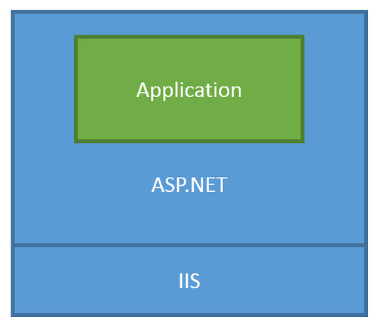
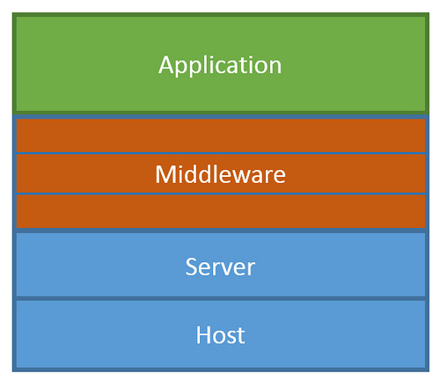
ASP.NET Core Middleware
Traditional ASP.NET Application Model
ASP.NET Core Middleware

Slide 8
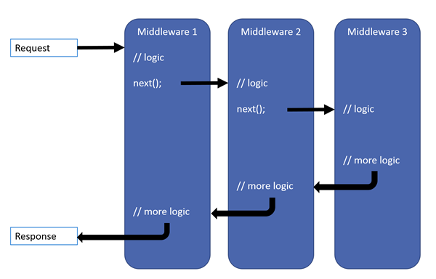
ASP.NET Core Middleware

Slide 9
MVC + Web API + Web Pages = ASP.NET Core MVC

Slide 10
ASP.NET Core frameworks - similar, but different
Web Pages
MVC
Web API
Razor
HTML Helpers
HTML Helpers
Controllers
Controllers
Actions
Actions
Filters
Filters
Model binding
Model binding
DI
DI

Slide 11
MVC

Slide 12
What’s (pretty much) the same
MVC developer flow
Models / Views / Controllers
Routing / Attribute Routing
HTML Helpers

Slide 13
What’s Changed
No web.config (configuration)
No Global.asax or App_Start
No CSS / JS in project root (wwwroot)
bower and bowerrc
bundleconfig.json
New Program.cs / Startup.cs
Run with IISExpress / Kestrel

Slide 14
What’s new (sessions later)
(some aren’t MVC features but are useful for MVC dev)
Views get TagHelpers
DI more thoroughly integrated
Globalization / localization
MVC + APIs merged

Slide 15
TagHelpers
HTML helpers expressed as tags
Ex. Instead of:
@Html.LabelFor(m => m.UserName, new { @class = "col-md-2 control-label" })
Write this:
<label asp-for="UserName" class="col-md-2 control-label"></label>
Easier to customize with additional attributes
Work seamlessly with the HTML editor

Slide 16
TagHelpers
@using (Html.BeginForm(new { ReturnUrl = ViewBag.ReturnUrl })) {
@Html.AntiForgeryToken()
@Html.ValidationSummary(true)
<fieldset>
<legend>Log in Form</legend>
<ol>
<li>
@Html.LabelFor(m => m.UserName)
@Html.TextBoxFor(m => m.UserName)
@Html.ValidationMessageFor(m => m.UserName)
</li>

Slide 17
TagHelpers
<form anti-forgery=“true“ validation-summary=“true” action="Create“>
<fieldset>
<legend>Log in Form</legend>
<ol>
<li>
<label for=“UserName”>
<input for=“UserName”>
<span validation-for="Name" style="color:blue" />
</li>

Slide 18
TagHelpers: Create Your Own
public interface ITagHelper
{
int Order { get; }
Task ProcessAsync(TagHelperContext context, TagHelperOutput output);
}
Examples: https://github.com/aspnet/Mvc/tree/dev/src/Microsoft.AspNet.Mvc.TagHelpers

Slide 19
JavaScriptServices
Useful infrastructure for SPA’s on ASP.NET Core
Hosts Webpack to compile and serve client-side code
Advanced features like Hot Module Reloading and client / server side routing integration
Can invoke arbitrary NPM packages from .NET code
https://github.com/aspnet/JavaScriptServices

Slide 20
Lab
Building an ASP.NET Core Site using CLI

Slide 21
Lab
Razor Pages

Slide 22
Lab
Tag Helpers

Slide 23
Lab
SPA’s JavaScript Services

