Slide 1
Porting to .NET Core

Slide 2
When Should You Port To .NET Core
Need .NET Core Features (e.g. Cross-Platform)
New Project
Able to Upgrade Individual Component / Service

Slide 3
When Shouldn’t You Port To .NET Core
Working Code, No Compelling Business Reason
Need Features Not In .NET Core (Pretty Few Now)

Slide 4
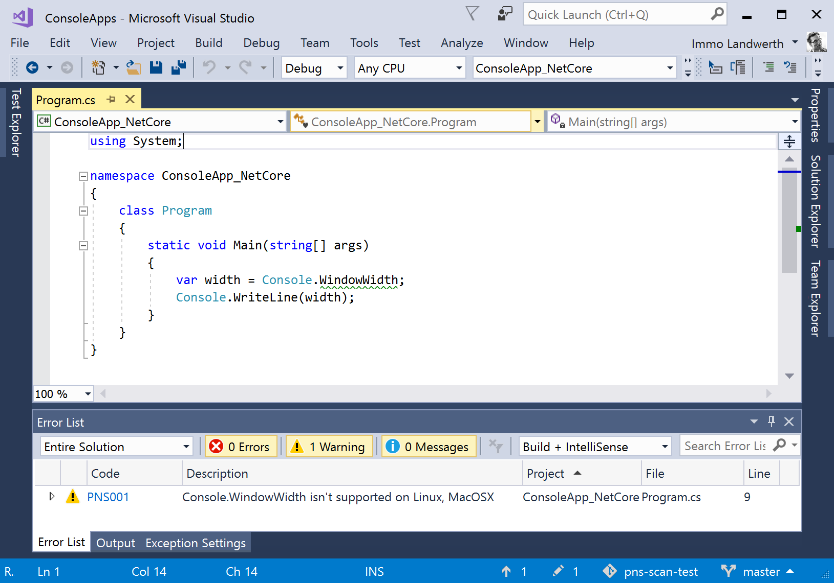
Platform-Compat Analyzer

Slide 5
Demo: Porting a Library

Slide 6
Demo: Porting an ASP.NET MVC 5 Application

Slide 7
ASP.NET Considerations
Modules / Handlers
Startup / Configuration
Front-end (static) files
Identity
Entity Framework (migrations, etc.)
Tool: Routing

Slide 8
Steps
Get ready
Learn with a new / internal application
Prepare Your Existing Application
Update to new release / patterns
Refactor to services
Test coverage (unit, integration, user interface)
Create a New Application
Select the nearest match
Copy / reference code

