Slide 1
ASP.NET Core
Notes:
Agenda
- Introduce .NET Core
- Development
- Deployment
- .NET CLI

Slide 2



ASP.NET Core in a Nutshell
Web
Forms
MVC
Web API
ASP.NET Core MVC + Razor Pages + API
ASP.NET 4.6
(System.Web)
ASP.NET Core 2.0
(Microsoft.AspNetCore)
.NET Framework
.NET Core
Platform for .NET applications on Windows
Cross-platform, modular libraries & runtime optimized for server and cloud workloads

Slide 3
ASP.NET Core features
Hosting
Kestrel, Startup
Middleware
Routing, authentication, static files, diagnostics, error handling, session, CORS, localization, custom
Dependency Injection
Configuration
Logging
Application frameworks
MVC, Identity, SignalR (future)

Slide 4
Middleware

Slide 5
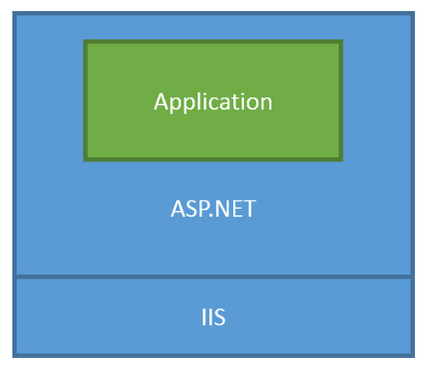
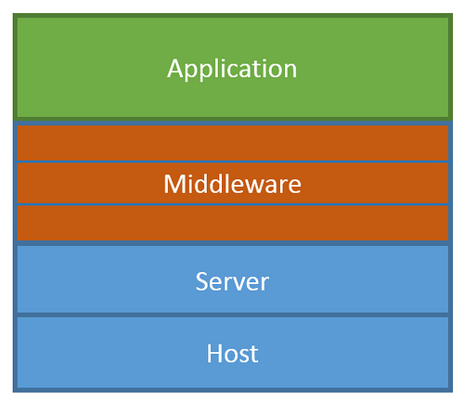
ASP.NET Core Middleware
Traditional ASP.NET Application Model
ASP.NET Core Middleware

Slide 6
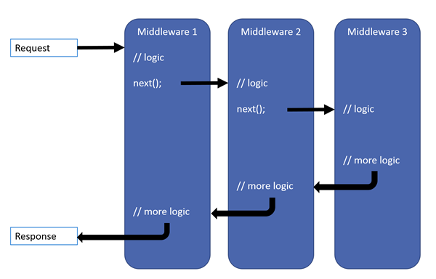
ASP.NET Core Middleware

Slide 7
MVC + Web API + Web Pages = ASP.NET Core MVC

Slide 8
ASP.NET Core frameworks - similar, but different
Web Pages
MVC
Web API
Razor
HTML Helpers
HTML Helpers
Controllers
Controllers
Actions
Actions
Filters
Filters
Model binding
Model binding
DI
DI

Slide 9
MVC

Slide 10
What’s (pretty much) the same
MVC developer flow
Models / Views / Controllers
Routing / Attribute Routing
HTML Helpers

Slide 11
What’s Changed
No web.config (configuration)
No Global.asax or App_Start
No CSS / JS in project root (wwwroot)
bower and bowerrc
bundleconfig.json
New Program.cs / Startup.cs
Run with IISExpress / Kestrel

Slide 12
What’s new (sessions later)
(some aren’t MVC features but are useful for MVC dev)
Views get TagHelpers
DI more thoroughly integrated
Globalization / localization
MVC + APIs merged

Slide 13
TagHelpers
HTML helpers expressed as tags
Ex. Instead of:
@Html.LabelFor(m => m.UserName, new { @class = "col-md-2 control-label" })
Write this:
<label asp-for="UserName" class="col-md-2 control-label"></label>
Easier to customize with additional attributes
Work seamlessly with the HTML editor

Slide 14
TagHelpers
@using (Html.BeginForm(new { ReturnUrl = ViewBag.ReturnUrl })) {
@Html.AntiForgeryToken()
@Html.ValidationSummary(true)
<fieldset>
<legend>Log in Form</legend>
<ol>
<li>
@Html.LabelFor(m => m.UserName)
@Html.TextBoxFor(m => m.UserName)
@Html.ValidationMessageFor(m => m.UserName)
</li>

Slide 15
TagHelpers
<form anti-forgery=“true“ validation-summary=“true” action="Create“>
<fieldset>
<legend>Log in Form</legend>
<ol>
<li>
<label for=“UserName”>
<input for=“UserName”>
<span validation-for="Name" style="color:blue" />
</li>

Slide 16
TagHelpers: Create Your Own
public interface ITagHelper
{
int Order { get; }
Task ProcessAsync(TagHelperContext context, TagHelperOutput output);
}
Examples: https://github.com/aspnet/Mvc/tree/dev/src/Microsoft.AspNet.Mvc.TagHelpers

Slide 17
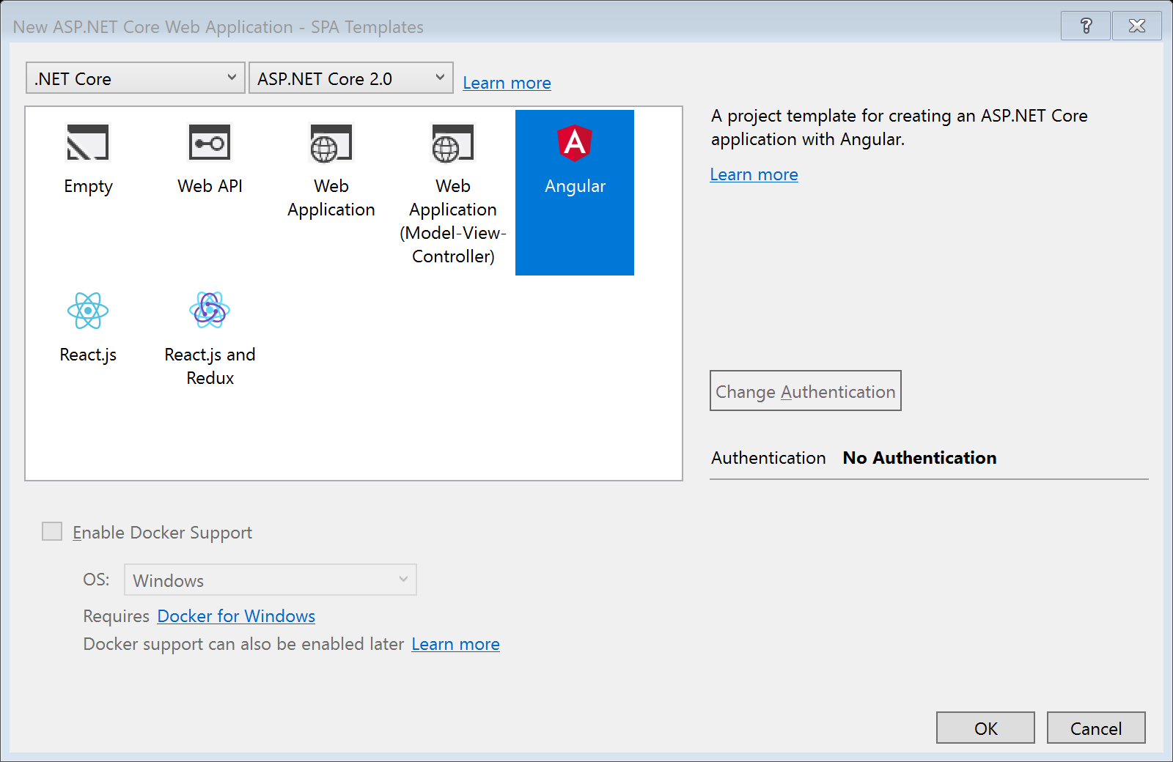
SPA Templates

Slide 18
SPA Templates: Built on JavaScriptServices
Useful infrastructure for SPA’s on ASP.NET Core
Hosts Webpack to compile and serve client-side code
Advanced features like Hot Module Reloading and client / server side routing integration
Can invoke arbitrary NPM packages from .NET code
https://github.com/aspnet/JavaScriptServices

Slide 19
Lab
Building an ASP.NET Core Site using CLI

Slide 20
Lab
Razor Pages

Slide 21
Lab
Tag Helpers

Slide 22
Lab
SPA Template

