Slide 1
The Azure SQL Workshop

Slide 2
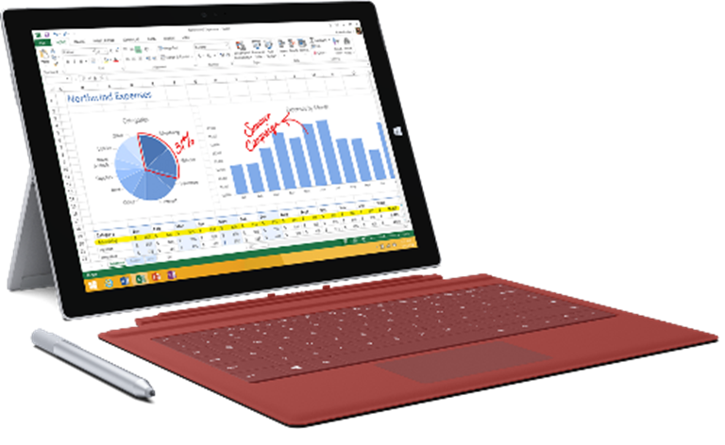
Prerequisites
Complete Installation
Using a Lab Environment
Walk-Through Demos
Notes:
Explain the Manual, Lab or Walk-through process, regardless of how you are teaching

Slide 3
The Azure SQL Workshop
Introduction to Azure SQL
Module 01
Security
Module 02
Performance
Module 03
Availability
Module 04
Putting it all together
Module 05
aka.ms/sqlworkshops
Notes:
(NOTE: Replace artwork on right with stock photo of your location)
Explain the Modules

Slide 4
00 – Prerequisites

Slide 5
01 – Introduction to Azure SQL

Slide 6
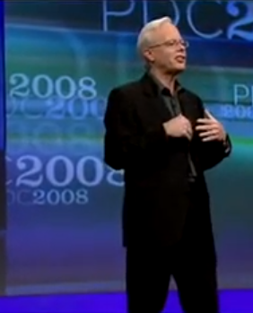
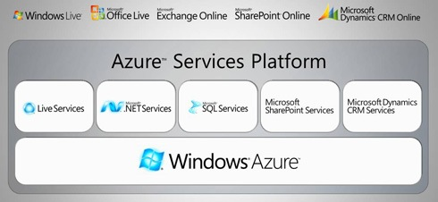
History of Azure SQL

Slide 7



Azure SQL
SQL virtual machines
Managed instances
Databases
Best for migrations and applications requiring OS-level access
Best for most lift-and-shift migrations to the cloud with instance-level access
Best for modern cloud applications. Hyperscale and serverless options are available

Slide 8





Azure SQL virtual machines
Challenges
Solution
The contract on my hardware is expiring
I have instances of SQL Server 2008 and 2008 R2
I want to migrate to the cloud as fast as possible
I use third party software that needs OS-level access
I have dependencies on SSRS
I want to extend our on-premises apps to Azure
I need an unlimited number of DBs
I want the full feature set of SQL Server 20XX
Best for migrations and applications requiring OS-level access
Free Extended Security Updates for SQL Server 2008/R2*
435 percent overall return on an Azure IaaS investment over five years (Forrester Consulting)
SQL Server and OS server access
Expansive SQL and OS version support
Automated manageability features for SQL Server
Automatic security patching
Point in time restore with Azure Backup
File stream, DTC, and Simple Recovery model available
Azure Key Vault integration
Support for Linux and Windows
Up to 3.4x faster and 87% cheaper than AWS EC2**
Customer example
Notes:
2 min
Does your application require custom VM or SQL config? DB engine version choice, feature compatibility with SQL box, app portability, access to VM/OS
* ESU worth 75% of license every year for the next three years after EOS; ** Applicable to Azure Marketplace images, customers using customer SQL Server 2008/R2 custom images can download the ESU for free and manually apply.
VMs: Allscripts https://customers.microsoft.com/en-us/story/allscripts-partner-professional-services-azure
Move 600 VMs to Azure within a few weeks. Some time later moving some to MI
Rehost SQL Server 2008 and 2008 R2 in Azure Virtual Machines to get three years of Extended Security Updates at no additional charge and upgrade to a newer version when ready
435 percent overall return on an Azure IaaS investment over five years (for a composite organization based on the interviewed customers) (Forrester Consulting)
https://azure.microsoft.com/en-us/overview/azure-vs-aws/cost-savings/#sql-server-iaas

Slide 9
TODO: IaaS vs PaaS slide

Slide 10
IaaS vs PaaS
Business continuity
High availability
Automated backups
Long term backup retention
Geo-replication
Scale
Advanced security
Automatic tuning
Built-in monitoring
Built-in intelligence
Notes:
Business continuity enables your business to continue operating in the face of disruption, particularly to its computing infrastructure.
High availability of Azure SQL Database guarantees your databases are up and running 99.99% of the time, no need to worry about maintenance/downtimes.
2 read replicas - GP
3 replicas, 1 read-scale replica, zone-redundant HA - BC
Primary read/write replica + up to 4 read replicas - HS
Automated backups are created and use Azure read-access geo-redundant storage (RA-GRS) to provide geo-redundancy.
Also Point in Time restore
Long term backup retention enables you to store specific full databases for up to 10 years.
Geo-replication by creating readable replicas of your database in the same or different data center (region). You can manually failover to readable replicas
Also Auto-failover groups allows an application to recover in case of a data center outage
Scale by easily adding more resources (CPU, memory, storage) without long provisioning.
Advanced security detects threats and vulnerabilities in your databases and enables you to secure your data.
Automatic tuning analyzes your workload and provides you the recommendations that can optimize performance of your applications by adding indexes, removing unused indexes, and automatically fixing the query plan issues.
Built-in monitoring capabilities enable you to get the insights into performance of your databases and workload, and troubleshoot the performance issues.
Built-in intelligence automatically identifies the potential issues in your workload and provides you the recommendations that can help you to fix the problems.

Slide 11

Azure SQL managed instance
Challenges
Solution
I want to migrate to Azure
I want to remove some of the management overhead and stress with regards to business continuity, high availability, and disaster recovery
I need instance-scoped features like SQL Server Agent, Database Mail, Service Broker, CLR, etc.
Best for most lift-and-shift migrations to the cloud
Single instance or Instance pool
SQL Server surface area (vast majority)
Native virtual network support
Fully managed Service
Near zero downtime migration using log-shipping
Projected return on investment of 212 percent over three years (Forrester Consulting)
Combine the best of SQL Server with the benefits of a managed service
Enable your on-premise identities on cloud instances, through integration with Azure Active Directory and AD Connect
Fully managed business continuity with failover groups
Customer example
Notes:
2 min
You get two levels of isolation:
Cluster level: Managed Instances for a tenant are fully isolated from other tenants. No connectivity or resource sharing is possible between different tenants.
Networking level: joining instances to a subnet in a VNET and restricting access to private IP addresses only provides full isolation from public Internet.
Managed Instance: Komatsu https://customers.microsoft.com/en-us/story/komatsu-australia-manufacturing-azure
Moved about 1.5 TBs of data very smoothly because of the near 100% compatibility with SQL Server
49% reduction in cost and 25% increase in performance gains

Slide 12

Azure SQL Database
Challenges
Solution
I want to build a modern multi-tenant SaaS app
I want to use a database with dedicated resources and predictable performance
I want to independently scale compute and storage in my database
I want to have unlimited databases storage when I need it
I want to build a mission critical application with highest uptime
I want to integrate Azure services into my applications
Best for modern cloud applications
Single database or elastic pool
Industry highest availability SLA of 99.995%
Hyperscale storage (100TB+)
Serverless compute
Fully managed service
Private link (preview)
Price-performance leader for mission-critical workloads while costing up to 86 percent less than AWS RDS (GigaOm)
High availability with AZ isolation
Business continuity at scale
Industry only business continuity SLA with 5 second RPO and 30 second RTO
Intelligent database
Customer example
Notes:
2 min
Potential demos here:
Online gaming site build demo for BC MI and read scale out
Serverless wine quality database
Database: AccuWeather https://customers.microsoft.com/en-us/story/accuweather-partner-professional-services-azure
New intelligent applications. Using Azure Machine Learning Services to make sales and customers predictions

Slide 13


Azure SQL
SQL virtual machines
Managed instances
Databases
Best for migrations and applications requiring OS-level access
Best for most lift-and-shift migrations to the cloud
Best for modern cloud applications. Hyperscale and serverless options are available
SQL virtual machine
Single instance
Instance pool
Single database
Elastic pool
SQL Server and OS server access
Expansive SQL And OS version support
Automated manageability features for SQL Server
SQL Server surface area (vast majority)
Native virtual network support
Fully managed service
Pre-provision compute resources for migration
Enables cost-efficient migration.
Ability to host smaller instances (2Vcore)
Currently in public preview
Hyperscale storage (up to 100TB)
Serverless compute
Fully managed service
Resource sharing between multiple databases to price optimize
Simplified performance management for multiple databases
Fully managed service

Slide 14
Deploy and Configure Azure SQL
Deployment methods
Configuration choices during deployment
Verify deployment
Determine what features exist
Configure SQL Server
Deploy databases
Configure databases
Load data
Migrate from legacy SQL Server

Slide 15
Deployment methods
Platform deployment
GUI deployment
Unattended deployment
Offline deployment

Slide 16
SQL Server: Configuration choices during deployment
Accept the EULA
Choose the features to be installed
Choose the collation
Choose Instant File Initiation
Choose Directories
Choose Service Accounts
Add sys admin account(s)
Choose tempdb config
Choose MAXDOP config
Choose memory config
Create resource group
Choose server name
Add admin login
Select region
Opt in for pools
Choose purchasing model
Choose service tier
Choose hardware generation
Choose networking options
Choose data source
Choose collation
Choose time zone
Opt in for Advanced Data Security
Review Terms and Privacy

Slide 17
Choosing purchasing model
DTU model
Simple, preconfigured
vCore model
Independent scalability
Compute
Compute
Microsoft’s recommendation
Storage
Storage
Pre-packaged, bundled unit that represents the database power
Designed for predictable performance, but somewhat inflexible and limited in options
DTU sizing offers simplicity of choice
This model allows you to independently choose compute and storage resources. It also allows you to use Azure Hybrid Benefit for SQL Server to gain cost savings.
Best for customers who value flexibility, control and transparency
Notes:
Overview: Azure SQL Database enables you to easily purchase fully managed PaaS database engine that fits your performance and cost needs. Depending on the deployment model of Azure SQL Database, you can select the purchasing model that fits your needs:
Talking Points:
Azure SQL Database give you flexible purchasing models to have simple preconfigured compute & storage or independent control over compute & storage.
vCore model. This model allows you to independently choose compute and storage resources. It also allows you to use Azure Hybrid Benefit for SQL Server to gain cost savings.
Best for customers who value flexibility; control and transparency
Customers can select compute and storage independently
Allows customers to right-size their compute requirements in the cloud
vCore sizing offers flexibility of choice
Database Transaction Unit (DTU) model. Bundled measure of compute, storage and IO resources.
Best for customers who want simple, pre-configured resource options
Reference
https://docs.microsoft.com/en-us/azure/sql-database/sql-database-service-tiers

Slide 18

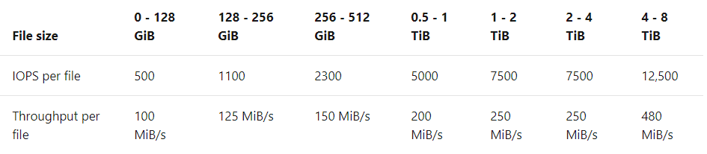
General Purpose Architecture
Cloud Database Architecture
Separation of compute and storage
Stateless compute VM
TempDB on local SSD
Azure Premium Storage
Replicated remote files
Active compute node
Redundant node
Property | Value
vCores | 4-80
Memory | 5.1 GB/core
IO latency | 5-10ms
IOPS | Up to 30K
Load | 22MB/s
Scaled node
Azure storage account

Slide 19
Business Critical Architecture
All databases on local SSD
Failed node is replaced with the spare
Primary endpoint
(read-write)
Always On AG
Property | Value
vCores | 4-80 + 4-80 (read-only)
Memory | 5.1 GB/core + 5.1 GB/core (read-only)
IO latency | < 3 ms
In-memory OLTP | Yes 3GB-130GB
Load | 48 MB/s
Super-fast SSD
Secondary replica
Primary replica
Secondary replica
Spare node
Secondary replica
Secondary replica
Secondary endpoint
(read-only)

Slide 20

Business Critical – Upgrade SLO
Primary endpoint
(read-write)
Always On AG
Always On AG
Super-fast SSD
Super-fast SSD
Secondary replica
Primary replica
Secondary replica
Primary replica
Secondary replica
Secondary replica
Secondary replica
Secondary replica
Secondary endpoint
(read-only)

Slide 21

Hyperscale
Compute
Features that make this possible:
Resilient Buffer Pool Extension (RBPEx)
Snapshot-based backups
Accelerated Database Recovery (ADR)
External log service
Tiered storage
Completely separated compute and storage
No single point of failure
Storage encrypted at rest
P
S
S
S
Log
Service
128GB
128GB
128GB
128GB
1
1
1
1
Page
Servers
128GB
128GB
128GB
128GB
32
32
32
32
Remote
Data
Storage
Notes:
Completely separated compute from storage
Introduced multi-tier caching level
Delivers performance and helps with availability of the system
Separated out the log service to remove traditional contention that exists between log and data files
Removed backup operations from the compute node
Unlike normal sql which traditionally, when you have to add more space, you would grow the file
In hyperscale we add more files so we can scale the storage layer on the horizontal axes
Multiple layers of tier performance cahce, its stateless
Hyperscale is built based on a new cloud-born architecture which decouples compute, log and storage.
Compute. The compute node is where the relational engine lives, so all the language elements, query processing, and so on, occur. All user interactions with a Hyperscale database happen through these compute nodes. Compute nodes have SSD-based caches (labeled RBPEX - Resilient Buffer Pool Extension in the preceding diagram) to minimize the number of network round trips required to fetch a page of data. There is one primary compute node where all the read-write workloads and transactions are processed. There are one or more secondary compute nodes that act as hot standby nodes for failover purposes, as well as act as read-only compute nodes for offloading read workloads (if this functionality is desired).
Log Service: Local SSD cache
Page Servers. Page servers are systems representing a scaled-out storage engine. Each page server is responsible for a subset of the pages in the database. Nominally, each page server controls 128 of data. No data is shared on more than one page server (outside of replicas that are kept for redundancy and availability). The job of a page server is to serve database pages out to the compute nodes on demand, and to keep the pages updated as transactions update data. Page servers are kept up-to-date by playing log records from the log service. Page servers also maintain SSD-based caches to enhance performance. Long-term storage of data pages is kept in Azure Storage for additional reliability.
Log service. The log service node accepts log records from the primary compute node, persists them in a durable cache, and forwards the log records to the rest of the compute nodes (so they can update their caches) as well as the relevant page server(s), so that the data can be updated there. In this way, all data changes from the primary compute node are propagated through the log service to all the secondary compute nodes and page servers. Finally, the log record(s) are pushed out to long-term storage in Azure Storage, which is an infinite storage repository. This mechanism removes the necessity for frequent log truncation. The log service also has local cache to speed up access.
Remote Data Storage. The Azure storage node is the final destination of data from page servers. This storage is used for backup purposes as well as for replication between Azure regions. Backups consist of snapshots of data files. Restore operation are fast from these snapshots and data can be restored to any point in time.
Hyperscale is an all new storage layer under the database
Hyperscale is architected for the cloud from the ground up.
Hyperscale is fully compatible with Azure SQL Database
Hyperscale is no limits
Hyperscale is VLDB size without the VLDB headaches
Support for 100TB+
Low latency, high throughput for large databases.
Backups are snapshot-based
No impact on query performance
Rapid database restore
ADR - Accelerated Database Recovery feature in SQL Server 2019, which makes the undo phase of recovery much faster
RBPEx – SQL 2016 buffer pool extensions (BPE), or the ability to extend the buffer pool of SQL Server onto local SSD to simulate having more RAM. In Azure SQL Database Hyperscale, Microsoft further improved this feature with the use of Hekaton, its in-memory, latch-free database structure, to make the data written there recoverable in the event of failure. BPE, which is now called RBPEX for "resilient buffer pool extension," ultimately allows the scaling-out of data via the use of page servers
Snapshot-based backups: SQL Server 2014 introduced the ability to store data files in Azure Storage as http endpoints, and later advances in Azure Storage combined with code enhancements allowed for constant backup with very fast restore times, even at hundreds of terabytes.
Scalable new tiered storage architecture
Architected for cloud
Fully compatible with Azure SQL Database
Scale compute and storage separately
Scale up in constant time.
Support for 100TB+ Infinite Log
Supports 4 Read replicas
Restore in constant time
No impact of backups on compute
No impact of checkpoints on compute
Accelerated database recovery

Slide 22
Backup & Restore
Log Service
Snapshots
Log Landing Zone
Page Server 1
Page Server 2
Long term long storage
Page Server 3
Start LSN of oldest transaction (latest snapshot with ADR)
among all snapshots
Point in time
Point in time
Primary Compute
Recovery
Backup has no impact to apps
Parallelized copy (metadata)
Constant time PITR
Accelerated database recovery
Log Service
Page Servers
Log Landing Zone
Long term long storage
Azure Storage
Notes:
Restores are not a size of data operation.

Slide 23
02 – Security

Slide 24
03 – Performance

Slide 25
04 – Availability

Slide 26
05 – Putting it all together

Slide 27
Next Steps for SQL Server 2019
http://aka.ms/bobwardms
http://aka.ms/bobsqldemos
http://aka.ms/sqllinuxbook
Use our free training at https://aka.ms/sqlworkshops
Learn from videos and demos at https://aka.ms/sqlchannel
Download and try SQL Server 2019 at http://aka.ms/ss19
Read the what’s new for SQL 2019 documentation
Sign-up for the EAP program at https://aka.ms/eapsignup
Watch the video Modernizing SQL Server at https://www.youtube.com/watch?v=5RPkuQHcxxsto to plan your migration

