Slide 1
Using Docker Containers for running distributed Applications in Azure environment
Oleg Chorny
Microsoft SPDS MVP

Slide 2
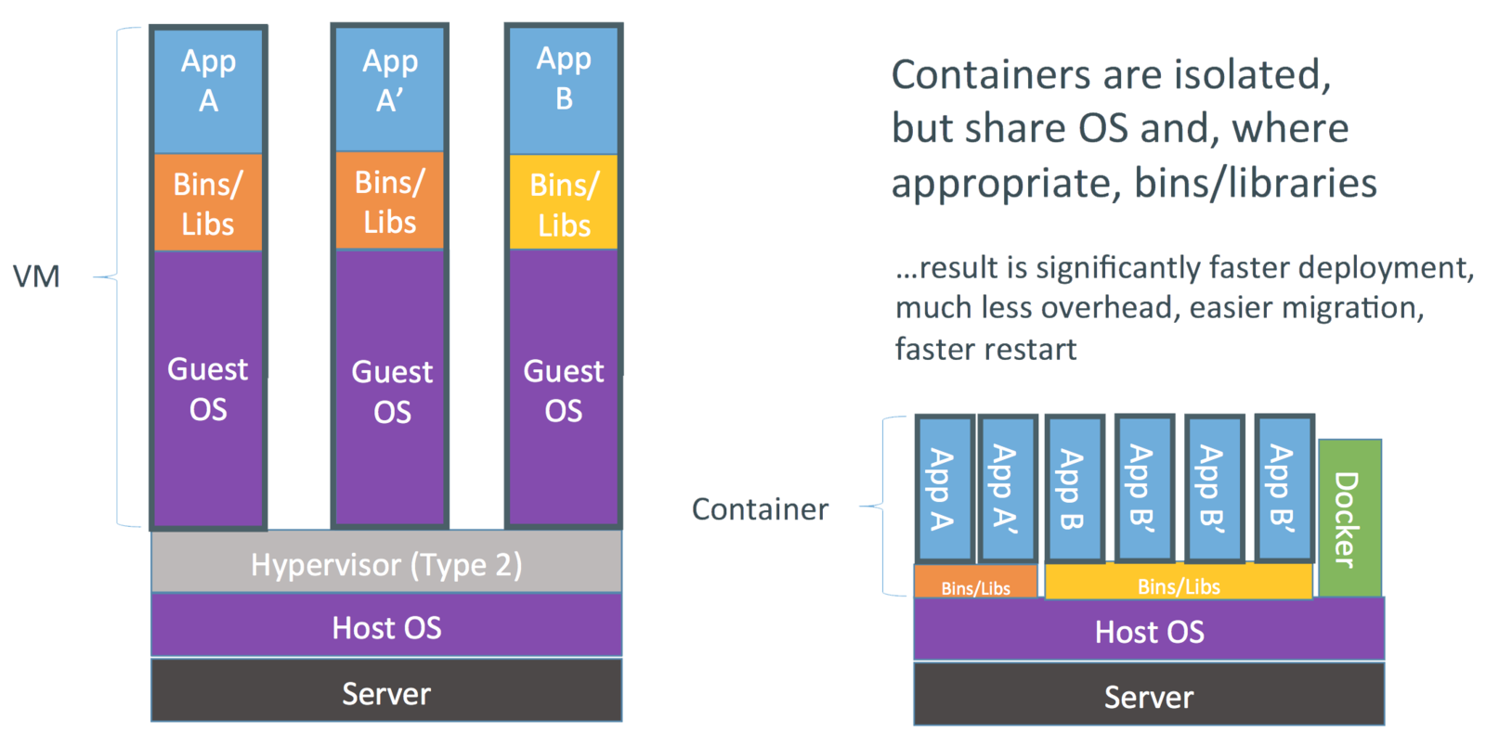
Virtual Machines vs Containers

Slide 3
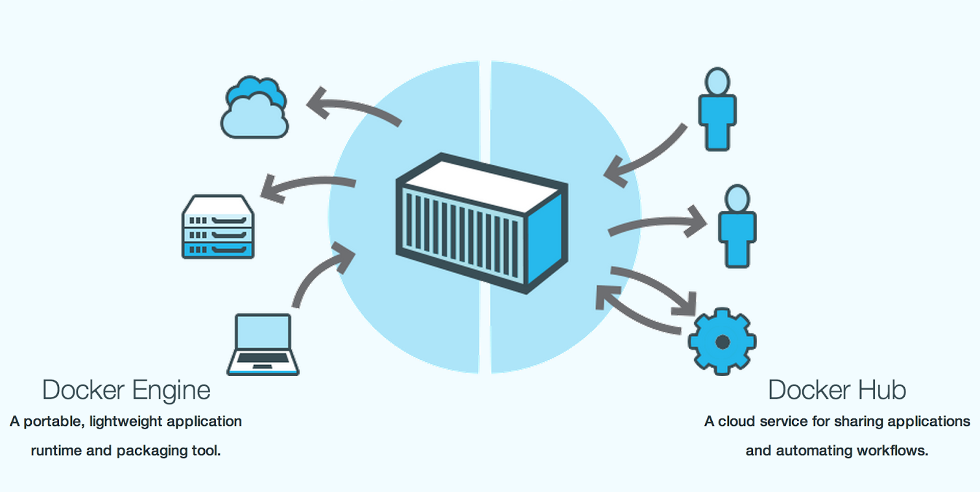
Docker Ecosystem

Slide 4
Demo
Notes:
# Installing the azure-cli
sudo apt-get update
sudo apt-get install nodejs-legacy -y
sudo apt-get install npm -y
sudo npm install -g azure-cli -y
# Installing the docker
sudo apt-get install docker.io -y
# configuring access to azure subscription
sudo azure account download
sudo azure account import <accountname.publishsettings>
#getting a list of VMs
sudo azure vm list
# getting the ubuntu image name
sudo azure vm image list | grep Ubuntu-14_04
#setting the name of image, username and password
vmname1="azureday-ua-01"
vmname2="azureday-ua-02"
vmname3="azureday-ua-03"
imagename="b39f27a8b8c64d52b05eac6a62ebad85__Ubuntu-14_04_2_LTS-amd64-server-20150309-en-us-30GB"
password="P@ssw0rd"
username="adadmin"
#creating vms
sudo azure vm docker create $vmname1 -l "East US 2" -e 22 $imagename $username $password
sudo azure vm docker create $vmname2 -l "East US 2" -e 22 $imagename $username $password
#adding HTTP endpoint
sudo azure vm endpoint create $vmname1 80
sudo azure vm endpoint create $vmname2 80
#getting the list of endpoints
sudo azure vm endpoint list $vmname1
sudo azure vm endpoint list $vmname2
#getting the list of docker images
sudo docker search lamp
sudo docker search apache
# pulling the apache-php image
sudo docker pull tutum/apache-php
# looking on a history
sudo docker history tutum/apache-php
#running container
sudo docker run -ti tutum/apache-php bash
#editing the index
root@<container id>:/app# vi /var/www/html/index.php
#getting a list of running containers
sudo docker ps
#getting a list of containers
sudo docker ps -a
#commiting changes to image
sudo docker commit <image id> ochorny/azuredayua
#getting list of images
sudo docker images
# pushing image to repo
sudo docker push ochorny/azuredayua
# pulling image on target vm in azure
sudo docker --tls -H tcp://$vmname1.cloudapp.net:4243 run -d -p 80:80 ochorny/azuredayua /usr/sbin/apache2ctl -D FOREGROUND
sudo docker --tls -H tcp://$vmname2.cloudapp.net:4243 run -d -p 80:80 ochorny/azuredayua /usr/sbin/apache2ctl -D FOREGROUND
# checking a list of running containers
sudo docker --tls -H tcp://$vmname1.cloudapp.net:4243 ps -a
sudo docker --tls -H tcp://$vmname2.cloudapp.net:4243 ps -a
# stop container just for example
sudo docker --tls -H tcp://$vmname1.cloudapp.net:4243 stop <containerId>
sudo docker --tls -H tcp://$vmname1.cloudapp.net:4243 start <containerId>
#running one more instance
sudo azure vm docker create $vmname3 -l "East US 2" -e 22 $imagename $username $password
sudo azure vm endpoint create $vmname3 80
sudo docker --tls -H tcp://$vmname3.cloudapp.net:4243 run -d -p 80:80 ochorny/azuredayua /usr/sbin/apache2ctl -D FOREGROUND

Slide 5
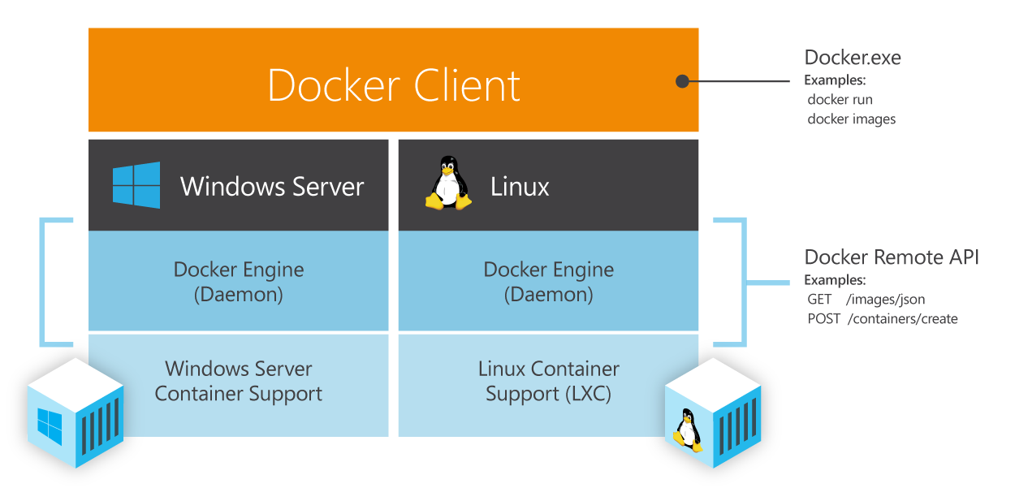
Coming Soon: Docker on Windows

Slide 6
Links
Using the Docker VM Extension from Azure Cross-Platform Interface (xplat-cli) http://azure.microsoft.com/en-us/documentation/articles/virtual-machines-docker-with-xplat-cli
How to use docker-machine with Azure https://azure.microsoft.com/en-us/documentation/articles/virtual-machines-docker-machine
Using the Docker VM Extension with the Azure Portal http://azure.microsoft.com/en-us/documentation/articles/virtual-machines-docker-with-portal
How to Implement Containerization with Docker to Increase Density and Performance of Virtual Machines http://channel9.msdn.com/Events/Microsoft-Azure/Level-Up-Azure-IaaS-for-IT-Pros/How-to-Implement-Containerization-with-Docker-to-Increase-Density-and-Performance-of-Virtual-Machine
Docker User Guide https://docs.docker.com/userguide

