Slide 1
Синхронизация каталогов Azure Active Directory - deep dive.
Александр Ткаченко
MCT

Slide 2



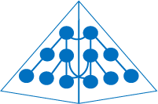


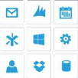
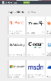
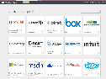

Identities everywhere, accessing everything
Microsoft apps
Active Directory
AD
Custom LOB apps
ISV/CSV apps
Non-MS cloud-based apps
Consumer identity providers
PCs and devices

Slide 3


Delivering a seamless user authentication experience
Active Directory
DirSync with password hash sync
Active Directory
User attributes are synchronized using DirSync including a password hash, Authentication is completed against Windows Azure Active Directory
DirSync
Active Directory
Active Directory
User attributes are synchronized using DirSync, Authentication is passed back through federation and completed against Windows Server Active Directory
AD FS

Slide 4
DEMO
Configuring directory integration

Slide 5
Q&A
Александр Ткаченко
MCT

