Slide 1
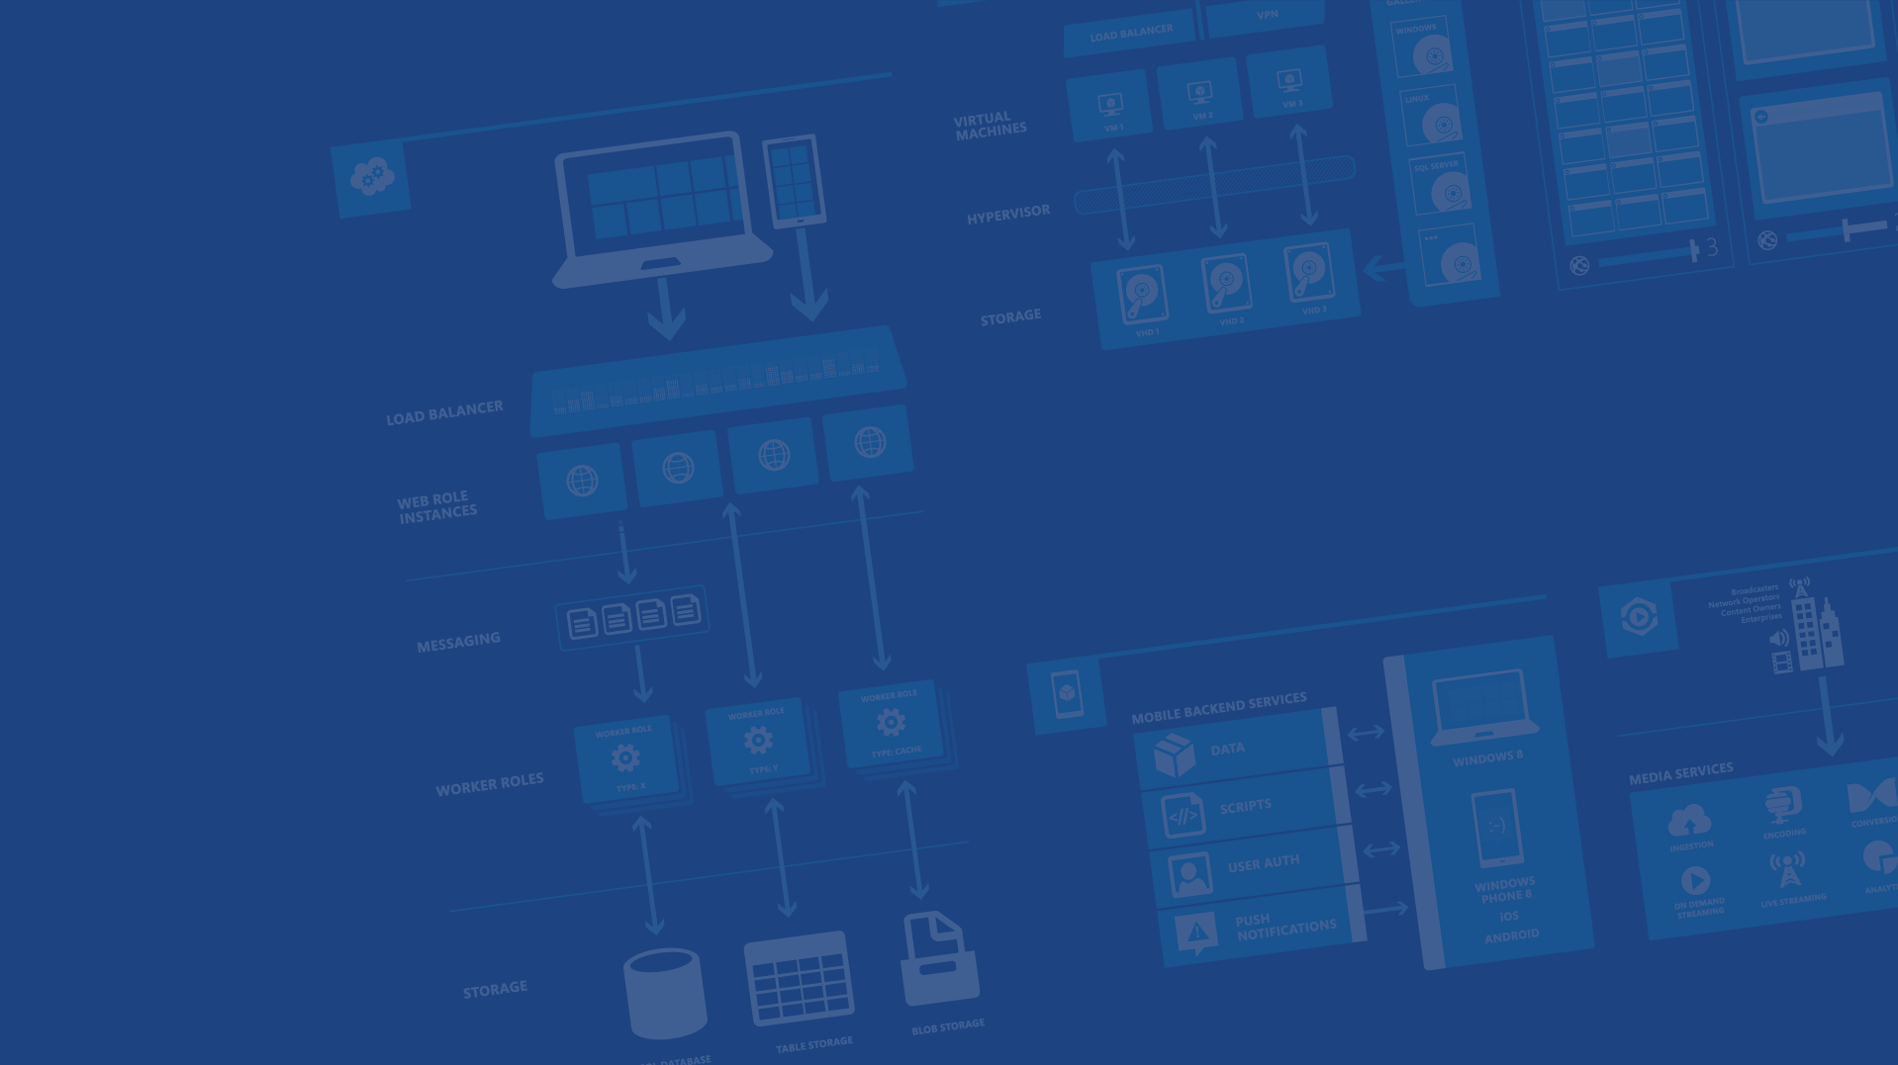
Azure Access Control Service & Identity
Alexander Semichev
Matrix42 Cloud Team
Microsoft Azure
Notes:
Speaker note: Azure with Office 365 working together with the power of identity and access control

Slide 2
Agenda
Azure Access Control Service (ACS)
Security tokens: JWT, SAML2
ACS Scenarios(Active & Passive)
Real DEMO

Slide 3
Azure Access Control Service

Slide 4
What is ACS
Most developers are not identity experts and do not want to spend time developing authentication
and authorization mechanisms for their applications and services.
ACS is an Azure service that provides an easy way for you to authenticate users
to access your web applications and services without having to add complex authentication logic
to your code.

Slide 5
ACS Features:
No need to implement your own authentication mechanism
Integration with Windows Identity Foundation (WIF).
Support for popular web identity providers (IPs) including Microsoft accounts
(Windows Live ID), Google, Yahoo, and Facebook.
Easy to add your custom Identity Provider
Support for Active Directory Federation Services (AD FS) 2.0.
A Management Portal that allows administrative access to the ACS settings.

Slide 6
Security tokens: JWT, SAML2

Slide 7
Simple Web Token
Depricated!!!

Slide 8
Json Web Token (JWT)
Structure:
<base64-encoded header>.<base64-encoded claims>.<base64-encoded signature>
Base64 encoded token Sample:
eyJ0eXAiOiJKV1QiLCJhbGciOiJIUzI1NiJ9.eyJpc3MiOiJodHRwczovL2FjY291bnRzLm1hdHJpeDQyLmNvbSIsImF1ZCI6InVybjptYXRyaXg0MmNvbSIsIm5iZiI6MTQyODUxOTk4NiwiZXhwIjoxNDI4Nzc5MTg2LCJuYW1la
WQiOiJhcnRodXIuYWRtaW5AaW1hZ292ZXJ1bS5jb20iLCJ1bmlxdWVfbmFtZSI6ImFydGh1ci5hZG1pbkBpbWFnb3ZlcnVtLmNvbSIsImF1dGhtZXRob2QiOiJodHRwOi8vc2NoZW1hcy5taWNyb3NvZnQuY29tL3dzLzIw
MDgvMDYvaWRlbnRpdHkvYXV0aGVudGljYXRpb25tZXRob2QvcGFzc3dvcmQiLCJhdXRoX3RpbWUiOiIyMDE1LTA0LTA4VDE5OjA2OjI1Ljg2NFoiLCJlbWFpbCI6ImFydGh1ci5hZG1pbkBpbWFnb3ZlcnVtLmNvbSIsInJv
bGUiOlsiZW50ZXJwcmlzZV85OTJjMmU5YS05MWYzLTQ3NGMtOTc1My04MDM0YWRiZGQ2NGVfSVQgQWRtaW5zIiwiZW50ZXJwcmlzZV85OTJjMmU5YS05MWYzLTQ3NGMtOTc1My04MDM0YWRiZGQ2NGVfbW
FuYWdlciIsImVudGVycHJpc2VfOTkyYzJlOWEtOTFmMy00NzRjLTk3NTMtODAzNGFkYmRkNjRlX1NhbGVzIiwiSW1hZ292ZXJ1bS5TYWxlcyIsIk1hdHJpeDQyLkNoYW5uZWx0aXZpdHkuUGFydG5lcnMiLCJNYXRyaXg0
Mi5NaW5kdG91Y2guQWRtaW5zIiwiTWF0cml4NDIuTWluZHRvdWNoLkNsb3VkT3BlcmF0aW9ucyIsIk1hdHJpeDQyLkFjY291bnRzLlByZXZpZXcuQXBwcyIsIk1hdHJpeDQyLkNoYW5uZWx0aXZpdHkuUGFydG5lcnMu
REUuR2xvYmFsIl0sImlkZW50aXR5L2NsYWltcy9maXJzdG5hbWUiOiJBcnRodXIiLCJpZGVudGl0eS9jbGFpbXMvbGFzdG5hbWUiOiJBZG1pbiIsImlkZW50aXR5L2NsYWltcy9jb21wYW55IjoiSW1hZ29WZXJ1bSIsImlkZW5
0aXR5L2NsYWltcy9zYWx1dGF0aW9uIjoiTXJzIiwiZW50ZXJwcmlzZWlkIjoiOTkyYzJlOWEtOTFmMy00NzRjLTk3NTMtODAzNGFkYmRkNjRlIiwiZW50ZXJwcmlzZW5hbWUiOiJJbWFnb1ZlcnVtIiwiaWRlbnRpdHkvY2xhaW
1zL2Vudmlyb25tZW50IjoiaHR0cHM6Ly9hY2NvdW50cy5tYXRyaXg0Mi5jb20ifQ.5VcGi0j3KR3DUJ0-75Qf8Um_0Gytrq28Yte3zShd8oY
Decoded token sample:
{
"iss": "https://accounts.matrix42.com",
"aud": "urn:matrix42com",
"nbf": 1428519986,
"exp": 1428779186,
"nameid": “alexander.semichev@matrix42.com",
"unique_name": "alexander.semichev@matrix42.com",
"authmethod": "http://schemas.microsoft.com/ws/2008/06/identity/authenticationmethod/password",
"email": "alexander.semichev@matrix42.com",
"role": [
"Matrix42..Partners",
"Matrix42..Admins",
],
"identity/claims/firstname": “Alexander",
"identity/claims/lastname": “Semichev",
"identity/claims/company": “Matrix42 AG",
}
{
"typ": "JWT",
"alg": "HS256"
}

Slide 9
Saml2 token
See example from file

Slide 10
ACS Scenarios(Active & Passive)

Slide 11
Traditional authentication

Slide 12
Challenge

Slide 13
Authentication with ACS

Slide 14
IDP & ACS & Tokens passive flow
Client
Identity Provider
ACS
RP(Relying Party)
1. Request resource
2. Redirect to IDP(Identity Provider)
3. Login at IDP page
4. Authenticate &
Issuer IDP Token
(JWT, SAML2, etc.)
5. Redirect to ACS
6. Send IDP token to ACS
7. Validate token,
Run Rules engine,
Issue ACS token
8. Redirect to RP with ACS token
10. Validate ACS token
9. Send ACS token to RP
11. Return resource

Slide 15
Example with multiple IDP’s

Slide 16
IDP & ACS & Tokens active flow
Client
Identity Provider
ACS
RP(Relying Party)
1. Send credentials(Username & Password)
2. Authenticate &
Issuer IDP Token
(JWT, SAML2, etc.)
3. Send IDP token to ACS
4. Validate token,
Run Rules engine,
Issue ACS token
5. Return ACS token
7. Validate ACS token
6. Send ACS token to RP
8. Return resource

Slide 17
Real Demo

