Slide 1
Storing Data On Azure
Milan Nankov

Slide 2

Milan Nankov Co-founder @ New Venture Software
Twitter: | https://twitter.com/milannankov
Github: | https://github.com/milannankov
Blog: | https://www.newventuresoftware.com/blog
www.newventuresoftware.com

Slide 3
Azure User Group Bulgaria
Facebook https://www.facebook.com/groups/azureugbg/
Meetup https://www.meetup.com/Azure-User-Group-Bulgaria/
Github https://github.com/AzureUserGroupBulgaria
Slack https://azureugbg.slack.com/
#AzureUGBG

Slide 4
Agenda
Data storage
Azure Storage
DocumentDB
SQL Server
Beer!

Slide 5
Data storage

Slide 6
Data Storage
Transactions
Security
Eventual Consistency
Structured data
Unstructured data
Price
Caching
Performance
Partitioning
Scaling
Notes:
Talk about how data storage is a broad term.
Create a common ground and terms so that we can have a fruitful discussion

Slide 7


Structured
Easy to process/search
Rows / column
vs.
Unstructured
Difficult to process by machines
Human readable
No. | Title | Directed by | Air date
1 | "Rainforest Shmainforest" | Trey Parker & Eric Stough | April 7, 1999
2 | "Spontaneous Combustion" | Matt Stone | April 14, 1999
3 | "The Succubus" | Trey Parker | April 21, 1999
4 | "Jakovasaurs" | Matt Stone | June 16, 1999

Slide 8
Horizontal Partitioning
id | country | name | email
1 | Canada | Sara Garza | sgarza0@goo.ne.jp
2 | Canada | Harold Bennett | hbennett1@tripadvisor.com
3 | Canada | Steven Collins | scollins2@symantec.com
4 | Canada | Lori Hansen | lhansen3@hostgator.com
5 | United States | Steven Johnston | sjohnston4@loc.gov
6 | United States | Jesse Thomas | jthomas5@ovh.net
id | country | name | email
1 | Canada | Sara Garza | sgarza0@goo.ne.jp
2 | Canada | Harold Bennett | hbennett1@tripadvisor.com
3 | Canada | Steven Collins | scollins2@symantec.com
4 | Canada | Lori Hansen | lhansen3@hostgator.com
id | country | name | email
5 | United States | Steven Johnston | sjohnston4@loc.gov
6 | United States | Jesse Thomas | jthomas5@ovh.net

Slide 9
Horizontal Partitioning
Known as Sharding
Based on Partition Key
Spread load on multiple servers

Slide 10
Vertical Partitioning
id | name | email | state | postal | phone
1 | Alice Collins | acollins0@list-manage.com | Arizona | 85732 | 1-(520)656-5911
2 | Rachel Richards | rrichards1@studiopress.com | Florida | 32813 | 1-(407)106-9061
3 | Heather Mendoza | hmendoza2@histats.com | North Carolina | 28220 | 1-(704)842-7531
4 | Lawrence Dixon | ldixon3@comcast.net | California | 95054 | 1-(858)230-6437
5 | Michelle Jones | mjones4@examiner.com | District of Columbia | 20268 | 1-(202)794-2673
6 | Kimberly Ortiz | kortiz5@behance.net | Texas | 75205 | 1-(972)296-4566

Slide 11
Vertical Partitioning
Optimizes queries
Can help with security

Slide 12
Transactions
Delete #1
Delete #2
Insert #1
Insert #2
Insert #3
transaction

Slide 13
Price
Pay per request
Pay per GB
Pay per month

Slide 14
Performance
How performance is measured

Slide 15
Security
Security at rest
Security in transit
Authorization

Slide 16
Scaling
Can the storage adapt
Manual / automatic

Slide 17

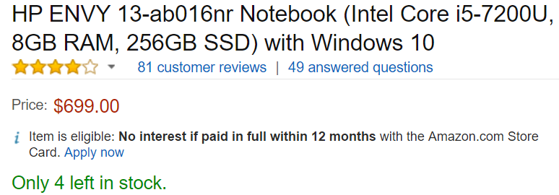
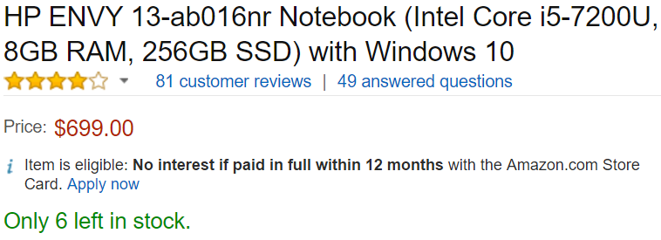
Eventual Consistency
www.amazon.com

Slide 18
Azure Storage

Slide 19
Azure Storage
“Azure Storage is the cloud storage solution for modern applications that rely on durability, availability, and scalability to meet the needs of their customers. ”
Notes:
Talk about why Azure storage is important

Slide 20
Durability
All data is replicated
Data can be recovered after hardware failure
copy 1
copy 2
copy 3

Slide 21

Availability
Data is always available

Slide 22
Replication types
LRS – Locally redundant storage
ZRS – Zone-redundant storage
GRS – Geo-redundant storage
RA-GRS – Read-access geo-redundant
Notes:
Talk about how they promote availability and durability

Slide 23
Locally redundant storage (LRS)
North Europe
3 copies
Notes:
Talk about how they promote availability and durability

Slide 24
Zone-redundant storage (ZRS)
North Europe
3 copies
3 copies
Notes:
Talk about how they promote availability and durability

Slide 25
Zone-redundant storage (ZRS)
North Europe
3 copies
3 copies
Notes:
Talk about how they promote availability and durability

Slide 26
Geo-redundant storage (GRS)
West Europe
North Europe*
6 copies
6 copies
Notes:
Talk about how they promote availability and durability

Slide 27
Read-access geo-redundant storage (RA-GRS)
West Europe
North Europe
6 copies
6 copies
Notes:
Maximizes availability

Slide 28
Scalability
Adjusts with demand
Pay for what you use
1 MB
100 TB

Slide 29
Load Balancing
get data 1
Load Balancer
Server 1
Server 2
Server 4
data 1
data 4
data 3
data 2
data 5
Notes:
Talk about how Azure spreads data to be served by multiple servers

Slide 30
Load Balancing
get data 4
get data 5
get data 5
Load Balancer
get data 4
Server 1
Server 2
Server 4
data 1
data 4
data 3
data 2
data 5
Notes:
Talk about how Azure spreads data to be served by multiple servers

Slide 31
Load Balancing
get data 4
get data 5
get data 5
Load Balancer
get data 4
Server 1
Server 2
Server 4
data 1
data 4
data 3
data 2
data 5
Notes:
Talk about how Azure spreads data to be served by multiple servers

Slide 32
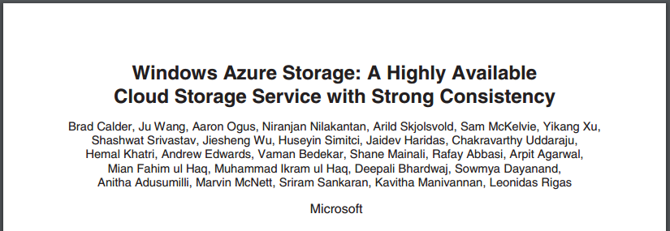
Inside Windows Azure Storage
https://www.youtube.com/watch?v=saPk02oYdjE&t=2346s
http://sigops.org/sosp/sosp11/current/2011-Cascais/printable/11-calder.pdf

Slide 33
Blob Storage

Slide 34
Blob Storage
Perfect for storing unstructured data
Documents, music, videos, etc

Slide 35
Blob Storage
Data is stored as blobs (objects)
Organized into containers

Slide 36


Blob Storage
Azure Storage Account
Blob 1
Container 1
Blob 2
Blob 3
…
Notes:
Talk about Azure storage account.
Talk about containers – way of organizing content, way of controlling access.

Slide 37
Accessing Azure Storage Programmatically
Storage Services REST API
Storage Client Library for .NET, Windows Phone, and Windows Runtime
Storage Client Library for C++
Storage Client Library for Java/Android
Storage Client Library for Node.js
Storage Client Library for PHP
Storage Client Library for Ruby
Storage Client Library for Python
Storage Cmdlets for PowerShell 1.0

Slide 38
Blob Storage Demo
Notes:
Create Azure Storage Account

Slide 39
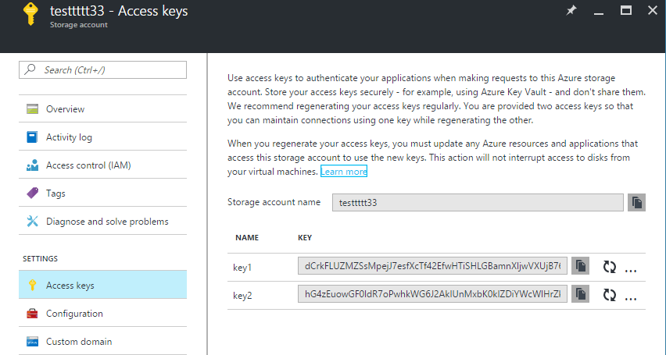
Access keys

Slide 40
Blob - Storage Prices
Monthly charges per GB of data stored
STORAGE CAPACITY | LRS | ZRS | GRS | RA-GRS
First 1 TB / Month | $0.024 per GB | $0.03 per GB | $0.048 per GB | $0.061 per GB
Next 49 TB (1 to 50 TB) / Month | $0.0236 per GB | $0.0295 per GB | $0.0472 per GB | $0.0599 per GB
Next 450 TB (50 to 500 TB) / Month | $0.0232 per GB | $0.029 per GB | $0.0464 per GB | $0.0589 per GB
Next 500 TB (500 to 1,000 TB) / Month | $0.0228 per GB | $0.0285 per GB | $0.0456 per GB | $0.0579 per GB
Next 4,000 TB (1,000 to 5,000 TB) / Month | $0.0224 per GB | $0.028 per GB | $0.0448 per GB | $0.0569 per GB
Notes:
Mention that this is about General purpose storage accounts

Slide 41
Blob – Access Prices
$0.0036 per 100,000 transactions for Block Blobs. Transactions include both read and write operations to storage.

Slide 42
Cost Example
Write 100GB spread over 100 files +
Each file is accessed 100,000 times
Cost = $ 6.46

Slide 43
Security
Can control access using Shared Access Signatures
Data in transit - Client-Side Encryption, HTTPS, or SMB 3.0
Encryption at rest - Storage Service Encryption

Slide 44
Performance
Resource | Default Limit
TB per storage account | 500 TB
Target throughput for single blob | Up to 60 MB per second, or up to 500 requests per second
Azure Storage Scalability and Performance Targets

Slide 45
Blob Storage
Easy to use
Pay for what you use
Can be connected to CDN

Slide 46
Table Storage

Slide 47
Table Storage
Schemaless key/value store
Easy to use
Cost-effective vs. traditional SQL databases

Slide 48
Table Storage
Organized into tables
Unit of store is entity (rows)
Entities have properties
Notes:
Compare all to SQL

Slide 49
Table Storage
Azure Storage Account
Entity 1
Table
Entity 2
Entity 3
…

Slide 50
PartitionKey
Required property
Partitions entities into buckets
Enables load balancing

Slide 51
RowKey
Required property
Unique within a partition

Slide 52
PartitionKey & RowKey
ID = PartitionKey + RowKey
ID is unique across a table

Slide 53
PartitionKey & RowKey
Id (RowKey) | Country (Partition Key) | name | email
1 | Canada | Sara Garza | sgarza0@goo.ne.jp
2 | Canada | Harold Bennett | hbennett1@tripadvisor.com
3 | Canada | Steven Collins | scollins2@symantec.com
4 | Canada | Lori Hansen | lhansen3@hostgator.com
5 | United States | Steven Johnston | sjohnston4@loc.gov
6 | United States | Jesse Thomas | jthomas5@ovh.net

Slide 54
Table Storage Demo
Notes:
Create Azure Storage Account

Slide 55
Table - Storage Prices
Monthly charges per GB of data stored
STORAGE CAPACITY | LRS | GRS | RA-GRS
First 1 TB / Month | $0.0701 per GB | $0.095 per GB | $0.12 per GB
Next 49 TB (1 to 50 TB) / Month | $0.065 per GB | $0.08 per GB | $0.10 per GB
Next 450 TB (50 to 500 TB) / Month | $0.06 per GB | $0.0701 per GB | $0.09 per GB
Next 500 TB (500 to 1,000 TB) / Month | $0.055 per GB | $0.065 per GB | $0.08 per GB
Next 4,000 TB (1,000 to 5,000 TB) / Month | $0.045 per GB | $0.06 per GB | $0.075 per GB
Notes:
Mention that this is about General purpose storage accounts

Slide 56
Table – Access Prices
$0.0036 per 100,000 transactions for Block Blobs. Transactions include both read and write operations to storage.

Slide 57
Cost Example
100GB database +
100,000,000 transactions
Cost = $ 15.60

Slide 58
Security
Can control access using Shared Access Signatures
Data in transit - Client-Side Encryption, HTTPS, or SMB 3.0
Encryption at rest - Storage Service Encryption

Slide 59
Performance
Resource | Default Limit
TB per storage account | 500 TB
Max number of properties in a table entity | 252
Total Request Rate (assuming 1 KB object size) per storage account | Up to 20,000 IOPS, entities per second
Target throughput for single table partition | Up to 2000 entities per second
Azure Storage Scalability and Performance Targets

Slide 60
The Case Of haveibeenpwned.com
Notes:
Create Azure Storage Account

Slide 61
“We need a database therefore we need SQL Server.”

Slide 62

Troy Hunt
Microsoft Regional Director
MVP
Pluralsight Author
Blogger
Creator of haveibeenpwned.com
https://www.troyhunt.com
Notes:
Talk about Troy and his amazing blog

Slide 63
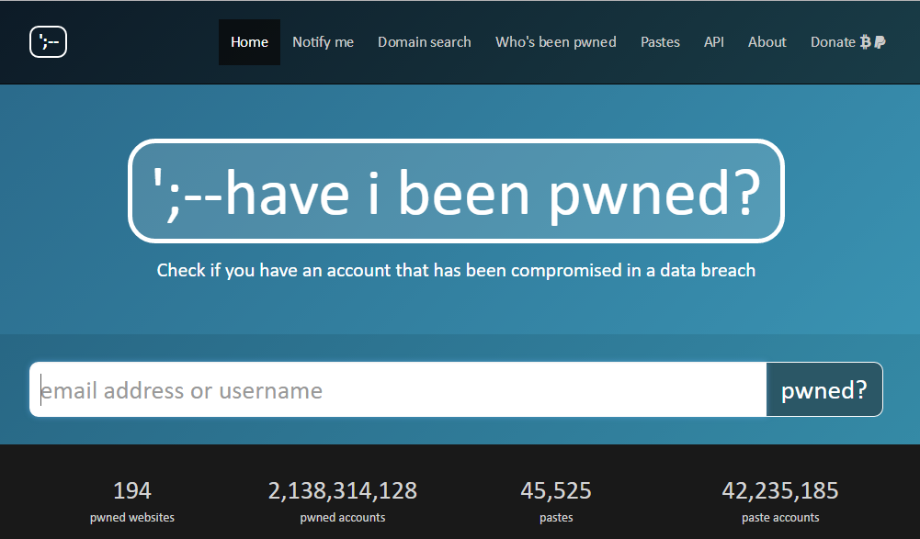
Have I been pwned?

Slide 64
Have I been pwned?
Searching for an email should be fast
PartitionKey = domain
RowKey = alias
domain | alias | websites
hotmail.com | george | Adobe; Stratfor
hotmail.com | kartman | Adobe; Stratfor
hotmail.com | jjabrams | Adobe; Stratfor
hotmail.com | candy | Adobe; Stratfor
hotmail.com | ivana234 | Adobe; Stratfor
other.net | realslimshady | Adobe; Stratfor

Slide 65
Have I been pwned?
154M records searched < 10ms
No problems with spikes
Cost is just a fraction of SQL
Notes:
https://haveibeenpwned.com/HowFastIsAzureTableStorage/?email=troyhunt@hotmail.com
Using SQL would have taken a lot of time

Slide 66
Table Storage
Easy to use
Azure takes care of infrastructure
Pay for what you use
Very fast!

Slide 67
Azure Storage Wrap-up
Built to scale
Protects against failures
Blob storage
Table storage

Slide 68
DocumentDB

Slide 69


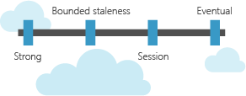

DocumentDB
“DocumentDB is a fully managed NoSQL database service built for fast and predictable performance, high availability, elastic scaling, global distribution, and ease of development.”
Guaranteed
low latency
Easy scale
Replicate Globally
Consistency
Choices

Slide 70
Guaranteed Latencies
Read < 10ms
Write < 15ms

Slide 71
Global Distribution
request 2
request 1
Notes:
Failovers and stuff

Slide 72
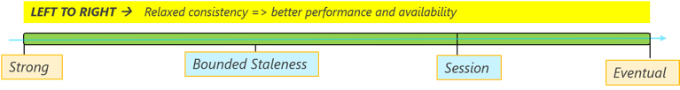
Consistency levels
Reads return most recent version
Write is only visible after it is committed durably
Cost of reads is higher
No guarantee on version reads
Lowest latency for both reads and writes
Lowest read cost

Slide 73
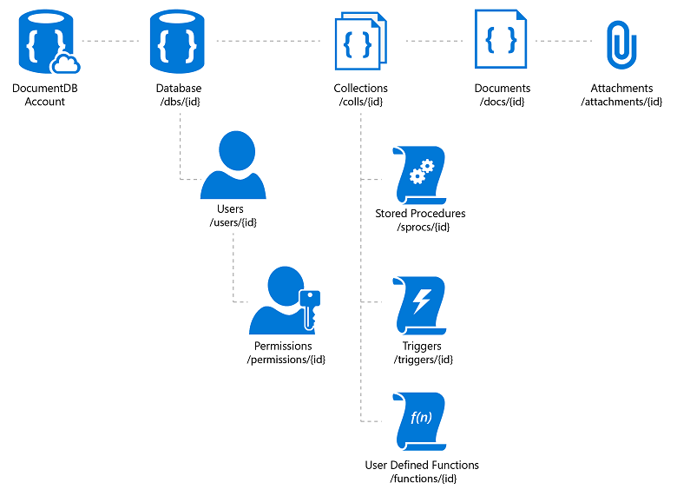
Hierarchical resource model

Slide 74
Document data model
Each record is a “document”
Indivisible unit
Each document is independent (own schema)
User defined (arbitrary) JSON content

Slide 75
Perfect for Aggregate Roots
Domain-Driven Design Concept
Modeling Aggregates with DDD and Entity Framework

Slide 76
Perfect for Aggregate Roots
BacklogItem
Task
EstimationLogEntry

Slide 77
DocumentDB in action
Notes:
Show how to create a DocumentDB instance & code

Slide 78
Security
Can control access with Users
Encryption not supported

Slide 79
Request Units
Measure of throughput in DocumentDB
1 RU = The throughput of the GET of a 1KB document
No need to think about CPU, IO and memory

Slide 80
Performance
SLA on latency, throughput, and consistency in addition to high availability
RUs are guaranteed

Slide 81
Price
If you create an account in East US 2 using two single partitions with 500 RU/sec and 700 RU/sec, respectively, you would have a total provisioned capacity of 1,200 RU/sec. You would thus be charged 12 x $0.008 = $0.096/hr.
In a month of 720 hours, if 720 hours are provisioned at 1,200 RU/sec, your monthly bill will show: 720 x $0.096/hr = $69.12/hr

Slide 82
Takeaways
Massively scalable cloud database
More cost transparency with RUs
Learning curve
For large systems & applications

Slide 83
SQL Server

Slide 84
Azure SQL
Paas offering
Automatic backup
Point in time restore
Active Geo-Replication
Notes:
Benefits over on-prem SQL
Long-term backup

Slide 85
SQL Server on Azure VMs
Iaas offering
No feature parity
Feature | SQL Server | Azure SQL Database
Active Geo-Replication | Not supported - see AlwaysOn Availability Groups | Supported
Auto scale | Not supported | Supported
Filestream | Supported | Not supported
Policy-based management | Supported | Not supported
….
Choose a cloud SQL Server option

Slide 86
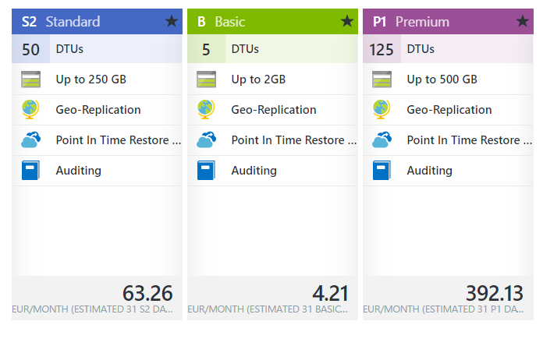
Tiers
Notes:
Basic
Best suited for a small database, supporting typically one single active operation at a given time. Examples include databases used for development or testing, or small-scale infrequently used applications.
Standard
The go-to option for cloud applications with low to medium IO performance requirements, supporting multiple concurrent queries. Examples include workgroup or web applications.
Premium
Designed for high transactional volume with high IO performance requirements, supporting many concurrent users. Examples are databases supporting mission critical applications.

Slide 87
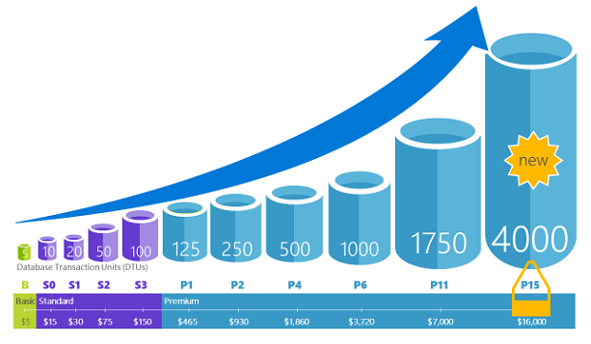
DTUs
Database Transaction Units
CPU, memory, and data I/O and transaction log I/O

Slide 88
Takeaways
Go-to choice for strong consistency
Much more flexible that regular SQL Server
Easy to use
Can be expensive

Slide 89
Questions?

Slide 90
Thank you!

