Slide 1
A Lap Around Azure App Service
Milan Nankov

Slide 2

Milan Nankov Co-founder @ New Venture Software
Twitter: | https://twitter.com/milannankov
Github: | https://github.com/milannankov
Blog: | https://www.newventuresoftware.com/blog
www.newventuresoftware.com

Slide 3
Agenda
Azure User Group Bulgaria
Azure App Service
Demos
Q&A
Beer!

Slide 4
Azure User Group Bulgaria
Facebook https://www.facebook.com/groups/azureugbg/
Meetup https://www.meetup.com/Azure-User-Group-Bulgaria/
Github https://github.com/AzureUserGroupBulgaria

Slide 5

Community

Slide 6

Special Thanks To
Martin Kulov & Marta Neshova

Slide 7
Azure App Service

Slide 8
History

Slide 9
Azure App Service
Platform-as-a-service (PaaS) offering
ASP.NET, Node.js, Java, PHP, and Python
Auto scale
Test/staging environments

Slide 10
Azure App Service
Hosting websites and web apps
Hosting mobile backends
Hosting RESTful APIs
Automate business processes
Run background jobs

Slide 11
App Service Plan
All services run within an App Service Plan
Physical resources being used
Defines performance & features
Five tiers: Free, Shared, Basic, Standard, and Premium

Slide 12
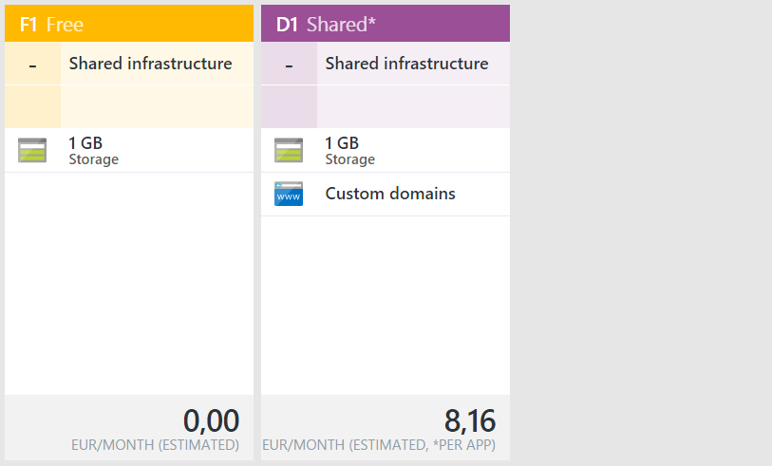
Free & Shared

Slide 13
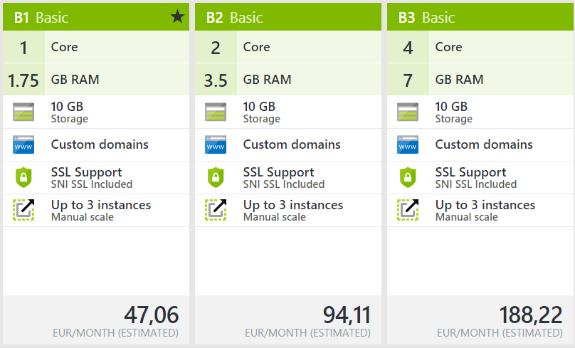
Basic

Slide 14
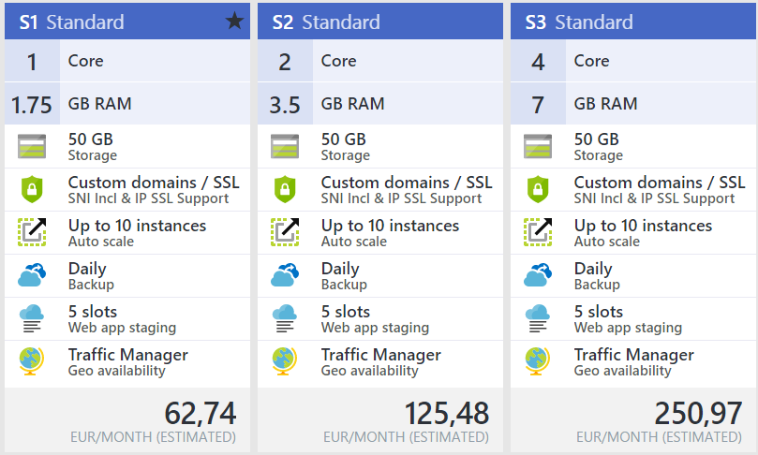
Standard

Slide 15
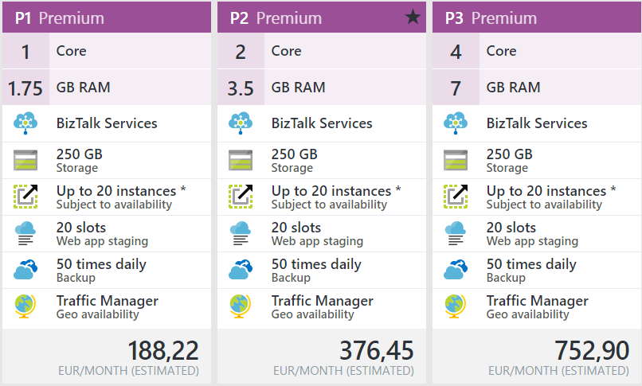
Premium

Slide 16
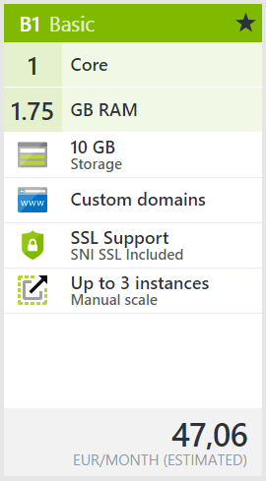
Flexibility

Slide 17
Flexibility

Slide 18
Flexibility

Slide 19
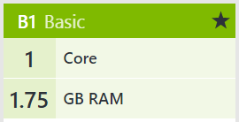
Flexibility

Slide 20
Azure Web Apps

Slide 21
Features
Supports .NET, Java, PHP, Node.js, and Python
Autoscale
Continuous deployment
Automatic backup and restore
Configurable deployment environments

Slide 22
Web App Demo

Slide 23
Demo Summary
Creating Web App
Deploying from Visual Studio
Application Settings
Staging environment

Slide 24
Azure API Apps

Slide 25
Features
Shares common App Service features
Hosting RESTful APIs
Support for Swagger https://github.com/swagger-api

Slide 26
API
GET – api/trumpometer/score
POST – api/trumpometer/entries
GET – api/trumpometer/entries

Slide 27
API APP Demo

Slide 28
Demo Summary
How to create API App
Deploying from Visual Studio
Swagger is cool

Slide 29
Azure Logic Apps

Slide 30
Features
Create business processes and workflows visually
Integrate with SaaS and enterprise applications

Slide 31
Logic App Demo

Slide 32
Demo Summary
How to create Logic App
???

Slide 33
Azure Mobile Apps

Slide 34
Features
Easily build mobile backends
Authentication and Authorization
Offline sync
Push notifications
Client SDKs

Slide 35
Mobile App Demo

Slide 36
Deployment

Slide 37
Deployment
Web Deploy
FTP
Containers
Continuous deployment BitBucket, GitHub, and Visual Studio Team Services

Slide 38
Deployment Demo

Slide 39
Demo Summary
Web Deploy
FTP
Containers
Continuous deployment BitBucket, GitHub, and Visual Studio Team Services

Slide 40
App Service on Linux

Slide 41
App Service On Linux
Public Preview
Run apps natively on Linux
Support for Docker containers

Slide 42
Linux Demo

Slide 43
Resources
WebJobs - https://docs.microsoft.com/en-us/azure/app-service-web/web-sites-create-web-jobs
Azure Free Trial - https://azure.microsoft.com/en-us/free/?b=17.01
App Service and Docker - https://blogs.msdn.microsoft.com/webdev/2016/11/16/new-docker-tools-for-visual-studio/

Slide 44
Questions?

Slide 45
Thank you!

