Slide 1
Going Serverless with Azure Functions
Milan Nankov

Slide 2

Milan Nankov Co-founder @ New Venture Software
Twitter: | https://twitter.com/milannankov
Github: | https://github.com/milannankov
Blog: | https://www.newventuresoftware.com/blog
www.newventuresoftware.com

Slide 3
Azure User Group Bulgaria
Facebook https://www.facebook.com/groups/azureugbg/
Meetup https://www.meetup.com/Azure-User-Group-Bulgaria/
Github https://github.com/AzureUserGroupBulgaria
Slack https://azureugbg.slack.com/
#AzureUGBG

Slide 4
Agenda
Introduction to Azure Functions
Demos
Architecting Cloud Apps

Slide 5
Cloud Paradigm Shift

Slide 6
Traditional Monolith
Cloud Approach
App 1
App 1

Slide 7
Application design
Traditional application
Compile-time contract validation
Local operations
Easier to reason about
Expensive to scale application
Hard to scale data access
Upgrades are long and costly
source: https://techcommunity.microsoft.com/t5/Tech-Summit-All-Sessions/BRK2296-Build-Microservices-and-container-solutions-using-Azure/m-p/18246/

Slide 8
Application design
Application composed of services
Runtime contract validation
Network operations
Harder to reason about
Cheaper to scale application
Easier to scale data access
Upgrade continuously
source: https://techcommunity.microsoft.com/t5/Tech-Summit-All-Sessions/BRK2296-Build-Microservices-and-container-solutions-using-Azure/m-p/18246/

Slide 9
Serverless

Slide 10
What is “serverless”
Abstraction of servers
Event-driven scale
Sub-second billing
source: https://techcommunity.microsoft.com/t5/Tech-Summit-All-Sessions/BRK2250-Build-serverless-applications-with-Azure-Functions/td-p/18249

Slide 11
Benefits of Serverless?
Focus on Business Logic
Reduced Time To Market
Reduced DevOps / Ease of Scale
source: https://techcommunity.microsoft.com/t5/Tech-Summit-All-Sessions/BRK2250-Build-serverless-applications-with-Azure-Functions/td-p/18249

Slide 12


Azure App Service
Web apps
Web apps that scale with your business
Mobile apps
Build mobile apps for any device
Functions
A serverless event based experience to accelerate your development.
API apps
Easily build and consume APIs in the cloud

Slide 13
Azure Functions
“Solution for easily running small pieces of code, or functions, in the cloud.”

Slide 14
Azure Functions
Features
Use C#, Node.js, F#, Python, PHP, Batch and more
Easy integration with other services
Automatic scale based on demand
Pay-per-use pricing model
Build on top of Azure App Service

Slide 15
Azure Functions architecture
Code
Config
Language Runtime C#, Node.js, F#, PHP, etc.
WebJobs Script Runtime Azure Functions Host – Dynamic Compilation, Language abstractions, etc.
WebJobs Core
Programming model, common abstractions
WebJobs Extensions
Triggers, input and output bindings
App Service Dynamic Runtime Hosting, CI, Deployment Slots, Remote Debugging, etc.
source: https://techcommunity.microsoft.com/t5/Tech-Summit-All-Sessions/BRK2250-Build-serverless-applications-with-Azure-Functions/td-p/18249

Slide 16
Demo: First Azure Function

Slide 17
Azure Functions
Common scenarios
Sending emails
Image/video processing
Aggregating logs
File maintenance
Database maintenance
Data transformation

Slide 18
Output
Trigger
Input
public static async Task<HttpResponseMessage> Run(HttpRequestMessage req, TraceWriter log)
{
log.Info("C# HTTP trigger function processed a request.");
// parse query parameter
string name = req.GetQueryNameValuePairs()
.FirstOrDefault(q => string.Compare(q.Key, "name", true) == 0)
.Value;
// Get request body
dynamic data = await req.Content.ReadAsAsync<object>();
// Set name to query string or body data
name = name ?? data?.name;
return name == null
? req.CreateResponse(HttpStatusCode.BadRequest, "Please pass a value for 'name'")
: req.CreateResponse(HttpStatusCode.OK, "Hello " + name);
}
Output

Slide 19
Output
Trigger
Input
public static async Task<HttpResponseMessage> Run(HttpRequestMessage req, TraceWriter log)
{
}
{
"bindings": [
{
"authLevel": "anonymous",
"name": "req",
"type": "httpTrigger",
"direction": "in"
},
{
"name": "$return",
"type": "http",
"direction": "out"
}
],
"disabled": false
}

Slide 20
Azure Functions
Triggers
BlobTrigger
Generic webhook
GitHub webhook
HTTPTrigger
QueueTrigger
TimerTrigger
Etc…

Slide 21
Azure Functions
Service plan options
Consumption plan
App Service Plan

Slide 22
Consumption Plan
Automatic scale of CPU and memory
Unit of scale is a function
Billing
Resource consumption in GB-s (gigabyte-seconds)
Executions

Slide 23
Demo: REST API with Azure Functions

Slide 24
Demo: Other Templates

Slide 25
Recap
The Serverless paradigm
Azure Functions Basic
Examples

Slide 26
Cloud Architecture With Azure Functions

Slide 27
Demo: Photo Of The Day Website

Slide 28
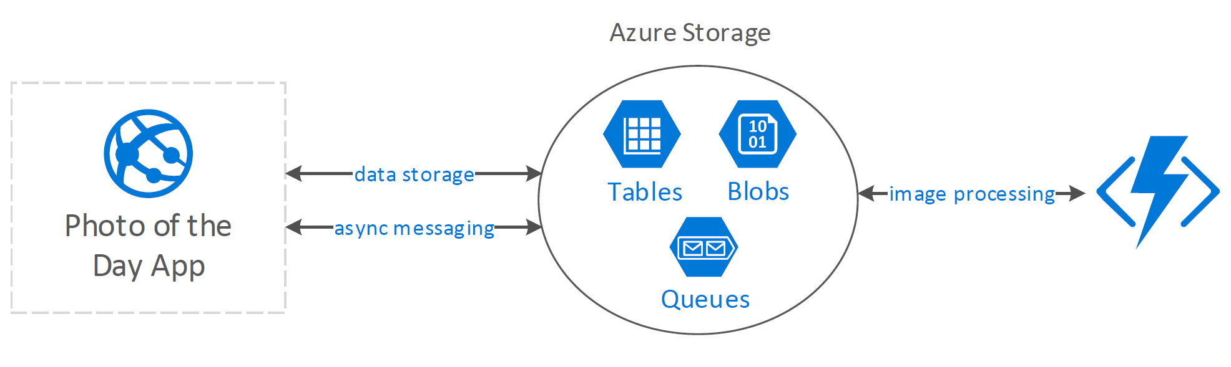

Slide 29
Azure Storage
“Azure Storage is the cloud storage solution for modern applications that rely on durability, availability, and scalability to meet the needs of their customers. ”

Slide 30
Queue Storage
Reliable messaging solution
Enables async communication between components
Usually used to decouple components

Slide 31
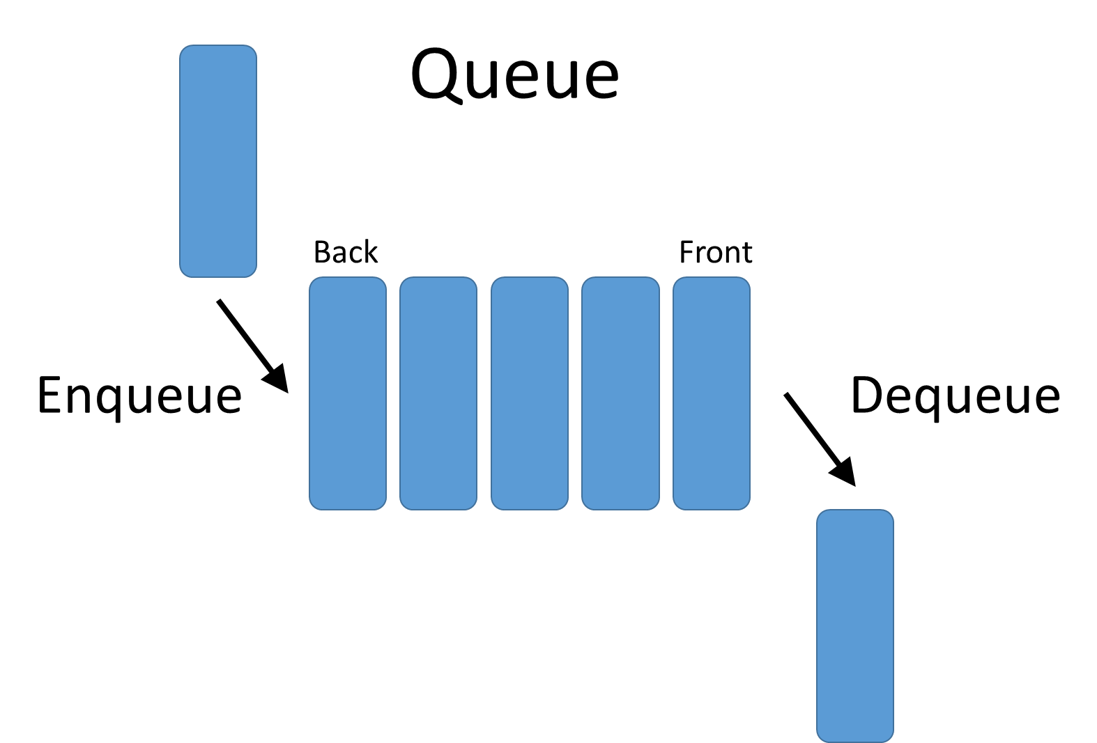
Queues in the cloud
Messages

Slide 32
Queue Messages
Message can be in any format
Binary
Plain text
JSON
Up to 64KB
Usually contains instructions
CloudQueueMessage

Slide 33
Queue storage using .NET

Slide 34
Using Queues
// Connect to your azure storage account
var storageAccount = CloudStorageAccount.Parse(“connectionString");
var client = storageAccount.CreateCloudQueueClient();
// Get a queue
var queue = client.GetQueueReference("messages");
queue.CreateIfNotExists();

Slide 35
Using Queues
// Get a queue
var queue = client.GetQueueReference("messages");
// Add message to queue
CloudQueueMessage message = new CloudQueueMessage("I need to be processed!");
queue.AddMessage(message);
// Peek message
CloudQueueMessage message = queue.PeekMessage();
Console.WriteLine("Message: " + message.AsString);
// Get message
CloudQueueMessage message = queue.GetMessage();
// Delete message
queue.DeleteMessage(message);

Slide 36
Queue storage wrap-up
Helps with decoupling app components
Queue message can be in any format
Queue message is up to 65KB
GetMessage() hides the message
URL Scheme
https://myaccount.queue.core.windows.net/queue/

Slide 37
PHOTO OF THE DAY APP
write messages
read messages
Image Processing
Queue Storage

Slide 38
DEMO: Image Processing

Slide 40
Get started and reach out!
Try Functions – https://functions.azure.com/try
Try App Service – https://tryappservice.azure.com

Slide 41
Thank you!

Slide 42
Questions?

