Slide 1
Azure Lightning Talks
Milan Nankov / Martin Kulov / Nikolay Stanev

Slide 2
Azure User Group Bulgaria
Facebook https://www.facebook.com/groups/azureugbg/
Meetup https://www.meetup.com/Azure-User-Group-Bulgaria/
Github https://github.com/AzureUserGroupBulgaria
Slack https://azureugbg.slack.com/
#AzureUGBG

Slide 3

Milan Nankov Co-founder @ New Venture Software
Twitter: | https://twitter.com/milannankov
Github: | https://github.com/milannankov
Blog: | https://www.newventuresoftware.com/blog
www.newventuresoftware.com

Slide 4
Agenda
Managing Resources with Resource Policies
What is Azure Data Warehouse
Introduction to Application Insights

Slide 5
Azure Resource Policies

Slide 6
Common Issues
Many resources
No conventions
Cannot track spending
Wrong instances deployed

Slide 7
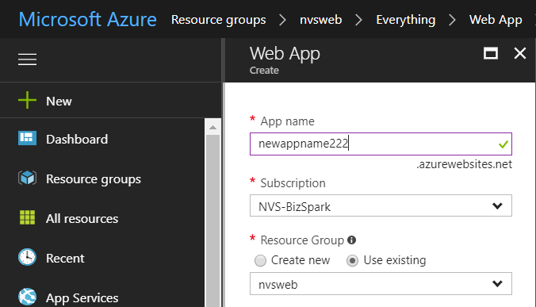
Deployment Request

Slide 8
{
"$schema": "https://schema.management.azure.com/schemas/2015-01-01/deploymentTemplate.json#",
"contentVersion": "1.0.0.0",
"resources": [
{
"type": "Microsoft.Web/serverfarms",
"sku": {
"name": "D1",
"tier": "Shared",
"size": "D1",
"family": "D",
"capacity": 0
},
"kind": "app",
"name": "[parameters('serverfarms_AzureUGBGWeb_name')]",
"apiVersion": "2016-09-01",
"location": "West Europe",
"scale": null,
"dependsOn": []
}
]
}

Slide 9
Policy satisfied?
Yes
Deployment Request
Allow Deployment
No
Reject Deployment

Slide 10
{
"$schema": "https://schema.management.azure.com/schemas/2015-01-01/deploymentTemplate.json#",
"contentVersion": "1.0.0.0",
"resources": [
{
"type": "Microsoft.Web/serverfarms",
"sku": {
"name": "D1",
"tier": "Shared",
"size": "D1",
"family": "D",
"capacity": 0
},
"kind": "app",
"name": "[parameters('serverfarms_AzureUGBGWeb_name')]",
"apiVersion": "2016-09-01",
"location": "West Europe",
"scale": null,
"dependsOn": []
}
]
}

Slide 11
{
"properties": {
"mode": "all",
"displayName": "Allowed VM SKUs",
"description": "Restrict VM SKUs that can be used.",
"policyRule": {
"if": {
"not": {
"field": "Microsoft.Compute/virtualMachines/sku.name",
"in": ["Basic_A0", "Basic_A1"]
}
},
"then": {
"effect": "deny"
}
}
}
}

Slide 12
{
"properties": {
"mode": "all",
"displayName": "Allowed VM SKUs",
"description": "Restrict VM SKUs that can be used.",
"policyRule": {
"if": {
"not": {
"field": "Microsoft.Compute/virtualMachines/sku.name",
"in": ["Basic_A0", "Basic_A1"]
}
},
"then": {
"effect": "deny"
}
}
}
}

Slide 13
{
"if": {
"not": {
"field": "Microsoft.Compute/virtualMachines/sku.name",
"in": [
"Basic_A0",
"Basic_A1"
]
}
},
"then": {
"effect": "deny"
}
}

Slide 14
{
"if": {
<condition> | <logical operator>
},
"then": {
"effect": "deny | audit | append"
}
}

Slide 15
Conditions
A condition evaluates whether a field meets certain criteria

Slide 16
Field
{
"if": {
"not": {
"field": "Microsoft.Compute/virtualMachines/sku.name",
"in": [
"Basic_A0",
"Basic_A1"
]
}
},
"then": {
"effect": "deny"
}
}
Criteria

Slide 17
Fields
name
kind
type
location
tags
tags.*
property aliases

Slide 18
{
"$schema": "https://schema.management.azure.com/schemas/2015-01-01/deploymentTemplate.json#",
"contentVersion": "1.0.0.0",
"resources": [
{
"type": "Microsoft.Web/serverfarms",
"sku": {
"name": "D1",
"tier": "Shared",
"size": "D1",
"family": "D",
"capacity": 0
},
"kind": "app",
"name": "[parameters('serverfarms_AzureUGBGWeb_name')]",
"apiVersion": "2016-09-01",
"location": "West Europe",
"scale": null,
"dependsOn": []
}
]
}

Slide 19
Criteria
equals
like
match
contains
in
containsKey
exists

Slide 20
{
"field": "Microsoft.Compute/virtualMachines/sku.name",
"exists": "true"
}
{
"field": "location",
"in": ["East US", "North Europe"]
}
{
"field": "Microsoft.Storage/storageAccounts/enableFileEncryption",
"equals": "true"
}
{
"field": "type",
"like": "Microsoft.Compute/virtualMachineScaleSets/*"
}

Slide 21
Logical Operators
Allow for a precise policy definition

Slide 22
Logical Operators
Not
AllOf
AnyOf

Slide 23
{
"if": {
"allOf": [
{
"exists": "true",
"field": "Microsoft.Compute/virtualMachines/sku.name"
},
{
"not": {
"field": "Microsoft.Compute/virtualMachines/sku.name",
"in": [
"Basic_A0",
"Basic_A1"
]
}
}
]
},
"then": {
"effect": "deny"
}
}

Slide 24
Demo: Creating resource policies

Slide 25
Resource policies
JSON based
Criteria on resource properties
Acts on deployment

Slide 26
Resources & References
Resource policy overview https://docs.microsoft.com/en-us/azure/azure-resource-manager/resource-manager-policy
Azure Resource Policy samples https://github.com/Azure/azure-policy-samples
Resource Manager Schemas https://github.com/Azure/azure-resource-manager-schemas

Slide 27
Resources & References
Assign and manage resource policies https://docs.microsoft.com/en-us/azure/azure-resource-manager/resource-manager-policy-create-assign
Understand the structure and syntax of Azure Resource Manager templates https://docs.microsoft.com/en-us/azure/azure-resource-manager/resource-group-authoring-templates

Slide 28
Thank you! Questions?

