Slide 1

Building event-based applications with Azure Event Grid
Milan Nankov

Slide 2

Milan Nankov Co-founder @ New Venture Software
Twitter: | https://twitter.com/milannankov
Github: | https://github.com/milannankov
Blog: | https://www.newventuresoftware.com/blog
www.newventuresoftware.com

Slide 3
Updates to the group
New Page
New Logo
December Event
November Event
No recordings and live streaming

Slide 4

https://www.facebook.com/AzureUserGroupBulgaria/

Slide 5
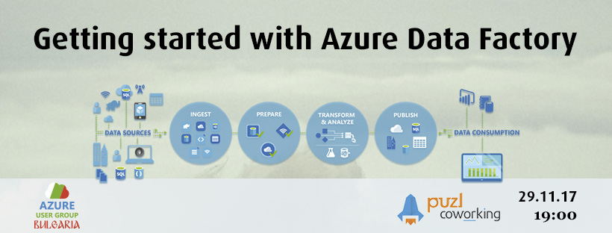
November

Slide 6

December

Slide 7
Azure User Group Bulgaria
Facebook https://www.facebook.com/AzureUserGroupBulgaria
Meetup https://www.meetup.com/Azure-User-Group-Bulgaria/
Github https://github.com/AzureUserGroupBulgaria
Slack https://azureugbg.slack.com/
#AzureUGBG

Slide 8
Agenda
Event-based computing
Event Grid
Demos
Discussion

Slide 9
Event-based computing

Slide 10











Modern computing is all about events

Slide 11

What if all these events could be managed and directed from one place?

Slide 13
Azure Event Grid
Fully-managed event routing
Near real-time event delivery at scale
Broad coverage within Azure and beyond
Backbone of event-driven computing

Slide 14
Benefits
Focus on innovation and pay per event
Ensure reliability and performance for your apps
Unlock new scenarios for your apps
Manage all events in one place

Slide 15
Reliability and performance
Sub-second end-to-end latency in the 99th percentile
10,000,000 events per second per region
24-hour retry with exponential back off for events not delivered
Near real-time
Massive scale-out
High reliability

Slide 16
Platform agnostic
Language agnostic

Slide 17
Event Grid

Slide 18
Event
User X was created Picture was uploaded
Something that happened in the system

Slide 19






An event source/publisher is where the event happens
Event handler is the place where the event is sent
Event publishers
Event handlers
Blob Storage
Azure Functions
Resource Groups
Logic Apps
Azure Subscriptions
Azure Automation
Event Hubs
WebHooks
Custom Events

Slide 20
Topics
Subscriptions
Event publishers
Event handlers
Blob Storage
User/Created User/Deleted
User/Created
Azure Functions
Resource Groups
Logic Apps
Azure Subscriptions
Azure Automation
Event Hubs
WebHooks
Custom Events

Slide 21
Benefit from broad coverage
Publishers
Subscribers
Immediately available
Immediately available
Blob Storage
Azure Functions
Resource Groups
Logic Apps
Azure Subscriptions
Azure Automation
Event Hubs
WebHooks
Custom Events
Coming soon
Azure Automation, Azure Active Directory, API Management, Logic Apps, IoT Hub, Service Bus, Azure Data Lake Store, Cosmos DB
Coming soon
Fabric Controller, Service Bus, Event Hubs, Azure Data Factory, Storage Queues

Slide 22
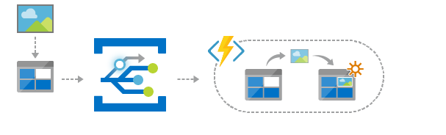
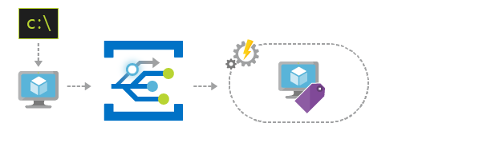
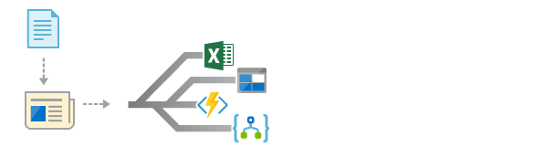
Scenarios
Serverless apps
Ops automation
Application integration
Instantly trigger a serverless function to run analysis when a new file is added to a blob storage container.
Speed up automation and simplify policy enforcement by notifying Azure Automation when underlying infrastructure is provisioned
Connects your app with other services. Create an application topic to route your app’s event data to any desired destination

Slide 23
Wallpaperz App
Wallpaperz App
Wallpaper Submitted
Wallpaper Published

Slide 24
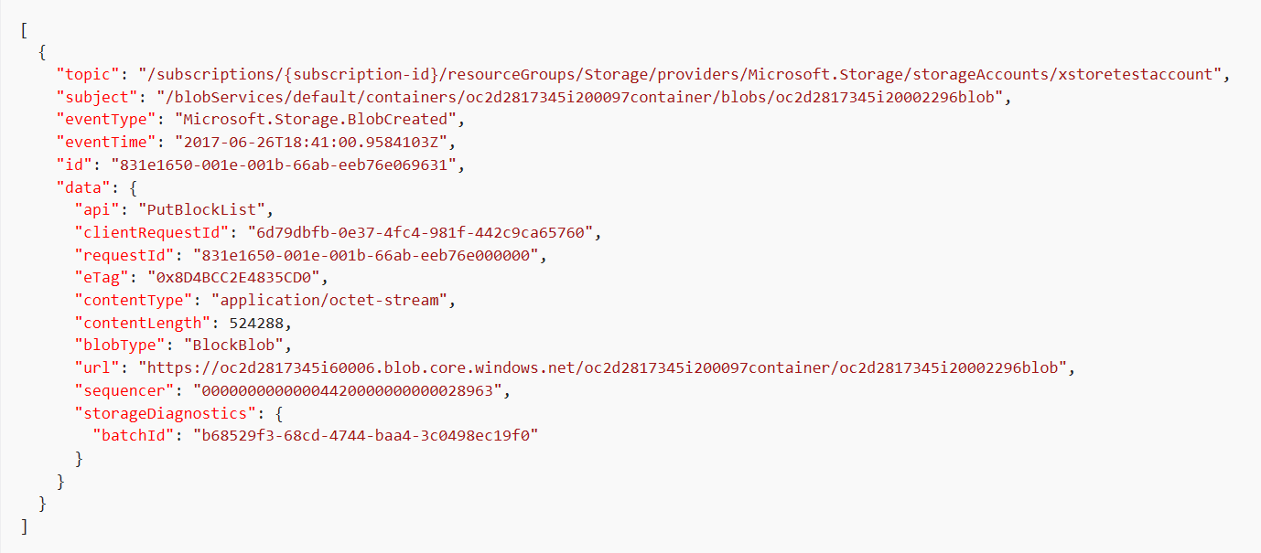
Event Schema

Slide 25
Event Grid guiding principles
Always available
Near real-time event delivery
At least once delivery
Dynamic scale
Platform agnostic (WebHook)
Language agnostic (HTTP protocol)

Slide 26
Target performance
Sub-second end-to-end latency in the 99th percentile
99.99% availability
10,000,000 events per second per region
100,000,000 subscriptions per region
50 ms publisher latency
24 hour retry with exponential back off for events not delivered
Transparent regional failover

Slide 27
Thank you!

Slide 28
Questions?

