Slide 1

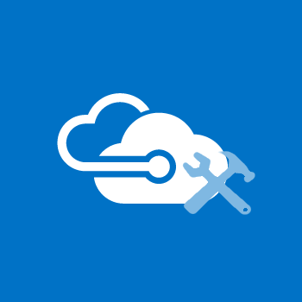
Azure Workshops
Azure AD Connect
#AZWorkshops

Slide 2
Why use Azure AD Connect
Use a Single Identity
Easy Deployment Experience for SSO
Replaces Older Versions of Identity Integration Tools

Slide 3



Components
Azure AD Connect
Supporting the hybrid enterprise
Features
As versatile as your business

Slide 4
AD Connect Components
Synchronization Services
Active Directory Federated Services (optional)
Azure AD Connect Health (optional)
Notes:
https://docs.microsoft.com/en-us/azure/active-directory/connect/active-directory-aadconnect

Slide 5
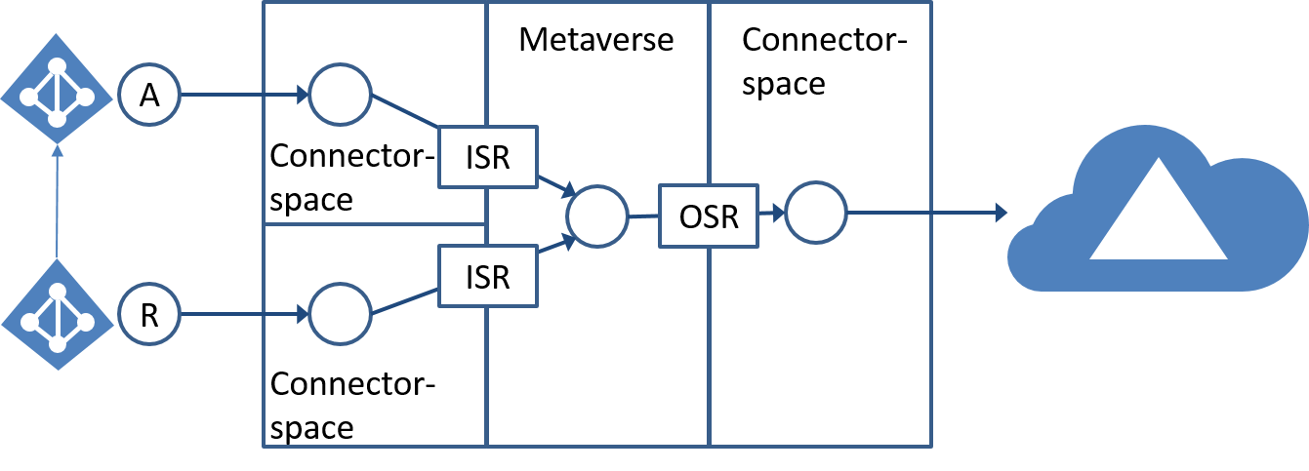
Synchronization Services
Responsible for:
Creating users, groups, and other objects
Ensuring replication consistency between on-premises and cloud
Two components:
Azure AD Connect sync (on-premises)
Azure AD Connect sync service (Azure service)
FIM Synchronization Service
Connector | Code modules used to communicate with a connected directory
Attribute Flow | The process of copying or transforming data from one system to another based on Synchronization Rules
Connector Space | Insulates the connected data source from changes propagating automatically
Metaverse | The consolidated view of all joined identities from neighboring connector spaces
Provisioning | Creating a new object within a connector space downstream from the source
Notes:
https://docs.microsoft.com/en-us/azure/active-directory/connect/active-directory-aadconnectsync-technical-concepts
A = Account
R = Resource

Slide 6
Active Directory Federated Services
Design Concepts
Used to:
Configure a hybrid environment using an on-premises AD FS infrastructure
Benefits:
Domain join Single Sign-On (SSO)
Enforcement of AD sign-in policies
Smart card or 3rd party MFA
High-availability failover with Azure
sourceAnchor
An attribute that is immutable during the lifetime of the object. It uniquely identifies an object as being the same object on-premises as in Azure AD. (Also called immutableId.)
userPrincipleName (UPN)
Azure AD uses the UPN to authenticate a user. When synchronizing users, you must choose the attribute to be used for the value of the UPN.
Notes:
https://docs.microsoft.com/en-us/azure/active-directory/connect/active-directory-aadconnectfed-whatis
https://docs.microsoft.com/en-us/azure/active-directory/connect/active-directory-aadconnect-design-concepts
Source Anchor:
Used for the following scenarios:
Links existing objects in Azure AD with on-premises objects when a new sync server is built or rebuilt after a disaster recovery scenario.
Allows objects to “hard match” existing objects in Azure AD with on-premises objects when moving from a cloud-only identity to a synchronized identity model.
In using federation, then together with the userPrincipleName, is used in the claim to uniquely identify the user.
Must adhere to the following rules:
Be less than 60 characters in length
Characters not being a-z, A-Z, or 0-9 are encoded and counted as 3 characters
Make sure that any other federated server being used that’s not ADFS, can encode to Base64 string
Not contain a special character: \ ! # $ % & * + / = ? ^ ` { } | ~ < > ( ) ' ; : , [ ] " @ _
Must be globally unique
Must be either a string, integer, or binary
Should not be based on user's name, these changes
Should not be case-sensitive and avoid values that may vary by case (sourceAnchor is case-sensitive)
Should be assigned when the object is created
Additional points:
Can not be changed once object has been created in Azure AD and the identity has been synchronized
Can only be set during initial installation. If you rerun the installation wizard, the option is read only. To change it, you’ll need to uninstall and reinstall AD Connect.
If you install another Azure AD Connect server, then you must select the same sourceAnchor attribute as previously used. If you have earlier been using DirSync and move to Azure AD Connect, then you must use objectGUID since that is the attribute used by DirSync.
If the value for sourceAnchor is changed after the object has been exported to Azure AD, then Azure AD Connect sync throws an error and does not allow any more changes on that object before the issue has been fixed and the sourceAnchor is changed back in the source directory.
UPNs:
The attribute values conform to the UPN syntax (RFC 822), that is it should be of the format username@domain
The suffix in the values matches to one of the verified custom domains in Azure AD

Slide 7

Active Directory Federated Services
Supported Topologies:
Single Azure AD Tenant - Single Forest
Supports one or more domains within a single forest
Only supports a single Azure AD tenant
For Azure AD authentication, password sync is used
Express installation of Azure AD Connection supports only this topology
Multiple sync servers are not supported (e.g. load balancing, filtered domain objects, etc.)
sourceAnchor
The recommended attribute is the objectGUID. It is the default attribute when using express settings in Azure AD Connect and the attribute used by the older DirSync.
Notes:
https://docs.microsoft.com/en-us/azure/active-directory/connect/active-directory-aadconnect-topologies

Slide 8
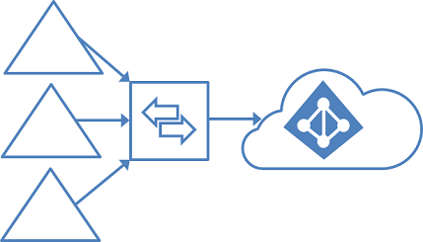
Active Directory Federated Services
Supported Topologies:
Single Azure AD Tenant - Multiple Forests
Ideal for Account-Resource forests
All forests must be accessible by single sync server
Each user must be represented only once in Azure AD
Duplicated groups are not consolidated
Multiple sync servers are not supported (e.g. one per forest)
sourceAnchor
The recommended attribute is the objectGUID.
Notes:
https://docs.microsoft.com/en-us/azure/active-directory/connect/active-directory-aadconnect-topologies
The default configuration in Azure AD Connect sync assumes:
Each user has only one enabled account, and the forest where this account is located is used to authenticate the user. This assumption is for both password sync and federation. UserPrincipalName and sourceAnchor/immutableID come from this forest.
Each user has only one mailbox.
The forest that hosts the mailbox for a user has the best data quality for attributes visible in the Exchange Global Address List (GAL). If there's no mailbox for the user, any forest can be used to contribute these attribute values.
If you have a linked mailbox, there's also an account in a different forest used for sign-in.
If your environment does not match these assumptions, the following things happen:
If you have more than one active account or more than one mailbox, the sync engine picks one and ignores the other.
A linked mailbox with no other active account is not exported to Azure AD. The user account is not represented as a member in any group. A linked mailbox in DirSync is always represented as a normal mailbox. This change is intentionally a different behavior to better support multiple-forest scenarios.

Slide 9
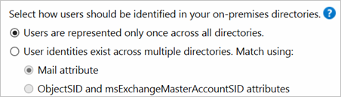
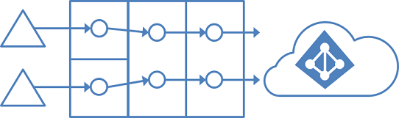
Active Directory Federated Services
Supported Topologies:
Single Azure AD Tenant - Multiple Forests
Ideal for merger/acquisition scenarios or where each business unit operates as a separate organization
All on-premises forests are treated as separate entities
Assumed no user exists in any other forest
Each forest has its own Exchange organization and no GALSync exists between the forests
Will become a single forest in Azure AD and appear with a unified GAL
Multiple Topologies
Notes:
https://docs.microsoft.com/en-us/azure/active-directory/connect/active-directory-aadconnect-topologies

Slide 10
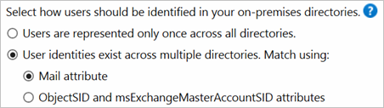
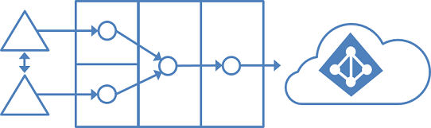
Active Directory Federated Services
Supported Topologies:
Single Azure AD Tenant - Multiple Forests
Distribution and Security Groups contain a mixture of users, contacts and Foreign Security Principals (FSPs)
FSPs are resolved to the real object in Azure AD
Commonly, there’s are two-way trusts between the forests
Users in one forest are created as contacts in another forest via GALSync (optional)
Objects are joined via the mail attribute – a user with a mailbox in one forest is joined with the contacts in other forests
Full Mesh with Optional GALSync
Notes:
https://docs.microsoft.com/en-us/azure/active-directory/connect/active-directory-aadconnect-topologies
NOTE: FSPs are used in Active Directory Domain Services (AD DS) to represent members from other forests in a security group.

Slide 11
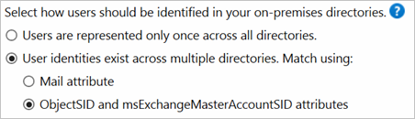
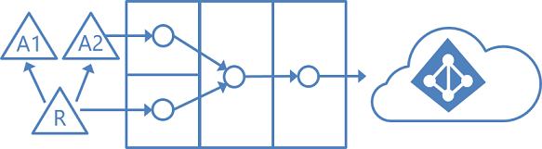
Active Directory Federated Services
Supported Topologies:
Single Azure AD Tenant - Multiple Forests
Distribution and Security Groups contain a mixture of users, contacts and Foreign Security Principals (FSPs)
FSPs are resolved to the real object in Azure AD
Multiple account forests; and, multiple resource forests who have disabled user accounts
Resource forests have full trust of account forests
Resource forests typically have extended AD schema with Exchange and Lync services – mailbox is linked to account forest
Account-Resource Forest
Notes:
https://docs.microsoft.com/en-us/azure/active-directory/connect/active-directory-aadconnect-topologies
NOTE: FSPs are used in Active Directory Domain Services (AD DS) to represent members from other forests in a security group.

Slide 12
Active Directory Federated Services
Supported Topologies:
Multiple Azure AD Tenants
1:1 relationship between each AD forest and each Azure AD tenant
Each Azure AD tenant is isolated and objects in one tenant cannot see objects in another
Notes:
https://docs.microsoft.com/en-us/azure/active-directory/connect/active-directory-aadconnect-topologies

Slide 13
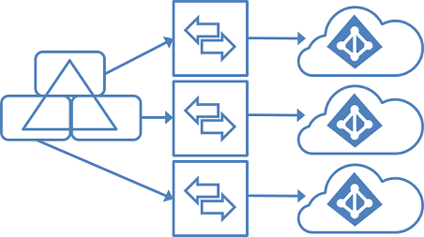
Active Directory Federated Services
Supported Topologies:
Multiple Azure AD Tenants
Each sync server must be configured with filtering so that each Azure AD tenant has a mutually exclusive set of objects
DNS domain can only be registered on a single Azure AD tenant
The UPNs of the users in the on-premises AD must use separate namespaces
There is no GALSync between Azure AD tenant instances (the address book in Exchange Online and Skype for Business shows only users in same tenant)
Restrictions
Only one Azure AD tenant can enable Exchange hybrid
Windows 10 devices can only be associated with a single tenant
SSO option for password-synchronization and pass-through authentication can only be used with one tenant
Some writeback features (group writeback with default configuration, device writeback) are not supported as they assume a single on-premises configuration
Notes:
https://docs.microsoft.com/en-us/azure/active-directory/connect/active-directory-aadconnect-topologies

Slide 14
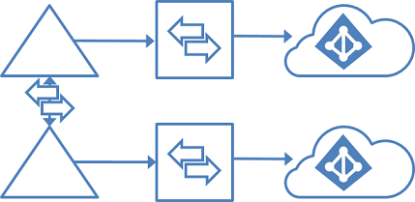
Active Directory Federated Services
Supported Topologies:
Multiple Azure AD Tenants
Use FIM 2010 or MIM 2016 on-premises to sync users (GALSync) between two Exchange organizations
Users in one organization appear as foreign users/contacts in the other
The two on-premises AD instances can sync independently with their own Azure AD tenant
GALSync with On-Premises Sync Server
Notes:
https://docs.microsoft.com/en-us/azure/active-directory/connect/active-directory-aadconnect-topologies

Slide 15
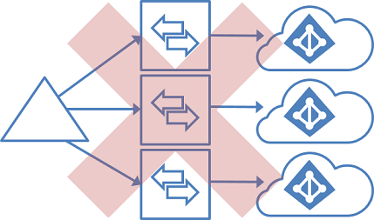
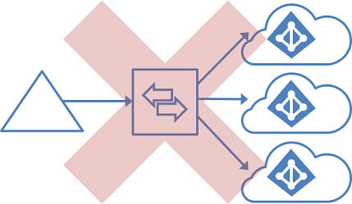
Active Directory Federated Services
Unsupported Topologies:
Each Object Multiple Times in an Azure AD Tenant
Unsupported Tasks:
Sync the same user to multiple Azure AD tenants
Make a configuration change so that users in one Azure AD tenant appear as contacts in another Azure AD tenant
Modify Azure AD Connect sync to connect to multiple Azure AD tenants
Notes:
https://docs.microsoft.com/en-us/azure/active-directory/connect/active-directory-aadconnect-topologies

Slide 16
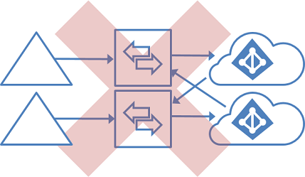
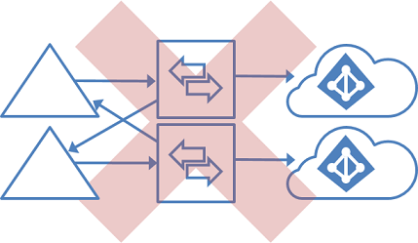
Active Directory Federated Services
Unsupported Topologies:
GALSync by Using Writeback
Unsupported Tasks:
Change the configuration of Azure AD Connect sync to read data from another Azure AD tenant
Exports users as contacts to another on-premises Active Directory instance by using Azure AD Connect sync
Notes:
https://docs.microsoft.com/en-us/azure/active-directory/connect/active-directory-aadconnect-topologies

Slide 17
Bottom Line
Azure AD Connect is a 1:1 synchronization tool. It can only read from one on-premises AD instance*; it can only write to one Azure AD tenant.
* Depending on the on-premises configuration as discussed in previous slides, the instance can be a world (via FSPs), a single forest or a single domain.

Slide 18
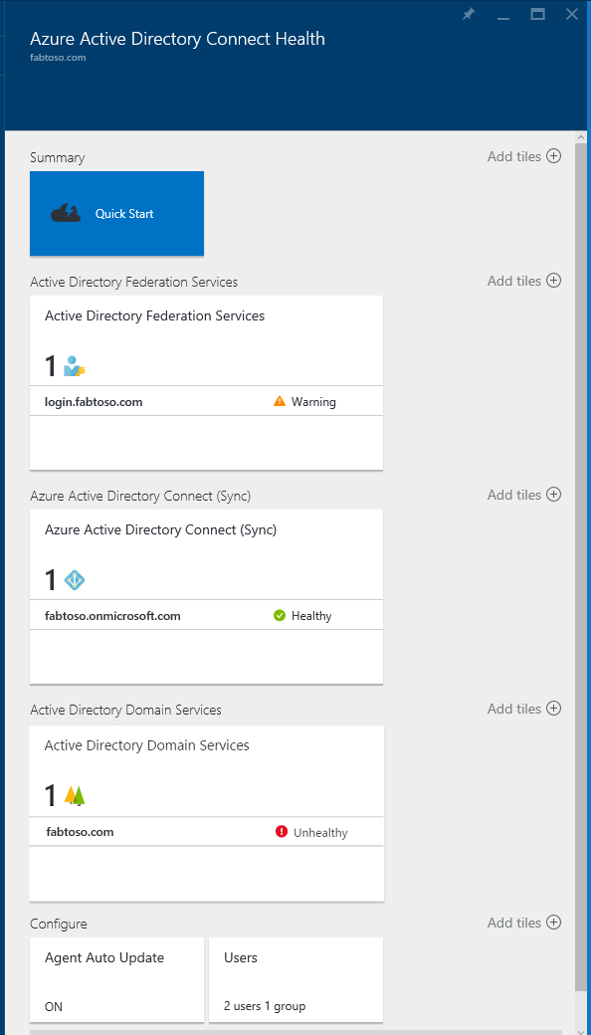

Azure AD Connect Health
Used for:
Robust monitoring of AD Synchronization
Benefits:
A central location in Azure portal to view activity
Notes:
https://docs.microsoft.com/en-us/azure/active-directory/connect-health/active-directory-aadconnect-health

Slide 19
Azure AD Connect Health
AD FS
Monitoring with alerts to know when AD FS and AD FS proxy servers are not healthy
Email notifications for critical alerts
Trends in performance data (e.g. capacity planning)
Usage analytics for AD FS sign-ins with pivots (apps, users, network location, etc.)
Reports for AD FS (e.g. top 50 users with bad username/password attempts and their last IP address)
Gain insights into your on-premises identity infrastructure that is used for accessing Office 365 or other Azure AD applications.
As simple as installing an agent on each on-premises identity server.
Sync
Monitoring with alerts to know when Azure AD Connect is not healthy
Email notifications for critical alerts
Sync operational insights, which include latency charts for sync operations and trends in operations
Quick glance information about sync properties and last successful export to Azure AD
Reports about object-level sync errors
AD DS
Monitoring alerts to detect with domain controllers are unhealthy
Email notifications for critical alerts
Domain Controllers dashboard providing a quick view of health and operational status of controllers
Replication Status dashboard providing latest replication info and links to troubleshooting guides
Quick anywhere access to performance data graphs of popular performance counters
Notes:
https://docs.microsoft.com/en-us/azure/active-directory/connect-health/active-directory-aadconnect-health

Slide 20
AD Connect Features
Filtering
Used to limit which objects synchronized to Azure AD
Password Synchronization
Synchronizes the password hash between Active Directory and Azure AD
Password Writeback
Allows users to change passwords in the cloud while applying on-premises password policies
Device Writeback
Allows devices registered in Azure AD to be written back to on-premises AD for conditional access
Prevent Accidental Deletes
Protects cloud directory from numerous deletes at the same time
Automatic Upgrades
Ensures Azure AD Connect is always updated with the latest release
Notes:
https://docs.microsoft.com/en-us/azure/active-directory/connect/active-directory-aadconnect

Slide 21
Filtering
Group-based
Based on a single group
Can only be configured on initial installation using custom configuration
Used for pilots (e.g. sync’ing small sets of objects)
Domain-based
Used when adding or removing domains from on-premises organizations
Organizational Unit-based
Used for sync’ing OUs in Active Directory with Azure AD
Sync’s all objects in an organizational unit
Attribute-based
Filter objects based on their attribute values
Can have different filters for different object types
Notes:
https://docs.microsoft.com/en-us/azure/active-directory/connect/active-directory-aadconnectsync-configure-filtering

Slide 22
Password Synchronization
Process:
Every two minutes, the password synchronization agent on the AD Connect server requests the stored password hashes (the unicodePwd attribute) from a DC via the standard MS-DRSR replication protocol
Before sending, the DC encrypts the MD4 password hash by using a key that is a MD5 hash of the RPC session key and a salt
After the password sync agent has the encrypted envelope, it uses MD5CryptoServiceProvider and the salt to generate a key to decrypt the received data back to its original MD4 format
The sync agent expands the 16-byte binary password hash to 64 bytes by converting the hash to a 32-byte hexadecimal string, then converting this string back into a binary with UTF-16 encoding
The password sync agent adds a salt, consisting of a 10-byte length salt, to the 64-byte binary
The sync agent combines the MD4 hash plus salt, and input it into the PBKDF2 function with 1000 iterations and the HMAC-SHA256 keyed hashing algorithm
The sync agent takes the resulting 32-byte hash, concatenates both the salt and the number of SHA256 iterations to it, then transmits the string from Azure AD Connect to Azure AD over SSL
When a user attempts to authenticate against Azure AD, the entered password is ran through the same MD4+salt+PBKD2+HMAC-SHA256 process comparing resulting hash to the synchronized hash
Notes:
https://docs.microsoft.com/en-us/azure/active-directory/connect/active-directory-aadconnectsync-implement-password-synchronization

Slide 23
Password Synchronization Considerations
Security
Plain-text passwords are not exposed to the password sync feature, to Azure AD, or any of the associated services
Authentication is conducted against Azure AD, not the on-premises AD instance
Only the SHA256 password data is stored in Azure AD – a hash of a hash
SHA256 cannot be decrypted, alleviating pass-the-hash
Notes:
https://docs.microsoft.com/en-us/azure/active-directory/connect-health/active-directory-aadconnect-health

Slide 24
Password Synchronization Considerations
Password Policies:
Password Complexity
On-premises AD policy overrides cloud policy for synchronized users
Notes:
https://docs.microsoft.com/en-us/azure/active-directory/connect-health/active-directory-aadconnect-health

Slide 25
Password Synchronization Considerations
Password Policies:
Password Expiration
For users in scope, cloud account passwords are set to Never Expire
For accounts on-premises that have expired, users can continue to login to the cloud until the on-premises password has been changed then synchronized
Notes:
https://docs.microsoft.com/en-us/azure/active-directory/connect-health/active-directory-aadconnect-health

Slide 26
Password Synchronization Considerations
Password Policies:
Account Expiration
accountExpires attribute is not synchronized to Azure AD, therefore, an expired account in an on-premises AD will still be active in Azure AD
Use PowerShell to replicate enable/disable of AD accounts to Azure AD
Notes:
https://docs.microsoft.com/en-us/azure/active-directory/connect-health/active-directory-aadconnect-health

Slide 27
Password Synchronization Considerations
Password Policies:
Password Overwrites
Administrators can manually reset passwords using PowerShell
Once on-premises password is synchronized, manually updated password is overwritten
Synchronization has no impact on the Azure user who is signed in
Only when user tries to reauthenticate is the user challenged with new password
“Keep Me Signed In” (KMSI) can be enabled or disabled
Notes:
https://docs.microsoft.com/en-us/azure/active-directory/connect-health/active-directory-aadconnect-health

Slide 28
Password Synchronization Considerations
Password Policies:
Federal Information Processing Standard (FIPS)
By default, MD5 is disabled to lock down server
MD5 must be re-enabled for password synchronization
Notes:
https://docs.microsoft.com/en-us/azure/active-directory/connect-health/active-directory-aadconnect-health

Slide 29
Password Writeback
Azure AD self-service password reset
Empowers users to reset or unlock their password or accounts
Includes detailed reporting to track when users use the system along with notifications to alert of misuse or abuse
Requires appropriate licensing
Azure AD Premium P1 (or P2)
Enterprise Mobility + Security E3 (or E5)
Secure Productive Enterprise E3 (or E5)
Notes:
https://docs.microsoft.com/en-us/azure/active-directory/active-directory-passwords-getting-started

Slide 30
Device Writeback
Enables conditional access based on devices to AD FS (2012 R2 or higher) protected applications
Provides additional security and assurance that access to applications is granted only to trusted devices
Devices must be located in the same forest as the users
Only one device registration configuration object can be added to the on-premises AD forest
Requires Azure AD Premium
Notes:
https://docs.microsoft.com/en-us/azure/active-directory/connect/active-directory-aadconnect-feature-device-writeback

Slide 31
Prevent Accidental Deletes
Enabled by default when installing Azure AD Connect
Protects against accidental deletes of users and other objects
Prevents more than 500 objects from being deleted in a single export
Number can be increased with PowerShell
Will receive an error and sync will stop if too many deletes are staged
Notes:
https://docs.microsoft.com/en-us/azure/active-directory/connect/active-directory-aadconnectsync-feature-prevent-accidental-deletes

Slide 32
Automatic Upgrade
Enabled by default for the following:
Express settings installation and DirSync upgrades
The SQL Express LocalDB, which is what Express settings use
The AD account is the default MSOL_ account created by Express settings and DirSync
Have less than 100,000 object in the metaverse
Current state of automatic upgrade can be set and/or viewed with Powershell
States
Enabled – Automatic upgrade is enabled
Suspended – Set by the system only. The system is no longer eligible to receive upgrades
Disabled – Automatic upgrade is disabled
Notes:
https://docs.microsoft.com/en-us/azure/active-directory/connect/active-directory-aadconnect-feature-automatic-upgrade

