Slide 1
Big Data and Visualization Briefing Deck
2/28/2018
Charlotte, NC

Slide 2
SPEAKER NOTES
This deck can be used for the Big Data and Visualization Microsoft Cloud Workshop
The intended flow of the workshop is:
  Kickoff / Introductions
  Case Study Introduction
  Big Data Primer
    Different Options
  Whiteboarding Session
  Hands-On-Lab

Slide 3
Azure Big Data
Patterns and Tools
Notes:
Creating this as “Patterns” and “Tools” – because we want to show them different options for creating their white boarding session.
Ideally, we want to teach them “Here is a typical pattern to implement. At each phase, you have a choice of several different tools – each with pros and cons.
The overall pattern for the following slides is:
“Here’s a basic architecture”
“Here’s a brief synopsis of the new tools”
“Here’s a slightly different architecture”
“Here’s a brief synopsis of the new tools”
Repeat

Slide 4

Very High-Level Big Data Architecture
INGEST
STORE
TRANSFORM & ANALYZE
PUBLISH
Source Data
Apps + Insights
Notes:
This is the high-level architecture of big data – actually it’s the high-level architecture of business intelligence in general.
Now – each of these boxes has hundreds of different ways to accomplish the goals, but at the end-of-the-day, it’s all about this:
Get Data > Keep Data > Enrich the Data > Use the Data
This overall process might take days or it might take seconds – it really depends on the specific business requirement… that’s why it’s so important to be focused on the architecture in the business context your are putting it in.
Ingesting the data – might look like streaming data, it might look like batch.
Storing the data – might be in a relational database, might be in flat files, NoSQL, etc.
Enriching the data – data cleansing, predictive analytics
Serving the data – Might be back in flat files, relational databases, OLAP cube, notification or event, etc.

Slide 5
Solution scenarios
Let’s walk through these scenarios to see the architecture in action…
Modern DW
“We want to incorporate all of our data including ‘big data” with our data warehouse”
Advanced Analytics
      “We are trying to predict when our customers churn.”
Internet of Things (IoT)
“We are trying to get insights from our devices in real-time, etc.”

Slide 6
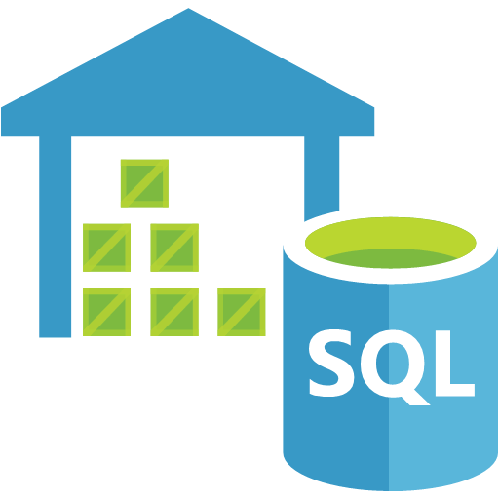
Traditional Data Warehouse
AZURE CLI
AZURE DATA FACTORY
BCP COMMAND LINE UTILITY
SQL SERVER INTEGRATION SERVICES

Slide 7
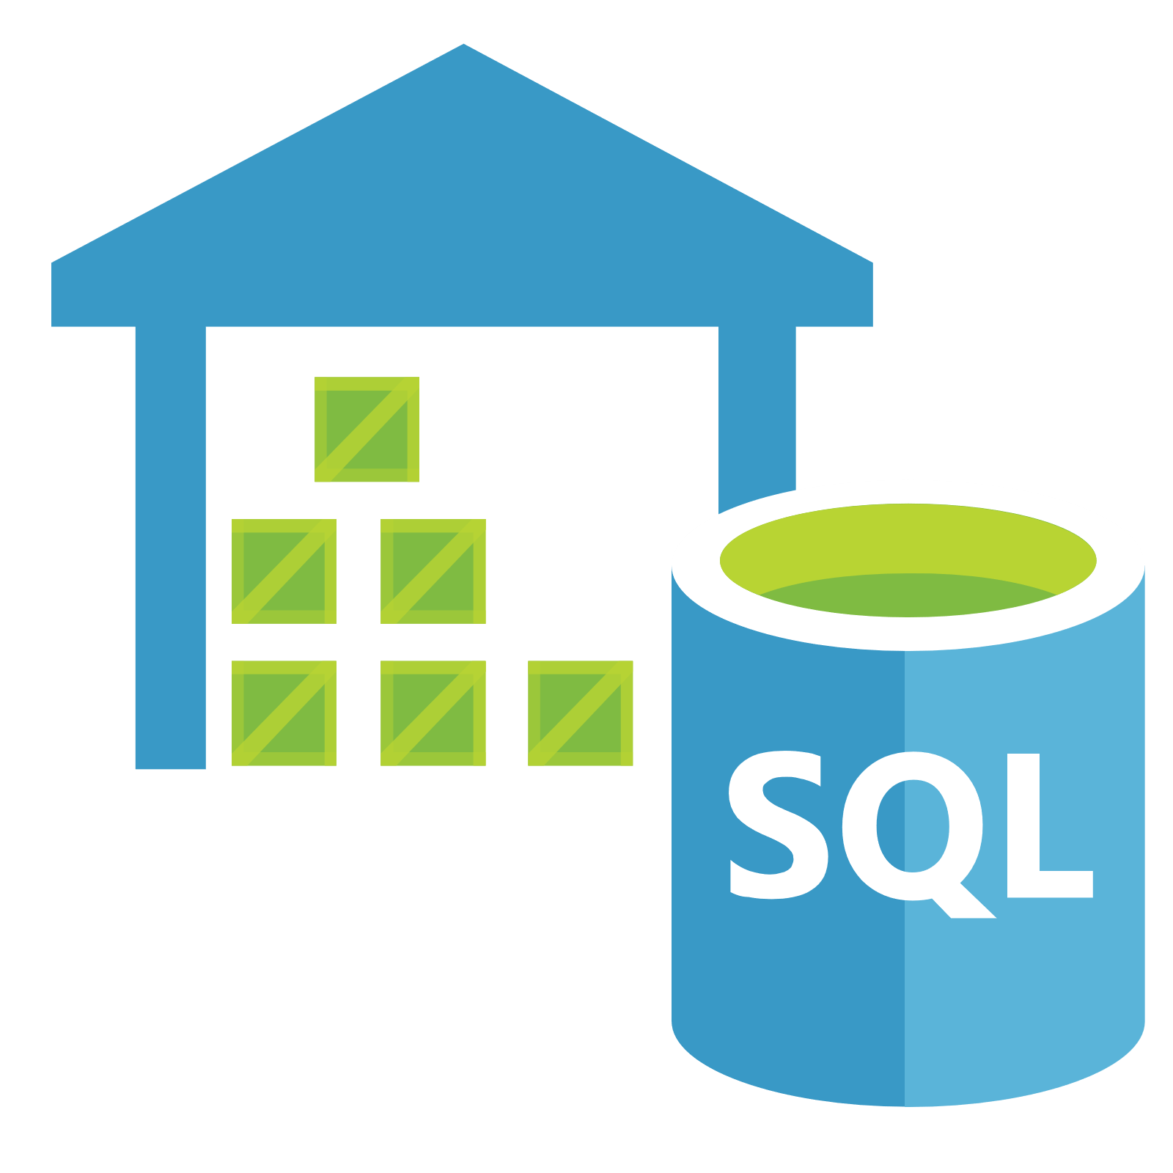
Azure SQL Data Warehouse
  Elastic data warehouse as a service with enterprise-class features
Enterprise-class cloud data warehouse that can grow, shrink, and pause in seconds
Petabyte scalability with massive parallel processing
Full SQL Server experience
Independent scale of compute and storage in seconds
Seamless compatibility with Power BI, Azure Machine Learning, HDInsight, and Azure Data Factory
Transaction of SQL queries across relational and non-relational data in Hadoop with PolyBase
Notes:
Fortunately, there’s Microsoft Azure SQL Data Warehouse.
[Click]
It is the industry’s first enterprise-class cloud data warehouse that can grow, shrink, and pause in seconds.
[Click]
It enables scaling with the HDInsight Hadoop service on Microsoft Azure. Based on the proven SQL Server relational database engine, it includes the features you expect from an enterprise data warehouse, including stored procedures, user-defined functions, table partitioning, indexes, and collations.
[Click]
SQL Data Warehouse works seamlessly with Power BI, Azure Machine Learning, HDInsight, and Azure Data Factory.
[Click]
It gives petabyte scalability with massive parallel-processing architecture that enables distributed processing to handle the rigors of modern data realities.
[Click]
It independently scales compute and storage in seconds.
[Click]
And importantly, Microsoft PolyBase provides the ability to query relational and non-relational data in Hadoop with a single, T-SQL-based query model that can support both relational and non-relational data in parallel.

Slide 8
Traditional Data Warehouse
AZURE CLI
AZURE DATA FACTORY
BCP COMMAND LINE UTILITY
SQL SERVER INTEGRATION SERVICES

Slide 9

Cloud Data Warehouse
AZURE CLI, AZURE DATA FACTORY
POLYBASE
AZURE DATA LAKE STORE
AZURE STORAGE
DATA MIGRATION SERVICE
AZURE SQL DATA WAREHOUSE
AZURE ANALYSIS SERVICES

Slide 10
Azure Storage Options
https://aka.ms/blob-vs-adls
AZURE BLOB STORAGE
AZURE DATA LAKE STORE
Purpose: General purpose object store for a wide variety of storage scenarios
Use Cases: Any type of text or binary data, such as application back end, backup data, media storage for streaming and general purpose data
Key Concepts: Storage account has containers, which in turn has data in the form of blobs
Structure: Object store with flat namespace
Limit: Specific limits documented here
Purpose: Optimized storage for big data analytics workloads
Use Cases: Batch, interactive, streaming analytics and machine learning data such as log files, IoT data, click streams, large datasets
Key Concepts: Data Lake Store account contains folders, which in turn contains data stored as files
Structure: Hierarchical file system
Limit: No limits on account sizes, file sizes or number of files
Learn and adapt
with your app!
Work within
your environment
  so you can focus on
  building great apps!
Scales on the fly
  without app downtime!
Build multitenant apps
  with customer isolation
  and efficiency!
Notes:
https://aka.ms/blob-vs-adls
Reduced
Dev Ops

Slide 11
Azure Analysis Services
  Enterprise grade analytics engine as a service
Learn and adapt
with your app!
Work within
your environment
  so you can focus on
  building great apps!
Scales on the fly
  without app downtime!
Build multitenant apps
  with customer isolation
  and efficiency!
Build semantic models
  Transform complex data into business user friendly semantic models
Proven technology
  Based on SQL Server Analysis Services
In-Memory Cache
  Gain instant insights with
  in-memory cache using your preferred visualization tools
Provision and scale
Easy to deploy, scale,
and manage as
platform-as-a-service
Notes:
Reduced
Dev Ops

Slide 12
Polybase
Available in SQL Server 2016+ and Azure SQL DW
CREATE EXTERNAL TABLE [dbo].[CarSensor_Data] (
[SensorKey] int NOT NULL,
[CustomerKey] int NOT NULL,
[GeographyKey] int NULL,
[Speed] float NOT NULL,
[YearMeasured] int NOT NULL
)
WITH (LOCATION='/Demo/',
DATA_SOURCE = MyAzureStorage,
FILE_FORMAT = TextFileFormat
);
SELECT * FROM [dbo].[CarSensor_Data];
AZURE STORAGE
AZURE DATA LAKE STORE

Slide 13
Cloud Data Warehouse
AZURE CLI, AZURE DATA FACTORY
POLYBASE
AZURE DATA LAKE STORE
DATA MIGRATION SERVICE
AZURE SQL DATA WAREHOUSE
AZURE ANALYSIS SERVICES

Slide 14

Cloud Data Warehouse
POLYBASE
DATA FACTORY
AZURE DATA LAKE STORE
AZURE SQL DATA WAREHOUSE
AZURE ANALYSIS SERVICES
DATA FACTORY

Slide 15

Azure Data Factory
Learn and adapt
with your app!
  Cloud-Scale Data Orchestration Tool
Work within
your environment
  so you can focus on
  building great apps!
SQL
Scales on the fly
  without app downtime!
Build multitenant apps
  with customer isolation
  and efficiency!
Manage Data Pipelines
  Create, schedule, orchestrate, and manage data pipelines
Provision Resources
  Manage transient resources to run your data pipelines
AZURE DATA FACTORY
Hybrid Data Movement
  Connect to on-premises and cloud data sources
SQL
{ }
Notes:
Reduced
Dev Ops

Slide 16
Cloud Data Warehouse
POLYBASE
DATA FACTORY
AZURE DATA LAKE STORE
AZURE SQL DATA WAREHOUSE
AZURE ANALYSIS SERVICES
DATA FACTORY

Slide 17

Cloud Data Warehouse
DATA FACTORY
AZURE DATA LAKE STORE
AZURE HDINSIGHT
POLYBASE
DATA FACTORY
AZURE SQL DATA WAREHOUSE

Slide 18


Azure HDInsight
Managed Hadoop Cluster – Built on Hortonworks
Cost-effectively scale workloads up or down through decoupled compute and storage.
Rich productivity suites for Hadoop and Spark – such as such as Visual Studio, Eclipse, and IntelliJ for Scala, Python, R, Java, and .NET support, Jupyter notebook, Microsoft Machine Learning Server.
Managed service open source analytics with an Industry-leading 99.9% SLA
Available in >25 regions globally
Secure and compliant: HIPPA, PCI, SOC compliance.
Notes:
backed by Microsoft and Hortonworks with 37 combined committers for Hadoop core—more than all other managed cloud providers combined—ready to support your deployment with the ability to fix and commit code back to Hadoop
https://azure.microsoft.com/en-us/services/hdinsight/

Slide 19
Cloud Data Warehouse
DATA FACTORY
AZURE DATA LAKE STORE
AZURE HDINSIGHT
POLYBASE
DATA FACTORY
AZURE SQL DATA WAREHOUSE

Slide 20

Cloud Data Warehouse
DATA FACTORY
AZURE DATA LAKE STORE
AZURE DATA LAKE ANALYTICS
POLYBASE
DATA FACTORY
AZURE SQL DATA WAREHOUSE

Slide 21
Azure Data Lake Analytics
Big Data Compute as-a-Service
Data Lake Store
Storage service optimized for big data analytics
Easily develop and run massively parallel data transformation and processing programs in U-SQL, R, Python and .NET over petabytes of data.
No infrastructure to manage.
Process data on demand.
Scale instantly.
Only pay per job
Enterprise-grade Support and Security
Data Lake Analytics
Big data as a service
HDInsight
Clusters as a service

Slide 22
3 Different Big Data Compute Options
 | HDP | CDH | MapR (Azure Marketplace) Any OSS Analytics technology | HDInsight Workload-optimized, managed clusters | Data Lake Analytics Specific apps in a multi-tenant form factor
 | IaaS Clusters | Managed Clusters | Big Data Compute as-a-service
Best for… | Lifting and shifting existing Hadoop workloads to the cloud without changes, full control | Spinning up HDInsight (PaaS) in minutes, fully managed by Microsoft with some control | Easiest way to get started on big data - Leverage SQL + C# skills, no infrastructure administration needed
Workloads | Full Hadoop distribution and projects | Most Hadoop distribution: batch, streaming, interactive and machine learning with ability to customize cluster | No Hadoop distribution: Batch processing supported currently (U-SQL)
Administrative | Will need Hadoop admin experience – everything done yourself. Still need to manage clusters. | Easier to use—Make admin jobs easier: OS upgrades, patching, Hadoop version upgrades done for you. Still need to manage clusters. | Easiest to use—minimal admin functions needed. No cluster notion. Instantly, scales elastically per job.
Developer | Use familiar Hadoop tooling (Hive, Spark, etc.). | Use familiar Hadoop tooling (Hive, Spark, etc.). Microsoft provides some Visual Studio and IntelliJ integration | Deep Visual Studio integration for coding, debugging, optimizing (.NET – C# / SQL)
Control & configuration | Full control of managing and running your clusters. Spin up VMs as needed | Some control and some configuration. Fully managed and monitored by Microsoft with 99.9% SLA, scale nodes on demand, control # of VMs on Azure | No need to control or configure Instantly scales elastically per job
Service Level Agreement | Only on VM network connectivity | 99.9% on both network connectivity and Hadoop bits are running in VMs | 99.9% SLA at GA
TCO | Lowest cost per query Higher TCO | Low cost per query Low TCO from balanced resourcing | Highest cost per query Lowest TCO

Slide 23
Solution scenarios
Modern DW
“We want to incorporate all of our data including ‘big data” with our data warehouse”
Advanced Analytics
      “We are trying to predict when our customers churn.”
Internet of Things (IoT)
“We are trying to get insights from our devices in real-time, etc.”

Slide 24



Advanced Analytics on Big Data
AZURE MACHINE LEARNING & MACHINE LEARNING SERVER
WEB & MOBILE APPS
DATA FACTORY
AZURE DATA LAKE STORE
AZURE HDINSIGHT
POLYBASE
DATA FACTORY
AZURE SQL DATA WAREHOUSE

Slide 25
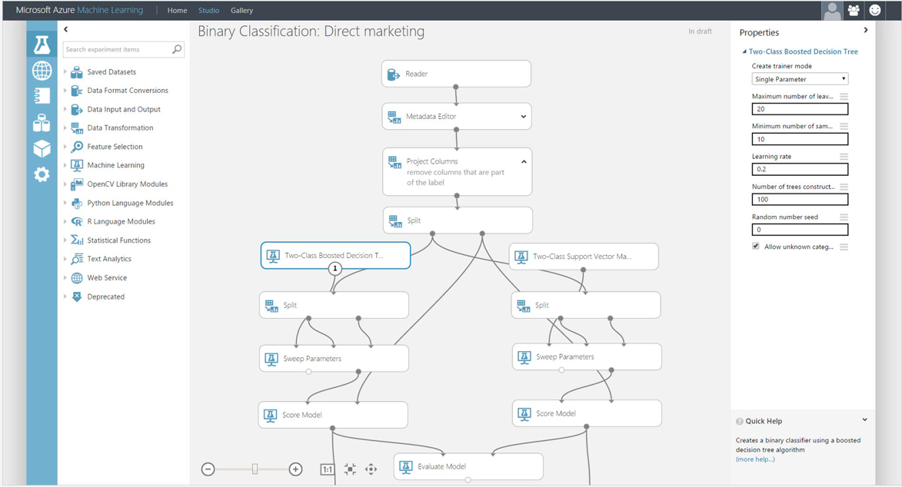
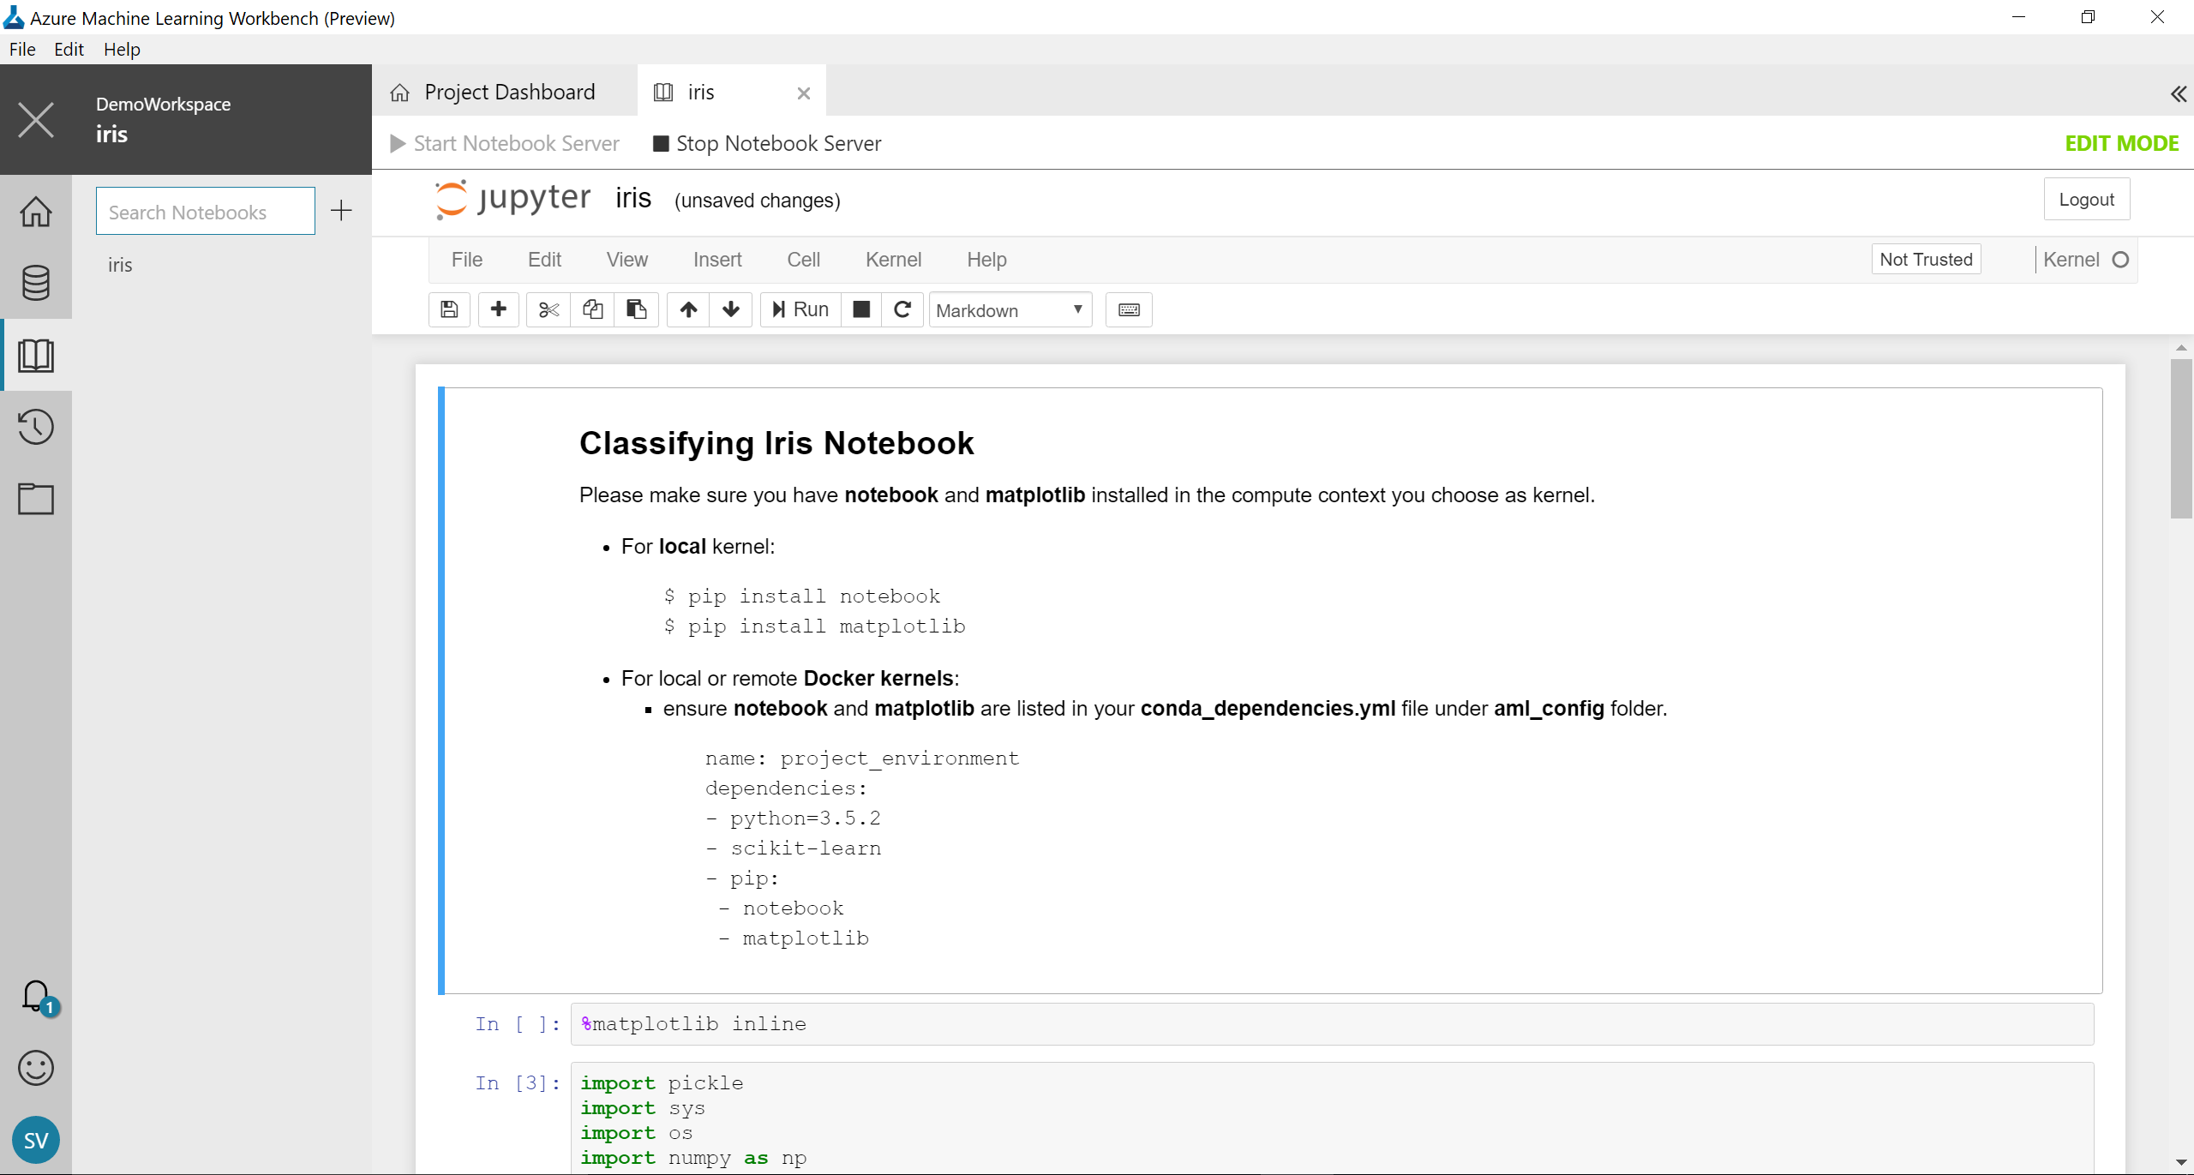
Azure Machine Learning
Learn and adapt
with your app!
Work within
your environment
  so you can focus on
  building great apps!
Scales on the fly
  without app downtime!
Build multitenant apps
  with customer isolation
  and efficiency!
Visual drag-and-drop
Code-first
Notes:
Reduced
Dev Ops

Slide 26
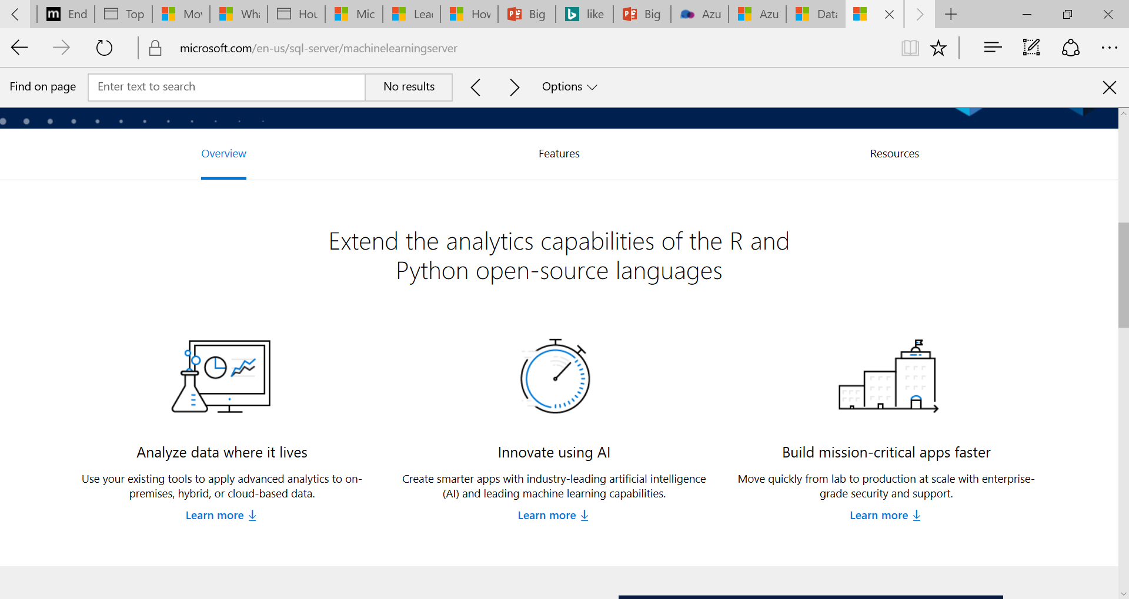
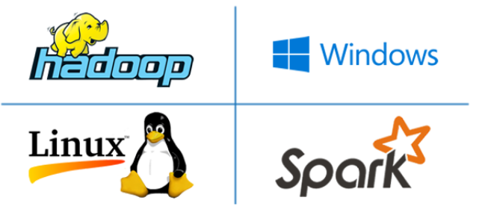
Microsoft ML Server
Extend beyond open source R and Python, and transform business with Enterprise-grade analytics
Create smarter apps with industry-leading artificial intelligence (AI) and leading machine learning capabilities, in addition to open source R and Python.
Learn and adapt
with your app!
Work within
your environment
  so you can focus on
  building great apps!
Scales on the fly
  without app downtime!
Build multitenant apps
  with customer isolation
  and efficiency!
Simplify deployment of your analytics models. Integrate analytics faster with apps written in any language and score easily across data platforms using web services and your preferred development environment.
When your data stores grow, Machine Learning Server can be deployed to perform at scale wherever your big data lives—including databases such as SQL Server 2016, Hadoop clusters, data warehouses, and even data stores in the cloud.
Notes:
https://www.microsoft.com/en-us/sql-server/machinelearningserver
Reduced
Dev Ops

Slide 27
Advanced Analytics on Big Data
AZURE MACHINE LEARNING & MACHINE LEARNING SERVER
WEB & MOBILE APPS
DATA FACTORY
AZURE DATA LAKE STORE
AZURE HDINSIGHT
POLYBASE
DATA FACTORY
AZURE SQL DATA WAREHOUSE

Slide 28
Solution scenarios
Modern DW
“We want to incorporate all of our data including ‘big data” with our data warehouse”
Advanced Analytics
      “We are trying to predict when our customers churn.”
Internet of Things (IoT)
“We are trying to get insights from our devices in real-time, etc.”

Slide 29



Stream Ingestion
AZURE MACHINE LEARNING & MACHINE LEARNING SERVER
AZURE IOT HUB
AZURE EVENT HUBS
AZURE HDINSIGHT
POLYBASE
ANALYTICAL DASHBOARDS
AZURE HDINSIGHT
(Kafka)
AZURE DATA LAKE STORE
AZURE SQL DATA WAREHOUSE

Slide 30

Stream Ingestion
AZURE MACHINE LEARNING & MACHINE LEARNING SERVER
AZURE IOT HUB
AZURE EVENT HUBS
AZURE STREAM ANALYTICS
POLYBASE
ANALYTICAL DASHBOARDS
AZURE HDINSIGHT
(Kafka)
AZURE DATA LAKE STORE
AZURE SQL DATA WAREHOUSE

Slide 31
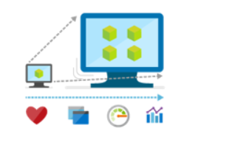
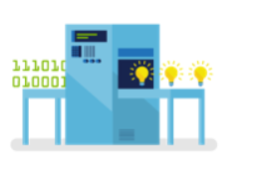
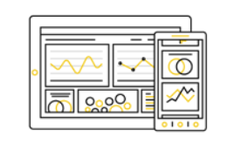
Azure Stream Analytics
An on-demand real-time analytics service
Develop massively parallel Complex Event Processing (CEP) pipelines with simplicity
Author powerful real-time analytics using very simple declarative SQL like language for more sophisticated analytics such as Pattern detection, Time windows, Joins & correlations
Instantly analyze data from all your IoT devices and gateways
Azure Stream Analytics seamlessly integrates with Azure IoT Hub and Azure IoT Suite to enable powerful real-time analytics on data from your IoT devices and applications.
Build real-time dashboards in minutes
Quickly build real-time dashboards with Power BI for a live command and control view. Real-time dashboards help transform live data into actionable and insightful visuals, and help you focus on what matters to you the most.
Notes:
https://azure.microsoft.com/en-us/services/stream-analytics/

Slide 32



All Together Now
DATA LAKE ANALYTICS
COSMOS DB, SQL DB
DATA LAKE STORE
DATA FACTORY
(Data movement)
HDINSIGHT
(Hadoop/Spark)
BLOB STORAGE
WEB & MOBILE APPS
SQL DATA WAREHOUSE
AZURE IOT HUB
OPERATIONAL REPORTS
MACHINE LEARNING
ANALYSIS SERVICES
EVENT HUBS
KAFKA ON HDINSIGHT
STREAM ANALYTICS
ANALYTICAL DASHBOARDS
INGEST
STORE
TRANSFORM AND ANALYZE
PUBLISH
Notes:
Starting from the left, we move data using ADF into Azure Data Lake store or a Blob store, and then depending on the analysis we use a mixture of ADLA and HDInsight to process/transform the data. We store the transformed data in SQL DB/SQLDW. Lastly we visualize the data using common tools like Power BI.

