Slide 1

Real world whiteboard design session case study
Migrate EDW to Azure SQL Data Warehouse

Slide 2

Step 1:
Review the customer case study

Slide 3
Customer situation
Coho
Coho is a retail company based in Austin, Texas, that focuses on buying and selling mobile electronics and services. Coho has approximately 500 stores spread throughout the United States and a successful, direct-to-consumer e-commerce site.
Last year Coho began migrating to the cloud with development/test environments moving first and upgrading all store personnel to using Office 365. This included configuring Azure Active Directory (AAD).
Coho stores use a third-party point of sales system that writes transactional data to an operational data store in real time.
The Coho e-commerce site is built with .NET and uses SQL Server 2014 to store customer profiles and online order information.

Slide 4
Customer situation (continued)
Coho – Data Warehousing
The Coho data warehouse holds a mix of online website orders and in-store point of sales data. Sales data from both the POS system and the website is transferred every night via SQL Server Integration Services (SSIS) packages to a central data warehouse. In order to support all of the required report functionality, other data from various systems, such as the Product Master system, is loaded to the data warehouse as well.
Frances Bradley, the Manager of Data Warehousing states, “We have outgrown the current data warehouse. The system runs just fine most of the year but a few times per year the system is just stressed beyond the limit.”
Notes:
Explain where delay is

Slide 5
Customer situation (continued)
Coho – Customer Analytics
The Coho analytics team currently capitalizes on a third-party data analytics company to provide sentiment analysis, among other things. The third-party processing takes approximately 24 hours to send, process, and return the curated data to Coho.
Jude Watkins, the Director of Customer Analytics, stated: “We need to be able to react quicker. Our data is currently stored in a dedicated on-premises SQL Server, but with the new Customer 360 project that is in pilot now, we are going to capitalize on HDInsight to store and process the raw data ourselves. We sometimes pull up-to-date sales data from the warehouse, but due to performance concerns on the warehouse side this is not done on a regular basis. We need our data to be near real-time. A key pillar to this effort will be a data warehouse solution that can handle the analytics workloads on a daily basis, even on high traffic days.”

Slide 6
Customer situation (continued)
Coho – Store Reporting
Store Reports are generated and emailed out to all store managers and up. Reports are customized for the individual user’s role and store/region. The current reports are very basic, and mostly text. Reports primarily draw from the data warehouse sales data; but also pull from some other SQL Servers. The reports also pull the critical key performance indicators (KPIs) from SQL Server Analysis Server, which is hosted on a separate machine from the warehouse.
The Vice President of Store Operations, Sloane Peterson, says: “Regional and store managers need to spend more time making their stores successful and less time pouring over spreadsheets in the back office. The current reports have valuable information, but this format is difficult to read on a mobile device and the data is not always clear. I want managers to have the same insights that we have at HQ.”

Slide 7
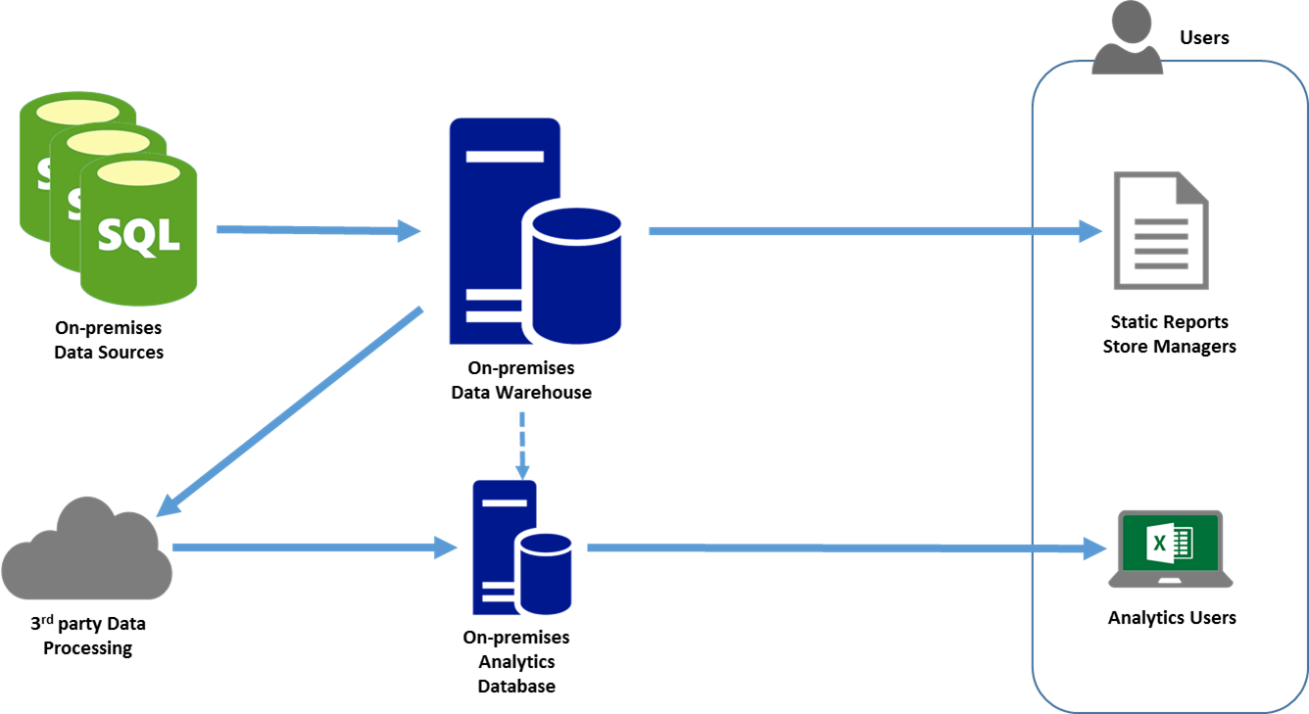
Current solution diagram
Current situation
EDW load is a typical load from operational data stores.
Third-party processing was chosen by the analytics team with very little input from IT.
Analytics lacks the ability to regularly use warehouse data directly, due to performance.
Static reports do not provide the flexibility needed by managers in the field.

Slide 8
Customer needs
A data warehouse solution that allows Coho to scale to meet peak demand while keeping costs in check.
Create a process for integration with the e-commerce site and the on-premises data sources.
Warehouse solution should integrate with the upcoming customer 360 project.
Upgrade the existing reporting system with a solution that supports self-service business intelligence (BI).
This warehouse contains Personally Identifiable Information (PII). It is absolutely critical that this data is not exposed.

Slide 9
Customer objections
We are concerned about spending too much to accommodate peak loads. We do not want to pay for a lot of excess warehouse capacity just to handle Black Friday. How will this solution help us control costs?
We cannot take a week-long outage to perform the migration. How are we optimizing the migration?
How will we integrate with existing systems?
We need to prepare for Customer 360. How will the new data warehouse solution integrate with HDInsight?
We would like to have the ability to archive data from the warehouse, but we cannot have data completely offline.
The self-service BI solution must be able to query the sales data in the warehouse as well as on-premises data sources. How will this system accomplish these goals?
We have some critical on-demand reports that require low-latency point lookups. We have heard that columnstores are not good for these kinds of lookups. How will we deal with these queries in SQL Data Warehouse?

Slide 10
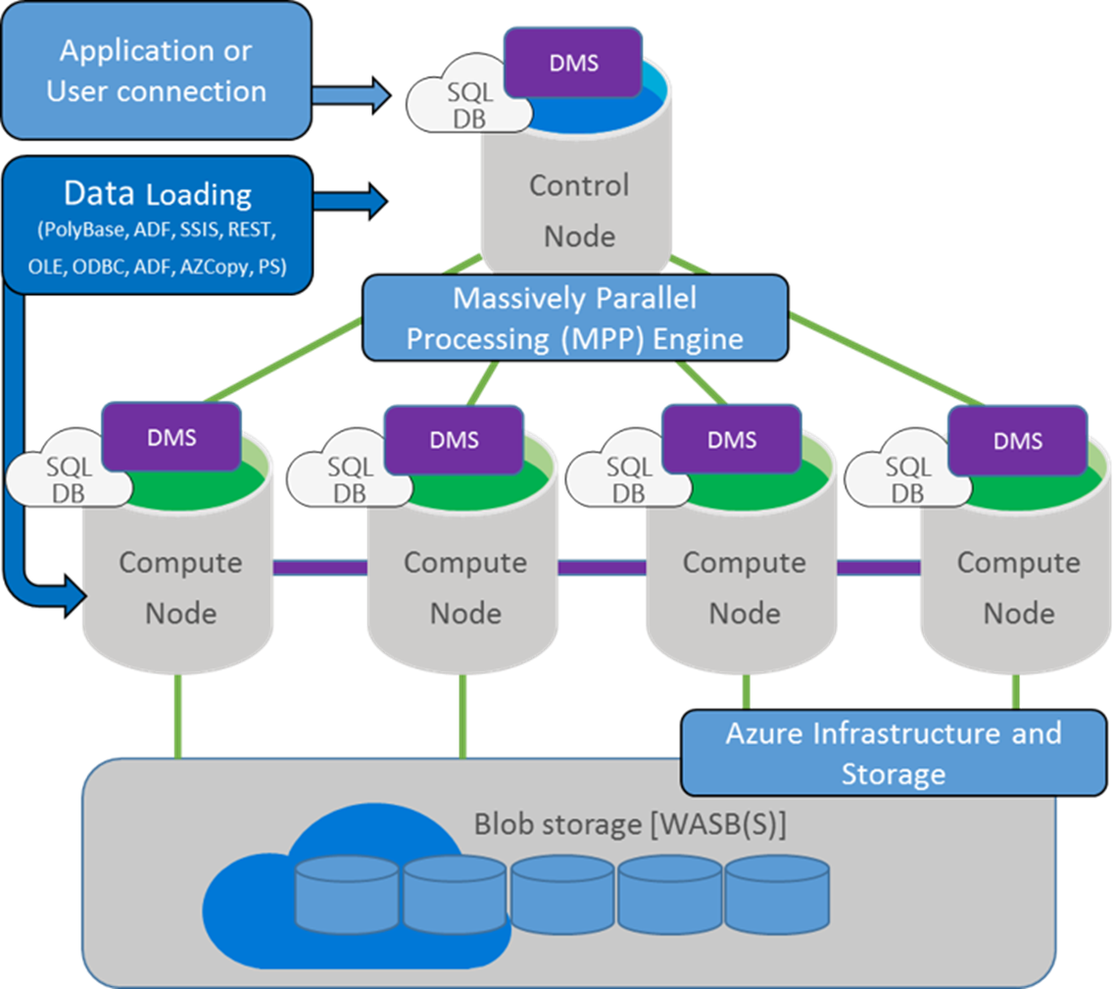
Common scenarios – Azure SQL Data Warehouse
Petabyte scale MPP data warehouse
Independently scale compute and storage
Ability to query relational data and data stored in Azure Blob storage or Hadoop
Seamless integration with Power BI, Azure ML, HDInsight, and Data Factory

Slide 11
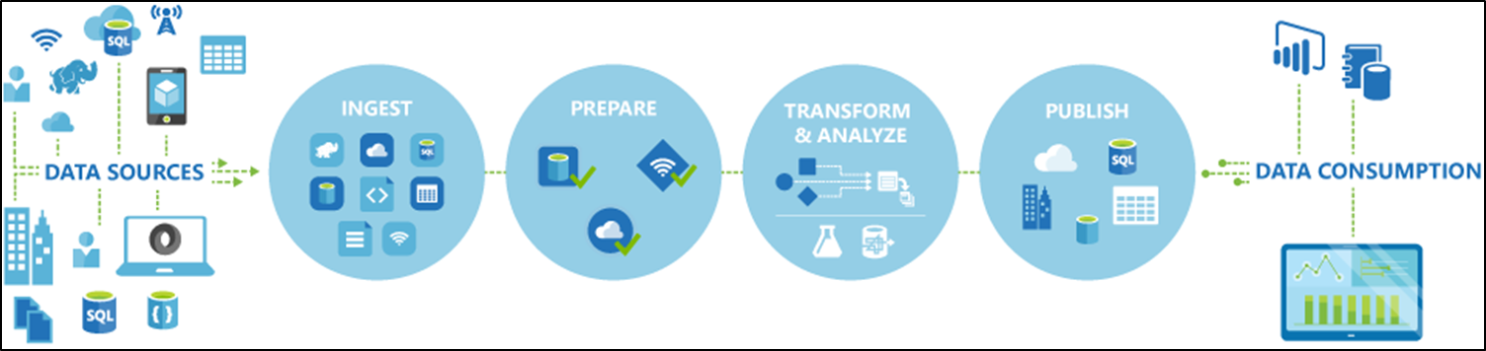
Common scenarios – Azure Data Factory
Create, schedule, orchestrate, and manage data pipelines.
Support connections to on-premises and cloud data sources.
Automate cloud resource management.

Slide 12
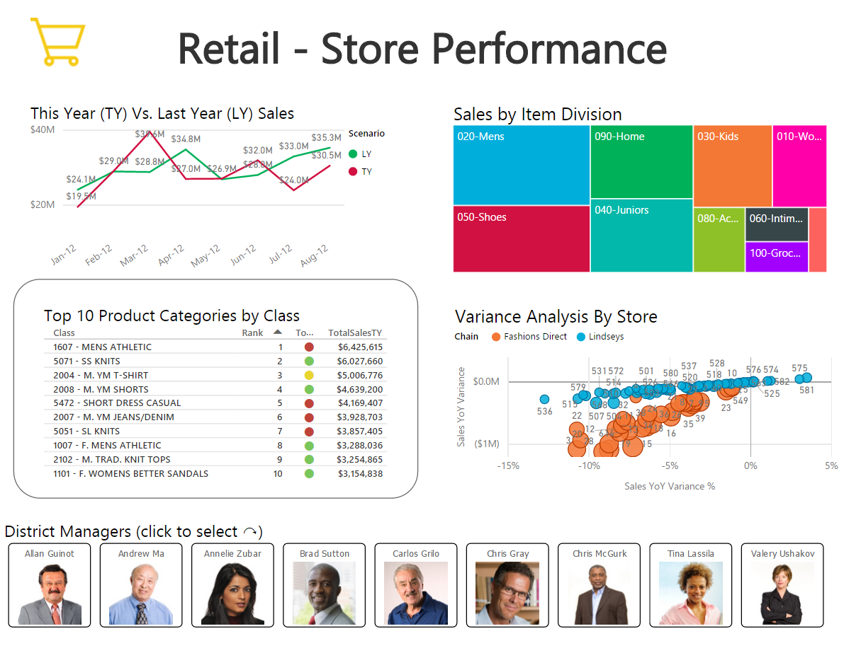
Common Scenarios – Power BI
Interactive reporting and dashboarding
Support for desktop and a variety of mobile clients
Integration with Azure Active Directory
Ability to connect to multiple data sources both in the cloud and on-premises

Slide 13
Step 2:
Call to action—design the solution
Outcome
Design a solution and prepare to present the solution to the target customer audience in a 15-minute chalk-talk format.
Timeframe
60 minutes
Business Needs (10 minutes) | Respond to questions outlined in your guide and list the answers on a flip chart.
Design (35 minutes) | Design a solution for as many of the stated requirements as time allows. Show the solution on a flip chart.
Prepare (15 minutes) | Identify any customer needs that are not addressed with the proposed solution. Identify the benefits of your solution. Determine how you will respond to the customer’s objections. Prepare for a 15-minute presentation to the customer.

Slide 14
Step 3:
Call to action—present the solution
Outcome
Present a solution to the target customer audience in a 15-minute chalk-talk format.
Timeframe
30 minutes
Directions
Each table team pairs with another table.
One table is the Microsoft team and the other table is the customer.
The Microsoft team presents its proposed solution to the customer.
The customer asks one of the objections from the list of objections.
The Microsoft team responds to the objection.
The customer team gives feedback to the Microsoft team.
Tables switch roles and repeat Steps 2 through 6.

Slide 15
Wrap-up
Outcomes
Identify the preferred solution for the case study.
Identify solutions designed by other teams.
Timeframe
15 minutes

Slide 16
Preferred target audience
Sloane Peterson, Vice President of Store Operations
Jude Watkins, Director of Customer Analytics
Frances Bradley, Manager of Data Warehousing

Slide 17
Preferred solution overview
The solution for Coho's scenario involved several technologies, including:
Migrating to Azure SQL Data Warehouse to better handle the high peak loads and to more seamlessly integrate with future analytics systems
Integrating with HDInsight by capitalizing on the external tables on the SQL Data Warehouse
Deploying Power BI to modernize the existing reports and dashboards, and enable mobile clients
Capitalizing on Azure Data Factory for integration and orchestration of cloud and on-premises data pipelines
Let’s review in more detail.

Slide 18
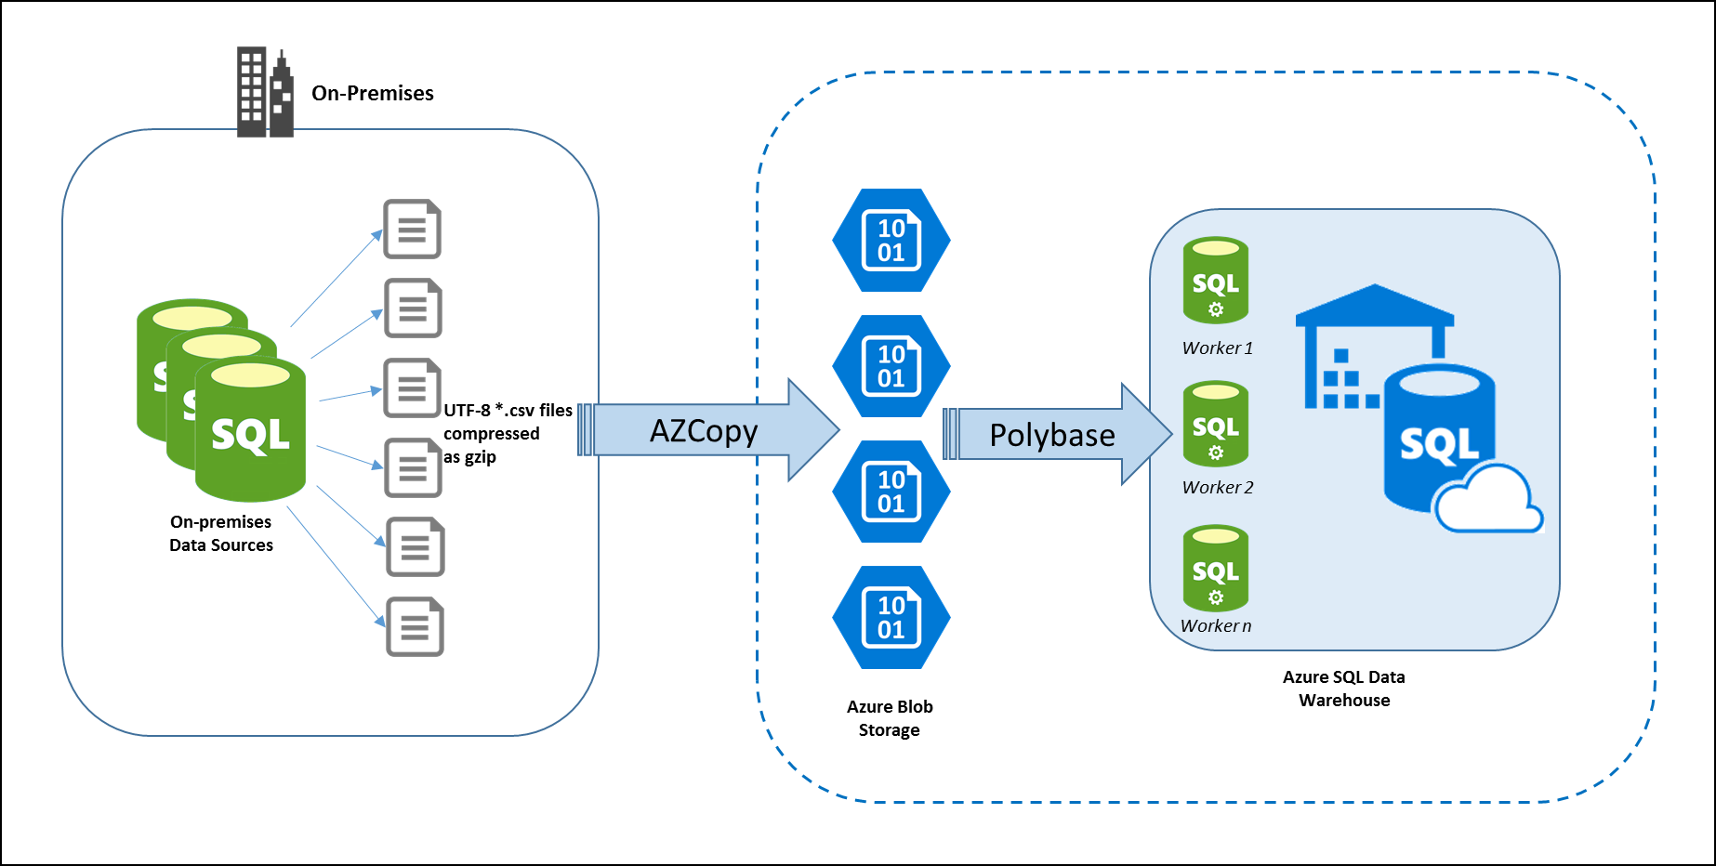
Plan for data warehouse migration
The pre-migration phase will consist of all of the data preparation steps. A checklist should be created with all the steps necessary to validate compatibility.
You should capitalize on the Data Warehouse Migration Utility to evaluate the current schema.
Identify and obtain feedback from stakeholders.
Consider any architectural changes early on as well.

Slide 19
Plan for data warehouse migration (continued)
Data warehouse sizing can be accomplished by executing run test migrations to test performance and obtain a ballpark number for starting a data warehouse unit (DWU) setting.
The actual migration process itself can be broken down into several steps. Migrating schema and code can be done ahead of time, but data is broken into Export, Transfer, and Load phases.
  Export data to csv files in UTF-8.
  Transfer files (e.g., using AZCopy).
  Load data using Polybase.

Slide 20
Plan for data warehouse migration (continued)
Ideally tables will use HASH distribution. This option uses an internal function to spread the data across the distributions by hashing a single column.
Create statistics on every column used in WHERE, JOIN, GROUP BY, ORDER BY, and DISTINCT clauses.
After a load completes, some of the data rows might not be compressed into the columnstore. To optimize query performance and columnstore compression after a load, rebuild the table to force the columnstore index to compress all the rows.

Slide 21
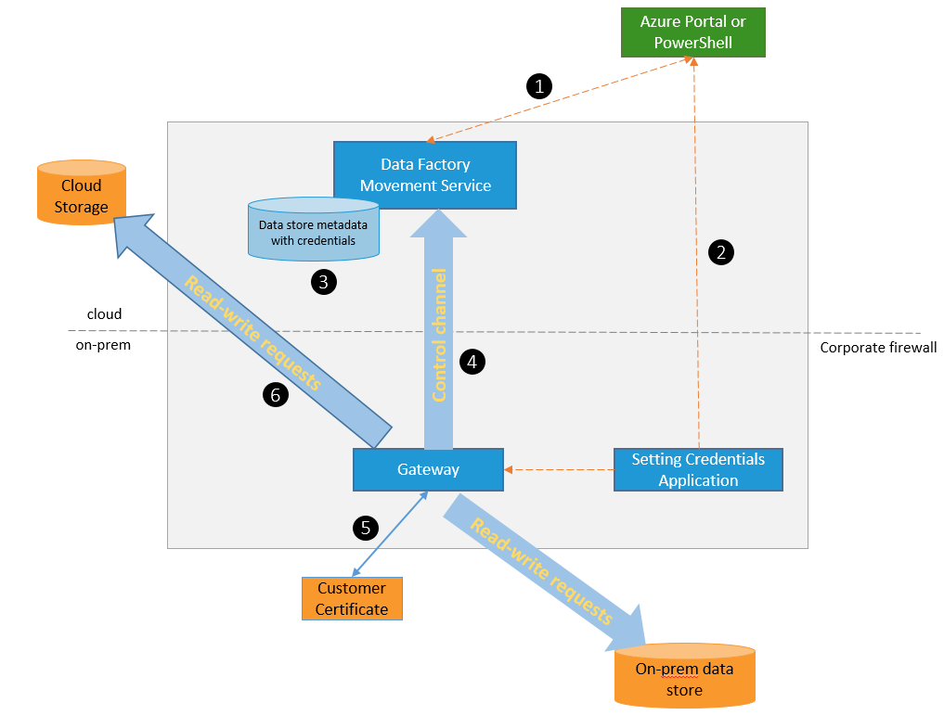
Data Warehouse Integration
Data Factory provides us with the capability to create, manage, and orchestrate all of our data pipelines in a single place.
Data Factory also provides support for all of our existing data sources.
For on-premises data sources, we will need to configure a dedicated Data Management Gateway.

Slide 22
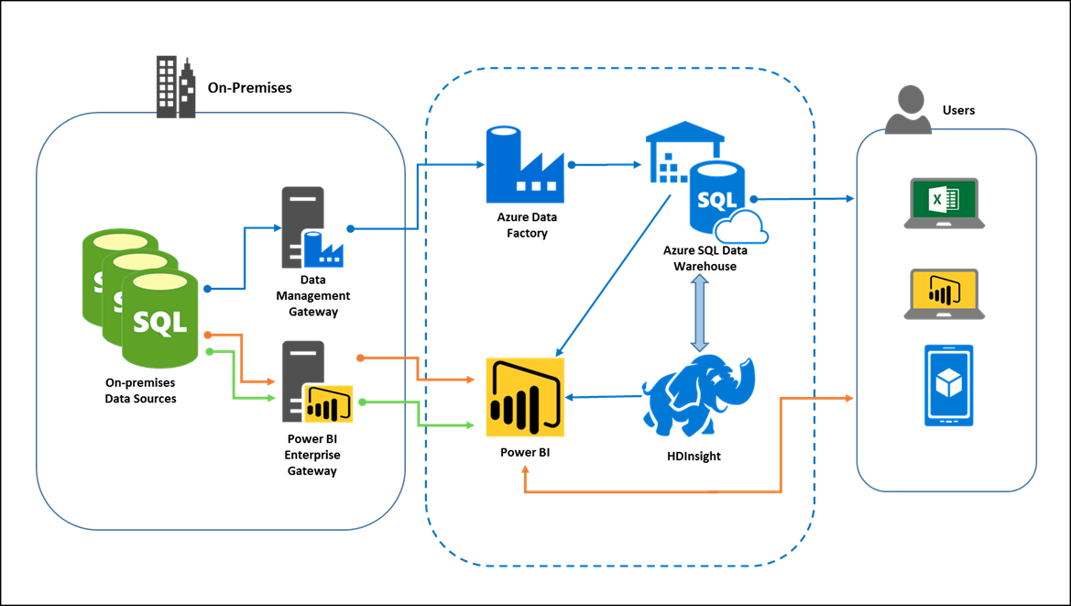
Self-service Business Intelligence
The analytics teams may continue to use Excel.
Power BI provides advanced reporting and dashboarding.
Power BI should be configured to use the existing Azure AD tenant.
On-premises data source connections require the use of a Power BI Enterprise Gateway.
If necessary, you may need to use the user principal name (UPN) mapping feature to authenticate with some on-premises data sources.

Slide 23
Customer objections
Objection
We are concerned about spending too much to accommodate peak loads. We do not want to pay for a lot of excess warehouse capacity just to handle Black Friday. How will this solution help us control costs?
Potential answer
In SQL Data Warehouse, you can quickly scale performance out or back by increasing or decreasing compute resources of CPU, memory, and I/O bandwidth. To scale performance, all you need to do is adjust the number of data warehouse units (DWUs) that SQL Data Warehouse allocates to your database. SQL Data Warehouse quickly makes the change and handles all of the underlying changes to hardware or software.

Slide 24
Customer objections (continued)
Objection
We cannot take a week-long outage to perform the migration. How are we optimizing the migration?
Potential answer
The migration will be tackled in a multi-phased approach. The first phase will migrate the schema and code to the SQL Data Warehouse. This will be done prior to the data migration, which will be the second phase. The data migration itself can be broken into three steps with each of the following steps optimized:
    Export: Use SSIS to export to multiple gzip compressed files.
    Transfer: Copy files to Azure blob storage using AZCopy. ExpressRoute will improve the performance and reliability of the copy.
    Load: Load the data from Azure blob storage using Polybase.
Notes:
Add this detail to earlier slide

Slide 25
Customer objections (continued)
Objection
How will we integrate with existing analytics systems?
Potential answer
The analytics teams can continue to use Excel to retrieve data with just a change to the data source connection. Additionally, they can take advantage of Power BI.

Slide 26
Customer objections (continued)
Objection
We need to prepare for Customer 360. How will the new data warehouse solution integrate with HDInsight?
Potential answer
Azure SQL Data Warehouse uses Polybase to connect to the underlying Azure Blob Storage of HDInsight. This allows us to create external tables referencing the files stored in HDInsight. At runtime, the SQL Data Warehouse optimizer determines if it is cheaper to run map reduce or if it is cheaper to just copy the data to the warehouse and run the query completely in SQL Data Warehouse.

Slide 27
Customer objections (continued)
Objection
We would like to have the ability to archive data from the warehouse but we cannot have data completely offline.
Potential Answer
We can archive data to Azure Blob Storage using Polybase. We can then create an external table to query the archive data.

Slide 28
Customer objections (continued)
Objection
The self-service BI solution must be able to query the sales data in the warehouse as well as on-premises data sources. How will this system accomplish these goals?
Potential Answer
Power BI can access data sources in Azure and on-premises. Accessing data in our Azure SQL Data Warehouse requires that the “Allow Access by Azure Services” be enabled. To access on-premises data sources, you will need to set up an Enterprise Gateway. Accessing data through an Enterprise Gateway requires a Power BI Pro subscription.

Slide 29
Customer objections (continued)
Objection
We have some critical on-demand reports that require low-latency point lookups. We have heard that columnstores are not good for these kinds of lookups. How will we deal with these queries in SQL Data Warehouse?
Potential Answer
Azure SQL Data Warehouse supports the use of secondary, non-clustered indexes. This allows for low-latency point lookups for some queries. To make best use of non-clustered indexes in Azure SQL Data Warehouse, only use them with high-cardinality columns used as filters in queries returning a small number of rows, and keep use to only those columns that truly benefit from the index, as the overhead of maintaining the non-clustered indexes will have an impact on load times.

Slide 30
Customer quote
“By using Azure SQL Data Warehouse, we are able to modernize our business reporting and accelerate our time to deliver insights.”
—Jude Watkins, Director of Customer Analytics, Coho

