Slide 1

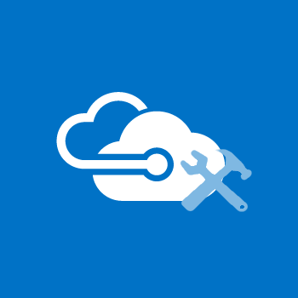
Azure Workshops
Virtual Networks
#AZWorkshops

Slide 2


Infrastructure
Virtual Networks
A global presence to support you where you are
Capabilities
The flexibility and power to support your infrastructure

Slide 3
Infrastructure
Global Availability
Localized
Connectivity
Notes:
https://docs.microsoft.com/en-us/azure/virtual-network/virtual-networks-overview

Slide 4
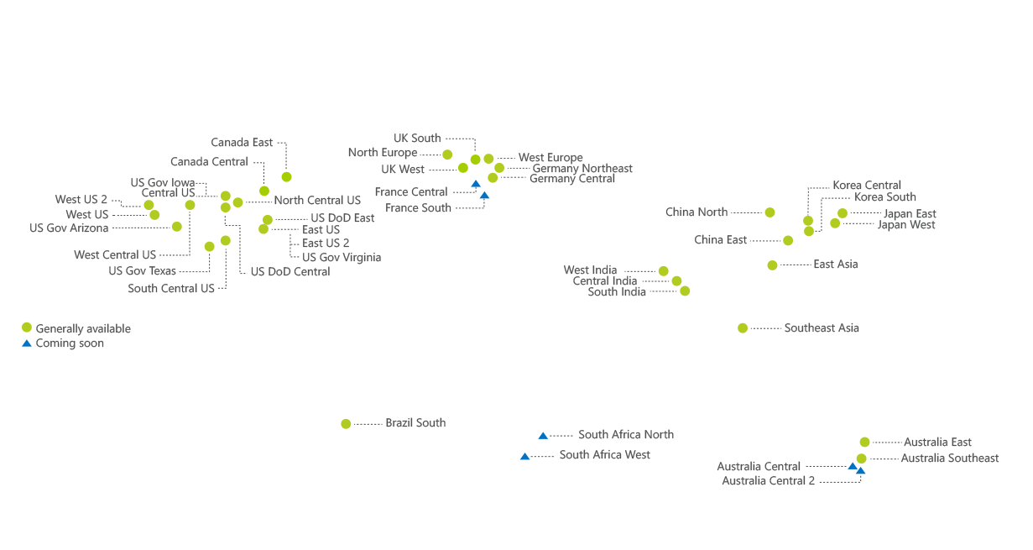
Global Availability
140 Countries
42 Regions
2nd Largest Global Network
Notes:
https://azure.microsoft.com/en-us/overview/datacenters/how-to-choose/

Slide 5
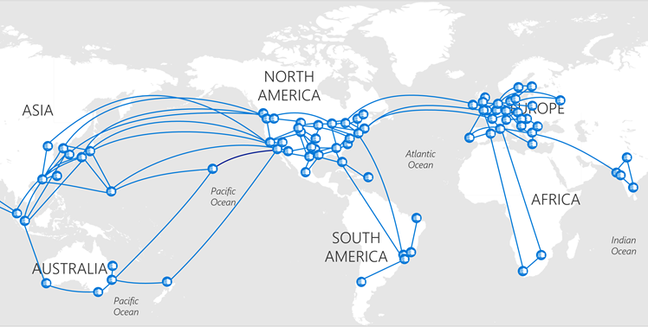
Localized
Edge Nodes
Azure is as close to our customers as possible
Benefits:
Edge nodes are interconnected to more than 2,500 unique Internet partners
Azure has over 130 locations that serve as points of presence
37 ExpressRoute sites globally
Connecting via ExpressRoute means your data can travel anywhere in the world without leaving Azure’s network
Notes:
https://azure.microsoft.com/en-us/blog/how-microsoft-builds-its-fast-and-reliable-global-network/

Slide 6
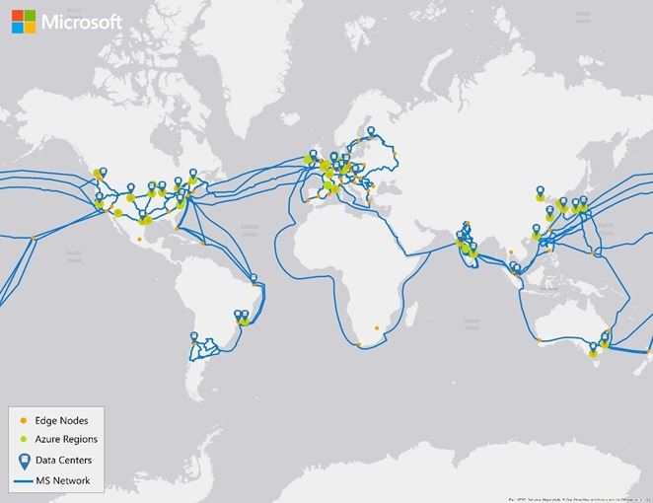
Connectivity
Topography
Azure’s private fiber backbone makes it one of the largest networks in the world
Benefits:
Azure can support up to 1.6 Pbps of inter-datacenter bandwidth within a given region
Data transferred between regions stays on Azure’s private fiber backbone – it never traverses the public Internet
Joined with Facebook to develop the MAREA cable, a 6,600 km submarine cable from Virginia to Spain, with 8 fiber pairs that supports 160 Tbps
Notes:
https://azure.microsoft.com/en-us/blog/how-microsoft-builds-its-fast-and-reliable-global-network/
https://blogs.technet.microsoft.com/hybridcloud/2016/05/26/microsoft-and-facebook-to-build-subsea-cable-across-atlantic/

Slide 7
Infrastructure
Virtual Networks
A global presence to support you where you are
Capabilities
The flexibility and power to support your infrastructure

Slide 8
Virtual Network Capabilities
Isolation
Connectivity
Internet
Azure Resources
Other Azure VNets
On-Premises
Traffic Filtering
Routing
Notes:
https://docs.microsoft.com/en-us/azure/virtual-network/virtual-networks-overview

Slide 9
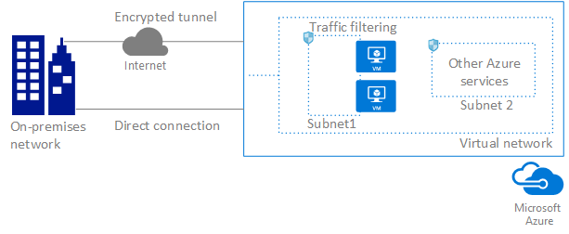
Sample Topology
Notes:
https://docs.microsoft.com/en-us/azure/virtual-network/virtual-networks-overview

Slide 10
Isolation
Features
VNets, by default, are separated from each other
Benefits:
Different environments (e.g. Development, Testing, Production) with the same CIDR blocks
No external access to VNets unless explicitly configured
VNets can be connected to each other
Segmentation via subnets
Azure provides internal name resolution for VMs and Cloud Services role instances connected to a VNet
VNet’s can be configured to use custom DNS servers
Automatically assigns public and private IPs to internal resources based on custom IP space as specified by RFC 1918
Name | IP Address Range | Number of Addresses
24-bit block | 10.0.0.0-10.255.255.255 | 16,777,216
20-bit block | 172.16.0.0-172.31.255.255 | 1,048,576
16-bit block | 192.168.0.0-192.168.255.255 | 65,536
Notes:
https://docs.microsoft.com/en-us/azure/virtual-network/virtual-networks-udr-overview
https://en.wikipedia.org/wiki/Private_network

Slide 11
Isolation
Restrictions
Azure reserves the first and last IP addresses within the subnets for protocol conformance, along with 3 more addresses used for Azure services (5 total IPs)
Cannot span multiple regions
Layer-3 overlays and do not support any Layer-2 semantics (VLANs)
Do not support multicast or broadcast
Do not currently support IPv6
Cannot use tracert to troubleshoot connectivity
Notes:
https://docs.microsoft.com/en-us/azure/virtual-network/virtual-networks-udr-overview
https://en.wikipedia.org/wiki/Private_network
https://docs.microsoft.com/en-us/azure/virtual-network/virtual-networks-faq

Slide 12
Internet Connectivity
Outbound Connections
All VMs and Cloud Service instances have internet connectivity
The private IP address of the resource is source network address translated (SNAT) to a public IP address by the Azure infrastructure
Use NSGs to prevent internal resources from accessing the outside internet
Scenario | Method | Note
Standalone VM (no load balancer, no Instance Level Public IP address) | Default SNAT | Azure associates a public IP address for SNAT
Load-balanced VM (no Instance Level Public IP address on VM) | SNAT using the load balancer | Azure uses the public IP address of the Load Balancer for SNAT
VM with Instance Level Public IP address (with or without load balancer) | SNAT is not used | Azure uses the public IP assigned to the VM
Notes:
https://docs.microsoft.com/en-us/azure/virtual-network/virtual-networks-udr-overview
https://docs.microsoft.com/en-us/azure/load-balancer/load-balancer-outbound-connections

Slide 13
Internet Connectivity
Outbound Connections
Source Network Address Translation (SNAT)
Virtual Machines (No Public IP)
Ephemeral ports on dynamically allocated public IP addresses are used to distinguish individual flows originated by the VM
SNAT dynamically allocates ephemeral ports (SNAT ports) when flows are created
SNAT ports are finite and can be exhausted causing outbound flows to fail
4-minute idle timeout for reclaiming SNAT ports
When the VM creates an outbound flow, Azure translates the private source IP of the outbound flow to a public source IP address
IP address is not configurable and does not count against subscription’s public resource IP limit nor is charged to subscription
Ephemeral ports of the public IP address are used to distinguish individual flows originated by the VM
One SNAT port is consumed per flow to a single destination IP address
For multiple flows (to the same destination IP address or different IP address), each flow consumes a single SNAT port
Notes:
https://docs.microsoft.com/en-us/azure/virtual-network/virtual-networks-udr-overview
https://docs.microsoft.com/en-us/azure/load-balancer/load-balancer-outbound-connections

Slide 14
Internet Connectivity
Outbound Connections
Source Network Address Translation (SNAT)
Load Balancer
Ephemeral ports of the Load Balancer’s public IP address are used to distinguish individual flows originated by the VM
SNAT dynamically allocates ephemeral ports (SNAT ports) when flows are created
SNAT ports are finite and can be exhausted causing outbound flows to fail
4-minute idle timeout for reclaiming SNAT ports
When the load-balanced VM creates an outbound flow, Azure translates the private source IP of the outbound flow to the public IP address of the public Load Balancer frontend
Ephemeral ports of the public IP address are used to distinguish individual flows originated by the VM
One SNAT port is consumed per flow to a single destination IP address
For multiple flows (to the same destination IP address or different IP address), each flow consumes a single SNAT port
Notes:
https://docs.microsoft.com/en-us/azure/virtual-network/virtual-networks-udr-overview
https://docs.microsoft.com/en-us/azure/load-balancer/load-balancer-outbound-connections

Slide 15
Internet Connectivity
Outbound Connections
Source Network Address Translation (SNAT)
Virtual Machine (with Public IP)
VMs, with an assigned public IP, pass all outbound connections through it’s public IP and, therefore, does not use SNAT
If your application initiates many outbound flows and you experience SNAT exhaustion, consider using assigning an ILPIP to avoid SNAT constraints
Doesn’t matter if VM is load-balanced or not
When an Instance Level Public IP (ILPIP) is assigned, SNAT is not used
VM uses ILPIP for all outbound flows
Notes:
https://docs.microsoft.com/en-us/azure/virtual-network/virtual-networks-udr-overview
https://docs.microsoft.com/en-us/azure/load-balancer/load-balancer-outbound-connections

Slide 16
Azure Resources
Connectivity
VNets are required to connect Azure resources to each other via a subnet
Benefits:
Imitation of on-premises infrastructure
DNS name resolution of resources within the same subnet
Securing and preventing access to resources on the network via NSGs
DNS name resolution for PaaS services is handled automatically by Azure’s internal DNS
DNS name resolution for IaaS services can be handled by Azure’s internal DNS or by Active Directory DNS on IaaS (VM)
VMs can be connected to subnets via one or more network interface cards (NICs)
NICs (on a VM) must be created or removed when the VM is created or while the VM is in a stopped state – NICs cannot be added or removed once the VM has been created
Notes:
https://docs.microsoft.com/en-us/azure/virtual-network/virtual-networks-udr-overview

Slide 17
Other Azure VNets
Configuration Options
Connect virtual networks with each other for increase in manageability, scalability, segmentation and security
Peering
Enables resources connected to different Azure virtual networks in the same region to directly communicate with each other
Bandwidth and latency are the same as if the resources were connected to the same virtual network
VNet-to-VNet Connection
Connect Azure virtual networks in different regions to allow resources to communicate with each other
Accomplished by utilizing an Azure VPN Gateway
Bandwidth and latency are determined upon the size of the configured VPN Gateway
Notes:
https://docs.microsoft.com/en-us/azure/virtual-network/virtual-networks-udr-overview

Slide 18
On-Premises
Configuration Options
Expand your on-premises infrastructure into Azure
Benefits:
Dynamically scale into the cloud
Greater versatility in DR and Backup strategies
Leverage on-premises licensing for cloud workloads
Point-to-Site VPN
Establishes a connection between a single PC and a remote Azure network (SSTP)
Great entry point as there’s very little change required to support
Latency is unpredictable due to traffic traversing public Internet
Site-to-Site VPN
Establishes a connection between your VPN device and a remote Azure network (IPSec/IKE)
Latency is unpredictable due to traffic traversing public Internet
Azure ExpressRoute
Established between your on-premise network and Azure via an ExpressRoute partner
Latency is predictable as the connection is private (traffic does not flow through the public Internet)
Notes:
https://docs.microsoft.com/en-us/azure/virtual-network/virtual-networks-udr-overview

Slide 19
Traffic Filtering
Configuration Options
Security solutions to determine what comes in and goes out of your network
Network Security Groups (NSGs)
Each NSG can contain multiple inbound and outbound rules to enable filtering based on source and destination IP address, port and protocol
An NSG can be applied to each NIC on a VM or to a subnet that a NIC or other Azure resource is connect to
Network Virtual Appliances (NVAs)
A VM that is running software that performs a specific network function
Available to provide WAN optimization
Typically used for user-defined and BGP routes
Can be used to filter traffic between VNets
Many solutions offered by partners and 3rd-party vendors
Notes:
https://docs.microsoft.com/en-us/azure/virtual-network/virtual-networks-udr-overview

Slide 20
Routing
Configuration Options
Azure automatically creates route tables that enable resources connected to any subnet in any VNet to communicate with each other
Manually create your own routes to increase efficiency and direct traffic through NVAs or on-premises data centers
User-defined Routes (UDRs)
Create custom route tables with routes that control where traffic is routed to for each subnet
BGP Routes
Connecting your VNet to your on-premises network using an Azure VPN Gateway or ExpressRoute can propagate BPG routes to your VNets
Notes:
https://docs.microsoft.com/en-us/azure/virtual-network/virtual-networks-udr-overview

