Slide 1





Cancer Metastasis Detection Using Local Features and Random Forests
Kimmo Kartasalo, MSc 3D reconstructions
Kaisa Liimatainen, MSc,
Machine learning
Mira Valkonen, BSc Feature engineering,
machine learning
Pekka Ruusuvuori, Doc. Bioimage informatics
Leena Latonen, PhD
Cancer biologist

Slide 2
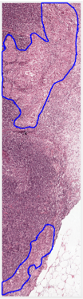
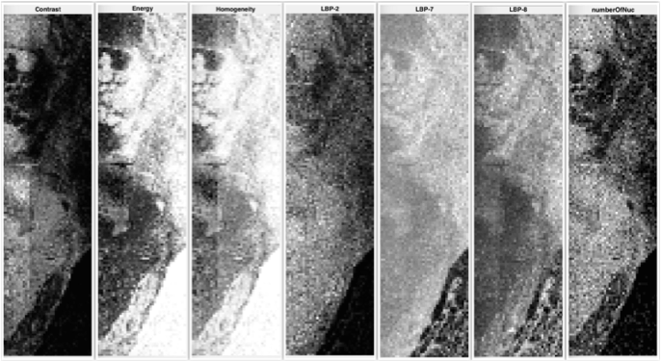
Feature Extraction
Feature Extraction:
The features extracted from the whole slide images include several local descriptors related to image morphology, texture, and spatial distribution of nuclei within a 200x200 pixel block in full resolution.
Features such as LBP, HOG, SIFT, MSER, GLCM descriptors were extracted.

Slide 3
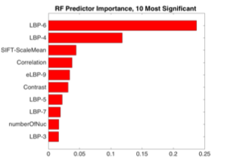
Random Forest Model
Training Data:
200 000 positive and 200 000 negative training samples were randomly selected from tissue area of the training images.
214 features extracted from each sample block.
Model:
Ensemble of 50 decision trees.
Bootstrap aggregation to improve stability and accuracy

Slide 4
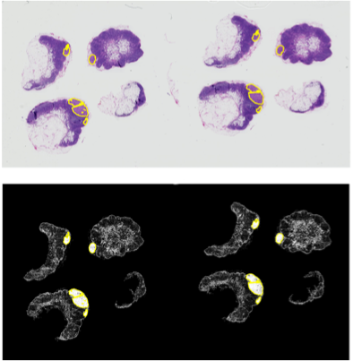
Results
Results: The confidence values returned by the classifier were further processed using morphological operations and thresholded into binary detections.
Advantages:
Can be extended with new features
Easy to interpret

Slide 5
Thank you!

