Slide 1
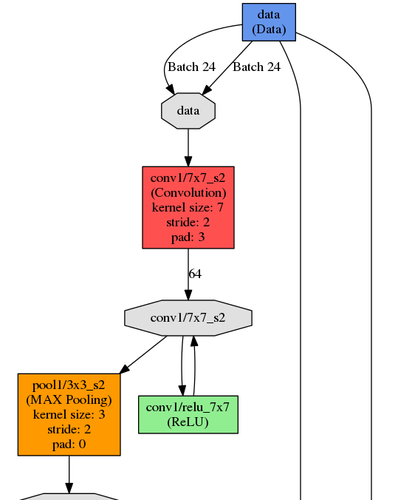
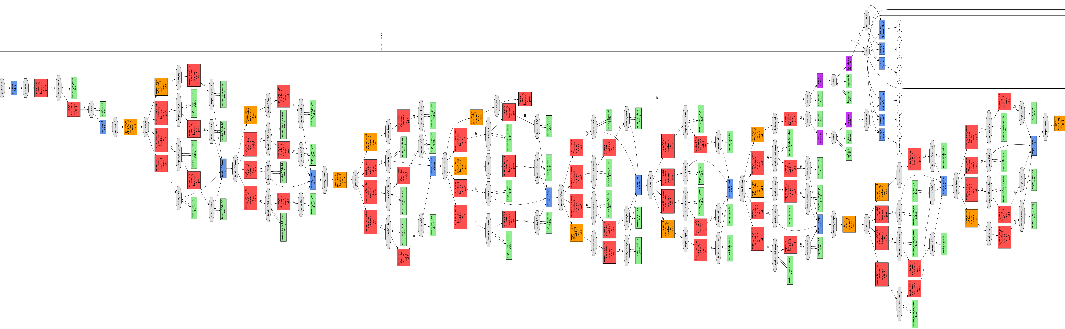
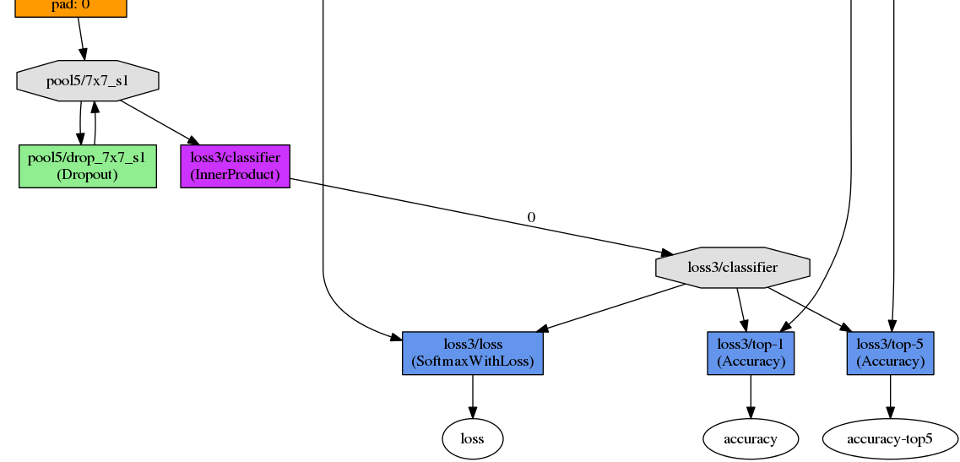
Convolutional Network by GoogLeNet
Image Dimensions:256x256
Image Type:Color
Resize Transformation:Squash
Training Images:799963
Validation Images:266654 (25.0%)
Christian Szegedy, Wei Liu, Yangqing Jia, Pierre Sermanet, Scott Reed, Dragomir Anguelov, Dumitru Erhan, Vincent Vanhoucke, Andrew Rabinovich In IEEE Computer Vision and Pattern Recognition (CVPR), Boston, USA, 2015.
Matsuda et al, Osaka University, Department of Bioinformatic Engineering

Slide 2
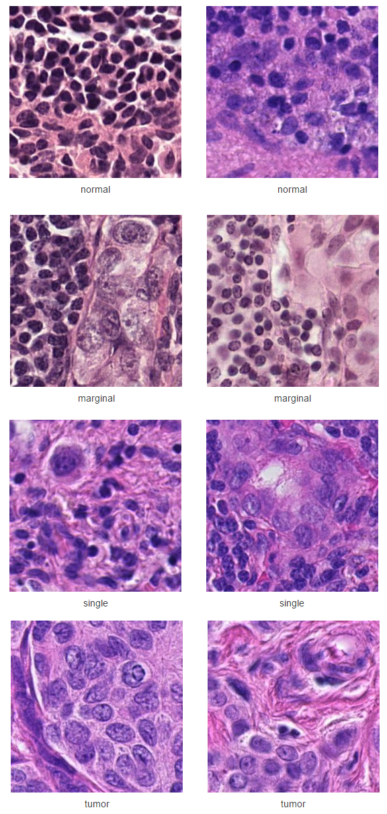
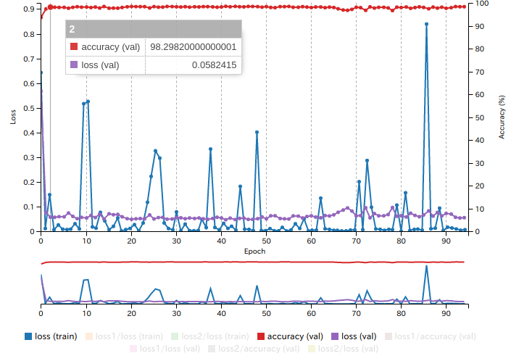

Dataset
Training
Normal: Train_Normal
Marginal: >25 and <75 region of Tumor Single: One or more rounded Tumor
Tumor: Full Tumor
66664 iteration
2 epoch
Accuracy 98.2982
Loss 0.05824
Matsuda et al, Osaka University, Department of Bioinformatic Engineering

