Slide 1
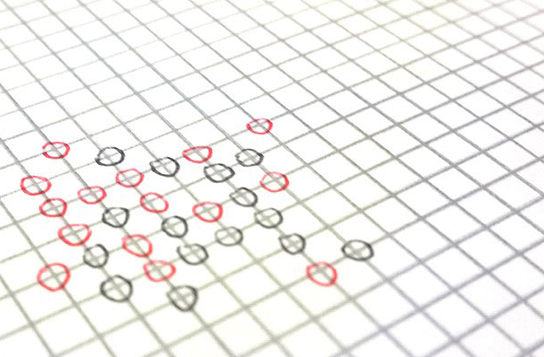

OMOK
SYSTEM PROGRAMMING
TEAM PROJECT
2016115179 백도희
2015114648 이장원
2015117854 김영훈
2015117414 김근우

Slide 2

INDEX
PROJECT TOPIC
FUNCTION
SERVER CONSOLE
CLIENT CONSOLE
DEMO
SYSTEM PROGRAMMING TEAM PROJECT

Slide 3
PROJECT TOPIC
11 X 11 오목 게임
SYSTEM PROGRAMMING TEAM PROJECT

Slide 4
PROJECT TOPIC
오목 GAME
UI
Server-client model
SYSTEM PROGRAMMING TEAM PROJECT

Slide 5
FUNCTION
11 X 11 오목 게임
SERVER
CLIENT
GAME 의 전반적인 운영
GAME 판/ 게임상태 전송
GAME 승패 결정
GAME 결과 정보 제공
GAME 정보 수신
서버에 전송
SYSTEM PROGRAMMING TEAM PROJECT

Slide 6
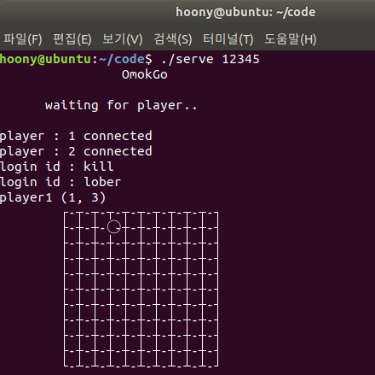
SERVER CONSOLE
SYSTEM PROGRAMMING TEAM PROJECT

Slide 7
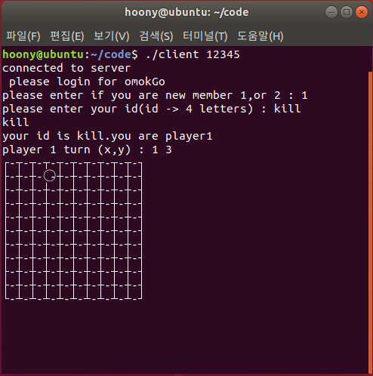
CLIENT CONSOLE
SYSTEM PROGRAMMING TEAM PROJECT

Slide 8
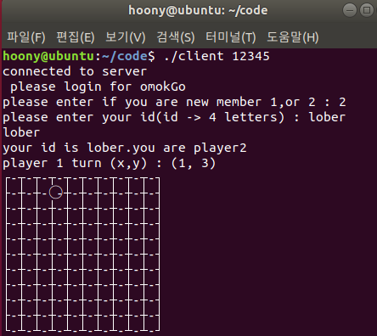
CLIENT CONSOLE
SYSTEM PROGRAMMING TEAM PROJECT

Slide 9
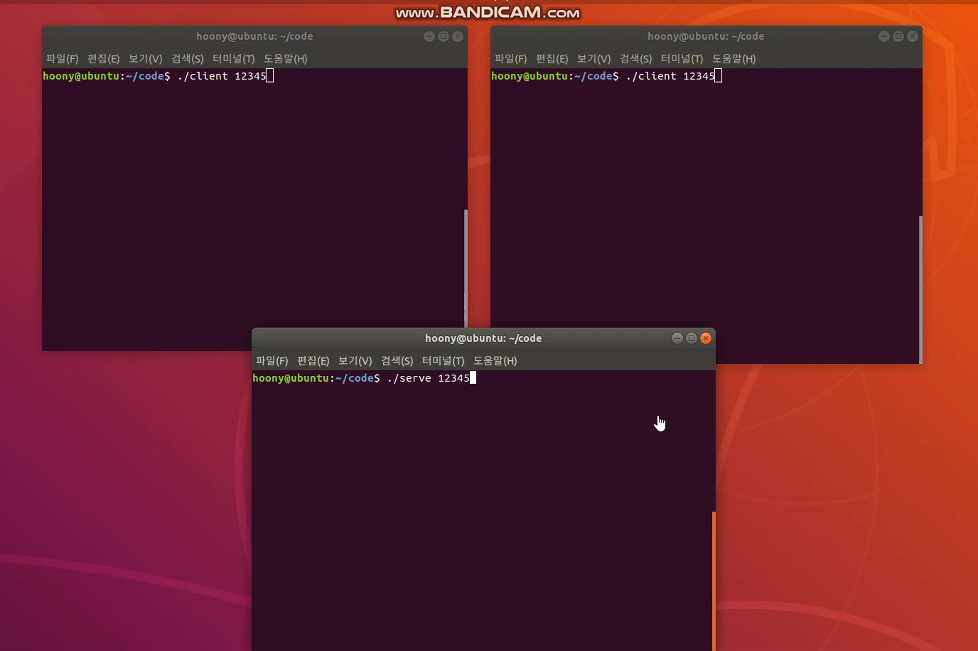
DEMO
SYSTEM PROGRAMMING TEAM PROJECT

Slide 10
THANK YOU FOR LISTENNING
SYSTEM PROGRAMMING
TEAM PROJECT
SYSTEM PROGRAMMING TEAM PROJECT

