Slide 1
FUNDINV
Fund management, without the blind spots
A working platform connecting investors, managers, operations and administrators.
Notes:
Open with the outcome. FundInv is not another stock-trading interface. It is an operating portal that connects the people, approvals and accounting behind a managed fund.

Slide 2
Fund operations break at the hand-offs
Fragmented work Requests, approvals and reports live across spreadsheets and email.
Slow confidence Investors wait while teams reconcile the same information twice.
Hidden risk Manual settlement and P&L changes are difficult to trace and explain.
2
Notes:
Frame the problem as a coordination problem. Each individual tool can work, but confidence breaks when the investor request, cash verification, fund accounting and final report are handled separately.

Slide 3
Singapore’s fund industry is large and still growing
A growing fund ecosystem creates demand for operating systems that improve control, transparency and service without replacing investment expertise.
S$6.07T
12.2%
1,298
Assets under management at end-2024
Year-on-year AUM growth in 2024
Fund management companies at end-2024
3
Notes:
Keep this slide simple: Singapore is already a major fund-management centre. FundInv's opportunity is the operating layer used by fund teams, particularly smaller firms that still rely heavily on manual coordination.
[Sources]
- Monetary Authority of Singapore, Singapore Asset Management Survey 2024 announcement: https://www.linkedin.com/posts/mas_mas-has-released-the-singapore-asset-management-activity-7351056474837504000-ptkd
- Bank for International Settlements, Remarks on the MAS Annual Report 2024/2025: https://www.bis.org/review/r250717h.htm

Slide 4
FundInv turns disconnected tasks into one controlled journey
One platform carries the investor’s intent from request to verified settlement, then reflects the result in fund value and reporting.
Clear request
The investor chooses a fund and a fixed amount.
Controlled settlement
Operations checks requested cash against received cash.
Visible outcome
Units, NAV and allocated P&L update only after completion.
4
Notes:
Describe FundInv as a workflow, not a feature list. The value is that the request, verification, accounting and reporting all refer to the same record.

Slide 5
Every role gets the right view and responsibility
Clear role boundaries keep decisions accountable without making the experience complicated.
INVESTOR
MANAGER
OPERATIONS
ADMIN
Choose funds
Run the fund
Verify settlement
Govern access
Request subscriptions or redemptions and follow holdings, NAV and P&L.
Create funds, set strategy and finalise daily valuation.
Compare requested and received cash before completion.
Invite users and review activity across the platform.
FUNDINV
5
Notes:
Emphasise separation of duties. FundInv does not give every user every action. Each role sees the information needed for its responsibility, which reduces confusion and strengthens governance.

Slide 6
FundInv is built for fund operations, not retail stock trading
Its differentiation is the control and accounting layer between an investor’s request and the portfolio result they eventually see.
Fund-first
Investors hold units in managed funds rather than purchasing individual securities.
Role boundaries
Critical actions are divided across manager, operations and admin roles.
Accounting integrity
External cash flows stay separate from investment P&L.
6
Notes:
This is the key positioning slide. FundInv is not competing on trade execution. It is designed around fund ownership, controlled settlement and understandable performance reporting.

Slide 7
A subscription becomes a transparent three-step journey
1 · REQUEST
2 · VERIFY
3 · REPORT
Investor decides
Selects an approved fund and a server-locked amount.
Operations confirms
Matches requested and received amounts before completion.
Everyone sees the result
Units, NAV and records update from one settlement.
7
Notes:
Use this slide to introduce the live demonstration. The important safeguard is that no fund units change before Operations verifies the exact amount and completes settlement.

Slide 8
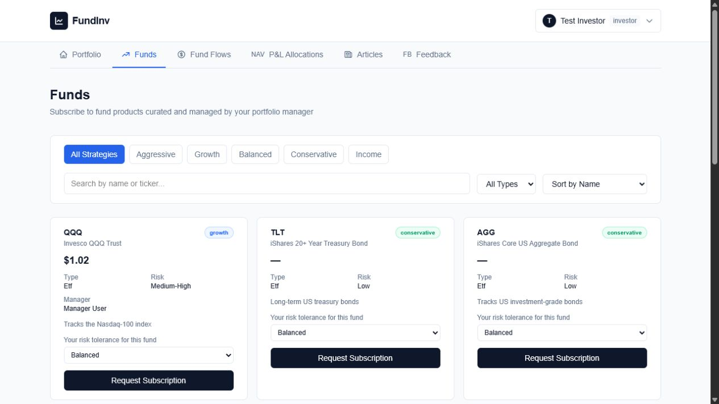
Investor decisions start with context
A guided catalogue
Strategy, risk and manager information sit beside each subscription decision. The amount is locked before the payment step.
8
Notes:
Show the real interface. The investor chooses from approved funds and sees strategy and risk context before requesting a subscription. This is a demonstration environment; the PayNow QR is simulated and does not move real money.
[Sources]
- FundInv live application, investor fund catalogue, captured 4 August 2026: https://dxnh4gknox8f9.cloudfront.net/dashboard/investor/funds

Slide 9
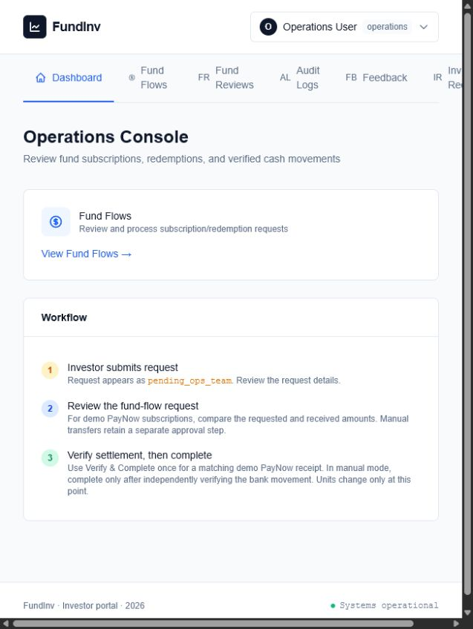
Controls are visible at the moment money moves
Operations sees the decision point
Requested and received amounts are compared before settlement. A matching demo PayNow receipt can be verified and completed once; manual transfers retain independent approval and completion.
The safeguard is part of the workflow, not a reminder outside it.
FUNDINV
9
Notes:
Keep this explanation non-technical. Operations receives a clear work queue and a clear control: verify the recorded amount before settlement. The system changes units only after completion.
[Sources]
- FundInv live application, Operations Console, captured 4 August 2026: https://dxnh4gknox8f9.cloudfront.net/dashboard/operations

Slide 10
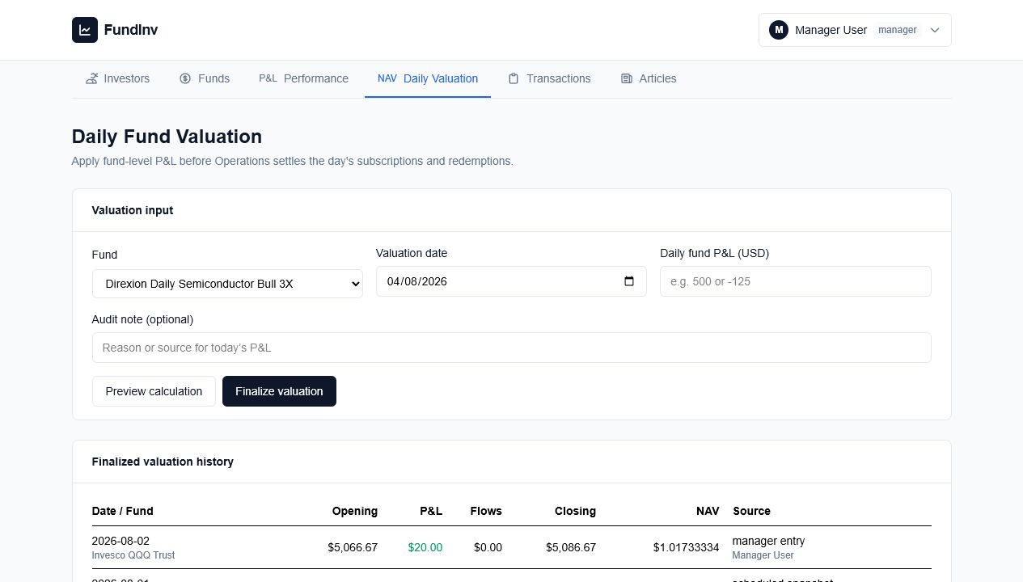
P&L stays clear and auditable
Fund accounting stays understandable
Managers apply daily fund-level P&L before flows settle. NAV changes with performance, while subscriptions and redemptions remain external cash movements.
10
Notes:
Explain the business rule: investment performance is applied before external flows. That prevents deposits from appearing as profit and keeps each investor's allocated result understandable.
[Sources]
- FundInv live application, Manager Daily Fund Valuation, captured 4 August 2026: https://dxnh4gknox8f9.cloudfront.net/dashboard/manager/valuations

Slide 11
FundInv is a working platform, not a concept
The capstone demonstrates the complete operating journey in a live cloud environment, with persistent data and role-specific controls.
4
LIVE
VERIFIED
Role-specific portals
Public cloud deployment
Cross-role flows, P&L and reporting
11
Notes:
This is the proof point. The platform is deployed, its database persists independently of the developer laptop, and the key workflows have been exercised across Investor, Manager, Operations and Admin roles.

Slide 12
A commercial model can grow with customer value
Platform access
Recurring subscription for the core fund operating portal.
Implementation
Onboarding, configuration and data migration.
Premium services
Advanced reporting, integrations and support.
Revenue pattern
Revenue pattern
Revenue pattern
Recurring
One-time
Add-on
12
Notes:
Present this as a testable commercial hypothesis, not established revenue. The core model is recurring software access, supported by implementation work and optional premium services.

Slide 13
Start with a focused pilot, then expand on evidence
Pilot with one manager
Onboard a small fund team and representative operational data. Observe the real workflow.
Prove daily value
Measure processing time, exceptions, reporting confidence and user adoption.
Expand deliberately
Add regulated payment rails, integrations and more firms after controls are validated.
PHASE 1
PHASE 2
PHASE 3
13
Notes:
The sensible go-to-market path is a narrow pilot, not a broad launch. The pilot should validate whether the workflow saves time, reduces exceptions and improves investor confidence.

Slide 14
The next investment should reduce commercial risk
The product foundation is built. The next stage should strengthen regulated payments, production assurance and customer readiness.
Regulated payments
Integrate an authorised provider and formal reconciliation controls.
Production assurance
Complete security testing, monitoring and continuity drills.
Customer readiness
Build pilot onboarding, support and service commitments.
14
Notes:
Be explicit that the current PayNow flow is a simulation. Commercial use requires a regulated payment route, legal and compliance review, security testing and operating procedures. This honesty increases credibility.

Slide 15
FUNDINV
Partner with us to prove the next stage
Pilot customer
Strategic guidance
Commercial backing
Notes:
Close with a concrete conversation: identify a pilot partner, define the workflow and success measures, and agree what commercial or strategic support is needed to reach that milestone.

