Slide 1
INFORMATION RETRIEVAL
Week 10 – Evaluation
16.05.2025
Severin Mills

Slide 2

Today
1
2
3
Exercise Recap
Theory
Kahoot
Champion Lists
Evaluation
Probabilistic Retrieval
Exercise 9: Evaluation
16.05.2025
2

Slide 3
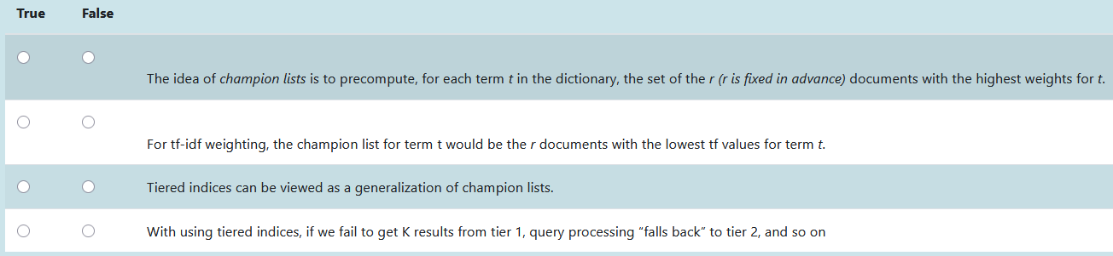
Exercise 8: Champion Lists
Q1
Remove terms with low idf.
Benefit: Usually low idf terms are contained in more documents.
16.05.2025

Slide 4
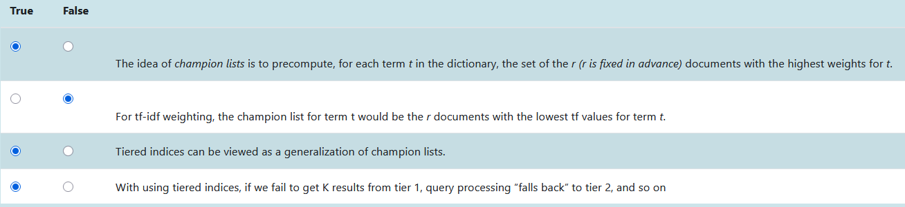
Exercise 8: Champion Lists
Q1
Definition of Champion Lists
No, it would be the highest tf values
True, we use tiered indices to prevent scarce returns
Definition of tiered indices
16.05.2025

Slide 5
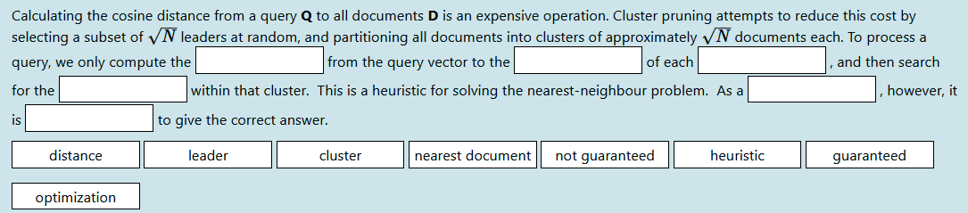
Exercise 8: Champion Lists
Q2
16.05.2025

Slide 6
Exercise 8: Champion Lists
Q2
distance
16.05.2025

Slide 7
Exercise 8: Champion Lists
Q2
distance
leader
16.05.2025

Slide 8
Exercise 8: Champion Lists
Q2
distance
leader
cluster
16.05.2025

Slide 9
Exercise 8: Champion Lists
Q2
distance
leader
cluster
nearest document
16.05.2025

Slide 10
Exercise 8: Champion Lists
Q2
distance
leader
cluster
nearest document
heuristic
16.05.2025

Slide 11
Exercise 8: Champion Lists
Q2
distance
leader
cluster
nearest document
heuristic
not guaranteed
16.05.2025

Slide 12
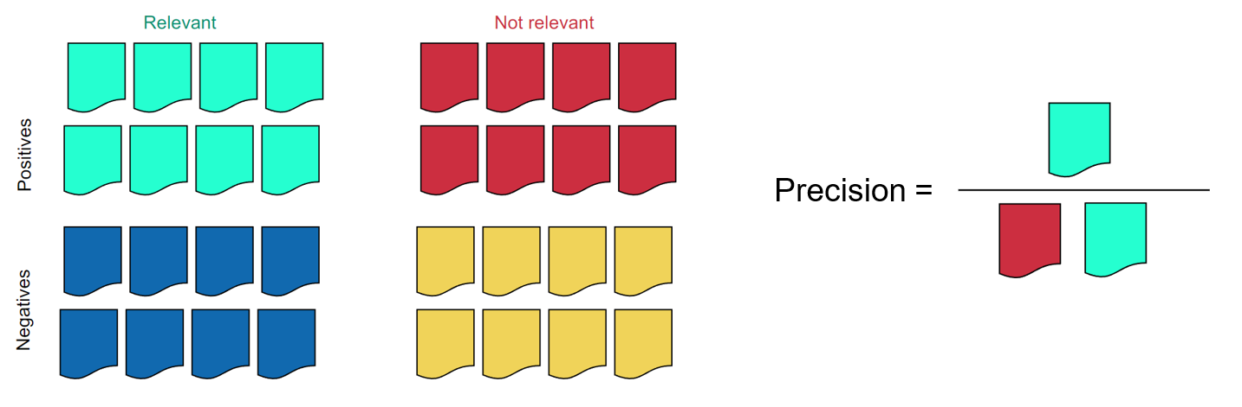
Evaluation
Recall and Precision
16.05.2025

Slide 13
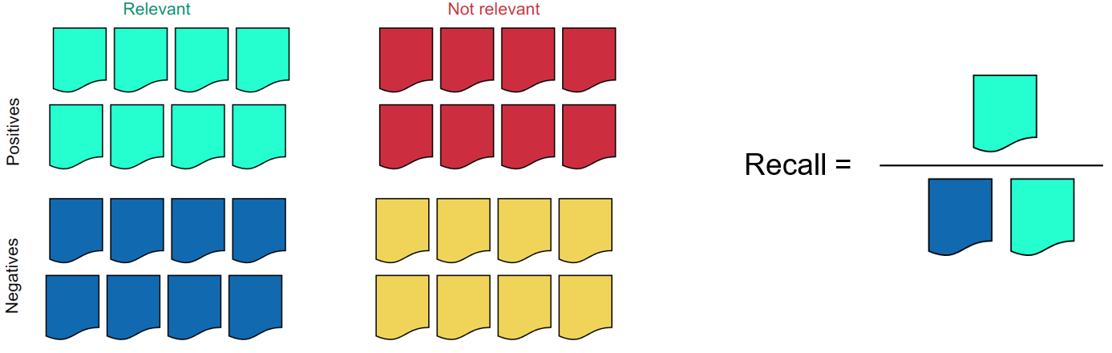
Evaluation
Recall and Precision
16.05.2025

Slide 14
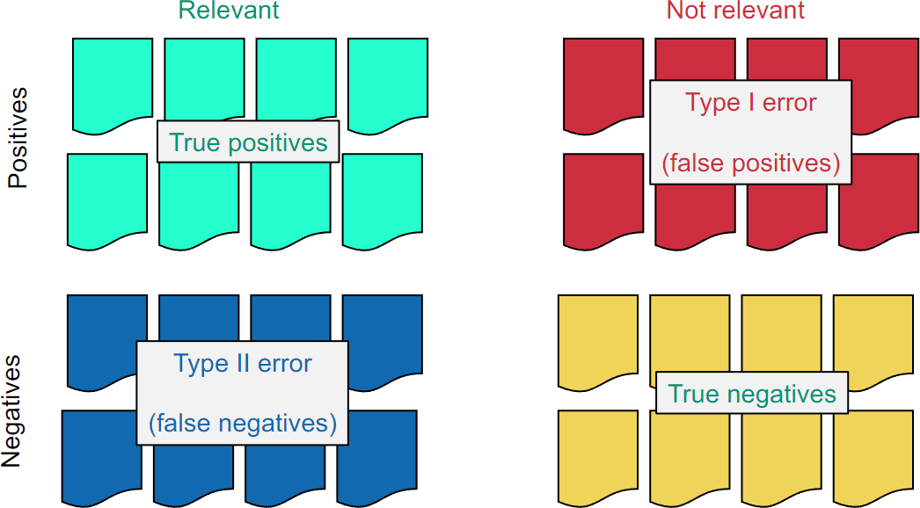
Evaluation
Specificity and Accuracy
16.05.2025

Slide 15
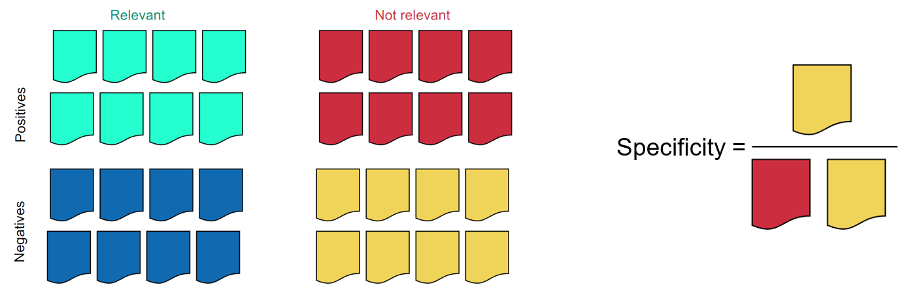
Evaluation
Specificity and Accuracy
hj
16.05.2025

Slide 16
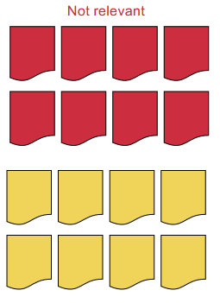
Evaluation
Specificity and Accuracy
Specificity:
50%
16.05.2025

Slide 17
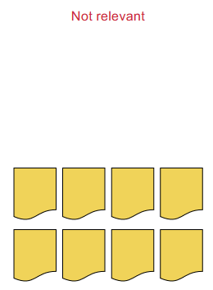
Evaluation
Specificity and Accuracy
Specificity:
100%
16.05.2025

Slide 18
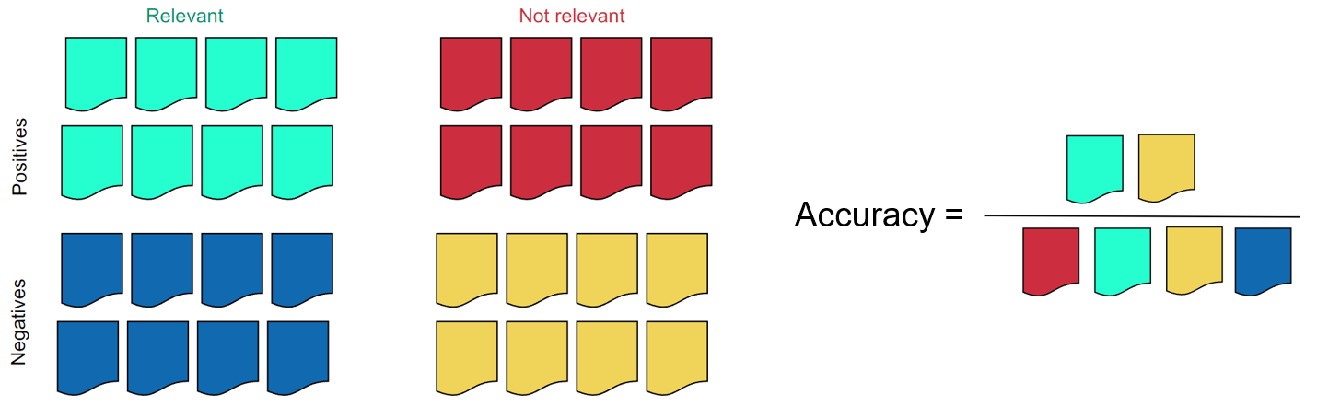
Evaluation
Specificity and Accuracy
16.05.2025

Slide 19
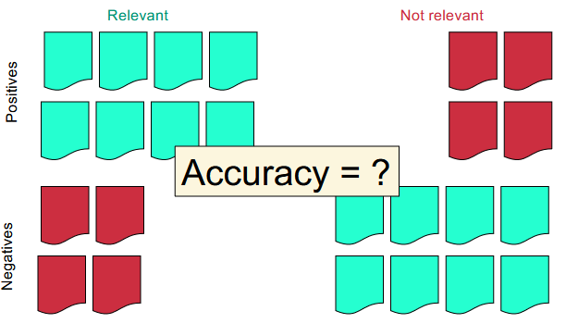
Evaluation
Specificity and Accuracy
16.05.2025

Slide 20
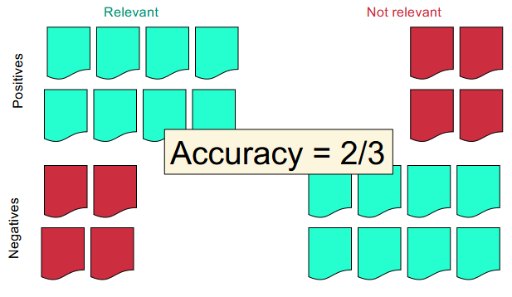
Evaluation
Specificity and Accuracy
Specificity:
100%
16.05.2025

Slide 21
Evaluation
Defining all the terms
Recall: How good is the system at returning as many relevant results to you
Precision: How useful are the returned results
Specificity: How good is the system at not bothering you with useless stuff
Accuracy: How good is the system in total
16.05.2025

Slide 22
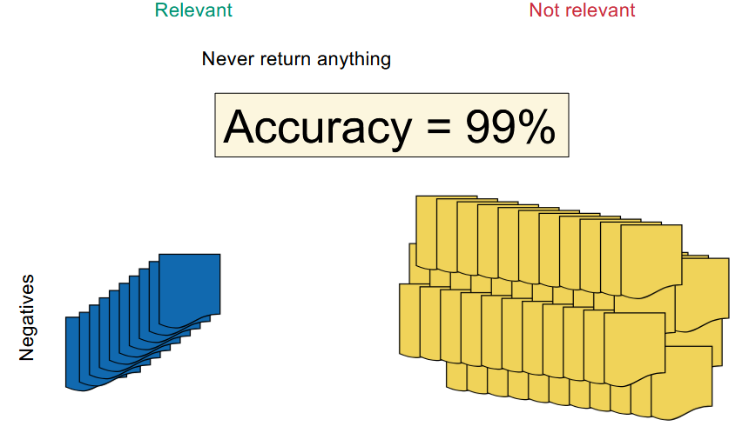
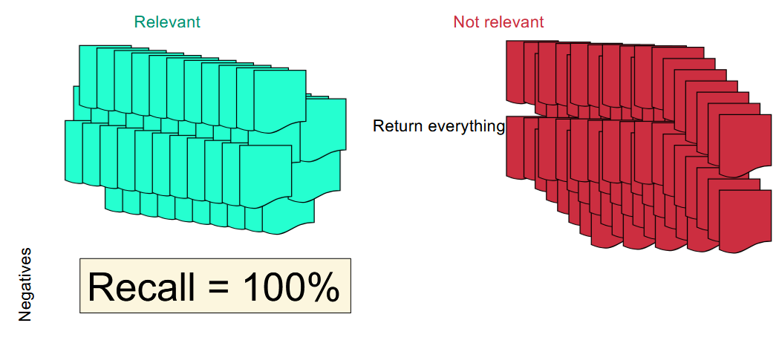
Evaluation
Hacking Recall and Accuracy
Issue: You can hack accuracy and recall by never returning anything or always returning everything respectively.
16.05.2025

Slide 23
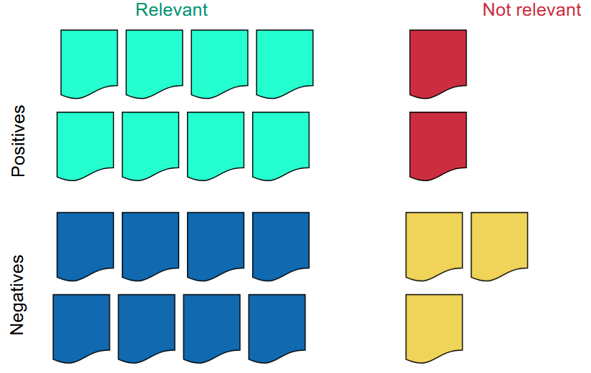
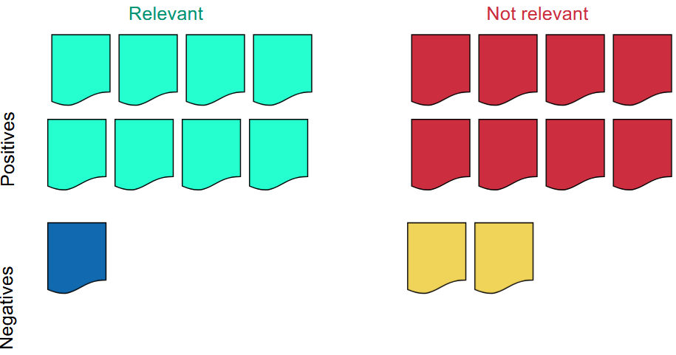
Evaluation
Compromise
High precision
High recall
16.05.2025

Slide 24
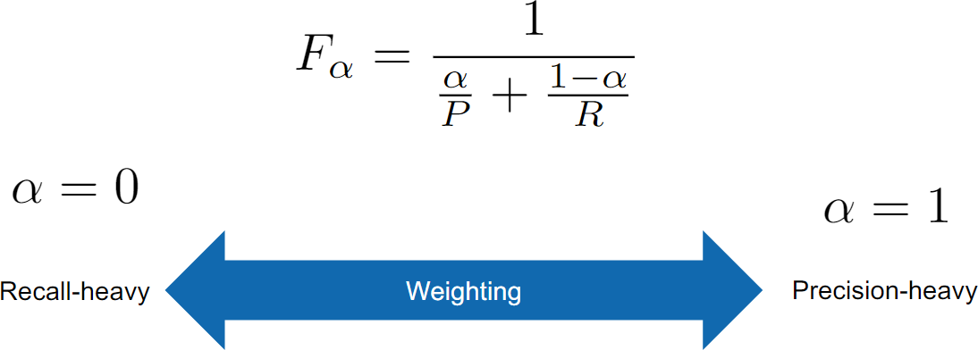
Evaluation
Merge Precision and Recall: F-Measure
Use the mean to balance the trade-off on both sides.
16.05.2025

Slide 25
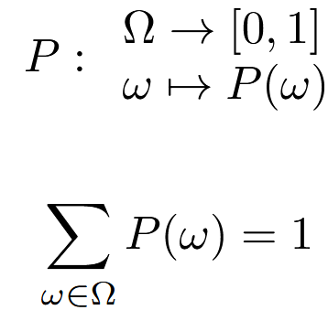
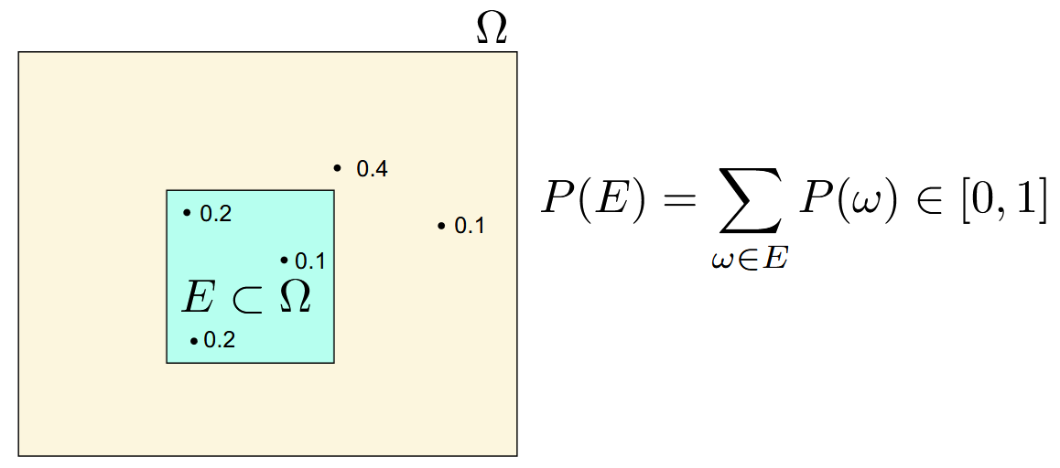
Probabilistic Retrieval
Definitions
Universe
Event
Complement (of E)
16.05.2025

Slide 26
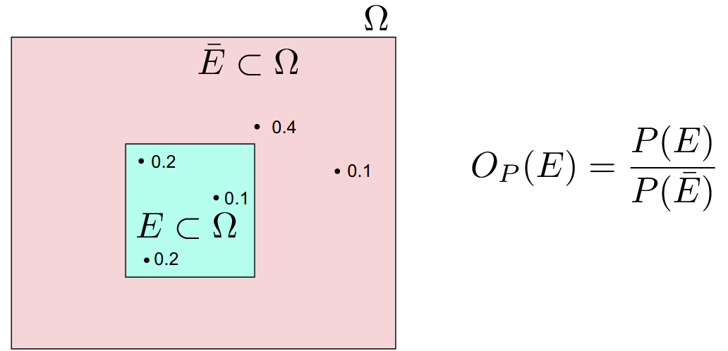
Probabilistic Retrieval
Odds
16.05.2025

Slide 27
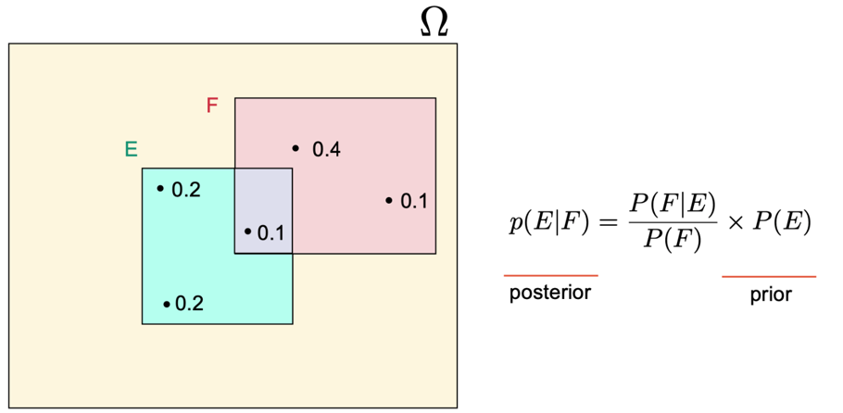
Probabilistic Retrieval
Bayes’ Rule
16.05.2025

Slide 28
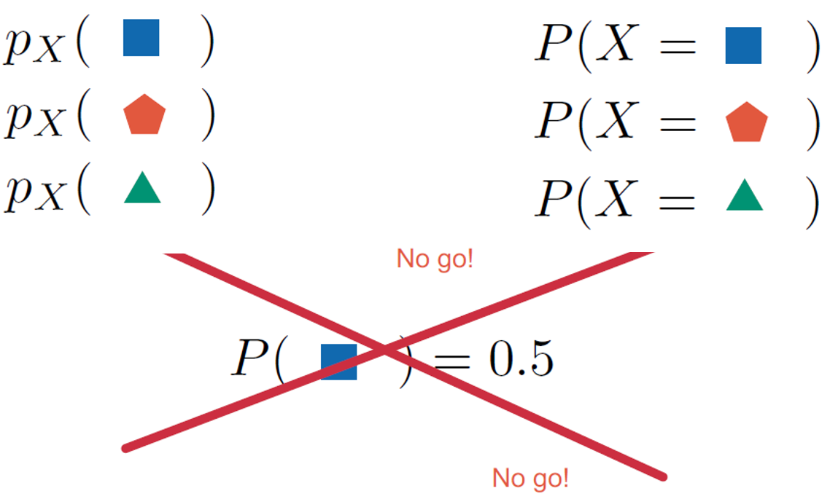
Probabilistic Retrieval
Notation
16.05.2025

Slide 29
Mystery Exercise
Mystery
Will be uploaded to Moodle
Entirely optional
First 3 students to submit correct solution will win a prize
16.05.2025

Slide 30
Kahoot
https://create.kahoot.it/details/duplicate-of-information-retrieval-ex-07-vector-space-models-mschoeb/ef383953-b43a-4abd-af2a-d9ebf2ad1019
16.05.2025

