Slide 1

INFORMATION RETRIEVAL
Week 3 – Term vocabulary
14.03.2025
Severin Mills

Slide 2

About me
Who am I?
Severin Mills
4th Semester BSc
Usually in HG F 26.5
Website: smills.ch
Slides, Material will be uploaded here
E-Mail: smills@ethz.ch
14.03.2025
1

Slide 3
Today
1
2
3
Exercise Recap
Theory
Kahoot / Exam questions
Discussion
Questions
Tokenization
Linguistic preprocessing
Skip lists
Advanced indices
Exercise 2: Advanced indices
Vote: Kahoot or Exam questions
14.03.2025
2

Slide 4


Exercise 1
Discussion
14.03.2025
3

Slide 5
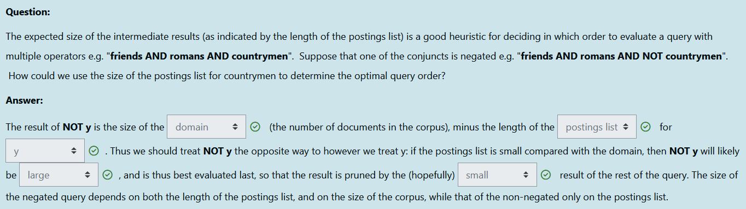
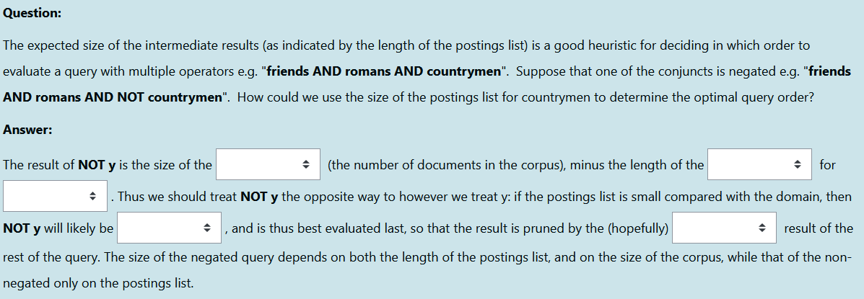
Exercise 1
Discussion
domain
postings list
y
large
small
14.03.2025
3

Slide 6
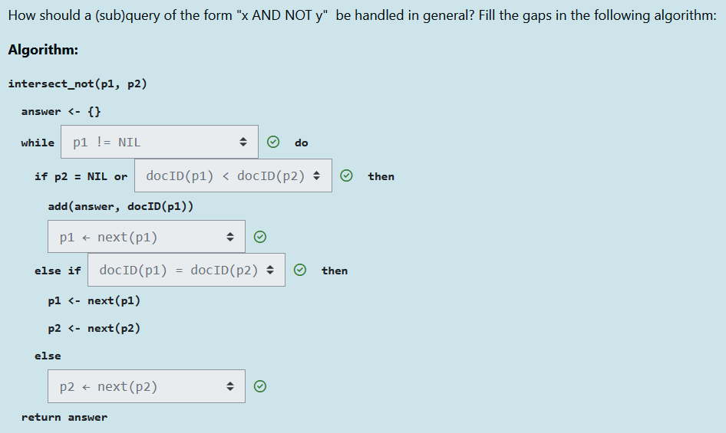
Exercise 1
Discussion
p1 != nil
p2 ← next(p2)
docID(p1) = docID(p2)
p1 ← next(p1)
docID(p1) < docID(p2)
14.03.2025
3

Slide 7
Exercise 1
Discussion
Moodle Quizzes are very helpful for exam – do them!
Questions to Quiz or Notebooks?
14.03.2025
3

Slide 8
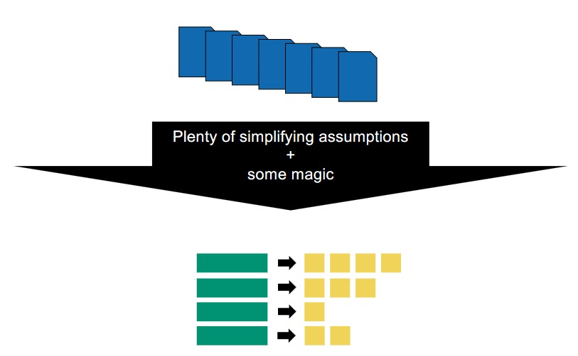
Term Vocabulary
Index construction
Previously:
14.03.2025
4

Slide 9
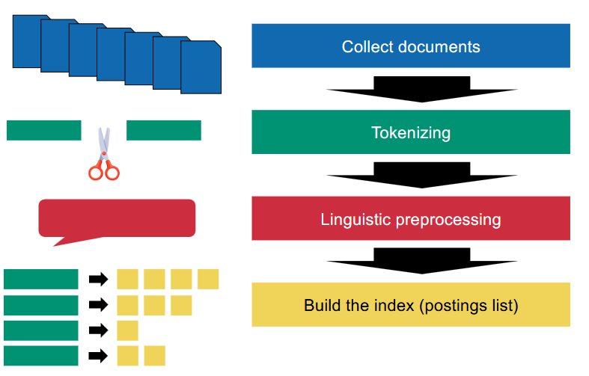
Term Vocabulary
Index construction
Actually:
14.03.2025
5

Slide 10
Term Vocabulary
Collecting documents
What is a document?
Language?
Encoding?
Context?
14.03.2025
6

Slide 11
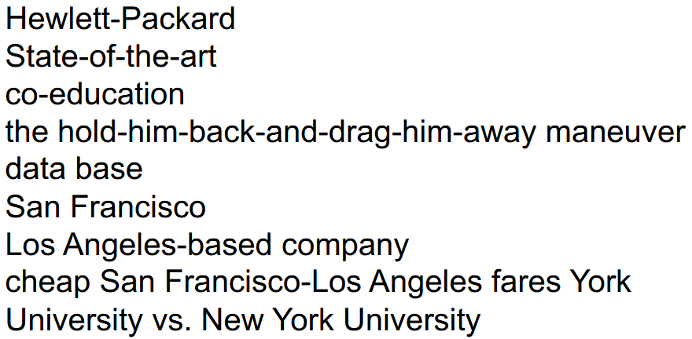
Term Vocabulary
Tokenization
Corner cases!
Throw away punctuation, symbols
Issues?
Remove stop words: is, the, as, from (Reuters’ list)
Why?
14.03.2025
7

Slide 12
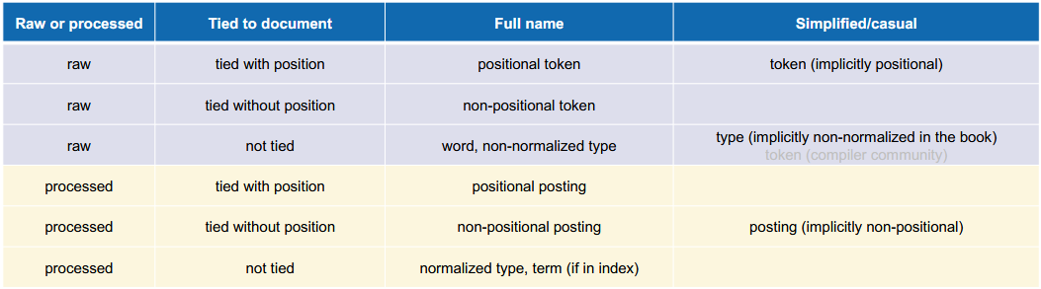
Term Vocabulary
Tokenization
Token vs. Type
e.g. “Big dogs love big dogs”
Tokens: “Big”, “dogs”, “love”, “big”, “dogs”
Types (terms): “Big”, “dogs”, “love”
Normalized vs. Non-normalized
Learn by heart for exam!
14.03.2025
8

Slide 13
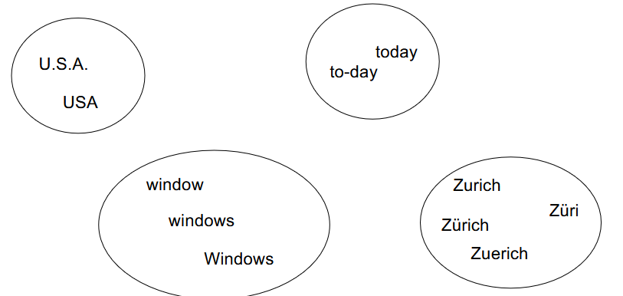
Term vocabulary
Linguistic preprocessing
Normalization
Equivalence classes
Lowercasing (“Apple” -> “apple”)
Removing characters (“U.S.A.” -> “USA”)
Accents and diacritics
14.03.2025
9

Slide 14
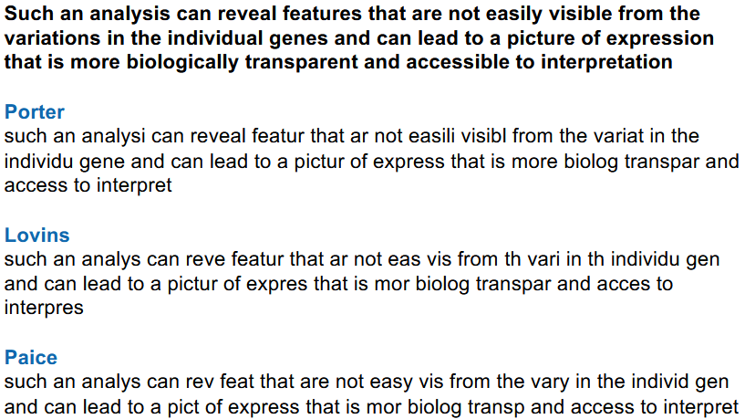
Linguistic preprocessing
Stemming
Simple Rules for dropping letters
Meaning of word not considered
Porter Stemmer
14.03.2025
10

Slide 15
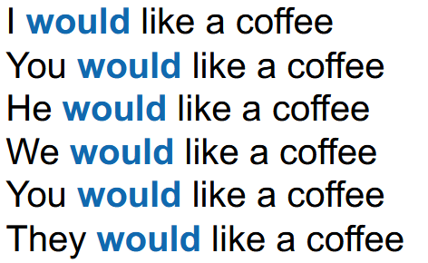
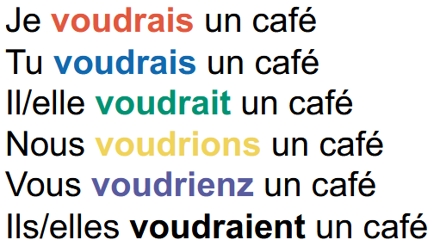
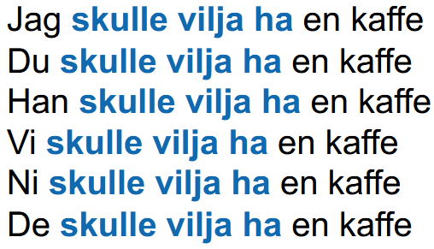
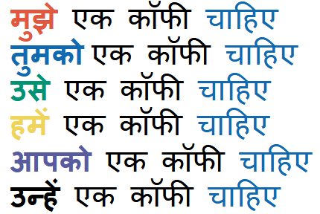
Linguistic preprocessing
Lemmatization
Morphological analysis of words
Meaning of word considered
e.g. better -> good
14.03.2025
11

Slide 16



Linguistic preprocessing
Stemming vs. Lemmatization
What to use when?
Lemmatization
Stemming
=> Depends mostly on amount of morphology
Lemmatization
14.03.2025
12

Slide 17
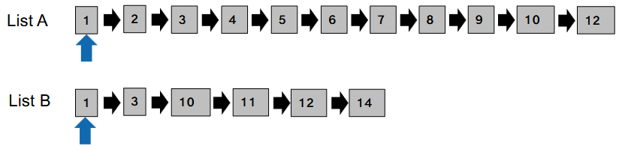
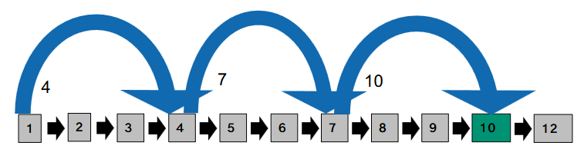
Term Vocabulary
Skip Lists
Intersection algorithm:
What happens if size of postings list is huge?
Possible Solution: Skip Lists!
14.03.2025
13

Slide 18
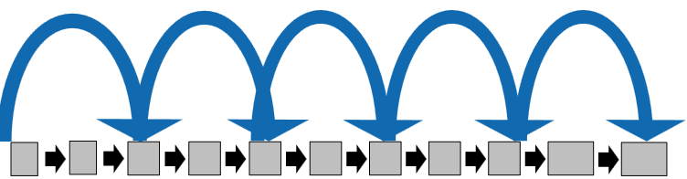
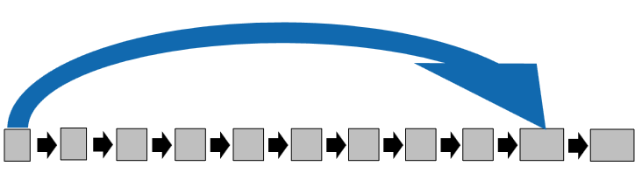
Term Vocabulary
Skip Lists
Too short skips?
ineffective
many comparisons
waste of space
Too long skips?
too few comparisons
not very usable (few opportunities)
14.03.2025
14

Slide 19
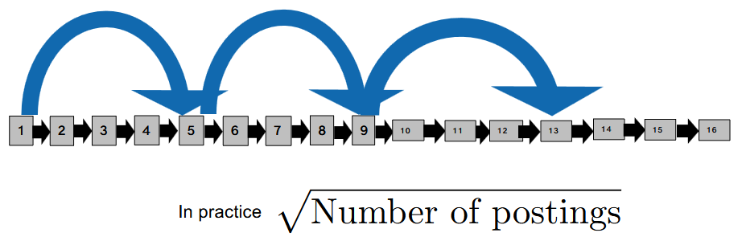
Term Vocabulary
Skip Lists
14.03.2025
15

Slide 20
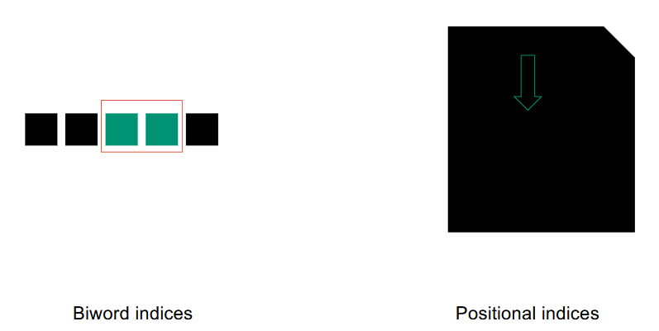
Term Vocabulary
Phrase search
In the real world: one-word queries are uncommon
“Information Retrieval” instead of “Information” AND “Retrieval”
Inverted index cannot be used directly for phrase queries
Why?
No information on proximity!
Solutions?
14.03.2025
16

Slide 21
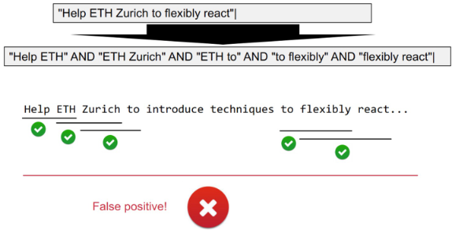
Term Vocabulary
Bi-word Index (alt. k-word Index)
Disadvantages?
False positives
Exponential vocabulary increase (#terms)^k
14.03.2025
17

Slide 22
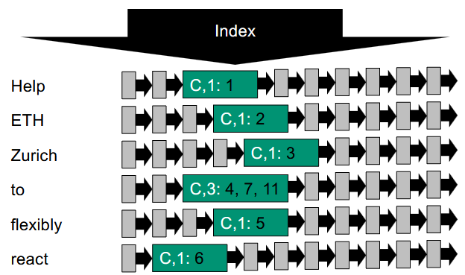
Term Vocabulary
Positional Index
Store docID, term frequency and position in document
14.03.2025
18

Slide 23
Exercise 2
Advanced indices
Notebook
k-word index
Positional Index
Stemming
Moodle quiz
Using the Porter Stemmer
14.03.2025
19

Slide 24
Vote
Exam questions or Kahoot?
14.03.2025
20

Slide 25
Kahoot
https://create.kahoot.it/details/cbb1ed53-a726-44d0-ab70-0a976c7b6505
14.03.2025
20

Slide 26
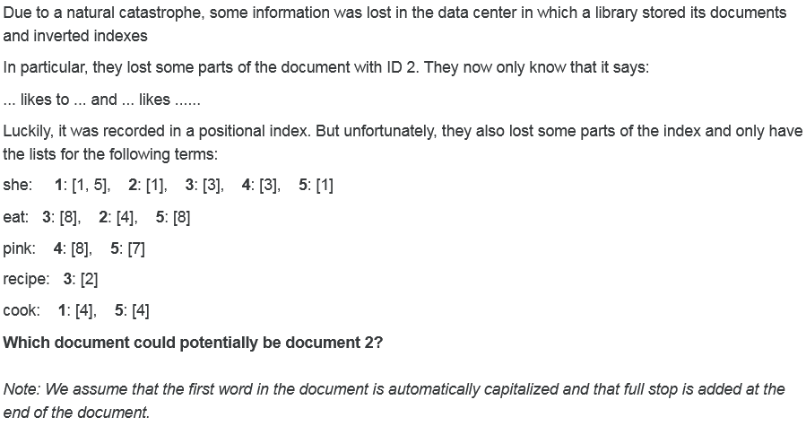
Exam questions
FS22 – Question 12
14.03.2025
21

Slide 27
Exam questions
FS22 – Question 12
The postings list for “eat” only contains index 4, but in the statement, it is also used in position 9.
14.03.2025
22

Slide 28
Exam questions
FS22 – Question 12
14.03.2025
23

Slide 29
Exam questions
FS22 – Question 12
Keyword: potentially
The postings list for wink was not recovered, so there is nothing that goes against this document being in the data center.
14.03.2025
24

Slide 30
Exam questions
FS22 – Question 12
14.03.2025
25

Slide 31
Exam questions
FS22 – Question 12
The postings list for “recipe” has no posting for document 2.
14.03.2025
26

Slide 32
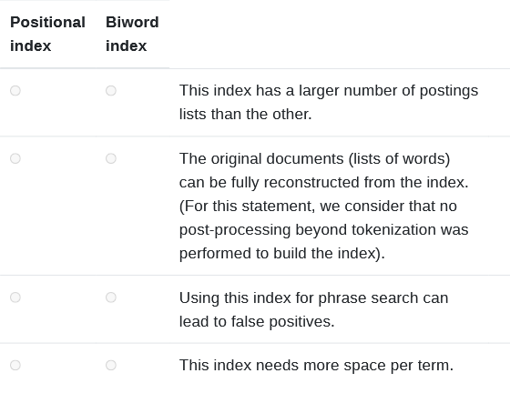
Exam questions
FS19 – Question 17
14.03.2025
27

Slide 33
Exam questions
FS19 – Question 17
Biword index, since the term vocabulary grows exponentially in k-word indices and will thus have more postings lists.
Positional index, since it saves the exact position in the documents.
Biword index
Positional index, since it also stores the exact positions.
14.03.2025
28

