Slide 1
INFORMATION RETRIEVAL
Week 7 – Ranked Retrieval
11.04.2025
Severin Mills

Slide 2

Today
1
2
3
Exercise Recap
Theory
Kahoot / Exam questions
Discussion
Questions
Recap: Heap’s / Zipf’s Law
Parametric Search
Shared inverted index
Scores / Weights
Exercise 4: Heap’s and Zipf’s Law
11.04.2025
2

Slide 3
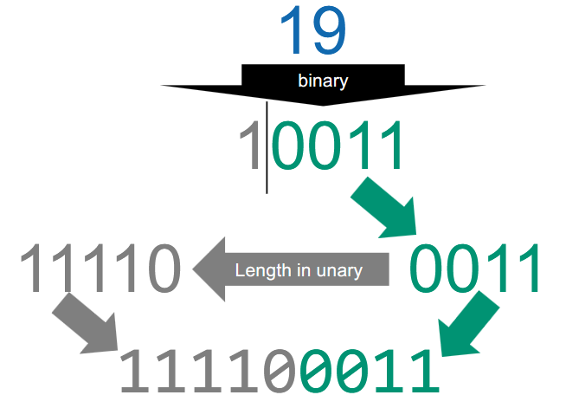
Exercise 5: Index Compression
Gamma code mapping
Recall:
11.04.2025
Notes:
Range queries: Hash map is not sorted and cannot be iterated through.

Slide 4
Exercise 5: Index Compression
Gamma code mapping
Example: 7
To binary: 111
Trim leading 1: 11
Unary length: 110
Combine: 11011
11.04.2025
Notes:
Range queries: Hash map is not sorted and cannot be iterated through.

Slide 5
Exercise 5: Index Compression
Gamma code mapping
Example: 12
1100
100
1110
1110100
11.04.2025
Notes:
Range queries: Hash map is not sorted and cannot be iterated through.

Slide 6
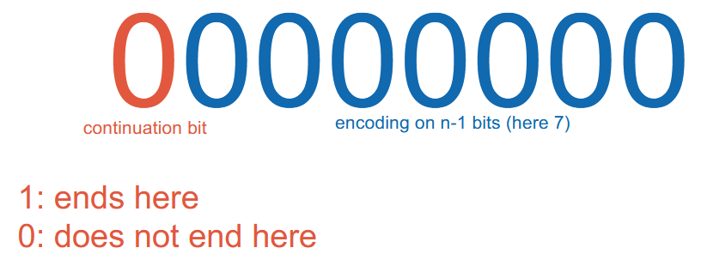
Exercise 5: Index Compression
Variable byte encoding
Recall:
11.04.2025
Notes:
Range queries: Hash map is not sorted and cannot be iterated through.

Slide 7
Exercise 5: Index Compression
Variable byte encoding
Example: 356, 8-bit packets
To binary: 101100100
Split up into 7-bit segments: 10 1100100
Add continuation / termination bits: 00000010 1100100
11.04.2025
Notes:
Range queries: Hash map is not sorted and cannot be iterated through.

Slide 8
Exercise 5: Index Compression
Variable byte encoding
Example: 356, 8-bit packets
To binary: 101100100
Split up into 7-bit segments: 10 1100100
Add continuation / termination bits: 00000010 1100100
11.04.2025
Notes:
Range queries: Hash map is not sorted and cannot be iterated through.

Slide 9
Exercise 5: Index Compression
Variable byte encoding
Example: 46
To binary: 101110
Split up into 7-bit segments: Not needed
Add continuation / termination bits: 10101110
11.04.2025
Notes:
Range queries: Hash map is not sorted and cannot be iterated through.

Slide 10
Exercise 5: Index Compression
Variable byte encoding
Example: 767 (Binary: 1011111111)
To binary: 1011111111
Split up into 7-bit segments: 101 1111111
Add continuation / termination bits: 00000101 11111111
11.04.2025
Notes:
Range queries: Hash map is not sorted and cannot be iterated through.

Slide 11
Exercise 5: Index Compression
Ordering encoding methods
Gamma encoding: Always starts with a string of 1s, middle bit is 0, always odd size
Unary encoding: The value of the number + 1
Fix-length encoding: Number in binary rounded up to the next multiple of the packet size
Variable length: If n := Number in binary and p := packet size, then the size is ceil(| n | / (p – 1)) * p
11.04.2025
Notes:
Range queries: Hash map is not sorted and cannot be iterated through.

Slide 12
Exercise 5: Index Compression
Largest code points
Variable length encoding: Check packet size, remove first bit of every segment
Fix-length: Size of maximum encoding
Unary: size – 1
Gamma: If n is the size, the largest number that fits in ceil((n – 1) / 2)
11.04.2025
Notes:
Range queries: Hash map is not sorted and cannot be iterated through.

Slide 13
Exercise 5: Index Compression
Discussion
Lot of exam questions! Practice is key here.
11.04.2025
Notes:
Range queries: Hash map is not sorted and cannot be iterated through.

Slide 14
Recap: Index Compression
Terminology
N: number of documents
T: number of tokens (positional postings)
M: number of terms
11.04.2025
Notes:
Range queries: Hash map is not sorted and cannot be iterated through.

Slide 15
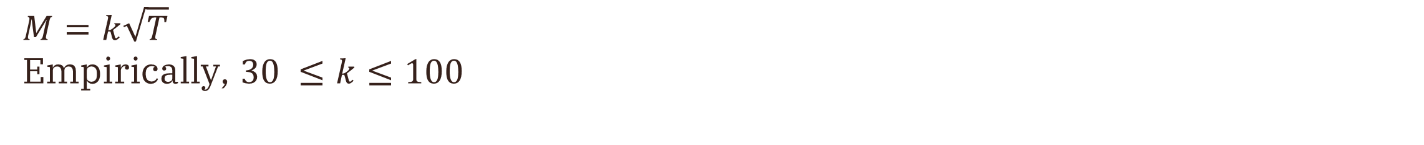
Recap: Index Compression
Heap’s law
$$M=k\sqrt{T}$$
Empirically, $30 ≤k≤100$
11.04.2025
Notes:
Tells us the number of terms grows about the order of sqrt of the number of tokens (i.e. the larger our vocabulary is, the less new words we will get)

Slide 16
Recap: Index Compression
Zipf’s law
$$\text{Frequency} =\frac{k}{Rank}$$
11.04.2025
Notes:
Tells us the distribution of terms is quite different between the most frequent terms and less frequent ones

Slide 17
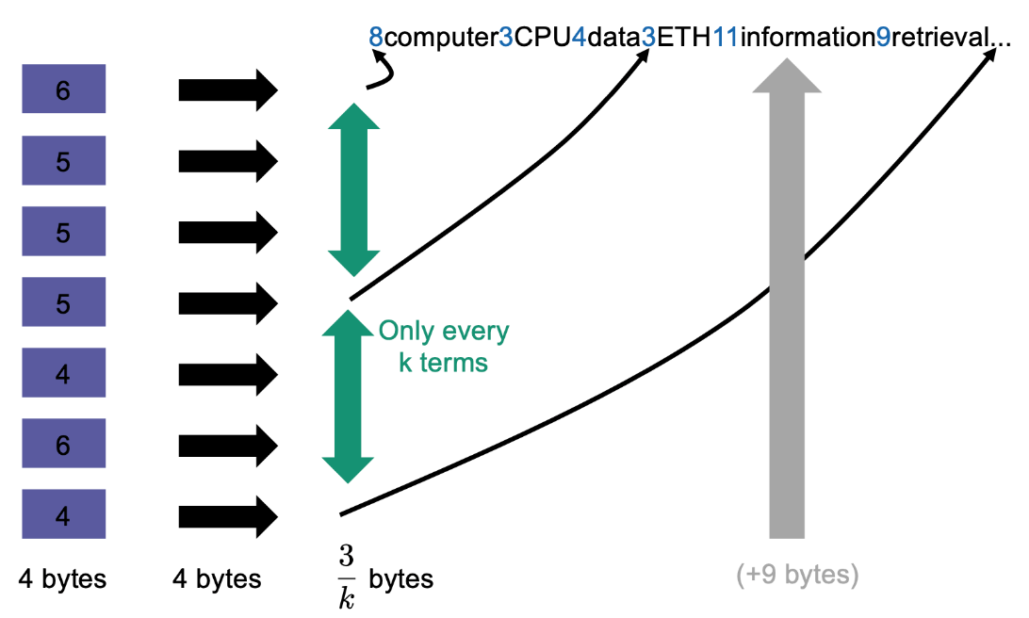
Recap: Index Compression
Compression of the dictionary
Store pointers
Words start with number indicating length
11.04.2025

Slide 18
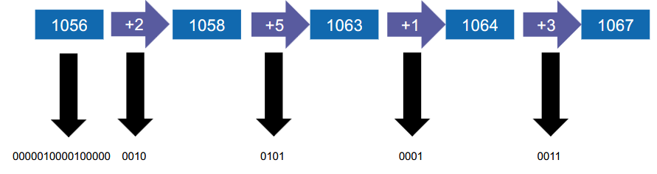
Recap: Index Compression
Compression of the postings list
Encoding the gaps => What issue arises?
11.04.2025
Notes:
When variable lengths then it’s wasteful

Slide 19
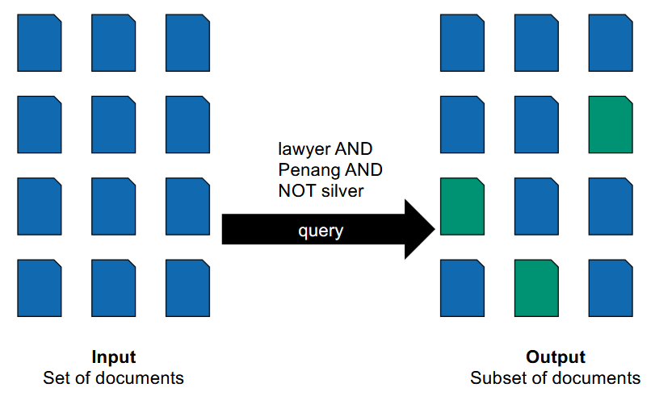
Ranked Retrieval
Boolean retrieval
Until now:
11.04.2025

Slide 20
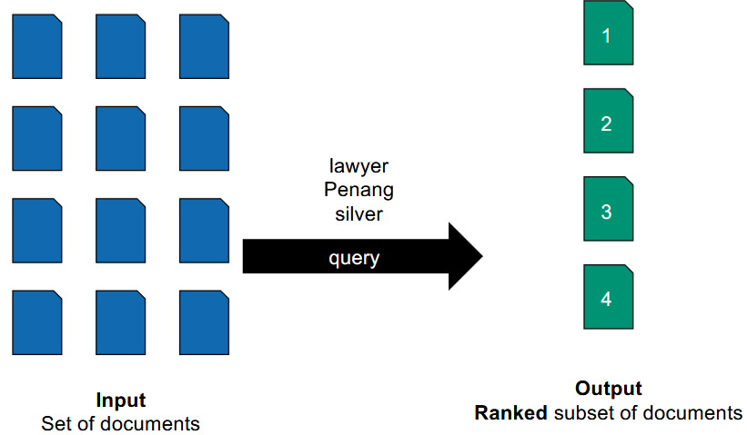
Ranked Retrieval
Boolean retrieval
What we want:
11.04.2025

Slide 21
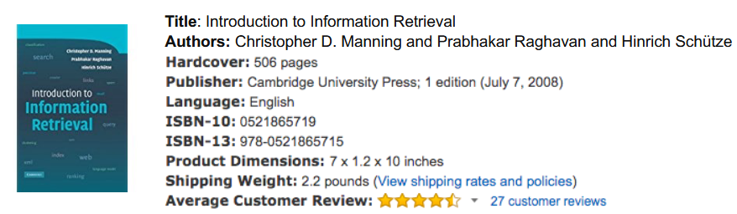
Ranked Retrieval
Parametric search
Split index up between metadata
11.04.2025

Slide 22
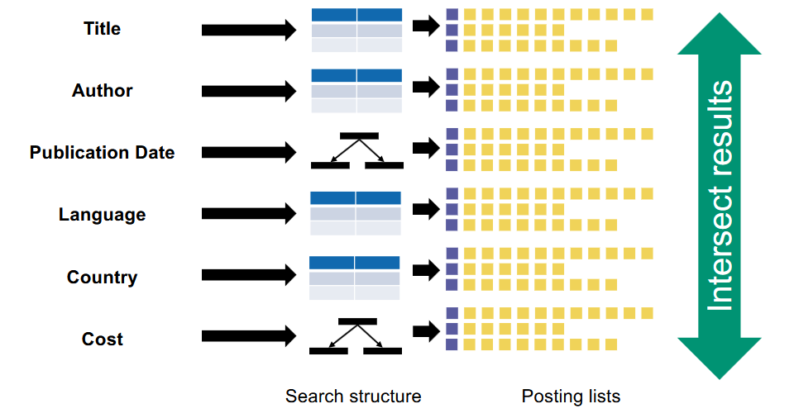
Ranked Retrieval
Parametric search
One index for each metadata entry (i.e. author, title, etc.)
Intersect results at the end
→ Zone search
11.04.2025

Slide 23
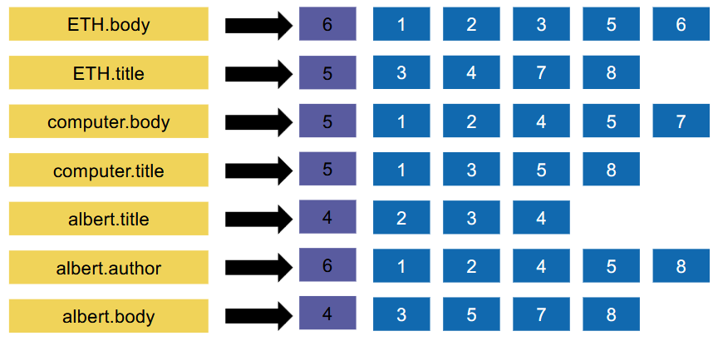
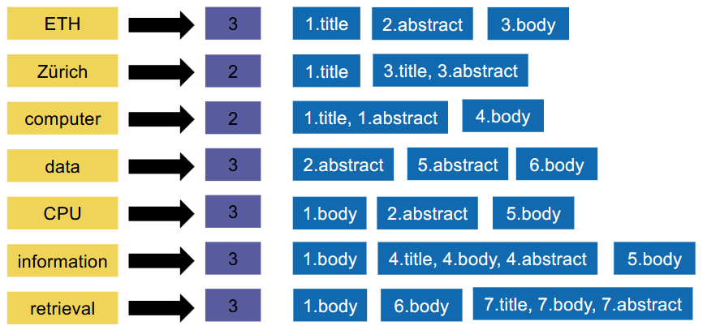
Ranked Retrieval
Shared inverted index
Zones in terms vs. Zones in postings
11.04.2025
Notes:
Can already rank results by weighting the zones

Slide 24
Ranked Retrieval
Shared inverted index
Zones in terms vs. Zones in postings
11.04.2025
Notes:
Can already rank results by weighting the zones

Slide 25
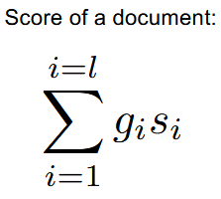
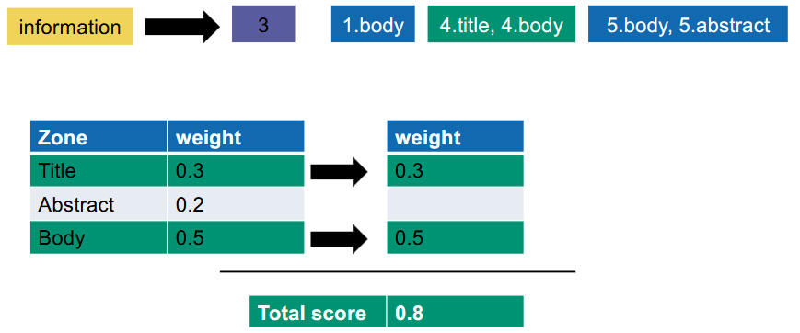
Scoring
Single-term query
$g_{i}:zone weight$
$s_{i}:zone i contains term or does not contain term$
Sort documents based on score, return top-k results
11.04.2025
Notes:
Can already rank results by weighting the zones

Slide 26
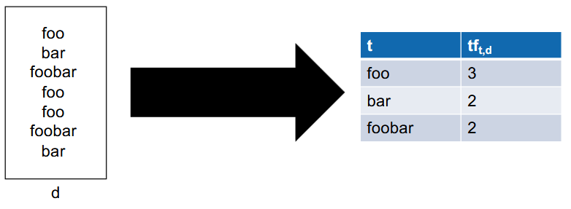
Scoring
Term frequency
Number of times a term occurs in a document
11.04.2025
Notes:
Scoring only based on term frequency might not return good results, since it does not account for rare words.

Slide 27
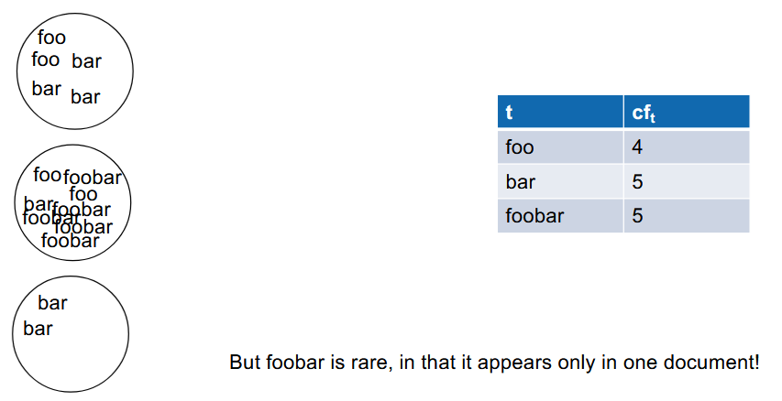
Scoring
Collection frequency
Number of times a term occurs in the whole collection
11.04.2025
Notes:
Now we give foobar too much weight, since it only occurs in one document.

Slide 28
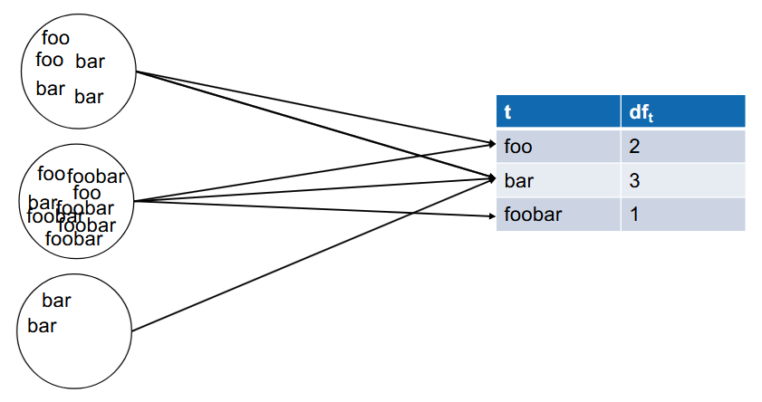
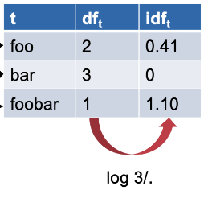
Scoring
Document frequency
Number of documents where a term occurs
Inverse document frequency: ${idf}_{t}=\ln{\frac{N}{m}}$, where $N≔largest {df}_{t}, m≔{df}_{t}$
11.04.2025
Notes:
Use inverse document frequency to measure rarity of a term in a document

Slide 29
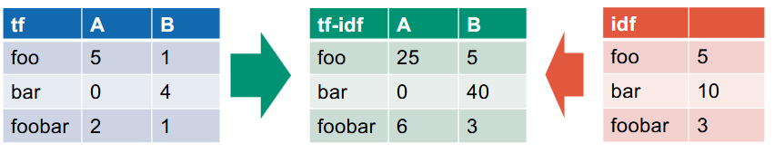
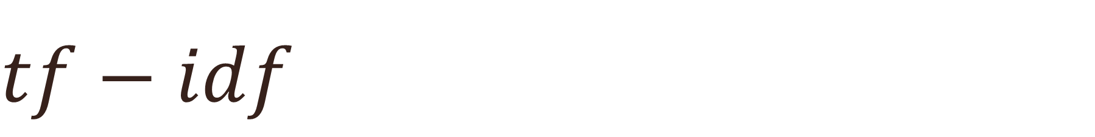
Scoring
$$tf−idf$$
$tf$-$idf$ $=tf ×idf$
11.04.2025
Notes:
Use inverse document frequency to measure rarity of a term in a document

Slide 30
Exercise 6: Heap’s law
Questions
Moodle: Multiple choice
Coding: Plot Heap’s and Zipf’s law
11.04.2025
Notes:
Use inverse document frequency to measure rarity of a term in a document

Slide 31
Kahoot
https://create.kahoot.it/details/information-retrieval-ex-06-repetitions/7ad1b588-2650-41bf-a05e-ee7ac16f8b77
11.04.2025

