Slide 1
INFORMATION RETRIEVAL
Week 9 – Vector Space Model
02.05.2025
Severin Mills

Slide 2

Today
1
2
3
Exercise Recap
Theory
Kahoot
Discussion
Questions
Recap: Ranked Retrieval
Vector Space Model
SMART Notation
BONUS: Vector Space Model
02.05.2025
2

Slide 3
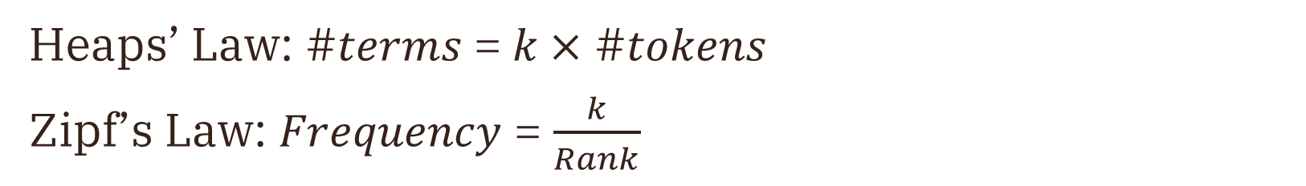
Exercise 6: Heaps’ & Zipf’s Law
Recap
Heaps’ Law: #𝑡𝑒𝑟𝑚𝑠 = 𝑘 $×$ #𝑡𝑜𝑘𝑒𝑛𝑠
Zipf’s Law: 𝐹𝑟𝑒𝑞𝑢𝑒𝑛𝑐𝑦 = $\frac{k}{Rank}$
02.05.2025

Slide 4
Ranked Retrieval
Previously
We want to rank documents based on a score
Measure similarity between documents
02.05.2025
Notes:
Range queries: Hash map is not sorted and cannot be iterated through.

Slide 5
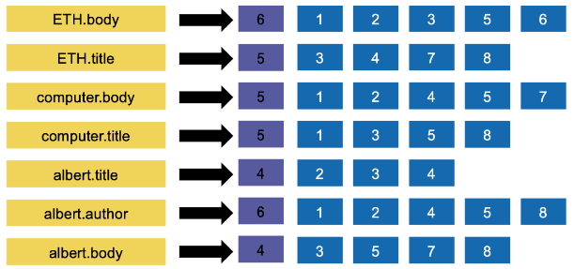
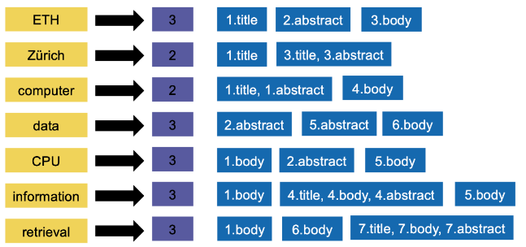
Ranked Retrieval
Scoring
Zones in terms
Zones in postings
02.05.2025
Notes:
Range queries: Hash map is not sorted and cannot be iterated through.

Slide 6
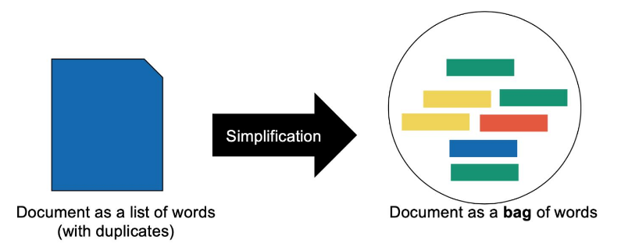
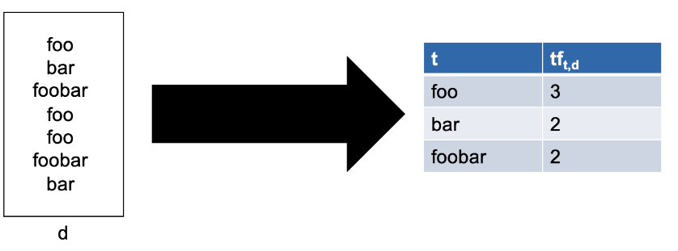
Ranked Retrieval
Scoring
02.05.2025
Notes:
Range queries: Hash map is not sorted and cannot be iterated through.

Slide 7
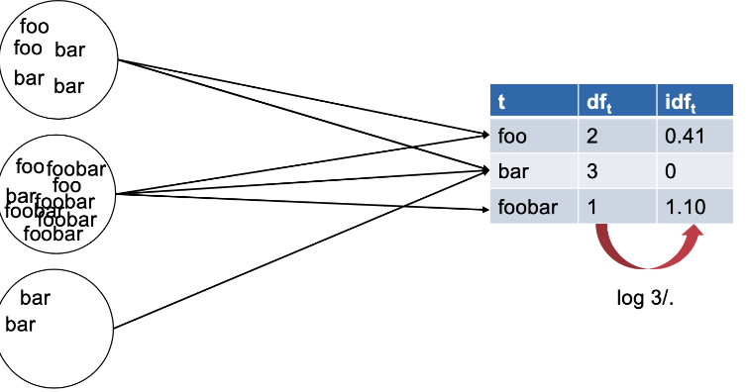
Ranked Retrieval
Scoring
If we want to measure rarity, we use the inverse document frequency
02.05.2025
Notes:
Range queries: Hash map is not sorted and cannot be iterated through.

Slide 8
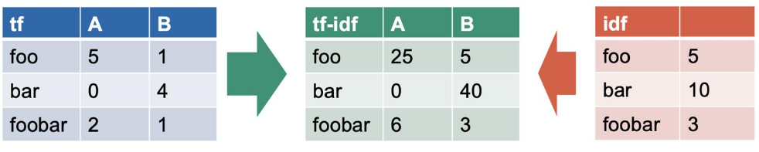
Ranked Retrieval
Putting it all together
tf-idf
02.05.2025
Notes:
Range queries: Hash map is not sorted and cannot be iterated through.

Slide 9
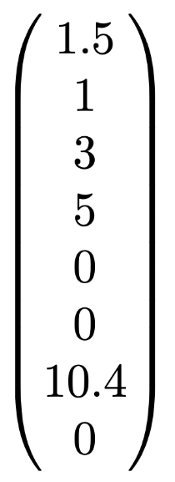
Vector Space Model
Now
Main idea: represent documents as vectors
02.05.2025

Slide 10

Vector Space Model
Vectorization
Boolean vector
Not very usable for ranking, why?
02.05.2025

Slide 11
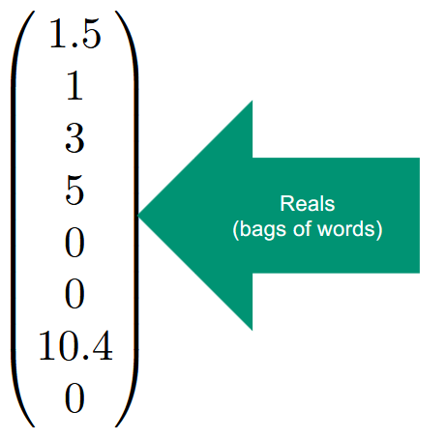
Vector Space Model
Vectorization
Use reals instead.
Could be term frequency, tf-idf (preferably), etc.
02.05.2025

Slide 12
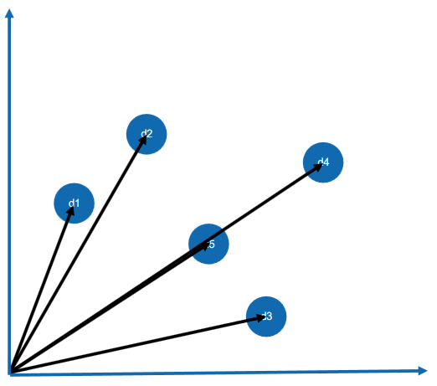
Vector Space Model
Vectorization
A document is then a vector in the first quadrant, $D∈ℝ^{M}$
02.05.2025

Slide 13
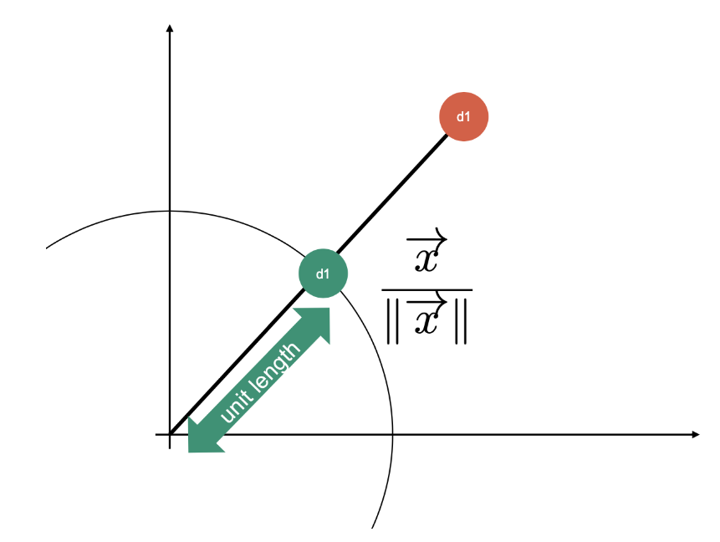
Vector Space Model
Vectorization
Normalize vectors
02.05.2025

Slide 14
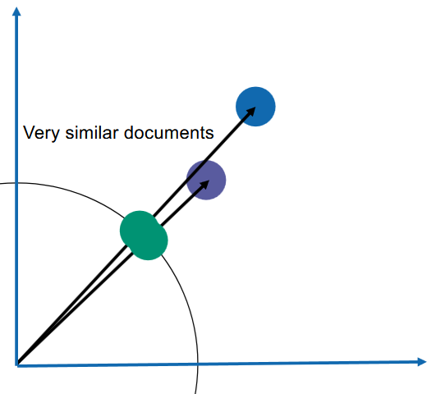
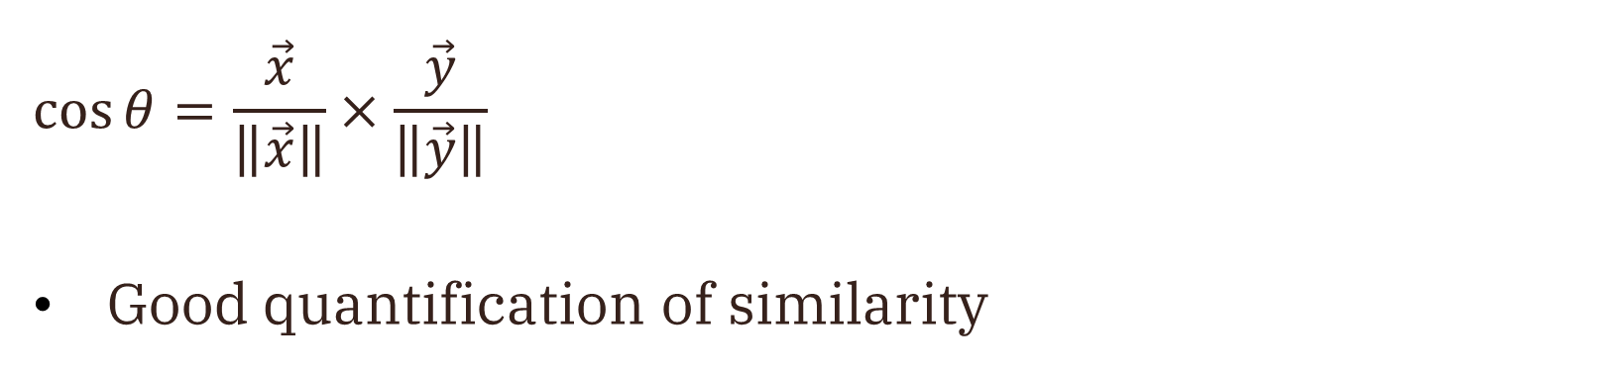
Vector Space Model
Inner Product (Renormalized)
$$\cos{θ}=\frac{\vec{x}}{\left\|\vec{x}\right\|}×\frac{\vec{y}}{\left\|\vec{y}\right\|}$$
Good quantification of similarity
02.05.2025

Slide 15
Vector Space Model
Queries as vectors
Build vector
Calculate cosine similarity of documents and return the nearest ones
What about a large collection of documents?
Doesn’t matter, since query size is constant
02.05.2025

Slide 16
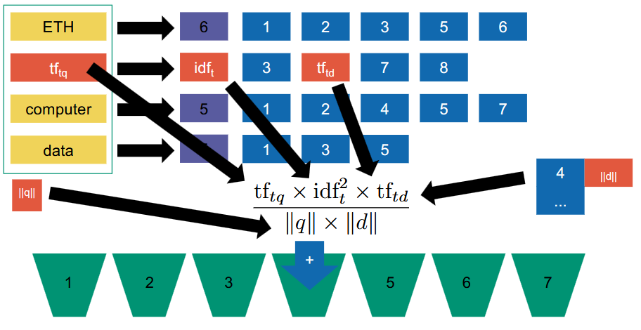
Vector Space Model
Inverted index
02.05.2025

Slide 17
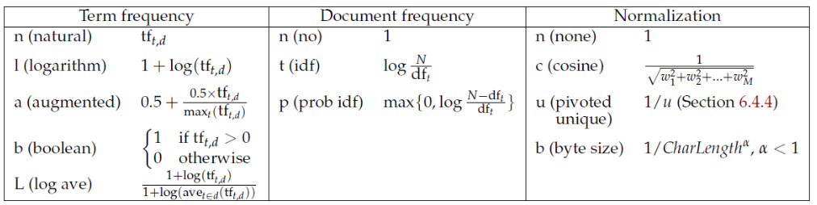
Vector Space Model
SMART Notation
02.05.2025

Slide 18
Exercise 7: Vector Space Model
BONUS TIME
Same as previous
Starts on 02.05 at 15:00, ends on 09.05 at 15:00
If you already passed 2 / 3 quizzes, you got the bonus (you should get a mail soon)
02.05.2025

Slide 19
Kahoot
https://create.kahoot.it/details/duplicate-of-information-retrieval-ex-07-vector-space-models-mschoeb/ef383953-b43a-4abd-af2a-d9ebf2ad1019
02.05.2025

