Slide 1
INFORMATION RETRIEVAL
Week 9 – Champion Lists
09.05.2025
Severin Mills

Slide 2

Today
1
2
3
Exercise Recap
Theory
Kahoot
Vector Space Model
Questions
Inexact Top-K Retrieval
Champions Lists
Exercise 8: Champion Lists
09.05.2025
2

Slide 3
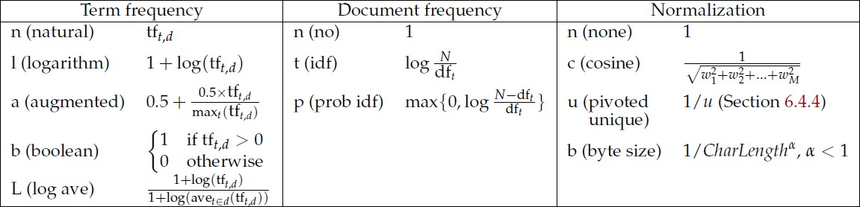
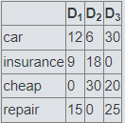
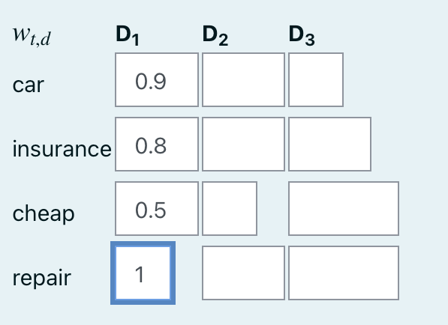
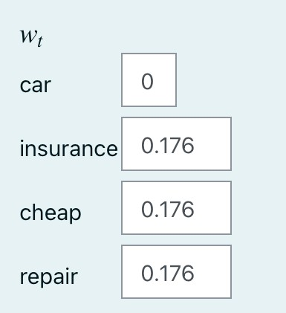
Exercise 7: Vector Space Model
Recap
tft,d
atc.nnn
09.05.2025

Slide 4
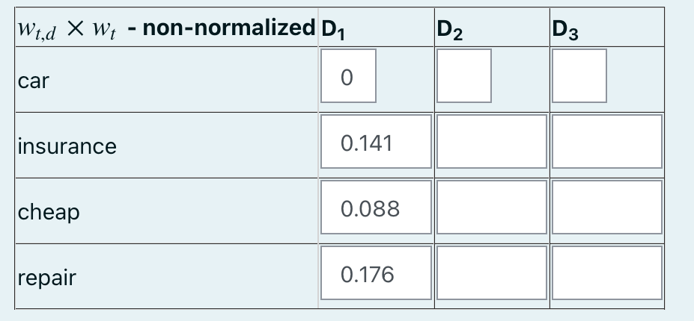
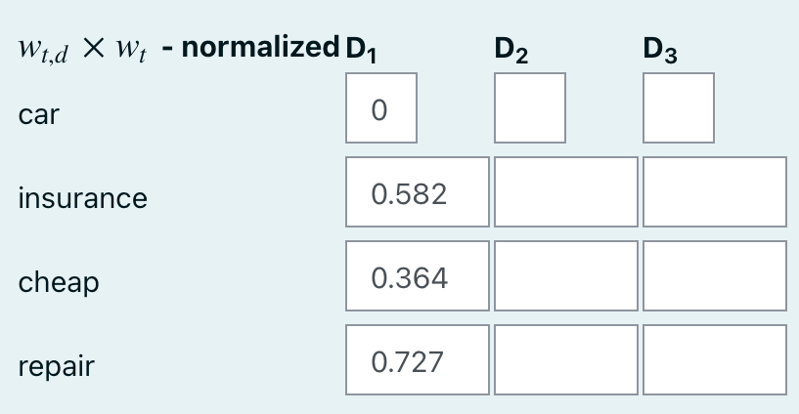
Exercise 7: Vector Space Model
Recap
tft,d
09.05.2025

Slide 5
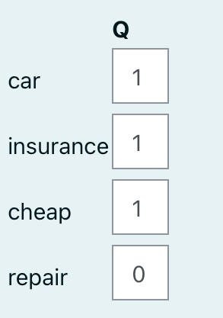
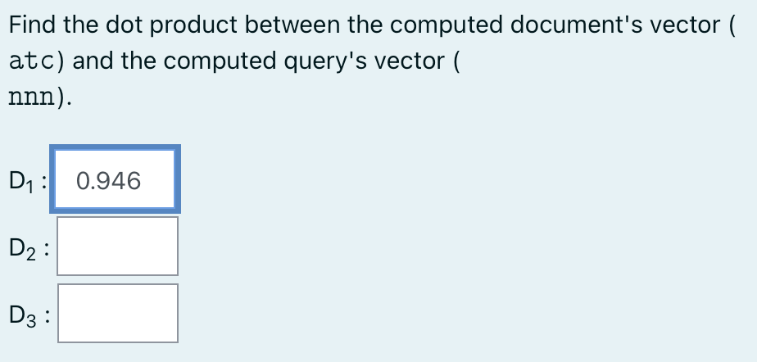
Exercise 7: Vector Space Model
Recap
09.05.2025

Slide 6
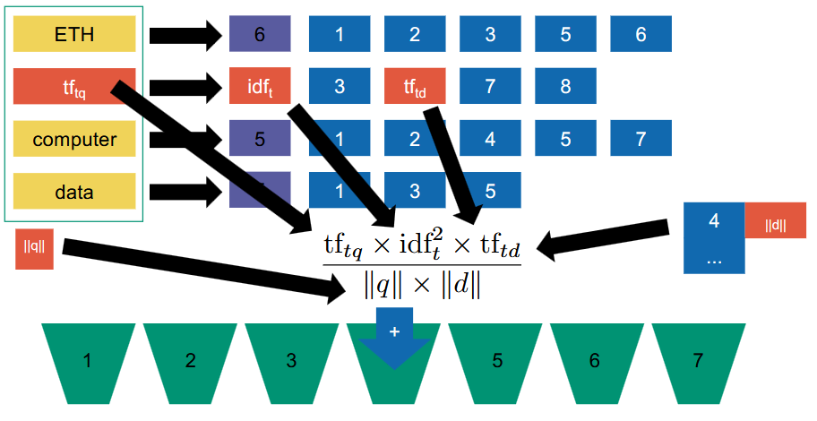
Recap: Vector Space Model
Inverted Index
09.05.2025

Slide 7
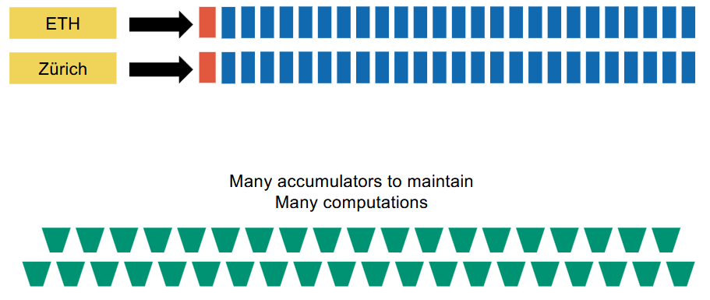
Inexact top-K Retrieval
Computations
Postings lists can be very large:
09.05.2025

Slide 8
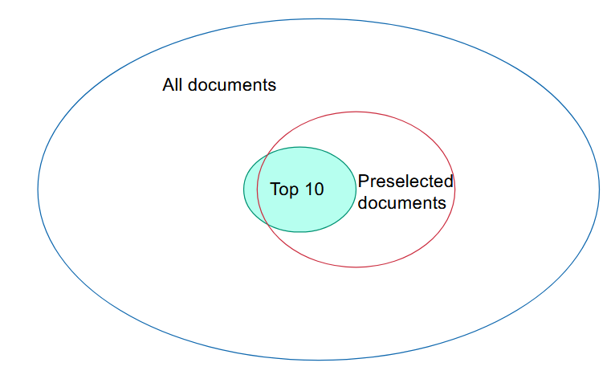
Inexact top-K Retrieval
Idea
Preselect documents.
Only compute scores in
smaller set.
09.05.2025

Slide 9
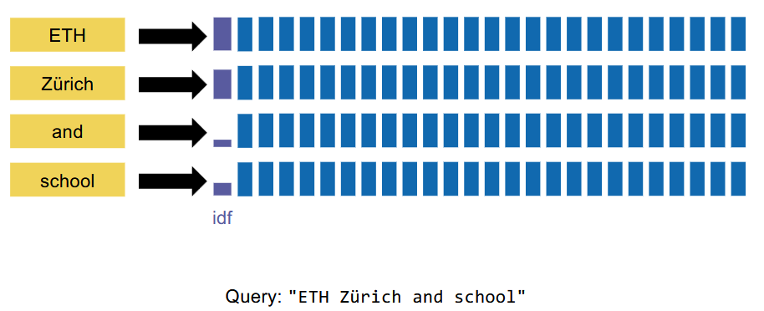
Inexact top-K Retrieval
Index Elimination
Remove terms with low idf.
09.05.2025

Slide 10
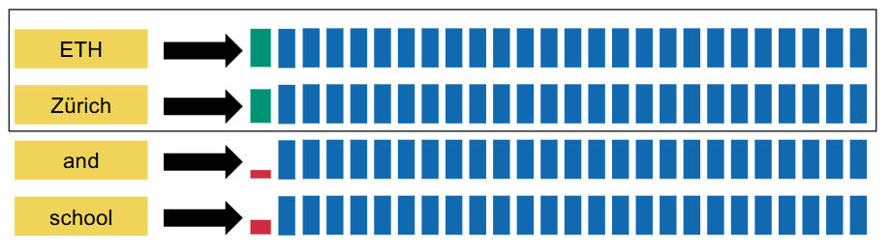
Inexact top-K Retrieval
Index Elimination
Remove terms with low idf.
Benefit: Usually low idf terms are contained in more documents.
09.05.2025

Slide 11
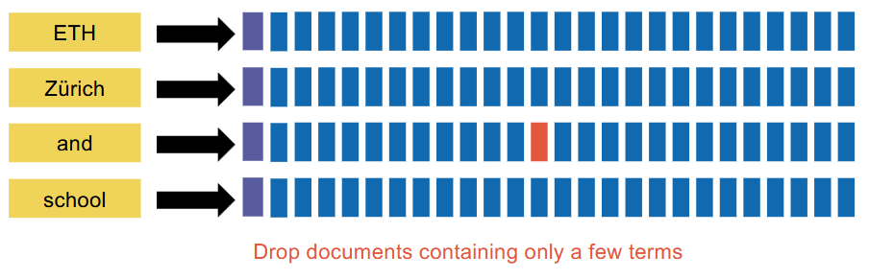
Inexact top-K Retrieval
Index Elimination
Second idea: Keep only documents containing most terms.
We may drop too many documents this way though.
09.05.2025

Slide 12
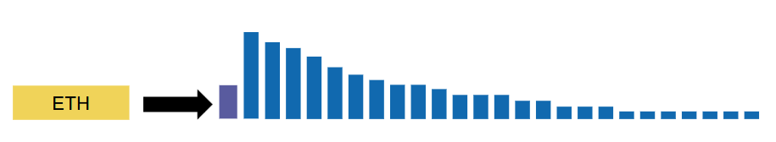
Inexact top-K Retrieval
Champion Lists
Sort postings by decreasing term frequency
09.05.2025

Slide 13
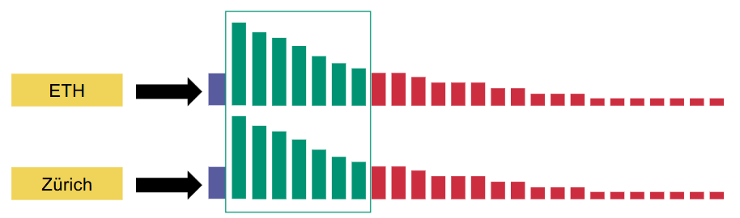
Inexact top-K Retrieval
Champion Lists
Sort postings by decreasing term frequency
Only keep top K documents
09.05.2025

Slide 14
Inexact top-K Retrieval
Champion Lists
Sort postings by decreasing term frequency
Only keep top K documents
Union those results
09.05.2025

Slide 15
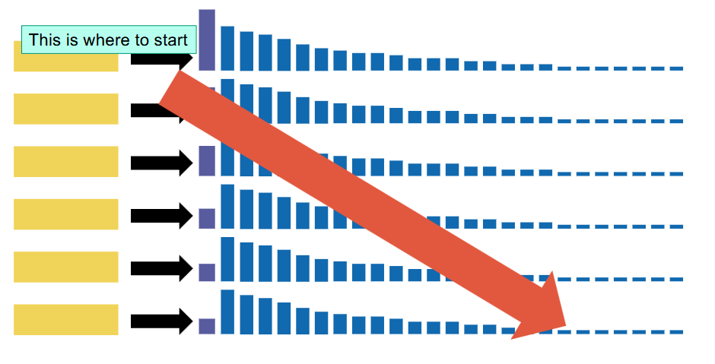
Inexact top-K Retrieval
Impact ordering
Create per-term Champion list
Sort terms by decreasing idf
Traverse term-at-a-time to collect top k documents
09.05.2025

Slide 16
Inexact top-K Retrieval
Impact ordering
Create per-term Champion list
Sort terms by decreasing idf
Traverse term-at-a-time to collect top k documents
What if we don’t have enough results?
09.05.2025

Slide 17
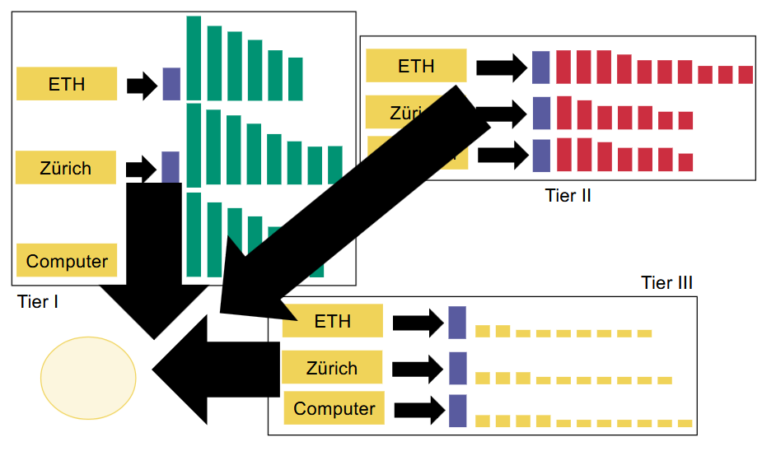
Inexact top-K Retrieval
Tiered indices
Create impact ordering
Union results from Tier I
If not enough results, union results from Tier II
If still not enough results, union results from Tier III
09.05.2025

Slide 18
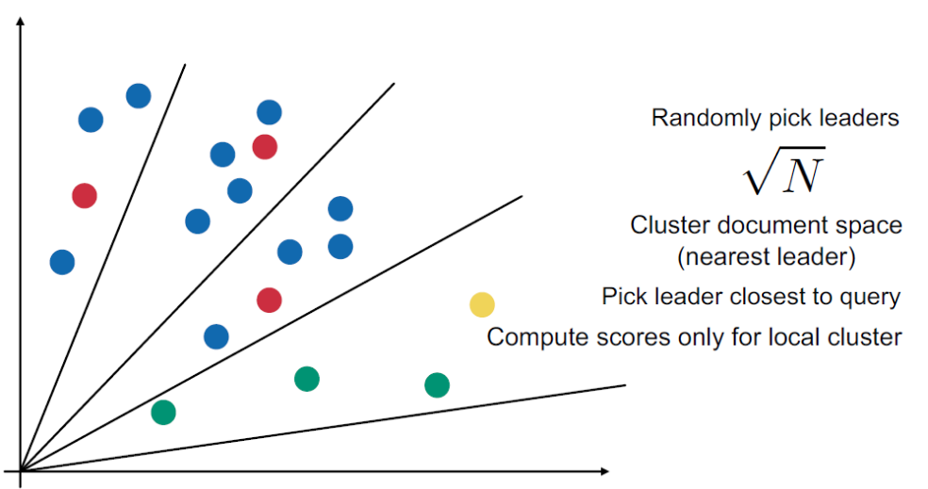
Inexact top-K Retrieval
Clustering
09.05.2025

Slide 19
Kahoot
https://create.kahoot.it/details/duplicate-of-information-retrieval-ex-08-champion-lists-vector-space-models-mschoeb/d450d0d9-513f-4387-8aca-15e8eaae63d9
09.05.2025

