Slide 1

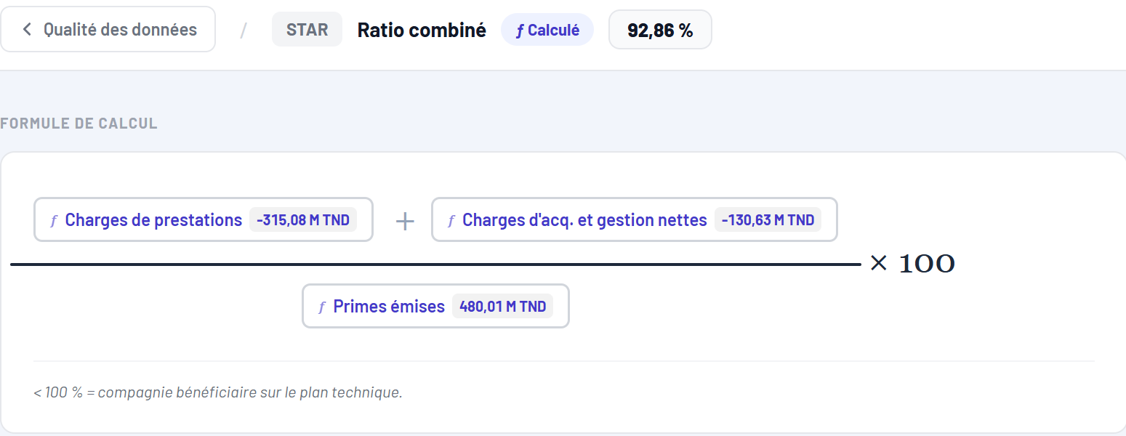
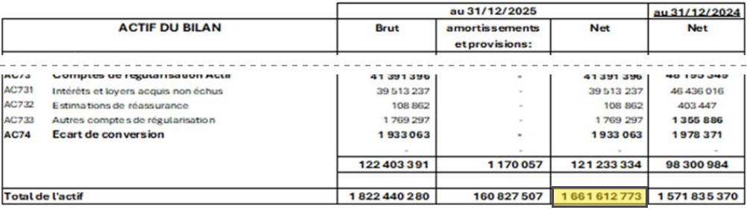
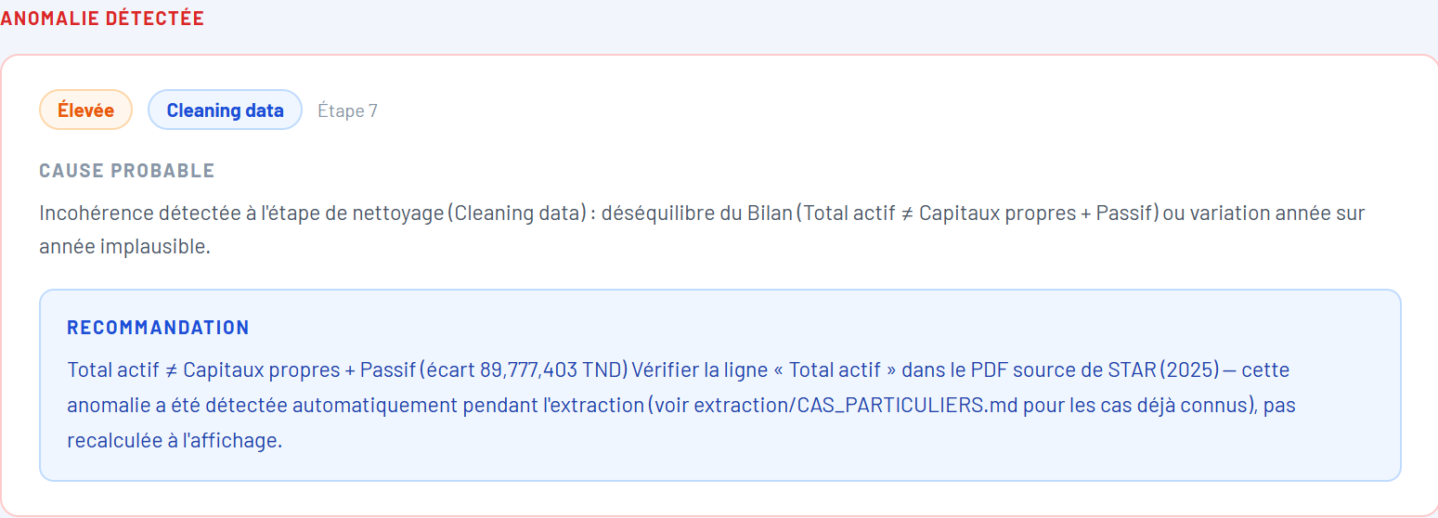
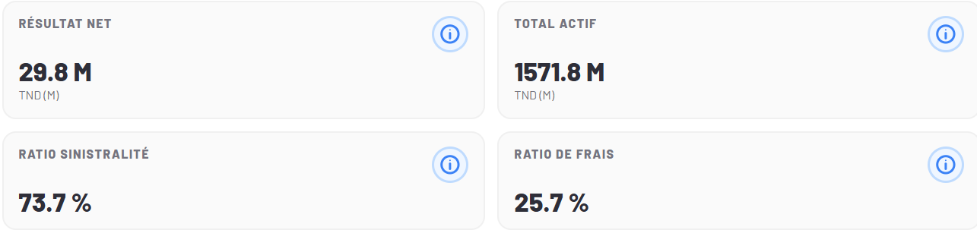
DATA PIPELINE & AI
The Data Pipeline in Five Steps
1
Collect
Get the reports
7 public sources + 1 internal
2
Extract
Read the tables
scanned pages: OCR
3
Model
Compute the KPIs
one definition per KPI
Data Understanding
Data Preparation
Modeling
The STAR report, as collected from the CMF
Page 2 of the report · the “Net” cell is read
Platform · Formule de calcul — Ratio combiné, STAR 2025
4
Validate
Check the numbers
anomalies are flagged
5
Deliver
Give access
dashboards · Excel · chatbot
EXAMPLE FOLLOWED END TO END
Evaluation
Deployment
STAR · 2025
Total actif
1 661 612 773 TND
Ratio combiné 92,86 %
Platform · anomaly detected on Total actif
Platform · Vue par assurance — STAR (2024)
2
Notes:
The data pipeline has five steps, and each one is mapped to a phase of the CRISP-DM methodology. To make it concrete, I follow one real figure through the five steps: the total assets, Total actif, of STAR for 2025, 1,661,612,773 dinars. One: Collect. We get the reports from seven public sources and one internal source; here is the STAR financial statements as published on the CMF website. Two: Extract. We read the tables of the report. The balance sheet on page 2 is a scanned page, so it is read with OCR, and the Net cell of the Total de l'actif row gives our figure; the column on its right, 1,571 million, is the previous year. Three: Model. The stored cells become KPIs, each with one single definition. Here is the formula of the Ratio combiné of STAR for 2025, 92.86 percent: the claims charges plus the acquisition and management charges, divided by the written premiums, and each component is a value taken from the reports. Four: Validate. The numbers are checked with accounting identities; here the platform flagged an anomaly on this very figure, because the total assets do not equal the equity plus the liabilities, with the probable cause and a recommendation to check the source PDF. That is exactly the role of the validation step. Five: Deliver. The verified KPIs are available in dashboards, an Excel export and a chatbot; the company profile of STAR is the dashboard view. The next slides detail each step.

