Slide 1

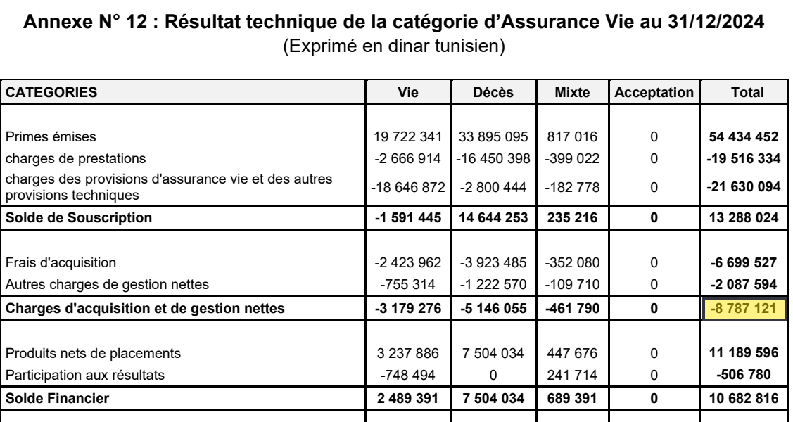
05
Data & AI
B. Pipeline stages
- Data pipeline -
COLLECT
EXTRACT
MODEL
VALIDATE
DELIVER
WHAT HAPPENS
One scraper per source; the CMF portal is automated (Selenium).
The company is selected, the annual reports are kept, duplicates are removed.
The result is the report itself: here, Annexe 12 of STAR 2024, on page 31.
THE DATA POINT · STAR · 2024 · ANNEXE 12
A cell of a table in the report
Annexe 12 · page 31 · −8 787 121
Annexe 12 of the STAR 2024 report (CMF), page 31 · the followed cell is highlighted
Notes:
Let me follow one real data point through the whole pipeline. We take the Annexe 12 of STAR for 2024, the technical account of the life insurance, and one cell of this table: the net acquisition and management charges, total column, minus 8,787,121 dinars. It starts here, at the collection step. A browser automation opens the CMF portal, selects the company and keeps only the annual reports; duplicates are removed, the link is checked, and the report is registered. What we collect is the report itself: on the right, the page 31 of the STAR 2024 report, with our cell highlighted. At this point, our data point is still a number inside a PDF.

Slide 2
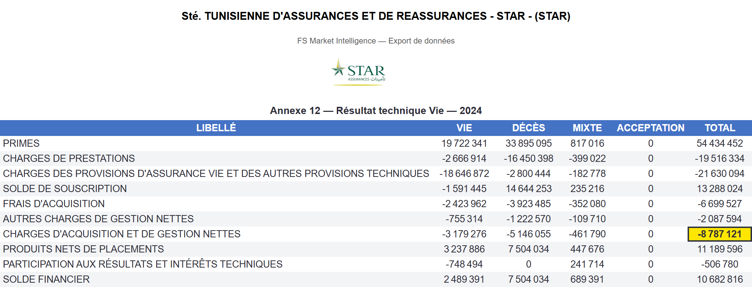
05
Data & AI
B. Pipeline stages
- Data pipeline -
COLLECT
EXTRACT
MODEL
VALIDATE
DELIVER
WHAT HAPPENS
The table is read from the PDF page (with OCR when the page is scanned).
Rows and columns are identified and named the same way for every company.
Each value is stored as a cell and can be exported to Excel.
THE DATA POINT · STAR · 2024 · ANNEXE 12
Charges d'acquisition et de gestion nettes
Excel export of the extracted table (Gestion des données → Générer l'Excel) · highlight added
Total = −8 787 121
Notes:
Second step: extraction. The table of the PDF is read, row by row and column by column, with an OCR when the page is scanned, and every label is normalized so that all companies share the same vocabulary. The result is stored as cells in the database and it can be exported to Excel: this is the real export generated by the platform for the Annexe 12 of STAR 2024. You can recognize the same table as in the PDF, and our data point, highlighted: minus 8,787,121 in the total column. The number is no longer a picture in a PDF, it is a structured value.

Slide 3
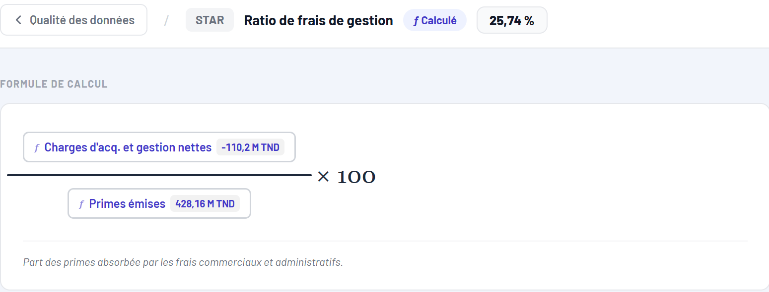
05
Data & AI
B. Pipeline stages
- Data pipeline -
COLLECT
EXTRACT
MODEL
VALIDATE
DELIVER
WHAT HAPPENS
KPIs are computed from the stored cells, with one formula each.
Our data point (−8,79 M for life) is a component of the Ratio de frais de gestion.
(−8,79 M Vie + −101,41 M Non-Vie) = −110,2 M ÷ Primes émises 428,16 M = 25,74 %.
THE DATA POINT · STAR · 2024 · ANNEXE 12
Component of the Ratio de frais de gestion
Platform · Formule de calcul — Ratio de frais de gestion, STAR 2024
→ 25,74 %
Notes:
Third step: modeling. The stored cells become KPIs, and each KPI has one single definition. Here is the formula of the expense ratio of STAR for 2024, shown by the platform: the net acquisition and management charges, minus 110.2 million, divided by the written premiums, 428.16 million, gives 25.74 percent. Our data point, minus 8.79 million, is the life part of the numerator; the non-life part, minus 101.41 million, comes from the Annexe 13. So our cell is now an ingredient of a KPI.

Slide 4
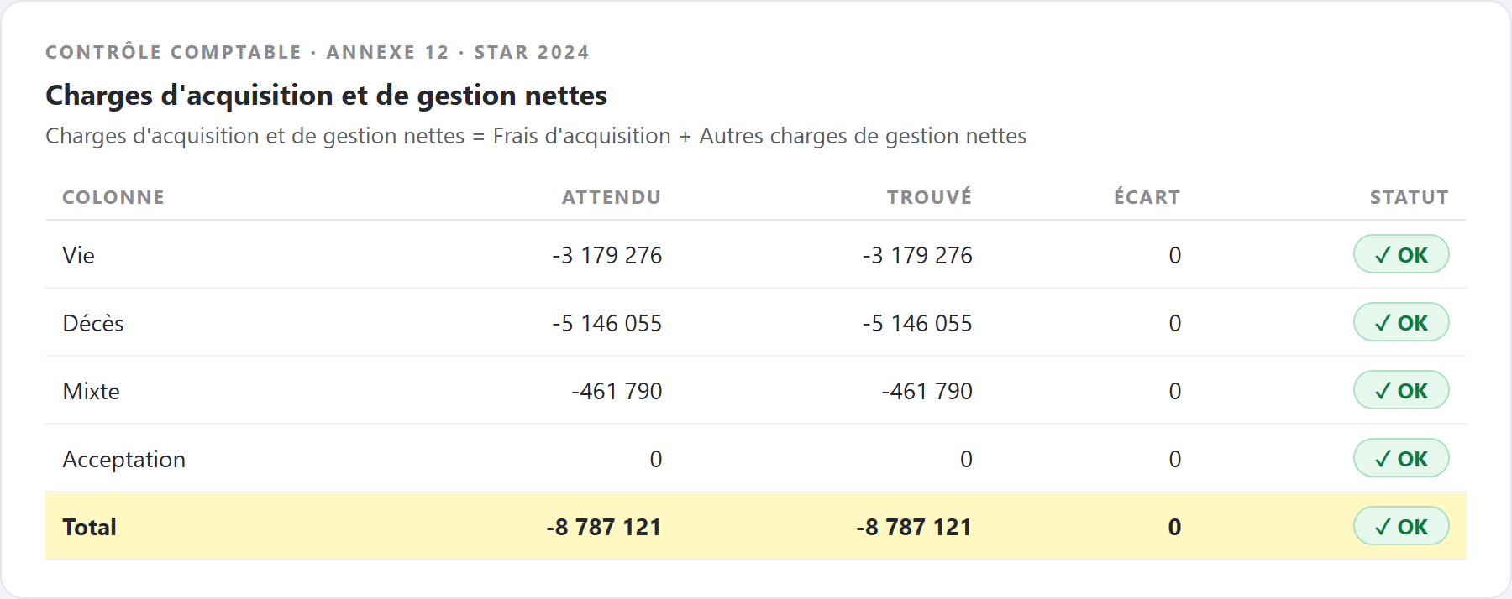
05
Data & AI
B. Pipeline stages
- Data pipeline -
COLLECT
EXTRACT
MODEL
VALIDATE
DELIVER
WHAT HAPPENS
Rule: Charges d'acquisition et de gestion nettes = Frais d'acquisition + Autres charges de gestion nettes.
Check: −6 699 527 + −2 087 594 = −8 787 121.
Result: gap of 0, status OK on all five columns.
THE DATA POINT · STAR · 2024 · ANNEXE 12
Checked by an accounting identity
Validation results stored by the pipeline (tableau_validations)
gap 0 → OK
Notes:
Fourth step: validation. The pipeline checks accounting identities on every table. For our data point, the rule is that the net acquisition and management charges must equal the acquisition costs plus the other management charges. Minus 6,699,527 plus minus 2,087,594 gives exactly minus 8,787,121: the gap is zero and the status is OK, in each of the five columns. If the numbers did not match, the platform would flag an anomaly with a probable cause, instead of silently accepting the value.

Slide 5
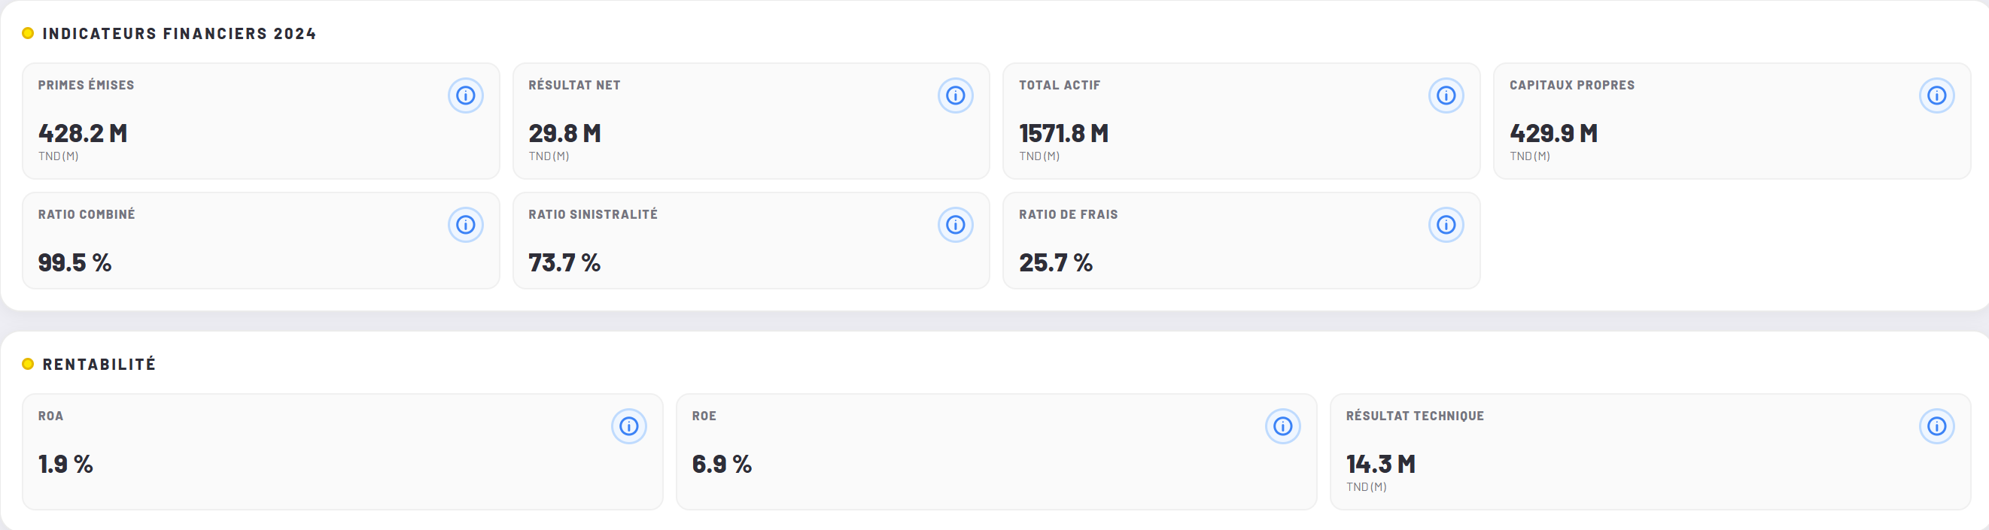
05
Data & AI
B. Pipeline stages
- Data pipeline -
COLLECT
EXTRACT
MODEL
VALIDATE
DELIVER
WHAT HAPPENS
Verified KPIs feed the dashboards, the Excel exports and the chatbot.
Consultants read each ratio in the company profile.
Here: the STAR profile, Indicateurs financiers 2024: Ratio de frais 25.7 %.
Platform · Vue par assurance — Indicateurs financiers 2024, STAR
THE DATA POINT · STAR · 2024 · ANNEXE 12
On screen: Ratio de frais 25.7 %
Primes émises 428.2 M
Notes:
Last step: delivery. The validated KPIs are available in the dashboards, in an Excel export and through the chatbot. Here is the STAR profile for 2024: the expense ratio, 25.7 percent, is the KPI we computed in the previous step, next to the premiums, 428.2 million, the combined ratio and the loss ratio. So we have followed one figure from a page of a PDF report to a screen that a consultant can use, through extraction, computation and validation.

