Slide 1

05
Data & AI
C. AI layer
- AI layer -
One question, three kinds of AI, one validated database
Generative AI
text-to-SQL · grounded explanations (LLM)
Question
Router
Answer
in natural language
KPI · company · year → intent
Predictive AI
with figures, method and sources
XGBoost vs Prophet · SHAP · OLS fallback
RAG
regulatory texts + CGA reports · sources cited
Validated KPI database · read-only SQL · numbers checked against facts · sources cited
Notes:
This is the AI layer of the platform, presented through the chatbot. A question in natural language first goes through a router that understands it. It is then sent to one of three engines: generative AI, which translates language into SQL and writes explanations; predictive AI, which forecasts KPIs by making XGBoost and Prophet compete; and RAG, which answers regulatory questions from documents. Every answer comes back with its figures, its method and its sources. Below, the common principle: everything rests on the validated database from the data pipeline, the SQL is read-only, the numbers of the explanations are checked, and the sources are cited. In the following slides, I go through each block with one real example.

Slide 2
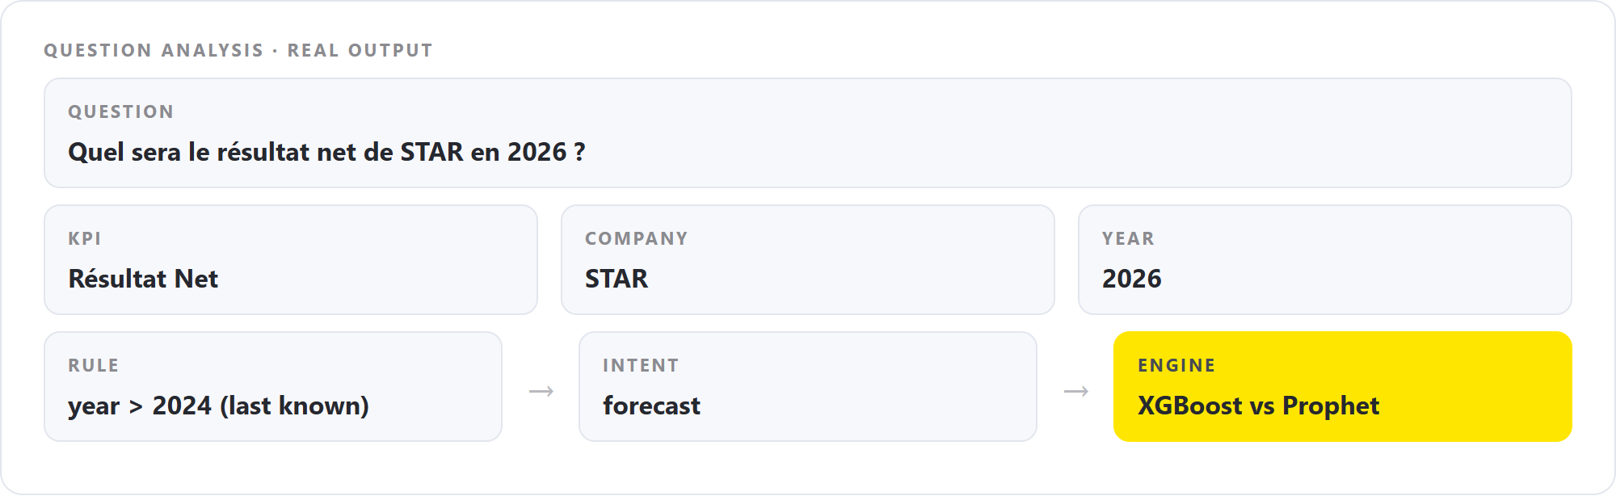
05
Data & AI
C. AI layer
- AI layer -
ROUTER
GENERATIVE
PREDICTIVE
RAG
GUARDRAILS
WHAT HAPPENS
The question is read: KPI, company and year are found by fuzzy matching, so typos are tolerated.
Rules turn these entities into an intent: forecast, ranking, evolution, regulatory, explanation…
The intent selects the engine; figures always come from the database, never from the model's memory.
Question analysis performed by the chatbot · real output for this question
THE QUESTION · STAR · 2026
Résultat Net · STAR · 2026
→ intent: forecast
Notes:
Before any AI model speaks, the chatbot has to understand the question. First, it extracts three things: the KPI, the company and the year, with fuzzy matching, so a typo or a variant of a name is still recognized. Then simple, transparent rules turn them into an intent. Here, the KPI is net result, the company is STAR, and the year, 2026, is after the last known year, so the intent is forecast. This is deliberate: routing is rule-based and predictable, and each intent goes to the engine that suits it. What matters for a BI audience is that the figures always come from the validated database, not from the memory of a language model.

Slide 3
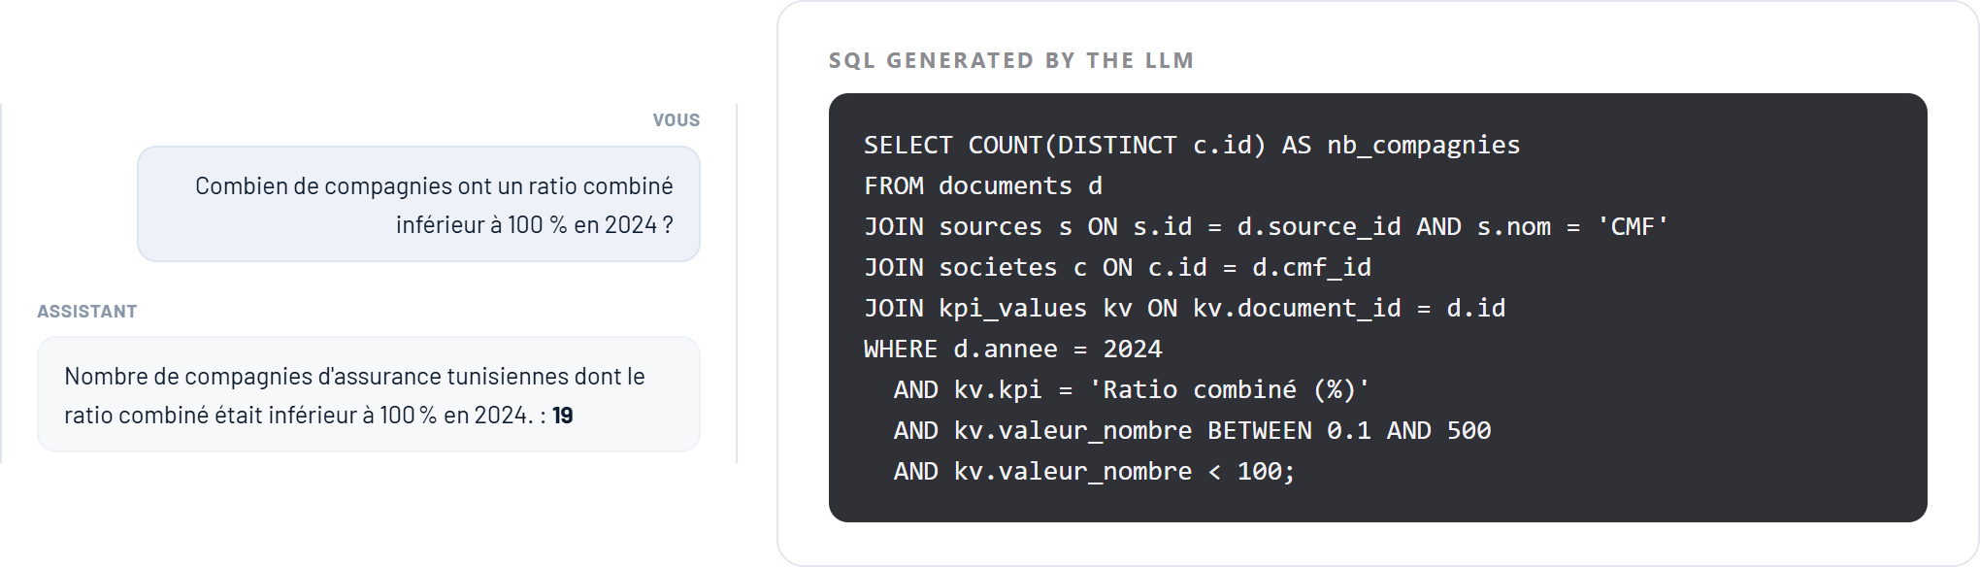
05
Data & AI
C. AI layer
- AI layer -
ROUTER
GENERATIVE
PREDICTIVE
RAG
GUARDRAILS
WHAT HAPPENS
The LLM receives the database schema and business rules, and returns a SQL query, not an answer.
Only SELECT statements are executed; anything else is rejected.
The figure comes from the database (19 companies); the LLM only writes the sentence.
Platform · chatbot answer (left) and the SQL query generated by the LLM (right)
THE QUESTION · COMBINED RATIO · 2024
Combined ratio below 100 %
SQL executed → 19
Notes:
This is the first generative use: text to SQL. For a question that is not covered by a predefined query, the language model, a large open model served by Groq, receives the schema of the database with a few business rules, for instance the units and the valid ranges, and it writes a SQL query. On the right you can see the real query for the question: how many companies have a combined ratio below 100 percent in 2024. The platform only executes SELECT statements, so the model can never modify data. The result, 19, is computed by the database, and the model only formulates the sentence. The generative model is used as a translator from language to query, not as a source of numbers.

Slide 4

05
Data & AI
C. AI layer
- AI layer -
ROUTER
GENERATIVE
PREDICTIVE
RAG
GUARDRAILS
WHAT HAPPENS
Facts are computed first: value, change vs the previous year, sector average, rank.
The LLM writes 2 to 4 sentences from these facts only.
Each number in the text is checked against the facts; if one is unknown, a fixed template replaces the text.
THE KPI · RÉSULTAT TECHNIQUE · STAR 2024
Explained from four facts
14,3 M TND · rank 7/17
Platform · KPI menu → Expliquer ce chiffre, answered by the chatbot
Notes:
The second generative use is the explanation of a figure. From the menu of a KPI, the consultant clicks Expliquer ce chiffre. The platform first computes the facts with SQL: the value, the change compared with last year, the sector average and the rank. The language model then writes two to four sentences using only these facts. And this is the important part: every number in the generated text is checked against the facts. If the model quotes a number that is not in the facts, the answer is rejected and replaced by a deterministic template. So the generative layer can phrase and contextualize, but it cannot invent. For the technical result of STAR, we get 14.3 million, up 212 percent versus 2023, but this increase starts from a negative base, so it should be read with care; the sector average is 16.4 million and STAR ranks 7 out of 17.

Slide 5
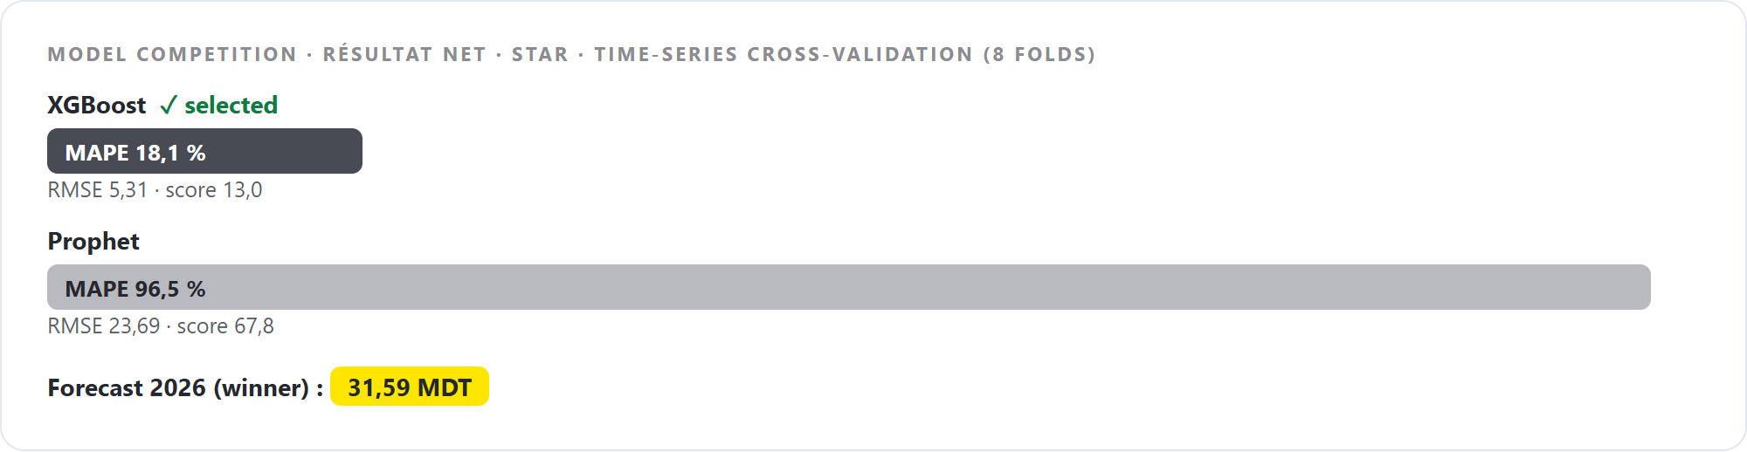
05
Data & AI
C. AI layer
- AI layer -
ROUTER
GENERATIVE
PREDICTIVE
RAG
GUARDRAILS
WHAT HAPPENS
Two models are trained on the KPI history: XGBoost and Prophet.
Each is tested on past years (time-series cross-validation, 8 folds) and scored on MAPE and RMSE.
The lowest score wins and produces the forecast.
Model comparison returned by the forecasting module · Résultat Net, STAR
THE FORECAST · RÉSULTAT NET · STAR
Best model selected automatically
XGBoost · MAPE 18,1 % vs 96,5 %
Notes:
The predictive part is not one model but a competition. For every question about the future, the platform trains two candidates on the history of the KPI: XGBoost, a gradient boosting model, and Prophet, a time-series model. It evaluates them on past years with a time-series cross-validation, always training on the past and testing on the following year, and computes the MAPE and the RMSE. The best score wins and is used for the forecast. For the net result of STAR, XGBoost has a MAPE of 18 percent against 96 percent for Prophet, so XGBoost is selected. The choice is data-driven and can differ from one KPI or one company to another. A limit to state honestly: we have about ten annual points per series, so the forecasts are indicative.

Slide 6
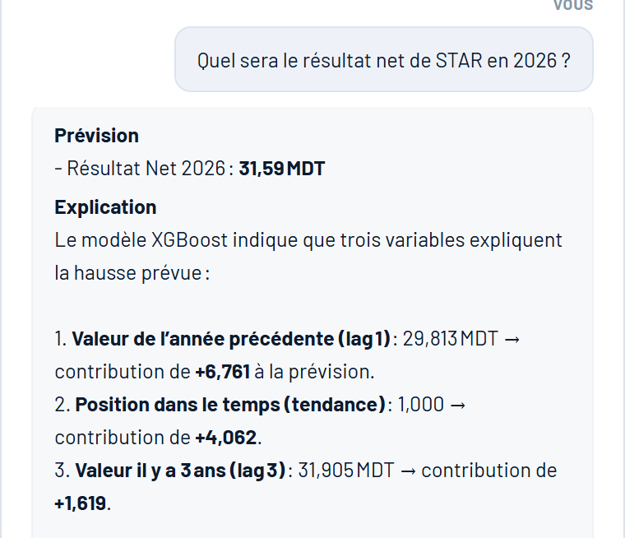
05
Data & AI
C. AI layer
- AI layer -
ROUTER
GENERATIVE
PREDICTIVE
RAG
GUARDRAILS
WHAT HAPPENS
Forecast for the net result of STAR in 2026: 31,59 MDT.
SHAP shows what pushed it up: last year's value (+6,761), time trend (+4,062), value 3 years ago (+1,619).
If the history is missing or too short, a linear regression (OLS) takes over.
THE FORECAST · STAR · 2026
Résultat Net · 2026
31,59 MDT
Platform · chatbot forecast with its explanation (SHAP)
Notes:
Once the winner is chosen, the platform produces the forecast and explains it. For STAR, the net result for 2026 is 31.59 million dinars. The explanation comes from SHAP, a method that measures the contribution of each input: the value of last year adds 6.7, the time trend adds 4.1, the value three years ago adds 1.6. The language model then rewrites this in a readable way, but the numbers come from the model. When a series does not exist or is too short, the module falls back to a simple linear regression, as for the market share of STAR in 2026, 8.5 percent, with a clear statement of the method and its limits. So an answer is always given, and its method is always stated.

Slide 7
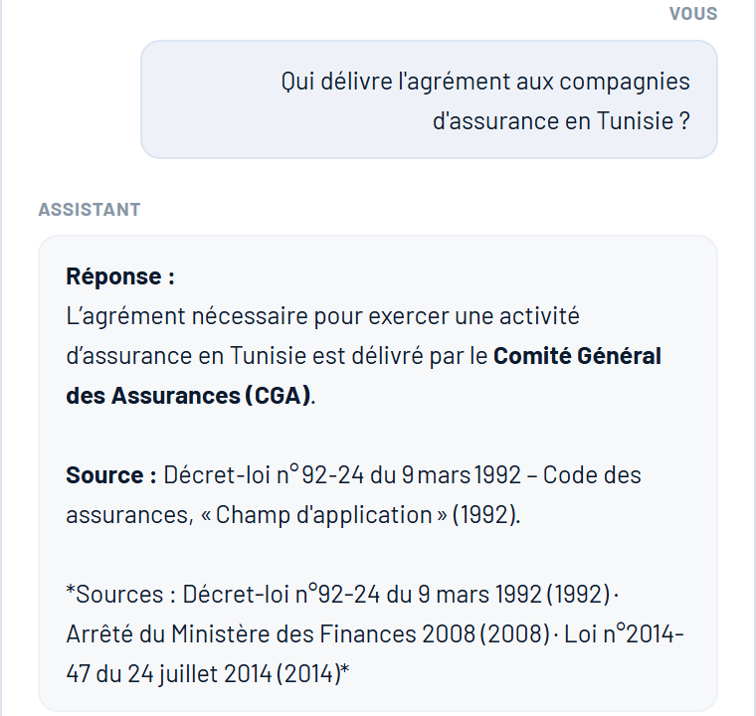
05
Data & AI
C. AI layer
- AI layer -
ROUTER
GENERATIVE
PREDICTIVE
RAG
GUARDRAILS
WHAT HAPPENS
Documents are split into passages: 11 regulatory texts and 106 extracts of CGA annual reports.
The 3 most relevant passages are retrieved (TF-IDF similarity).
The LLM answers only from them and cites its sources.
THE QUESTION · REGULATION
Who grants the licence?
CGA · Décret-loi 92-24
Platform · chatbot regulatory answer with its sources
Notes:
The third pillar is RAG, retrieval-augmented generation, for regulatory questions. The corpus contains eleven regulatory texts, such as the insurance code, CGA circulars or the Takaful law, and one hundred and six extracts automatically ingested from the annual reports of the CGA. When a question is regulatory, the three most relevant passages are retrieved with a TF-IDF similarity, and only these passages are given to the language model with the instruction to answer from them and to say so if the answer is not there. The answer cites its sources: here, the CGA grants the licence, according to the Décret-loi 92-24 of 1992. We chose TF-IDF because it is transparent and needs no additional service; embeddings are a natural evolution if the corpus grows.

Slide 8
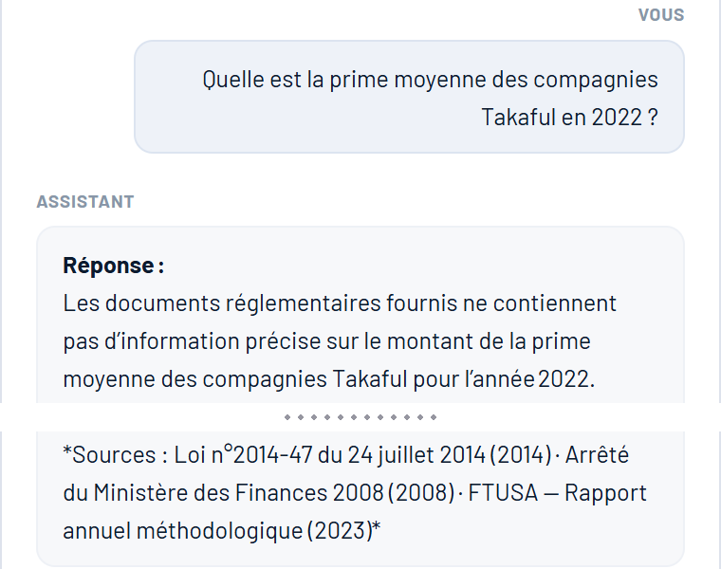
05
Data & AI
C. AI layer
- AI layer -
ROUTER
GENERATIVE
PREDICTIVE
RAG
GUARDRAILS
WHAT HAPPENS
Not in the documents? The assistant says so instead of inventing an answer.
SQL is read-only and numbers in explanations are verified against facts.
If the LLM is unavailable, database answers and fixed templates still work.
THE QUESTION · TAKAFUL · 2022
Answer not in the documents
Says so · cites its sources
Platform · chatbot answer when the documents do not contain the information
Notes:
To conclude, the guardrails, which are what makes these AI components usable in a consulting context. First, the assistant does not invent: asked for the average Takaful premium in 2022, which is not in the regulatory documents, it says so, explains what the documents contain and cites them. Second, the SQL generated by the model is read-only, and the numbers of an explanation are verified against the computed facts. Third, if the language model is not available, the platform still answers with deterministic templates and database figures. In short: the generative model formulates, the database and the predictive models compute, and the documents justify.

