Slide 1
DATA PIPELINE & AI
Seven Sources, One Pipeline
CMF
insurers' annual reports (PDF)
131
COLLECT
212
documents collected
5 report sources · 2 news feeds
INS
national statistics
27
BVMT
stock exchange: market data, ESG
26
FTUSA
insurance federation: sector reports
18
CGA
insurance regulator: sector reports
10
Atlas Magazine
press watch
news
ilBoursa
press watch
news
Documents per source, live database, September 2026.
1
Notes:
The pipeline starts from seven public sources. Five of them provide reports and statistics: the CMF with the annual reports of the insurers, 131 documents; the national statistics institute, 27; the Tunis stock exchange, 26; the insurers' federation, 18; and the insurance regulator, 10. Two more, Atlas Magazine and ilBoursa, feed the news watch. In total, 212 documents are collected and stored for the next stages.

Slide 2
DATA PIPELINE & AI
From Raw PDFs to Trusted KPIs
Collect
Extract
Model
Verify
Deliver
Data Understanding
Data Preparation
Modeling
Evaluation
Deployment
212
49,849
10,057
7,674
3
documents from
5 report sources
cells across
10 table types
KPI values
computed
accounting checks
+ anomaly audit
channels: dashboards,
Excel, chatbot
One figure, followed end to end
ASTREE · Total assets · 2025 = 881,075,424 TND — read on page 2 of a CMF report.
2
Notes:
The pipeline has five stages, mapped to the CRISP-DM phases of the methodology. Collect, extract, model, verify and deliver. The figures under each stage are real, from the live database: 212 documents, 49,849 extracted cells, 10,057 KPI values, 7,674 accounting checks, and three delivery channels. In the next slides I follow one single figure through the pipeline: the total assets of ASTREE for 2025.

Slide 3
DATA PIPELINE & AI
1 · Collect — Automated, Scheduled, Reliable
1
Open the portal
headless Chrome
2
Select the company
drop-down menu
3
Run the search
click on the button
4
Keep annual reports
filter and deduplicate
5
Verify and save
e.g. ASTREE 2025 → astree_efd311225.pdf
Real screenshot — Platform · Data Management
3
Notes:
Collection is automated, one scraper per source. For the CMF, a Selenium scraper opens the portal, selects each company, filters the annual reports, removes duplicates, checks the PDF link and saves the metadata. For example, ASTREE 2025 gives the file astree efd311225 dot pdf. On the right, the number of documents per source. And the Data Management page shows the result: all 131 expected CMF reports are collected, 100 percent.

Slide 4
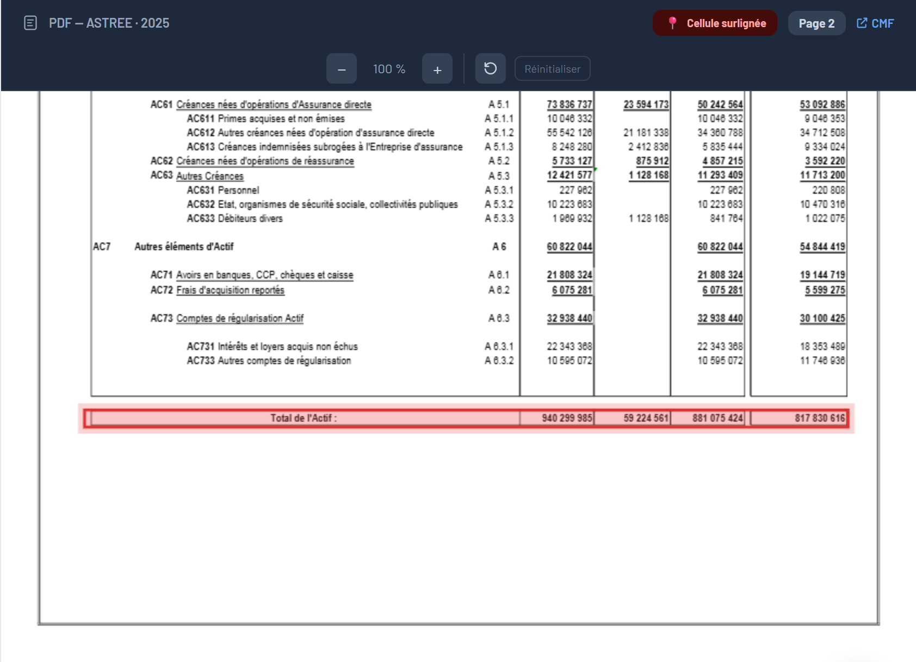
DATA PIPELINE & AI
2 · Extract — From a PDF Page to Cells
Stored as 4 cells
table bilan_actif · row “TOTAL — Total de l actif”
Column | Value (TND)
Brut | 940,299,985
Amortissements et provisions | 59,224,561
Net | 881,075,424
Net (N-1) | 817,830,616
pdfplumber reads the words
columns found by x-position
rows renamed to a canonical label
Real page — ASTREE 2025 · Balance sheet · p.2
Tesseract OCR for scanned / Arabic pages
4
Notes:
Extraction turns a PDF page into structured cells. On the left is the real page 2 of the ASTREE 2025 report. The extractor reads the words with pdfplumber, groups the numbers into columns by their horizontal position, and matches each row to a canonical name so that all companies share one vocabulary. On the right are the four cells stored for the total assets row. In total, 49,849 cells across ten table types. Scanned and Arabic pages go through Tesseract OCR.

Slide 5
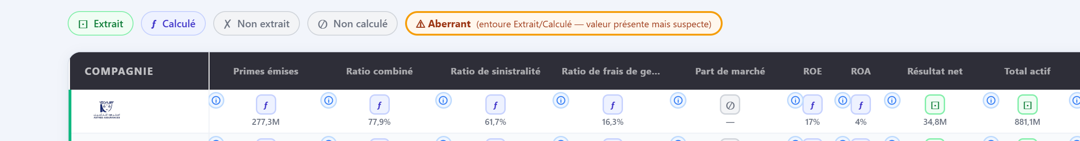
DATA PIPELINE & AI
3 · Model — KPIs from Stored Cells
Premiums written
Combined ratio
86,356,595 Life + 190,937,720 Non-Life
61.67 % loss ratio + 16.26 % expense ratio
= 277,294,315 TND
= 77.93 %
Real screenshot — Platform · Data Quality · ASTREE 2025 (first row)
5
Notes:
KPIs are computed from the stored cells, with one definition per KPI. For ASTREE 2025, premiums are 86.4 million for life plus 190.9 million for non-life, 277.3 million in total. The combined ratio, 77.9 percent, is the loss ratio, 61.7 percent, plus the expense ratio, 16.3 percent. Below, the real Data Quality page shows the same figures, and each value carries a status: extracted, calculated, not extracted, not calculated, or aberrant.

Slide 6
DATA PIPELINE & AI
4 · Verify — Accounting Identities as Checks
Passes within tolerance
Net acquisition & management charges = acquisition costs + other management charges
expected −8,187,565 · found −8,187,566 · gap −1 → OK
Catches an error
STAR · 2025 · Total assets ≠ Equity + Liabilities
gap of 89,777,403 TND → flagged for review
6
Notes:
Every extracted table is verified with accounting identities, for example net charges equal acquisition costs plus other management charges. There are 7,674 checks in the base. 4,202 pass, 55 percent. 979 show a gap, 13 percent, and 2,493 could not be run because a component is missing, 32 percent. On the right, a real check that passes within a one dinar rounding tolerance, and a real check that catches a gap of almost 90 million on the STAR balance sheet. The pipeline flags these cases instead of hiding them.

Slide 7
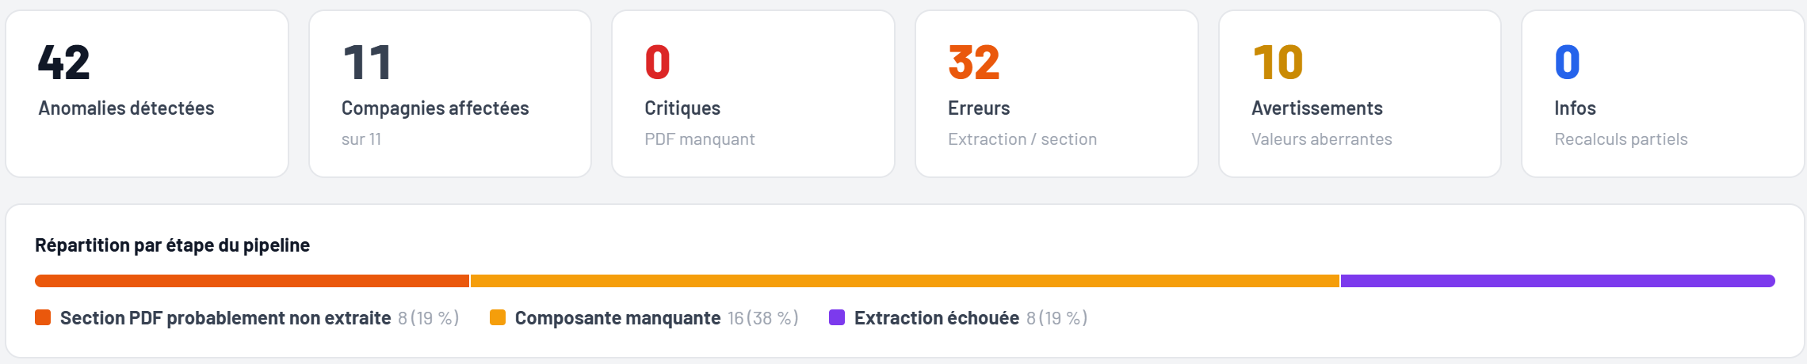
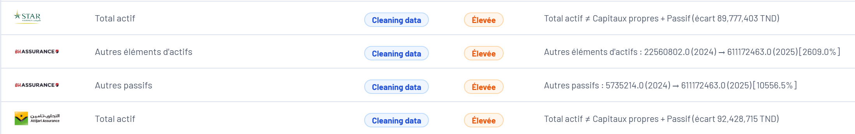
DATA PIPELINE & AI
4 · Verify — Flag Anomalies, Trace to the Source
Real screenshot — Platform · Pipeline Report · 2024
Real screenshot — Platform · System Anomalies · 2025
Real screenshot — one click: source PDF, cell highlighted
Real example — ASTREE · Total assets 2025 → Balance sheet, row “Total de l'actif”, column “Net”, page 2.
7
Notes:
Beyond the checks, the pipeline audits itself. For 2024 the anomaly report finds 42 anomalies across 11 companies, none critical, classified by the stage where they occur. The list shows real cases: balance sheets where total assets do not equal equity plus liabilities. And from any KPI, one click opens the source PDF at the right page with the cell highlighted. Here, the total assets of ASTREE, 881 million, are on page 2, in the Net column. This is what makes every number auditable.

Slide 8
DATA PIPELINE & AI
Conventional vs Takaful — One Pipeline, Two Models
Conventional · 21 insurers
33
6
one statement · standard ratios and formulas
Takaful ratios sourced
from IFSB references
new “Participants' Fund”
indicators
Takaful · 3 insurers
100%
90/90
two funds · combined 3-column balance sheet (NCT 43) · Wakala / Moudharaba fees
coverage on AT-Takafulia
(7 of 7 years)
existing tests still green
Real example — Zitouna Takaful 2024: premiums 34.9 M TND (family) and 91.2 M TND (general); Participants' Fund surplus 0.61 M and 1.11 M TND.
8
Notes:
Takaful insurers work on a different model, so the pipeline treats them separately. Conventional insurers, 21 of them, have one balance sheet and standard ratios. The three Takaful insurers have two funds, the Participants' Fund and the operator, a combined balance sheet on three columns following the Tunisian accounting standard NCT 43, and Wakala and Moudharaba fees. We documented 33 ratios from the IFSB references, extracted six new Participants' Fund indicators, and all 90 existing tests still pass. For example, for Zitouna Takaful in 2024, family premiums are 34.9 million dinars and general premiums 91.2 million.

Slide 9
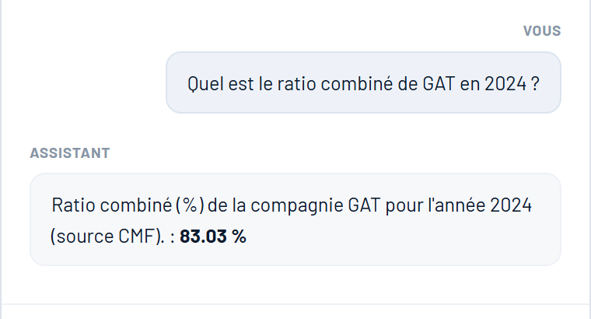
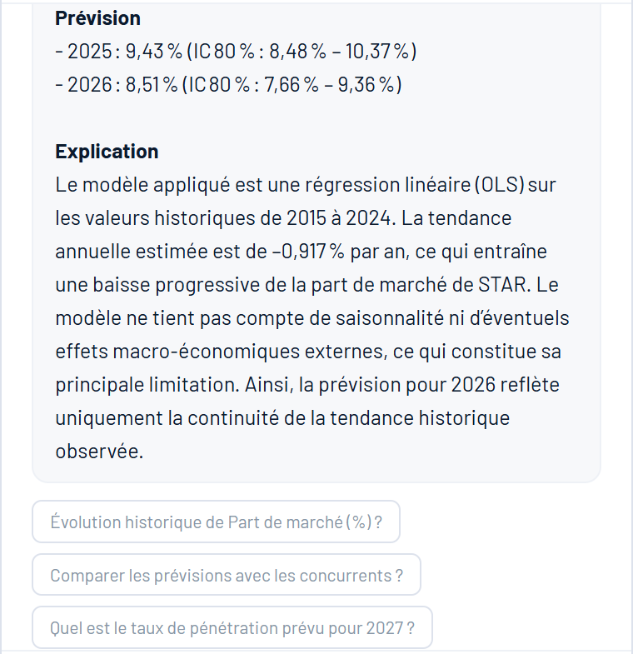
DATA PIPELINE & AI
AI — Three Capabilities on Trusted Data
Groq LLM · cloud API
Generate reports summarises the anomaly audit
2024: 42 anomalies across 11 companies, with causes and recommended checks.
Real answer — chatbot
Answer questions RAG on the platform data
SELECT-only queries: the chatbot reads the database, it never modifies it.
GAT · 2024 in the database
83.03 % ✓ same value
Real forecast — chatbot
Anticipate trends 80 % confidence interval
A forecast with a plain-language explanation. Today: linear trend (OLS).
Design rule — answers come from the verified database, not from the model's memory.
9
Notes:
The AI layer sits on top of the verified data and uses a Groq large language model. It does three things. It summarizes the anomaly audit: for 2024, 42 anomalies across 11 companies, with causes and recommended checks. It answers questions in natural language: on the right, a real answer of the chatbot, asked what the combined ratio of GAT was in 2024, it answers 83.03 percent, exactly the value stored in the database, and it is only allowed to run SELECT queries, so it never modifies data. And it anticipates trends: the second screenshot is a real forecast of the market share of STAR, 9.43 percent in 2025 and 8.51 percent in 2026, each with an 80 percent confidence interval and a plain-language explanation. Today this forecast uses a linear trend model; more advanced models are the next step. The rule stays the same: answers come from the database, not from the model's memory.

Slide 10
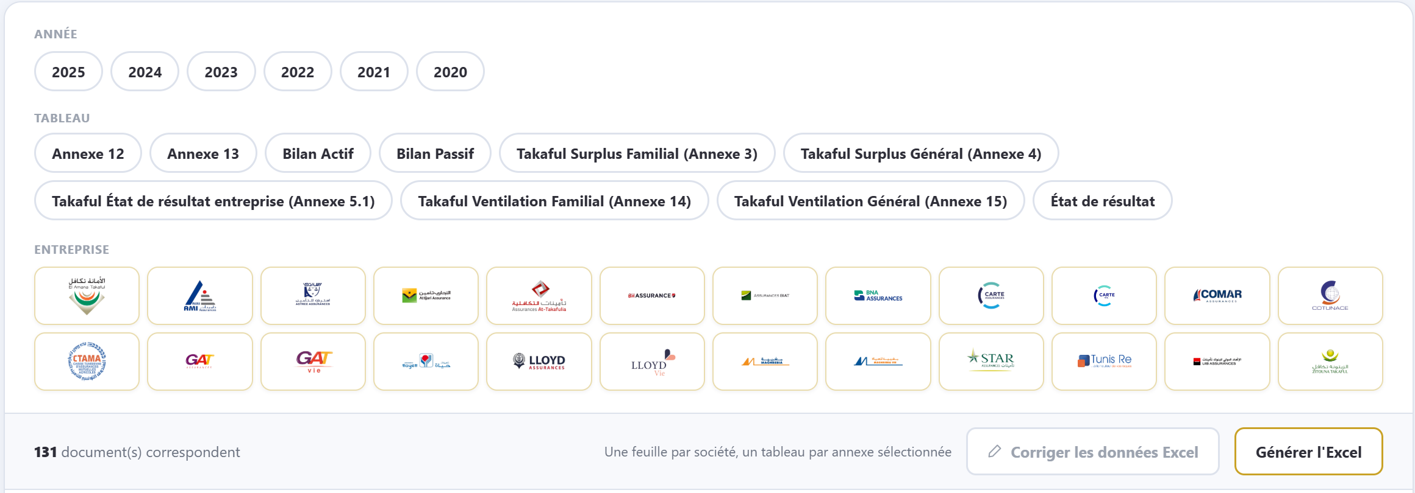
DATA PIPELINE & AI
5 · Deliver — Dashboards, Excel and Chatbot
Dashboards
interactive pages of the web platform
Excel export
one sheet per company, one table per annex
Chatbot
answers from the database (RAG)
Real screenshot — Platform · Data Management
10
Notes:
Finally the data is delivered three ways: dashboards on the web platform, an Excel export chosen by year, table and company, with one sheet per company and one table per annex, and the chatbot. Below is the real Data Management page: filters by year, table type and company, then one click to generate the Excel file.

Slide 11
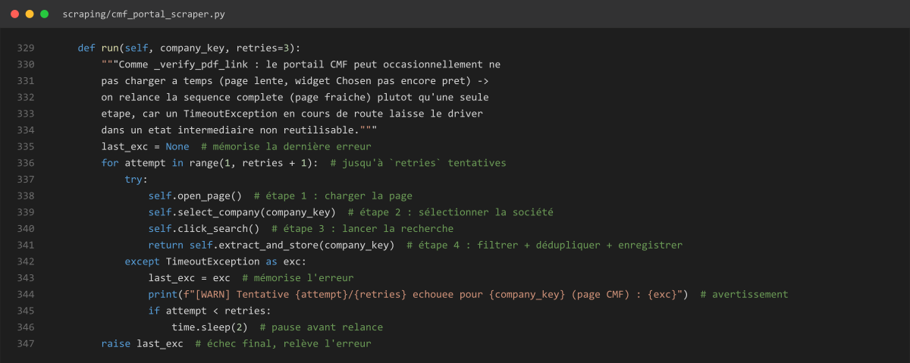
BACKUP · DATA PIPELINE
Backup — Collect: Robustness in the Code
3 attempts
per company on the CMF portal
3 attempts
per source, waiting 2 s, 4 s, 8 s
Isolated failures
one failing source never stops the others
Real code — scraping/cmf_portal_scraper.py
11
Notes:
If asked how the collection handles failures: the CMF portal is sometimes slow, so the whole sequence is retried up to three times, as in this real code. At the orchestrator level, each source also gets three attempts, waiting two, four and eight seconds, and one failing source never stops the others.

Slide 12
BACKUP · DATA PIPELINE
Backup — Orchestration: Runs on Its Own, Leaves a Trace
Scheduler starts the run
logs/pipeline.log · 2026-09-09
source_ok
CGA · attempt 1 · 2.7 s · 10 documents
Each source: up to 3 attempts
source_ok
INS · attempt 1 · 5.3 s · 38 documents
Quality check and anomaly audit
source_ok
BVMT · attempt 1 · 71.1 s · 47 documents
HTML run report + optional alert
kpi_extraction_ok
CMF · 4,530 KPI values · 216 documents
balance_check_failed
STAR · 2025 · gap 89,777,403
Watcher · every 30 minutes
news, regulatory texts, new documents
pipeline_end
failed_sources [] · 962.6 s
12
Notes:
The pipeline runs unattended. A scheduler starts the orchestrator, which runs each source with up to three attempts, then a quality check, and finally writes an HTML run report and can send an alert. In parallel a watcher thread checks every 30 minutes for news, regulatory texts and new documents. On the right are real log lines from a run on September 9: CGA, INS and BVMT succeed on the first attempt, and the KPI extraction saved 4,530 values from 216 documents.

Slide 13
BACKUP · DATA PIPELINE
Backup — 10 Table Types, 49,849 Cells
Real case · 6 columns
ATTIJARI's balance sheet has 6 value columns instead of 4. Columns are now assigned by position when counts match.
Real case · Notes column
Takaful statements add a “Notes” column whose numbers polluted the values. It is now stripped before reading.
13
Notes:
In total the extractors have produced almost fifty thousand cells across ten table types. Two real cases show why this is hard: ATTIJARI's balance sheet has six value columns instead of four, and Takaful statements add a Notes column whose numbers polluted the values.

Slide 14
BACKUP · DATA PIPELINE
Backup — Store: Every Value Keeps Its Origin
tableau_validations
7,674
documents
tableau_cellules
212
49,849
annexe12 · charges d'acquisition
gap −1 · status ok
ASTREE_2025.pdf
source CMF · year 2025
document #62
bilan_actif
TOTAL — Total de l actif
column Net · 881,075,424
kpi_values
10,057
Bilan · Total actif
881,075,424
MySQL 8 — one source of truth: each value keeps its document, table, row and column.
14
Notes:
Everything is stored in MySQL in four linked tables. Documents, 212 of them, point to their cells, 49,849. Validations, 7,674, and KPI values, 10,057, are both derived from the cells. Each box shows the real ASTREE row. Because every value keeps its document, table, row and column, any figure can be traced back to the PDF.

