Slide 1
DATA PIPELINE
From Raw PDFs to Trusted KPIs — The Pipeline
Collect
Extract
Validate
Store
Compute
Deliver
212
49,849
7,674
24
10,057
3
documents from
5 report sources
cells across
10 table types
accounting checks
companies in
one MySQL base
KPI values
channels: dashboards,
Excel, chatbot
One figure, followed end to end
ASTREE · Total assets · 2025 = 881,075,424 TND — read on page 2 of a CMF report.
Figures from the live database, September 2026.
1
Notes:
The data pipeline has six stages: collect, extract, validate, store, compute the KPIs, and deliver. The figures under each stage are real, taken from the live database. 212 documents were collected from five report sources. 49,849 cells were extracted across ten table types. 7,674 accounting checks were run. Everything sits in MySQL for 24 companies, and 10,057 KPI values are computed. In the next slides I follow one single figure through all six stages: the total assets of ASTREE for 2025.

Slide 2
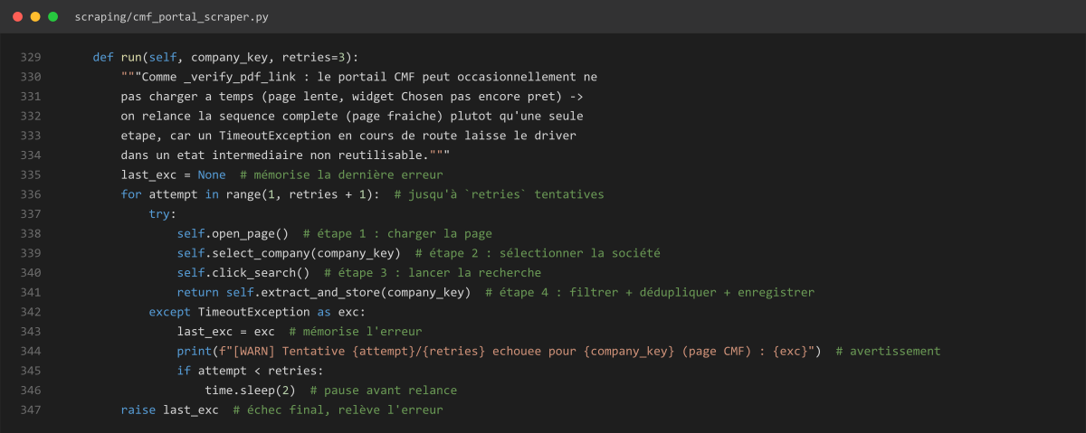
DATA PIPELINE
1 · Collect — One Scraper per Source
1
Open the portal
headless Chrome
2
Select the company
drop-down menu
3
Run the search
click on the button
4
Keep annual reports
filter and deduplicate
Verify and save
PDF link, then metadata
Real code — scraping/cmf_portal_scraper.py: up to 3 attempts per company
5
Real example — ASTREE · 2025 → astree_efd311225.pdf on cmf.tn, saved on 2026-09-16 as document #62.
2
Notes:
Collection starts with one automated scraper per source. Here is the CMF one, built with Selenium. It opens the portal in an invisible browser, selects the company, runs the search, keeps only the annual reports, removes duplicates, checks that the PDF link really answers, and saves the metadata. The portal is sometimes slow, so the code retries the whole sequence up to three times, as you can see in the real code on the right. For example, ASTREE 2025 gives the file astree underscore efd311225 dot pdf, saved as document number 62.

Slide 3
DATA PIPELINE
Collect — Coverage and Reliability
Real screenshot — Platform · Data Management
3 attempts
per source, waiting 2 s, 4 s, 8 s
Isolated failures
one failing source never stops the others
Scheduled
runs unattended, results logged as JSON
3
Notes:
The Data Management page of the platform shows the result. All 131 CMF reports that were expected are collected, 100 percent. On the right, the number of documents per source. The orchestrator gives each source three attempts, waiting two, four and eight seconds between them, and a source that fails never stops the others. This is what makes the collection safe to run on a schedule.

Slide 4
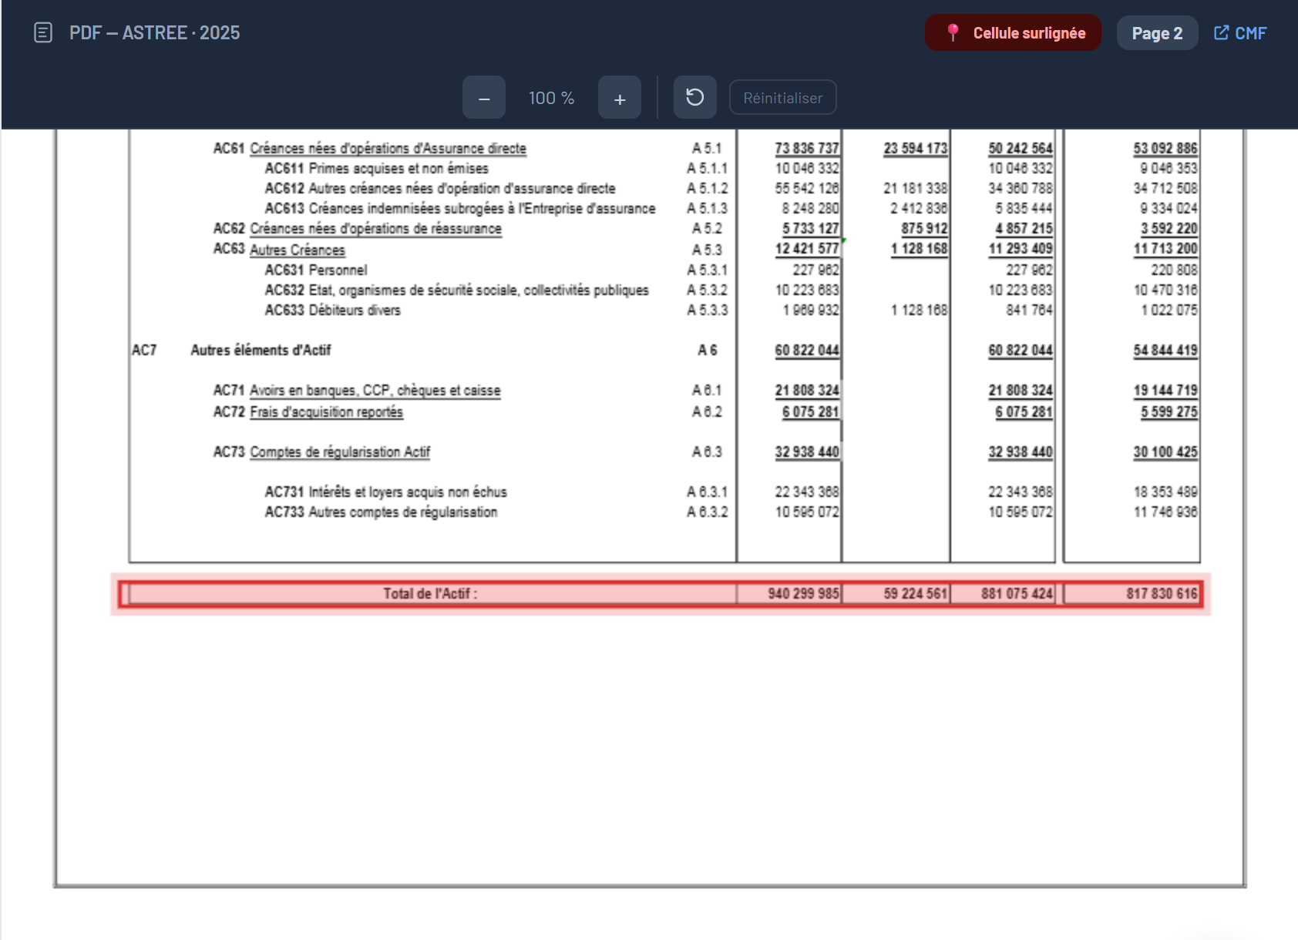
DATA PIPELINE
2 · Extract — From a PDF Page to Cells
Stored as 4 cells
table bilan_actif · row “TOTAL — Total de l actif”
Column | Value (TND)
Brut | 940,299,985
Amortissements et provisions | 59,224,561
Net | 881,075,424
Net (N-1) | 817,830,616
pdfplumber reads the words
columns found by x-position
rows renamed to a canonical label
Real page — ASTREE 2025 · Balance sheet · p.2
Tesseract OCR for scanned / Arabic pages
4
Notes:
Extraction turns a PDF page into structured cells. On the left is the real page 2 of the ASTREE 2025 report, the balance sheet. The extractor reads the words with pdfplumber, groups the numbers into columns by their horizontal position, and matches each row to a canonical name so that all companies share one vocabulary. On the right are the four cells stored for the total assets row: gross 940 million, depreciation 59 million, net 881 million, and last year's net 817 million. Scanned and Arabic pages go through Tesseract OCR instead.

Slide 5
DATA PIPELINE
Extract — 10 Table Types, 49,849 Cells
Real case · 6 columns
ATTIJARI's balance sheet has 6 value columns instead of 4. Columns are now assigned by position when counts match.
Real case · Notes column
Takaful statements add a “Notes” column whose numbers polluted the values. It is now stripped before reading.
5
Notes:
In total the extractors have produced almost fifty thousand cells across ten table types: balance sheet assets and liabilities, annexes 12 and 13 for the technical accounts, the income statement, and five Takaful tables. Two real cases show why this is hard. ATTIJARI's balance sheet has six value columns instead of four, so the column assignment had to be fixed. And Takaful statements add a Notes column whose numbers polluted the values, so it is now stripped before reading.

Slide 6
DATA PIPELINE
3 · Validate — Accounting Identities as Checks
Passes within tolerance
Net acquisition & management charges = acquisition costs + other management charges
expected −8,187,565 · found −8,187,566 · gap −1 → OK
Catches an error
STAR · 2025 · Total assets ≠ Equity + Liabilities
gap of 89,777,403 TND → flagged for review
6
Notes:
Every extracted table is verified with accounting identities, for example net charges equal acquisition costs plus other management charges. There are 7,674 checks in the base. 4,202 pass, 55 percent. 979 show a gap, 13 percent, and 2,493 could not be run because a component is missing, 32 percent. On the right, a real check that passes within a one dinar rounding tolerance, and a real check that catches a gap of almost 90 million on the STAR balance sheet. The pipeline flags these cases instead of hiding them.

Slide 7
DATA PIPELINE
4 · Store — Every Value Keeps Its Origin
tableau_validations
7,674
documents
tableau_cellules
212
49,849
annexe12 · charges d'acquisition
gap −1 · status ok
ASTREE_2025.pdf
source CMF · year 2025
document #62
bilan_actif
TOTAL — Total de l actif
column Net · 881,075,424
kpi_values
10,057
Bilan · Total actif
881,075,424
MySQL 8 — one source of truth: each value keeps its document, table, row and column.
7
Notes:
Everything is stored in MySQL in four linked tables. Documents, 212 of them, point to their cells, 49,849. Validations, 7,674, and KPI values, 10,057, are both derived from the cells. Each box shows the real ASTREE row: the document, the total assets cell, the KPI, and one validation. Because every value keeps its document, table, row and column, any figure can be traced back to the PDF.

Slide 8
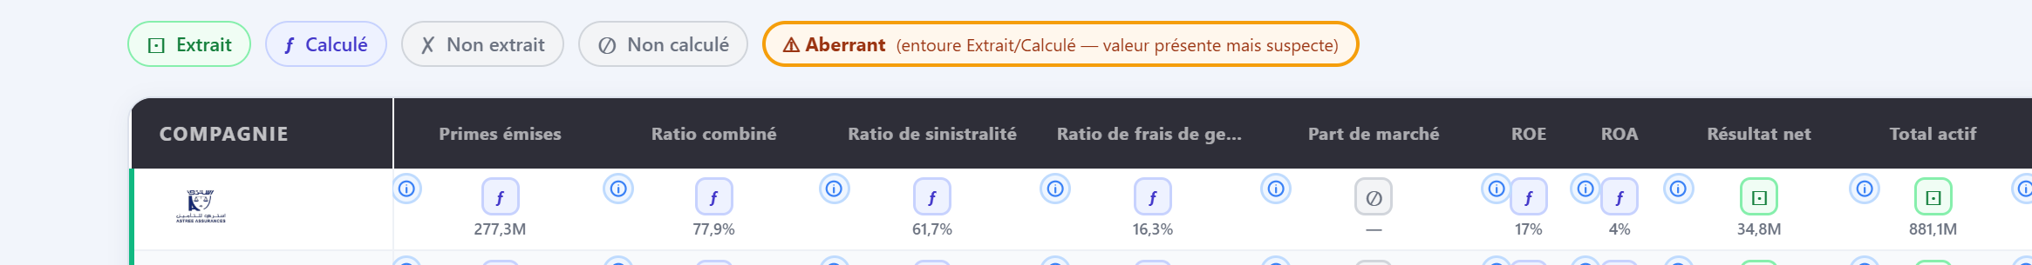
DATA PIPELINE
5 · Compute — KPIs from Stored Cells
Premiums written
Combined ratio
86,356,595 Life + 190,937,720 Non-Life
61.67 % loss ratio + 16.26 % expense ratio
= 277,294,315 TND
= 77.93 %
Real screenshot — Platform · Data Quality · ASTREE 2025 (first row)
8
Notes:
KPIs are computed from the stored cells, with one definition per KPI. For ASTREE 2025, premiums are 86.4 million for life plus 190.9 million for non-life, 277.3 million in total. The combined ratio, 77.9 percent, is the loss ratio, 61.7 percent, plus the expense ratio, 16.3 percent. Below, the real Data Quality page shows the same figures for ASTREE, and each value carries a status: extracted, calculated, not extracted, not calculated, or aberrant.

Slide 9
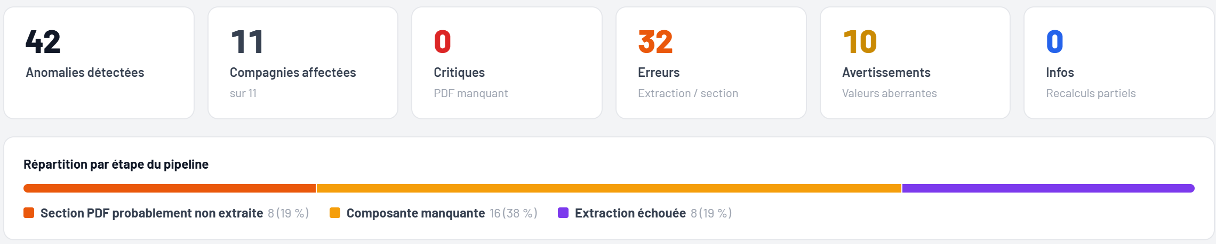
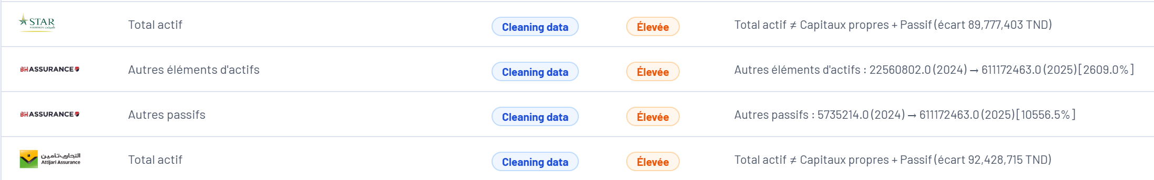
DATA PIPELINE
Quality — Anomalies Detected and Classified
3 classes of cause
PDF section not extracted · missing component · extraction failed
Real screenshot — Platform · Pipeline Report · 2024
Real screenshot — Platform · System Anomalies · 2025
9
Notes:
Beyond the checks, the pipeline audits itself. For 2024, the anomaly report finds 42 anomalies across 11 companies, none critical, and classifies them by the stage where they occur: PDF section probably not extracted, missing component, or extraction failed. Below, the anomaly list for 2025 shows real cases: balance sheets where total assets do not equal equity plus liabilities. Each anomaly points to its likely cause and links to the source PDF for review.

Slide 10
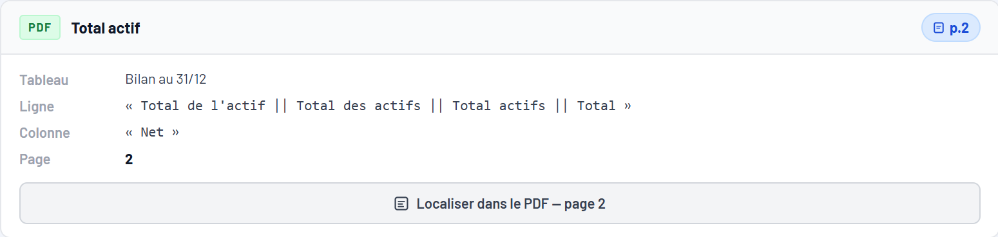
DATA PIPELINE
Every Number Links Back to Its PDF Cell
Real screenshot — Platform · KPI Detail
Table
Balance sheet at 31/12
Row
Total de l'actif
Column
Net
Page
2
Real screenshot — source PDF, cell highlighted
10
Notes:
The last guarantee is traceability. From any KPI, one click opens the source PDF at the right page with the cell highlighted. Here, ASTREE total assets 2025, 881.08 million dinars, is found on page 2, in the Net column of the Total de l'Actif row, and the row is highlighted in the PDF. The panel on the left shows the table, the row label, the column and the page that were used. This is what makes the numbers auditable by a consultant.

Slide 11
DATA PIPELINE
Orchestration — Runs on Its Own, Leaves a Trace
Scheduler starts the run
logs/pipeline.log · 2026-09-09
source_ok
CGA · attempt 1 · 2.7 s · 10 documents
Each source: up to 3 attempts
source_ok
INS · attempt 1 · 5.3 s · 38 documents
Quality check and anomaly audit
source_ok
BVMT · attempt 1 · 71.1 s · 47 documents
HTML run report + optional alert
kpi_extraction_ok
CMF · 4,530 KPI values · 216 documents
balance_check_failed
STAR · 2025 · gap 89,777,403
Watcher · every 30 minutes
news, regulatory texts, new documents
pipeline_end
failed_sources [] · 962.6 s
11
Notes:
The pipeline runs unattended. A scheduler starts the orchestrator, which runs each source with up to three attempts, then a quality check, and finally writes an HTML run report and can send an alert. In parallel, a watcher thread checks every 30 minutes for news, regulatory texts and new documents. On the right are real log lines from a run on September 9: the CGA, INS and BVMT sources succeed on the first attempt, and the KPI extraction saved 4,530 values from 216 documents.

Slide 12
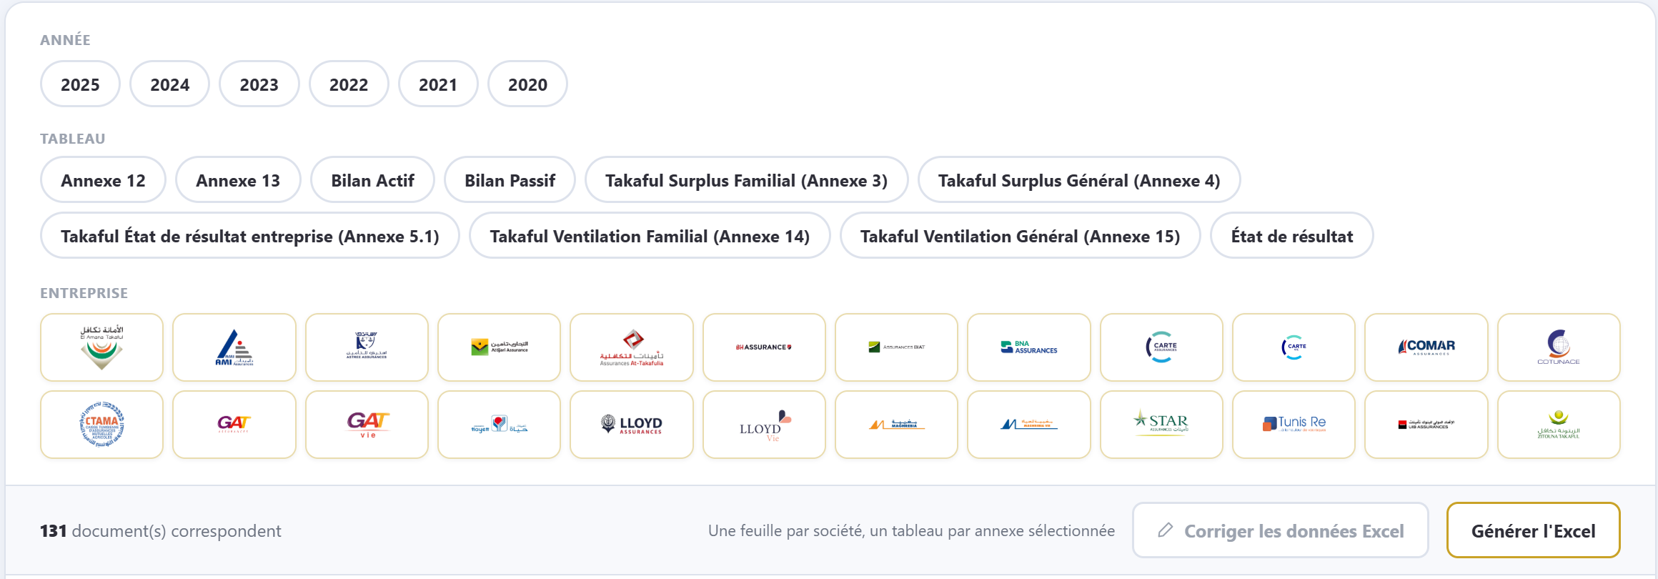
DATA PIPELINE
6 · Deliver — Dashboards, Excel and Chatbot
Dashboards
interactive pages of the web platform
Excel export
one sheet per company, one table per annex
Chatbot
answers from the database, with RAG
Real screenshot — Platform · Data Management
12
Notes:
Finally the data is delivered three ways. Dashboards, such as the Data Quality page you saw. An Excel export, chosen by year, table and company, with one sheet per company and one table per annex. And a chatbot that answers questions on the same data. Below is the real Data Management page: filters by year, table type and company, then one click to generate the Excel file.

Slide 13
DATA PIPELINE
Honest Limits and Next Steps
32 %
97.1 %
Arabic
of the 7,674 checks lack a source value
extraction reliability on Annex 13
the Arabic-only Takaful company is covered for its balance sheet only
flagged as missing, never guessed
68 of 70 documents
next: the other grids
Principle — when a value cannot be verified, the pipeline says so instead of guessing.
13
Notes:
To be transparent, here are the limits. 32 percent of the checks could not run because a component was missing; the pipeline flags them instead of guessing. The Annex 13 extraction reaches 97.1 percent, 68 out of 70 documents. And the Arabic-only Takaful company is only covered for its balance sheet. Next steps: extend Arabic coverage, and raise the share of checks that can run.

