Slide 1

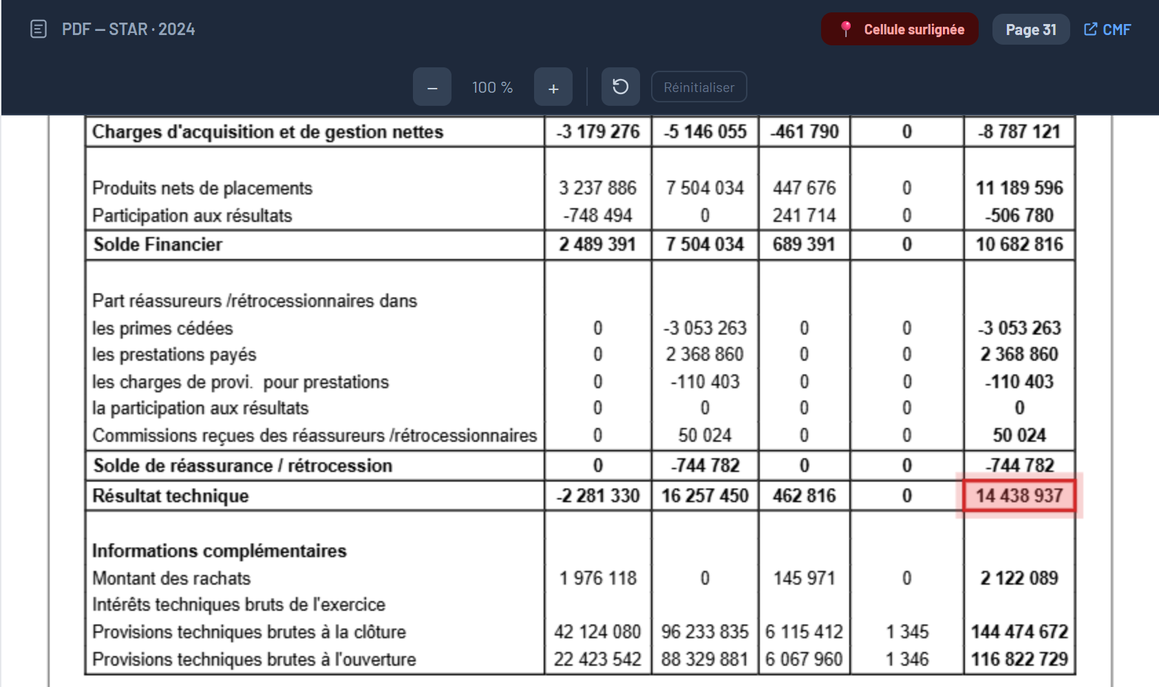
05
Data & AI
B. Pipeline stages (CRISP-DM)
- Data pipeline -
COLLECT
EXTRACT
MODEL
VALIDATE
DELIVER
WHAT HAPPENS
One scraper per source; the CMF portal is automated (Selenium).
The STAR 2024 annual report is kept, duplicates removed, the link registered.
Annexe 12 (life technical account) sits on page 31, Annexe 13 (non-life) on page 32.
THE KPI · RÉSULTAT TECHNIQUE · STAR 2024
Résultat technique Vie
Total = 14 438 937
Platform · Voir le document source — STAR 2024, page 31 of the CMF report · cell highlighted
Notes:
I follow one figure through the whole pipeline: the technical result of STAR for 2024, in dinars. It is a calculated KPI, not a number we can read directly: it is the life technical result plus the non-life technical result. It starts at collection: a browser automation opens the CMF portal, selects STAR, keeps the annual report and registers it. On screen, the platform shows the source document with the cell highlighted: Annexe 12, page 31, technical result of the life business, 14,438,937. The non-life part is on page 32, in Annexe 13. At this point, these are still numbers inside a PDF.

Slide 2
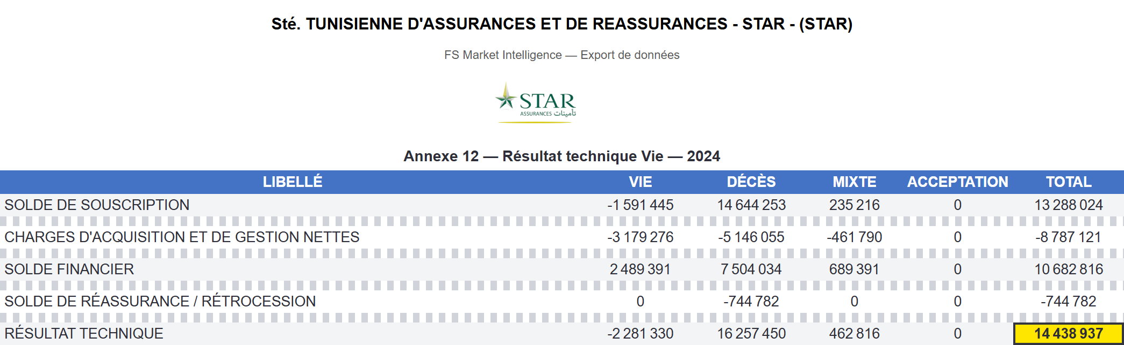
05
Data & AI
B. Pipeline stages (CRISP-DM)
- Data pipeline -
COLLECT
EXTRACT
MODEL
VALIDATE
DELIVER
WHAT HAPPENS
The table is read from the page (OCR when scanned); rows and columns get the same names for every company.
Values are cleaned: spaces removed, minus signs and brackets turned into negatives.
Each value becomes a stored cell: table, row, column, value.
THE KPI · RÉSULTAT TECHNIQUE · STAR 2024
Excel export of the extracted Annexe 12 (Gestion des données) · identity rows shown, other rows hidden
Résultat technique · Total
14 438 937
Notes:
Extraction. The table of page 31 is read row by row and column by column. Labels are matched to a canonical vocabulary, so a row is called the same way for all companies; the five columns are Vie, Décès, Mixte, Acceptation, Total. Values are cleaned: thousands separators removed, minus signs and brackets converted, isolated dashes read as zero. Each value is stored as a cell in the database. This is the real Excel export of Annexe 12: we show only the five rows that matter for our figure, and the technical result, total column, is 14,438,937, now a structured number.

Slide 3
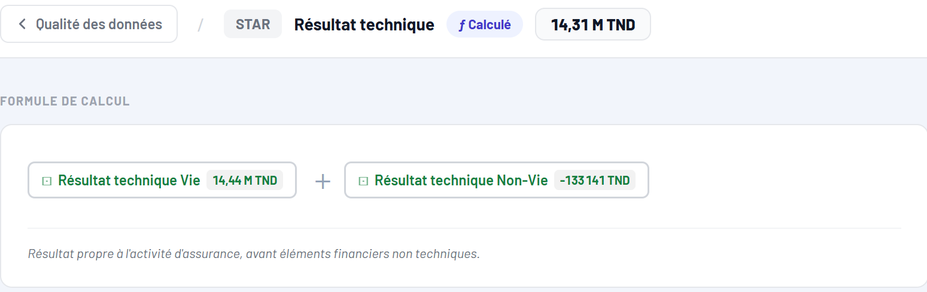
05
Data & AI
B. Pipeline stages (CRISP-DM)
- Data pipeline -
COLLECT
EXTRACT
MODEL
VALIDATE
DELIVER
WHAT HAPPENS
A KPI is one formula over stored cells; the formula is visible on the platform.
Résultat technique = Résultat technique Vie + Résultat technique Non-Vie.
14 438 937 (Annexe 12) + (−133 141) (Annexe 13) = 14 305 796 TND.
THE KPI · RÉSULTAT TECHNIQUE · STAR 2024
Platform · Formule de calcul — Résultat technique, STAR 2024
Résultat technique (TND)
14 305 796 = 14,31 M
Notes:
Modeling. The stored cells become KPIs, each with one definition. The technical result is the sum of two components: life, 14,438,937 from Annexe 12, and non-life, minus 133,141 from Annexe 13. The platform shows this formula and marks the KPI as calculated. The result is 14,305,796 dinars, 14.31 million. Our cell has become an ingredient of a KPI.

Slide 4
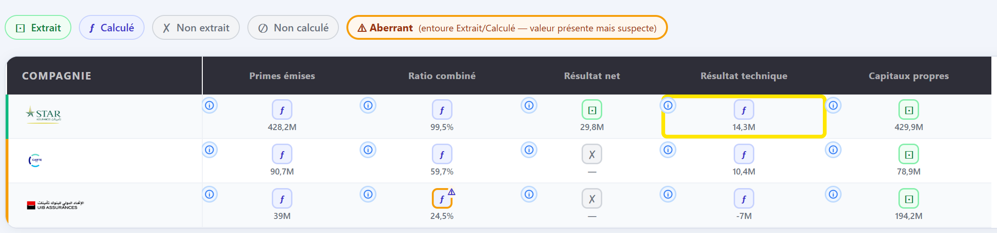
05
Data & AI
B. Pipeline stages (CRISP-DM)
- Data pipeline -
COLLECT
EXTRACT
MODEL
VALIDATE
DELIVER
WHAT HAPPENS
Rule: Résultat technique = Souscription + Charges + Financier + Réassurance.
Check (Total): 13 288 024 − 8 787 121 + 10 682 816 − 744 782 = 14 438 937.
Platform: every KPI gets a status; anything suspect is flagged (Aberrant, Non extrait).
Platform · Qualité Data 2024 — status of each KPI · columns and rows filtered · highlight added
THE KPI · RÉSULTAT TECHNIQUE · STAR 2024
Checked by an accounting identity
Gap 0 → no flag
Notes:
Validation. Before a value is used, the pipeline checks the accounting identity of the table: the technical result must equal the sum of the four balances above it. For the total column: 13,288,024, minus 8,787,121, plus 10,682,816, minus 744,782, gives exactly 14,438,937, gap zero (a one-dinar rounding on the Mixte column is tolerated). The result is visible on the platform, in the Qualité Data page: each KPI of each company has a status, extracted, calculated, not extracted, or aberrant, with an orange outline when the value is present but suspect. Our KPI, highlighted, is calculated and carries no flag, while other companies show a missing value or an aberrant ratio. So nothing is silently accepted.

Slide 5

05
Data & AI
B. Pipeline stages (CRISP-DM)
- Data pipeline -
COLLECT
EXTRACT
MODEL
VALIDATE
DELIVER
WHAT HAPPENS
Validated KPIs feed the company profiles, Excel exports and the chatbot.
From the KPI menu a consultant can open the source document or ask for an explanation.
Chatbot: 14.3 M TND, +212.4 % vs 2023, sector average 16.4 M, rank 7/17.
THE KPI · RÉSULTAT TECHNIQUE · STAR 2024
Résultat technique STAR 2024
14,3 M TND · rank 7/17
Platform · KPI menu → Expliquer ce chiffre, answered by the chatbot
Notes:
Delivery. The validated KPI reaches the consultant in the company profile, in the Excel exports and in the chatbot. From the menu of the KPI, the consultant can open the source document, with the highlighted cell we saw at the beginning, or ask the chatbot to explain the figure: here it gives 14.3 million dinars, an increase of 212 percent compared to 2023 because 2023 was negative, the sector average of 16.4 million, and the rank 7 out of 17. So the same figure is traceable from a PDF page to a decision-ready answer.

Slide 6
05
Data & AI
C. Normalisation & cleaning
- Normalisation · Names -
IN THE PDF (STAR · ANNEXE 12)
IN THE PLATFORM
ROW NAMES
“charges de prestations” (lower case)
Charges de prestations
“Participation aux résultats” (short name)
Participation aux résultats et intérêts techniques
“charges des provisions d'assurance vie et des autres” + “provisions techniques” (label on 2 lines)
Charges des provisions d'assurance vie et des autres provisions techniques
COLUMN NAMES
“Acceptatio” + “n” (header split on 2 lines, STAR 2025)
Acceptation · columns: Vie · Décès · Mixte · Acceptation · Total
METHOD
A canonical list of names per table + fuzzy matching (Python difflib). Every company and every year ends up with the same names, so figures can be compared.
Notes:
Now the normalization, on our fixed example, the Annexe 12 of STAR. Each company writes the same line in its own way. Look at three real cases from the report. The label charge de prestations is in lower case in the PDF. The line Participation aux résultats is shortened, while our canonical name is Participation aux résultats et intérêts techniques. And the line about the provisions is written on two lines in the PDF, so it is first merged. For the columns, it is the same: in the STAR 2025 report the header Acceptation is split in two lines, Acceptatio and n, and the header is recovered. The method is simple: for each table we keep a canonical list of names, and we match every extracted label to it with a fuzzy matching. The result is that all companies and all years share the same vocabulary, so the numbers are comparable and can be aggregated. What is not recognized stays visible, so that it can be corrected manually.

Slide 7
05
Data & AI
C. Normalisation & cleaning
- Normalisation · Values -
IN THE PDF (TEXT)
IN THE PLATFORM (NUMBER)
RULE
-8 787 121
-8 787 121
Spaces between thousands are removed (including non-breaking spaces)
(12 345)
-12 345
Brackets mean a negative amount (accounting notation)
− – —
-
All minus-sign variants become the same sign
- (alone)
empty
A lone dash means “nothing”, not a value
13,531,056.575
13 531 056,575
Both number formats are understood (comma or dot)
RESULT
Charges d'acquisition et de gestion nettes, STAR 2024, Total = -8 787 121: a real number that can be summed, compared and validated.
Notes:
After the names, the values. In a PDF a number is only text. Look at the real line of our example: minus 8 787 121 is written with spaces between the thousands. Before storing it, the pipeline applies a few rules. The spaces between thousands are removed, including the non-breaking spaces that some PDFs use. Brackets are read as a negative amount, which is the accounting notation. The different minus signs, the hyphen, the en dash, the em dash, are unified. A lone dash means nothing and is stored as empty, not as zero. And both number formats are understood, for example the American format with commas for thousands and a dot for decimals, that we met at COTUNACE. The result is a real number, here the net acquisition and management charges of STAR in 2024, minus 8,787,121, that can be summed, compared with other companies and validated. The first line and the last format come from real documents; the bracket and dash lines illustrate the rules.

Slide 8
05
Data & AI
C. Normalisation & cleaning
- Cleaning · Checks after extraction -
THE PROBLEM
A well-read number can still be wrong (misread digit, wrong column). The pipeline checks it before it is used.
1
Accounting identity
2
Year-over-year
3
Report, then correct
Résultat technique = the 4 balances: 13 288 024 − 8 787 121 + 10 682 816 − 744 782 = 14 438 937. Gap 0: OK.
Flag a fall of 95 % or more, a ×20 jump or a sign change vs last year. STAR premiums: 346,3 M → 428,2 M (+23,6 %): OK.
A flag never rewrites data: it goes to the anomaly report, and the analyst corrects manually (audited).
TOOLS
RESULT
Python rules
MySQL
Manual correction
Nothing is silently changed: errors are flagged, and every correction is traced.
Notes:
Cleaning: what happens after the extraction. A number that is well read can still be wrong, for instance a misread digit or a value put in the wrong column. So the pipeline checks it in three ways. First, the accounting identity of the table. For our example, the technical result must be equal to the sum of the four balances: 13,288,024, minus 8,787,121, plus 10,682,816, minus 744,782, gives exactly 14,438,937. The gap is zero, so it is validated. Second, a year-over-year plausibility check: a KPI that falls by 95 percent or more, is multiplied by twenty, or changes sign compared to the previous year is flagged, because it is more often an extraction error than a real evolution. For the premiums of STAR, from 346.3 to 428.2 million, that is plus 23.6 percent, so nothing is flagged. Third, a flag never rewrites the data: it is sent to the anomaly report, and the analyst can correct the value in the manual correction page, with an audit trail. So nothing is silently changed.

Slide 9
05
Data & AI
D. Exceptional cases
- Scanned PDFs -
THE PROBLEM
Some reports are pictures: the PDF has no text layer, so nothing can be read directly (e.g. AMI, COTUNACE).
1
Detect
2
Locate
3
Read
4
Rebuild
A page with almost no text characters switches to OCR mode.
Fast low-resolution OCR + fuzzy title match keep only the best pages.
340 dpi render, grid lines removed, Tesseract returns each word with its position.
Rows = OCR lines; columns from the x-position of the numbers.
TOOLS
RESULT
PyMuPDF
OpenCV
Tesseract (fra)
Fuzzy matching
Same table format as a normal PDF, so validation and KPIs run unchanged.
Example: AMI 2023 · Annexe 13 → 155 cells stored
Notes:
First exceptional case: scanned PDFs. Most reports have a text layer, so we can read the tables directly. But some companies, like AMI or COTUNACE, publish a scan: the page is only a picture. The pipeline detects it automatically, because such a page has almost no text characters, and it switches to OCR. Step two: it locates the right pages with a fast, low-resolution OCR and a fuzzy match on the title, so it does not process the whole document. Step three: the selected pages are rendered at 340 dpi, the grid lines of the table are removed with OpenCV, otherwise the OCR reads them as text, and Tesseract returns every word with its position. Step four: rows come from the OCR lines and columns from the horizontal position of the numbers. The output has exactly the same format as a normal table, so everything after that, validation and KPIs, does not change. For example, the Annexe 13 of AMI 2023 gives 155 stored cells.

Slide 10
05
Data & AI
D. Exceptional cases
- Arabic PDFs -
THE PROBLEM
El Amana Takaful publishes scanned reports in Arabic (right to left), and Arabic OCR misreads digits.
1
Find the row
2
Find the column
3
Crop the cell
4
Read the digits
Arabic OCR + fuzzy match on the expected Arabic label.
Same method on the column header.
Cut the exact cell out of the page image.
English OCR, digits only: Tunisian reports use Western digits.
TOOLS
RESULT
Tesseract (ara + eng)
RapidFuzz
Pillow
Arabic is used to find, English to read, and figures are cross-checked.
Example: Total actif 2024 = 38 089 744 TND
Notes:
Second exceptional case: Arabic PDFs, for El Amana Takaful. The reports are scanned, written right to left, and the Arabic OCR model is good at recognizing words but not reliable on digits: in our tests it read 38,089,744 as 35,089,4. So we split the job in two. First, we use the Arabic OCR only to find things: the row, by a fuzzy match on the expected Arabic label, for instance the label of the total assets, and the column, in the same way with its header. Then we crop this exact cell and read it again with the English model, restricted to digits, because Tunisian financial reports use Western digits even in Arabic. Arabic is used to find, English to read. And we cross-check the result: the total assets of 2024, 38,089,744 dinars, is also the N-1 column of the following year's report.

Slide 11
05
Data & AI
Data → AI
- From validated data to AI capabilities -
RECAP · HOW THE DATA GETS VALIDATED
Text layer usable?
PDF report
yes
Native extraction
text + table reading
no
Arabic scan?
Totals consistent?
yes
Arabic: find, then read
Arabic OCR finds the cell, English OCR reads digits
Normalise
names and values
yes
Store + compute KPIs
no
no
French OCR
340 dpi, grid lines removed
Flag anomaly
manual correction, audited
WHAT'S NEXT
Once a KPI is stored and validated, it becomes trustworthy enough to build on. From here, three AI capabilities consume this data — never the other way around: explaining a figure, forecasting it, and answering regulatory questions.
Notes:
Quick recap of the data journey we just went through, then a bridge to what comes next. A report comes in; if the text layer is usable, we read it directly; if not, it is a scan, and either Arabic OCR finds the cell for an English OCR to read, or a French OCR reads it after cleanup — the two special cases we just saw. Everything then joins: names and values are normalized, totals are checked, and either the KPI is stored and computed, or the anomaly is flagged for manual correction. This is where the data pipeline, governed by CRISP-DM, ends. What comes next is different in nature: three AI capabilities are built on top of this validated data — they consume it, they do not produce it. That is the architecture you saw earlier: the AI services call the already-validated database. Let's look at each of these three capabilities.

Slide 12
05
Data & AI
E. AI layer
- The chatbot and RAG -
Figures
database query (SQL, read-only)
Question
Router
Answer
in plain language
reads KPI, company, year
Future
with figures and sources
forecast: Prophet vs XGBoost
Regulation
RAG on legal documents
RAG IN 3 STEPS
1 Retrieve
2 Read
3 Answer
the 3 best passages among 11 legal texts and 106 CGA report extracts
the LLM receives only these passages
with cited sources, or says the answer is not in the documents
Notes:
Now the chatbot, in its simplest form. A question in plain language goes first to a router, which recognizes the KPI, the company and the year. Then there are three paths. For figures, the chatbot queries the KPI database with read-only SQL. For the future, it calls the forecasting module, where Prophet and XGBoost compete, which I detail next. And for regulation, it uses RAG, retrieval-augmented generation, which works in three steps. One, retrieve: the three most relevant passages are selected among eleven legal texts, such as the insurance code and CGA circulars, and one hundred and six extracts of the CGA annual reports. Two, read: the language model receives only these passages. Three, answer: it answers from them and cites its sources, or says clearly that the answer is not in the documents. So the model never answers from memory on regulation.

Slide 13
05
Data & AI
E. AI layer
- Generative AI · Anomaly report -
THE PROBLEM
Dozens of anomalies are detected each year (37 to 84); a consultant needs a short, reliable report, not a list.
1
Detect
2
Summarise
3
Write
4
Check
5
Assemble
Rules audit the extracted data and list the anomalies.
Counts, severity, most affected KPIs and a sample of real causes.
The LLM drafts summary, trends and 3 recommendations (300 words max).
Any number that is not in the facts: the text is rejected.
Narrative + computed tables; a fixed template if rejected.
TOOLS
RESULT
Groq · gpt-oss-120b
Python rules
Number check
The story is written by the LLM, but the tables are computed and every figure is verified: the report cannot invent numbers.
Notes:
First use of generative AI: the anomaly report. The pipeline detects anomalies with rules: a missing component, a suspicious variation, a gap with the sector. But a list of several dozen lines, 37 to 84 depending on the year, is not easy to use. So we first compute the facts: the number of anomalies, their severity, the most affected KPIs and a sample of the real causes. Then a language model, gpt-oss-120b served by Groq, writes a short report: an executive summary, the trends and three recommendations, in less than three hundred words, with the strict instruction to use only these facts. Then comes a check: every number in the text must exist in the facts, otherwise the text is rejected and replaced by a fixed template. Finally the tables are assembled, and they are computed directly, never rewritten by the model. The result is a readable report that cannot contain an invented figure.

Slide 14
05
Data & AI
E. AI layer
- Generative AI · Explain a figure -
THE PROBLEM
A consultant sees a number and asks: is it good? compared to what? An answer must be explained and never invented.
1
Ask
2
Compute the facts
3
Write
4
Check
In the KPI menu: “Expliquer ce chiffre”.
SQL gives value, change vs last year, sector average, rank.
The LLM writes 2 to 4 sentences from these facts only.
An unknown number: a fixed template replaces the text.
TOOLS
EXAMPLE
Groq · gpt-oss-120b
SQL
Number check
Résultat technique · STAR 2024: 14,3 M TND, +212 % vs 2023 (from a negative base), sector average 16,4 M, rank 7 of 17.
Notes:
Second use of generative AI: explaining a figure. In the menu of a KPI, the consultant clicks Expliquer ce chiffre. The platform first computes the facts with SQL: the value, the change compared to the previous year, the sector average and the rank. The language model then writes two to four sentences using only these facts, and a check verifies that every number in the text is one of the facts, otherwise a fixed template is used. For the technical result of STAR in 2024, the answer says 14.3 million dinars, an increase of 212 percent compared to 2023, but 2023 was negative, so the percentage must be read with care; the sector average is 16.4 million and STAR ranks seventh out of seventeen. The model phrases and puts the number in context, but it does not calculate or invent.

Slide 15
05
Data & AI
E. AI layer
- Predictive AI · Prophet vs XGBoost -
THE PROBLEM
Which model forecasts a KPI best? It depends on the KPI and the company, so the platform lets the models compete, every time.
1
Train
2
Test
3
Select
4
Explain
Prophet and XGBoost learn from the yearly history of the KPI.
Time-series cross-validation: train on the past, predict the next year.
Lowest error score (MAPE, RMSE) wins — no model is favoured in advance.
Forecast + explanation (SHAP or trend decomposition). If no history, linear regression.
RESULT
The winner is never fixed in the code: it is decided fresh for each KPI and each company, from real cross-validation scores. Next: two real, opposite outcomes.
Notes:
The predictive part, in the chatbot. We did not choose one model in advance: Prophet, a time-series model, and XGBoost, a gradient boosting model, compete for every question about the future. Step one, both are trained on the yearly history of the KPI. Step two, they are tested with a time-series cross-validation: always training on the past and predicting the following year, so the test is honest. Step three, the error scores, MAPE and RMSE, are compared and the best model is selected automatically — nothing is hard-coded, the winner can be either model. Step four, the forecast is produced and explained: SHAP for XGBoost, a trend and seasonality breakdown for Prophet. If there is no usable history, a simple linear regression takes over. To prove this is a real competition and not a fixed choice, here are two real cases, with opposite winners.

Slide 16
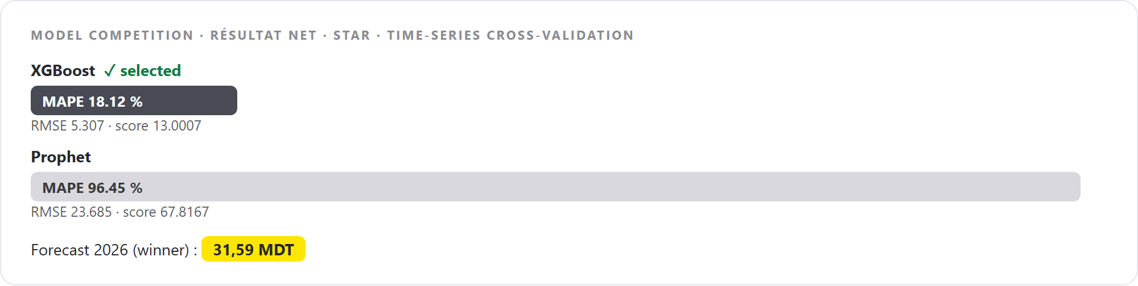
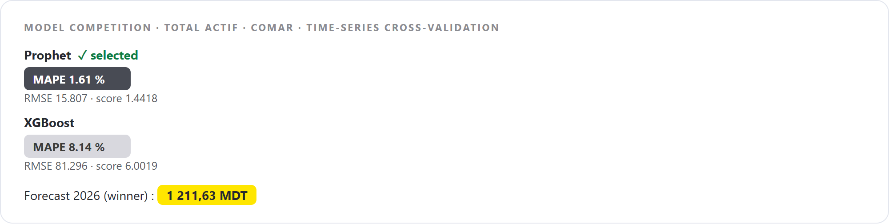
05
Data & AI
E. AI layer
- Predictive AI · Real evidence, both ways -
XGBoost wins · Résultat Net, STAR — sharp year-to-year swings, sign changes
Prophet wins · Total actif, COMAR — smooth, regular year-over-year growth
Both cards: rendered from the real ForecastService output (cross-validation scores), not a platform screenshot.
WHY IT FLIPS
XGBoost wins on volatile, irregular series (it learns from recent shocks). Prophet wins on smooth, trending series (it models the trend directly). Neither model is preferred by the code — the scores decide.
Notes:
Here is the proof that this is a real competition, not a fixed choice. On the left, the case we already saw: the net result of STAR, where the year-to-year values swing sharply and even change sign. XGBoost wins clearly, 18 percent error against 96 percent for Prophet, and forecasts 31.59 million dinars for 2026. On the right, a different KPI and a different company: the total assets of COMAR, which grow smoothly and regularly year after year. Here Prophet wins, 1.6 percent error against 8.1 percent for XGBoost, and forecasts 1,211.63 million dinars for 2026, explained by its trend and momentum, not by SHAP, because Prophet decomposes trend and seasonality rather than feature contributions. The pattern makes sense: XGBoost, built on lagged values, adapts well to irregular, shock-driven series; Prophet, built to model trend and seasonality, fits smooth, regular growth almost perfectly. Neither model is favoured in the code — only the cross-validation score decides, and these two real, opposite outcomes are the proof.

