Slide 1

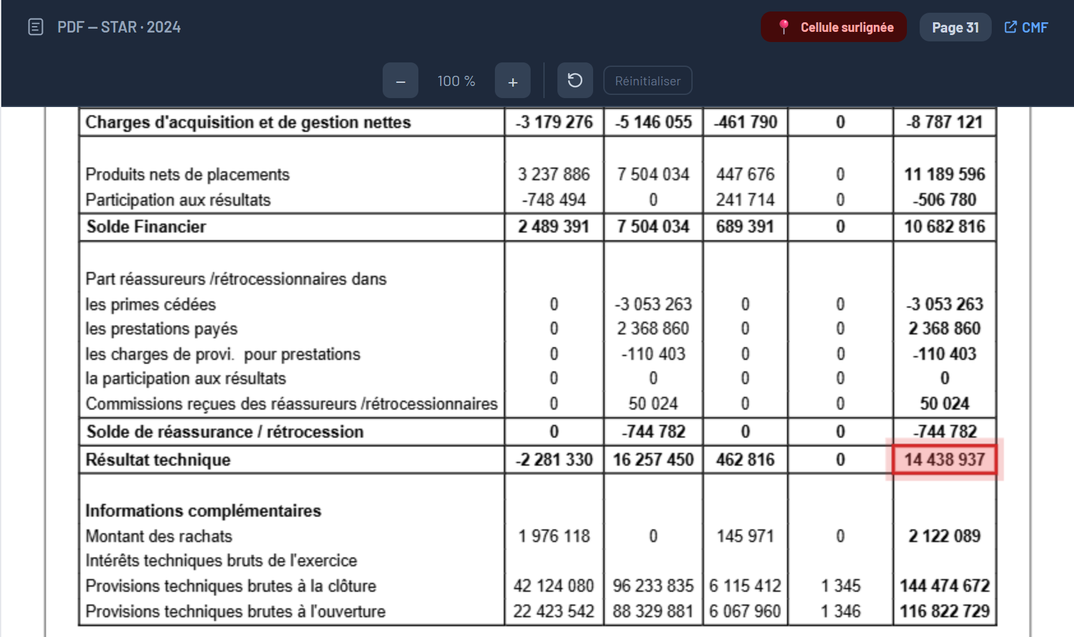
05
Data & AI
B. Pipeline stages
- Data pipeline -
COLLECT
EXTRACT
MODEL
VALIDATE
DELIVER
WHAT HAPPENS
One scraper per source; the CMF portal is automated (Selenium).
The STAR 2024 annual report is kept, duplicates removed, the link registered.
Annexe 12 (life technical account) sits on page 31, Annexe 13 (non-life) on page 32.
THE KPI · RÉSULTAT TECHNIQUE · STAR 2024
Résultat technique Vie
Total = 14 438 937
Platform · Voir le document source — STAR 2024, page 31 of the CMF report · cell highlighted
Notes:
I follow one figure through the whole pipeline: the technical result of STAR for 2024, in dinars. It is a calculated KPI, not a number we can read directly: it is the life technical result plus the non-life technical result. It starts at collection: a browser automation opens the CMF portal, selects STAR, keeps the annual report and registers it. On screen, the platform shows the source document with the cell highlighted: Annexe 12, page 31, technical result of the life business, 14,438,937. The non-life part is on page 32, in Annexe 13. At this point, these are still numbers inside a PDF.

Slide 2
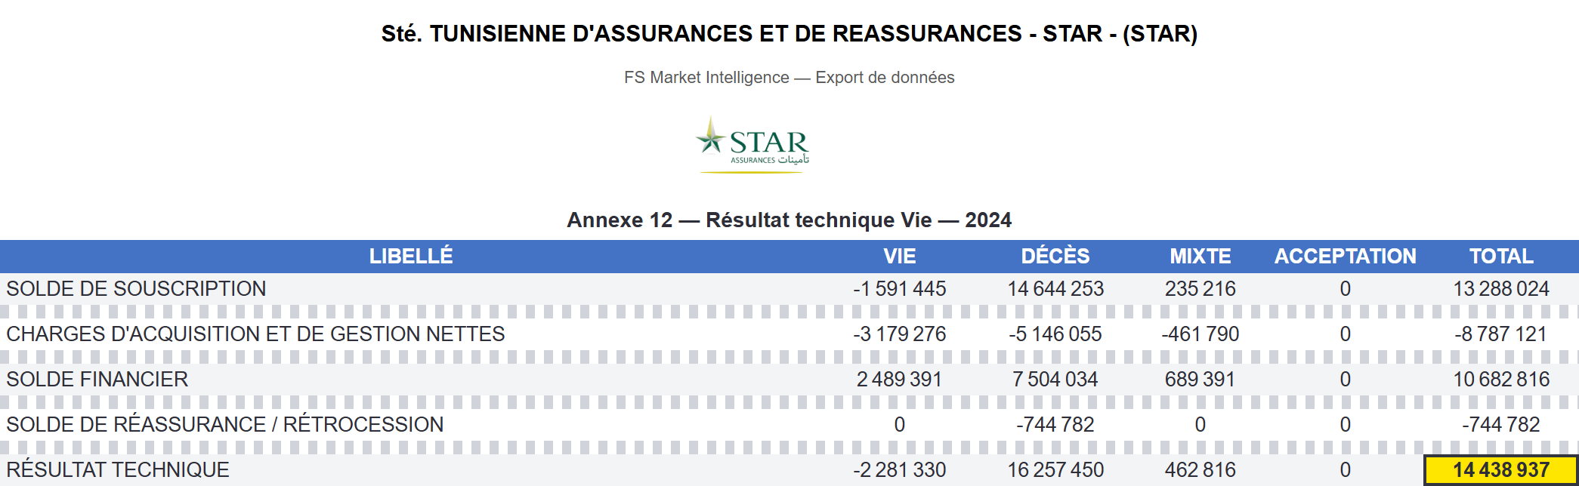
05
Data & AI
B. Pipeline stages
- Data pipeline -
COLLECT
EXTRACT
MODEL
VALIDATE
DELIVER
WHAT HAPPENS
The table is read from the page (OCR when scanned); rows and columns get the same names for every company.
Values are cleaned: spaces removed, minus signs and brackets turned into negatives.
Each value becomes a stored cell: table, row, column, value.
THE KPI · RÉSULTAT TECHNIQUE · STAR 2024
Excel export of the extracted Annexe 12 (Gestion des données) · identity rows shown, other rows hidden
Résultat technique · Total
14 438 937
Notes:
Extraction. The table of page 31 is read row by row and column by column. Labels are matched to a canonical vocabulary, so a row is called the same way for all companies; the five columns are Vie, Décès, Mixte, Acceptation, Total. Values are cleaned: thousands separators removed, minus signs and brackets converted, isolated dashes read as zero. Each value is stored as a cell in the database. This is the real Excel export of Annexe 12: we show only the five rows that matter for our figure, and the technical result, total column, is 14,438,937, now a structured number.

Slide 3
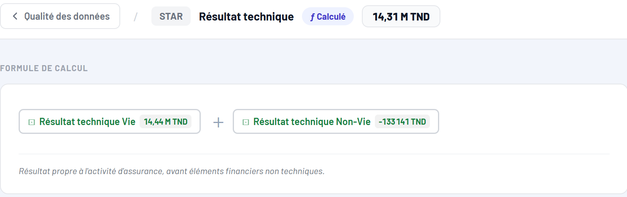
05
Data & AI
B. Pipeline stages
- Data pipeline -
COLLECT
EXTRACT
MODEL
VALIDATE
DELIVER
WHAT HAPPENS
A KPI is one formula over stored cells; the formula is visible on the platform.
Résultat technique = Résultat technique Vie + Résultat technique Non-Vie.
14 438 937 (Annexe 12) + (−133 141) (Annexe 13) = 14 305 796 TND.
THE KPI · RÉSULTAT TECHNIQUE · STAR 2024
Platform · Formule de calcul — Résultat technique, STAR 2024
Résultat technique (TND)
14 305 796 = 14,31 M
Notes:
Modeling. The stored cells become KPIs, each with one definition. The technical result is the sum of two components: life, 14,438,937 from Annexe 12, and non-life, minus 133,141 from Annexe 13. The platform shows this formula and marks the KPI as calculated. The result is 14,305,796 dinars, 14.31 million. Our cell has become an ingredient of a KPI.

Slide 4
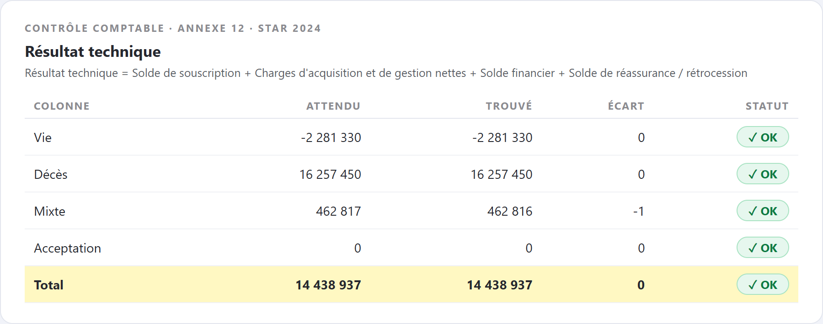
05
Data & AI
B. Pipeline stages
- Data pipeline -
COLLECT
EXTRACT
MODEL
VALIDATE
DELIVER
WHAT HAPPENS
Rule: Résultat technique = Solde de souscription + Charges d'acquisition et de gestion + Solde financier + Solde de réassurance.
Check on the Total column: 13 288 024 − 8 787 121 + 10 682 816 − 744 782 = 14 438 937.
Result: gap 0 (±1 rounding on Mixte), status OK on all five columns.
THE KPI · RÉSULTAT TECHNIQUE · STAR 2024
Checked by an accounting identity
Validation results stored by the pipeline (rule: resultat_technique)
gap 0 → OK
Notes:
Validation. Before the value is used, the pipeline checks the accounting identity of the table: the technical result must equal the sum of the four balances above it. For the total column: 13,288,024, minus 8,787,121, plus 10,682,816, minus 744,782, gives exactly 14,438,937. The gap is zero and the status is OK on all five columns; a one-dinar rounding on the Mixte column is tolerated. If it did not match, an anomaly would be raised instead of silently accepting the value.

Slide 5

05
Data & AI
B. Pipeline stages
- Data pipeline -
COLLECT
EXTRACT
MODEL
VALIDATE
DELIVER
WHAT HAPPENS
Validated KPIs feed the company profiles, Excel exports and the chatbot.
From the KPI menu a consultant can open the source document or ask for an explanation.
Chatbot: 14.3 M TND, +212.4 % vs 2023, sector average 16.4 M, rank 7/17.
THE KPI · RÉSULTAT TECHNIQUE · STAR 2024
Résultat technique STAR 2024
14,3 M TND · rank 7/17
Platform · KPI menu → Expliquer ce chiffre, answered by the chatbot
Notes:
Delivery. The validated KPI reaches the consultant in the company profile, in the Excel exports and in the chatbot. From the menu of the KPI, the consultant can open the source document, with the highlighted cell we saw at the beginning, or ask the chatbot to explain the figure: here it gives 14.3 million dinars, an increase of 212 percent compared to 2023 because 2023 was negative, the sector average of 16.4 million, and the rank 7 out of 17. So the same figure is traceable from a PDF page to a decision-ready answer.

