Slide 1


05
Data & AI
B. Pipeline stages
- Data pipeline -
COLLECT
EXTRACT
MODEL
VALIDATE
DELIVER
WHAT HAPPENS
One scraper per source; the CMF portal is automated (Selenium).
The company is selected, the annual reports are kept, duplicates are removed.
Each report is registered with its link: 3 attempts if the portal is slow.
THE DATA POINT · STAR · 2025
The report published by the CMF
star_efd311225.pdf
The STAR report, as collected from the CMF (page 1)
Notes:
Let me follow one real data point through the whole pipeline: the total assets of STAR for 2025. It starts here, at the collection step. A browser automation opens the CMF portal, selects the company, and keeps only the annual reports. Duplicates are removed, the link is checked, and each report is registered with its link; if the portal is slow, the sequence is retried up to three times. On the right, the STAR report exactly as it was collected from the CMF website: the financial statements of 2025. At this point, our data point is still inside a PDF file.

Slide 2
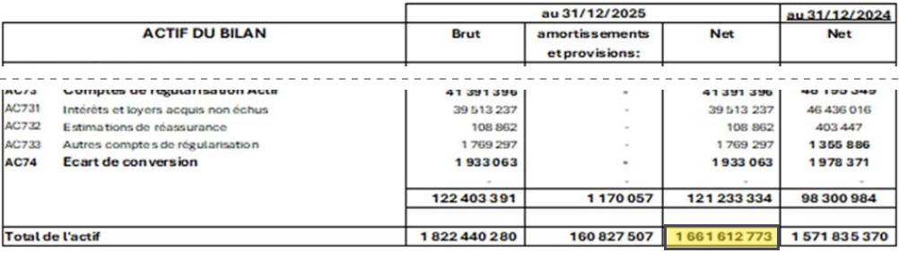
05
Data & AI
B. Pipeline stages
- Data pipeline -
COLLECT
EXTRACT
MODEL
VALIDATE
DELIVER
WHAT HAPPENS
The balance sheet, on page 2, is a scanned image.
OCR reads the table; its rows and columns are identified.
Each value is stored as a cell: table · row · column.
Page 2 of the report · the “Net” cell of “Total de l'actif” (highlight added for this slide)
THE DATA POINT · STAR · 2025
Cell: Total de l'actif · Net
1 661 612 773
Notes:
Second step: extraction. The balance sheet of STAR, on page 2, is a scanned image, so there is no text to read directly: an OCR reads the table and identifies the rows and the columns. Our data point is the cell at the crossing of the row Total de l'actif and the column Net: 1,661,612,773 dinars. The column on its right is the previous year. From now on, this number is no longer a picture in a PDF: it is a cell stored in the database, identified by its table, its row and its column.

Slide 3
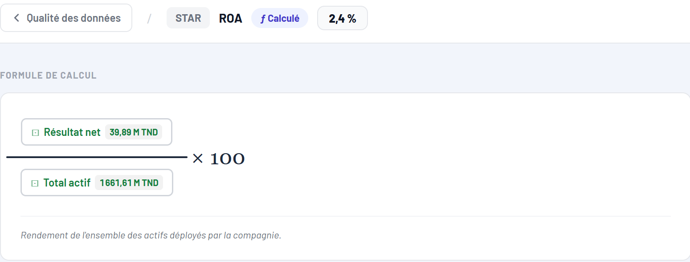
05
Data & AI
B. Pipeline stages
- Data pipeline -
COLLECT
EXTRACT
MODEL
VALIDATE
DELIVER
WHAT HAPPENS
KPIs are computed from the stored cells, with one formula each.
Our data point, Total actif, is the denominator of the ROA.
ROA = Résultat net ÷ Total actif × 100 = 39,89 M ÷ 1 661,61 M = 2,4 %.
THE DATA POINT · STAR · 2025
Input of the ROA
Platform · Formule de calcul — ROA, STAR 2025
Total actif 1 661,61 M → ROA 2,4 %
Notes:
Third step: modeling. The stored cells become KPIs, and each KPI has one single definition. Here is the formula of the ROA of STAR for 2025, shown by the platform. The return on assets is the net result divided by the total assets, times one hundred: 39.89 million divided by 1,661.61 million gives 2.4 percent. So our data point is now the denominator of a KPI. Both components are values extracted from the report, and the platform lets you click on each of them to see its source.

Slide 4
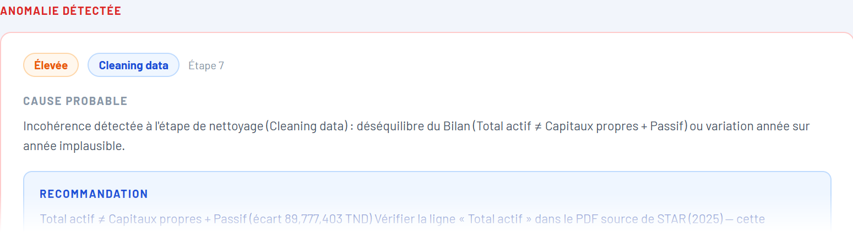
05
Data & AI
B. Pipeline stages
- Data pipeline -
COLLECT
EXTRACT
MODEL
VALIDATE
DELIVER
WHAT HAPPENS
Rule: Total actif must equal Capitaux propres + Passif.
Found: 1 661 612 773 vs 1 571 835 370, a gap of 89 777 403 TND.
Cause: the liabilities total is last year's column (N-1). Equity + liabilities = 1 661,6 M.
Platform · Anomalie détectée — Total actif, STAR 2025
THE DATA POINT · STAR · 2025
Both sides of the balance sheet are compared
gap of 89 777 403 TND → flagged
Notes:
Fourth step: validation. The platform checks accounting identities, and the first one is that the total assets must equal the equity plus the liabilities. For STAR 2025, the check finds a gap of about 90 million dinars and flags an anomaly, with a probable cause and a recommendation to check the source PDF. When we analyse it, the gap is exactly the difference between the two years: the total extracted on the liabilities side is the previous year's column. In fact, the equity, 450 million, plus the liabilities, 1,211 million, gives exactly our total assets. So the data point is correct, and the check has just caught an extraction error on the other side of the balance sheet. That is precisely the role of this step: nothing is corrected silently, and every inconsistency is flagged.

Slide 5
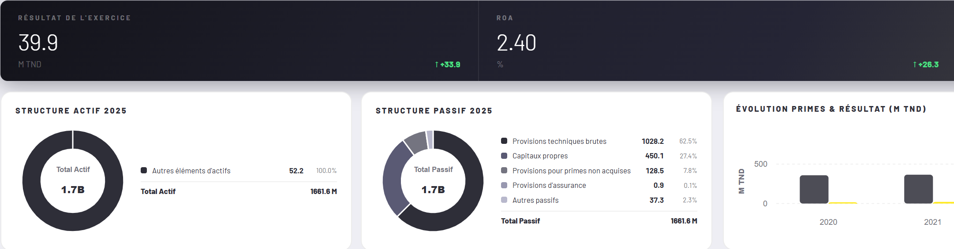
05
Data & AI
B. Pipeline stages
- Data pipeline -
COLLECT
EXTRACT
MODEL
VALIDATE
DELIVER
WHAT HAPPENS
Verified KPIs feed the dashboards, the Excel exports and the chatbot.
Consultants see each figure with its status and its source.
Here: the STAR profile, tab Performance financière, year 2025.
Platform · Vue par assurance — Performance financière, STAR 2025
THE DATA POINT · STAR · 2025
On screen: Total Actif 1661.6 M
ROA 2.40 % · ROE 8.90 %
Notes:
Last step: delivery. The verified KPIs are available in the dashboards, in an Excel export and through the chatbot. Here is the STAR profile, tab financial performance, for 2025: the structure of the assets shows our data point, total assets 1,661.6 million, and the net result, the ROA and the ROE that were computed from it. So we have followed one figure from a scanned page of a PDF to a screen a consultant can use, through extraction, computation and validation.

