Slide 1



Supervisor:
Dr. Muna Dmaidi
Done By:
Azza Abdulghani
Raghad AlSayeh

Slide 2

Outline:
1.Motivations.
2.What is Evento.
3.Features and functionalities.
4.Technologies and implementations.
5.Constraints.
6.Future work.

Slide 3
Motivations:
A lot of Events and Activities are created in the last few years ,
But difficult to reach them to interested people .
Effort required to collect users with their interested events
- most users forget event’s details.
- many people suffer from uninterested events.
keep tracking of multiple functionalities for multiple events .

Slide 4
Evento
Each user follow specific types of events .
Users know about their interested events only and keep track of them.
Advertise any type of event with its details to interested users.
Notification system when new event added or following process.
Show close events to the current location of user .

Slide 5

Search and follow other users in the application .
Calendar for personal user events e.g. daily events.
Payment system for paid events.

Slide 6
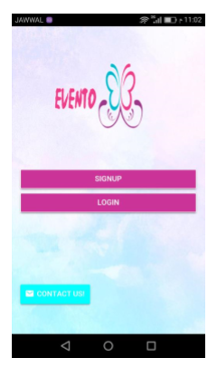
Welcome Page:
Signup action.
Contact us action.
Login action.

Slide 7
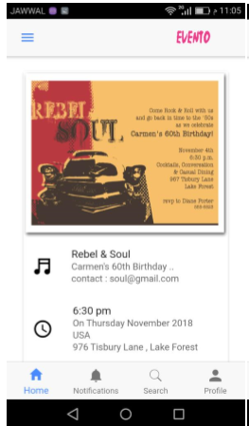
Login Page& Home Page:
dynamic events loading
Register and Pay
Show location

Slide 8
Profile Page:
Show registered Events
Unregister
Show Barcode

Slide 9
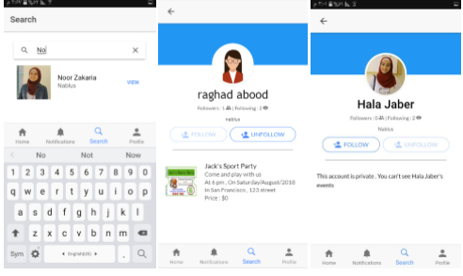
Search Page:
Search
Follow & Unfollow
Show public accounts

Slide 10
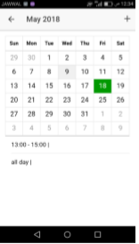
Side Menu :
Personal events
Show Followers
Show Followings
Edit Profile

Slide 11
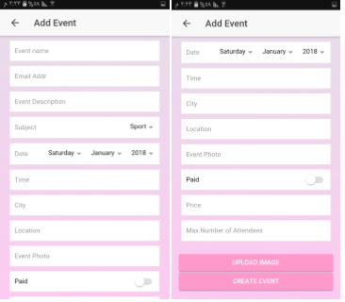
Create event Page:
Create New Event
Show in Home

Slide 12
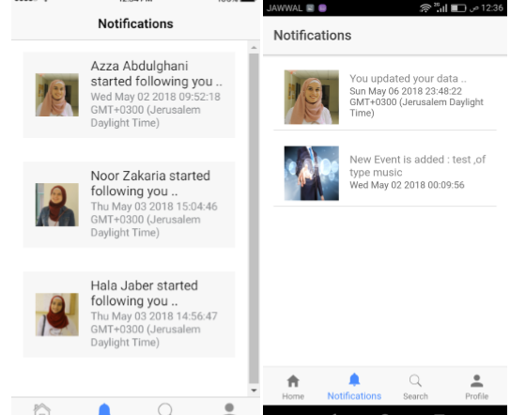
Notification Page:
New Event
Update Data
New Follower
Reminder

Slide 13
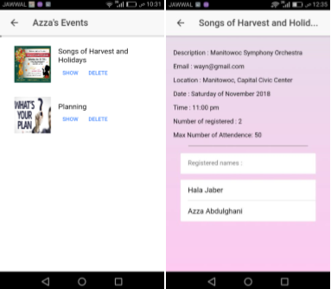
Show created events:
Show Event
Delete Event
Update Event
Scan Barcode

Slide 14
Show close events page:

Slide 15








Technologies and implementations:

Slide 16
Constraints:
Time
Max connection in firebase is 50.
Google Map , Limited places in Palestine

Slide 17
Future work:
Adding barcode optionally to the event.
Add new type of event.
Add more filters to events , not just type , for example : specific city , special invitations
Add new languages.

Slide 18


