Slide 1

The Journey of Meritto (Formerly NoPaperForms)
Revolutionizing the Enrollment Landscape

Slide 2
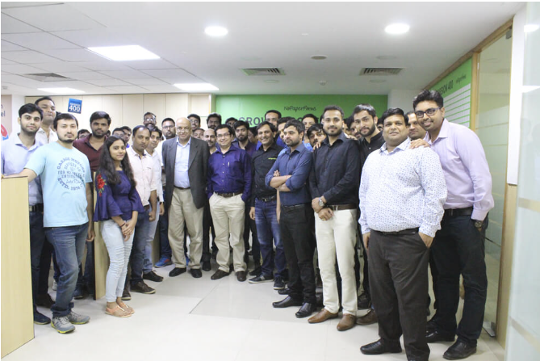
How It All Started (2017)
Founded in Okhla with a mission to simplify the admission process.
Launched to address the inefficiencies in traditional admission methods.
Focused on digitizing and automating admissions for educational institutions.

Slide 3
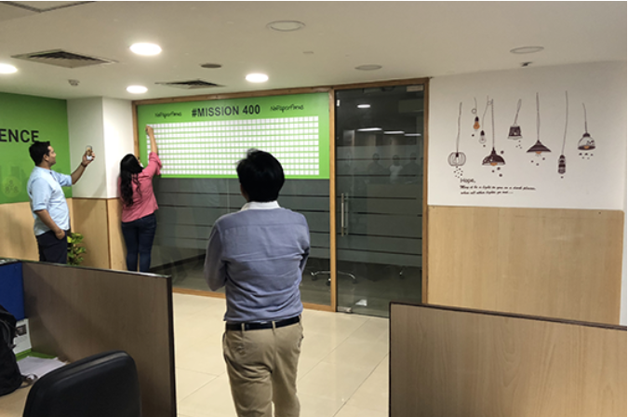
100 Days to Mission 400 (2018-2019)
Achieved 100 clients in 100 days, a significant milestone demonstrating the demand for their solution.
Set an ambitious target to onboard 400 clients in the following period.
Growth driven by the value and efficiency brought to the admissions process.

Slide 4
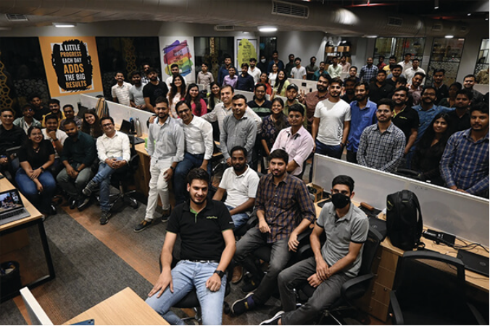
Expansion of Services
Evolved services to meet client needs, leading to the development of Enrollment Cloud and CRM.
Focused on end-to-end solutions, covering the entire admissions lifecycle.
Continuous innovation to stay ahead of market demands and client expectations.

Slide 5
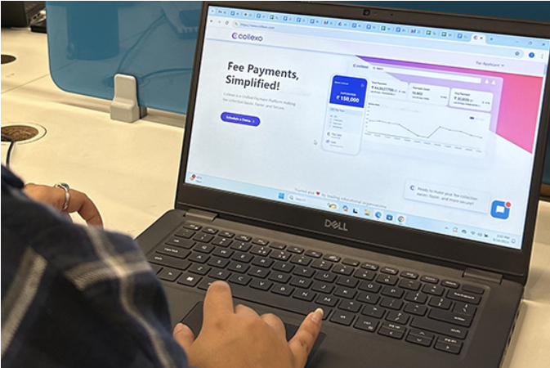
Innovation with Collexo (2021)
Launched Collexo to address complex fee collection processes.
Aimed at making fee management transparent, efficient, and hassle-free.
Integrated seamlessly with other solutions to provide a unified experience.

Slide 6
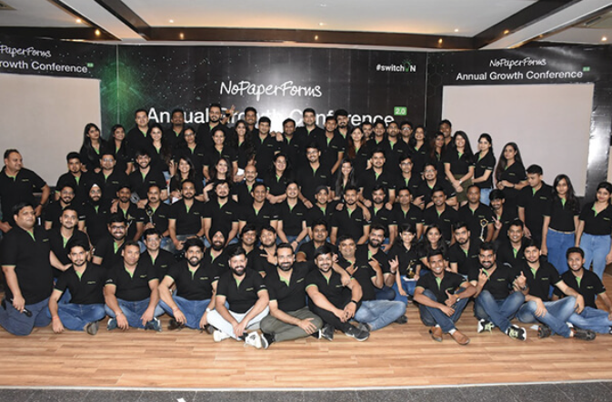
Reaching Global Markets (2023)
Expanded reach to 1000 clients worldwide.
Entered new international markets, including the UAE and Malaysia.
Continued commitment to innovation and customer satisfaction driving global success.

Slide 7


New Brand Identity (2023)
From NoPaperForms to Meritto
Rebranded to reflect broader capabilities and continued commitment to customers.
Name change symbolizes the evolution and future vision of the company
Aimed at reinforcing the brand’s identity and mission

Slide 8
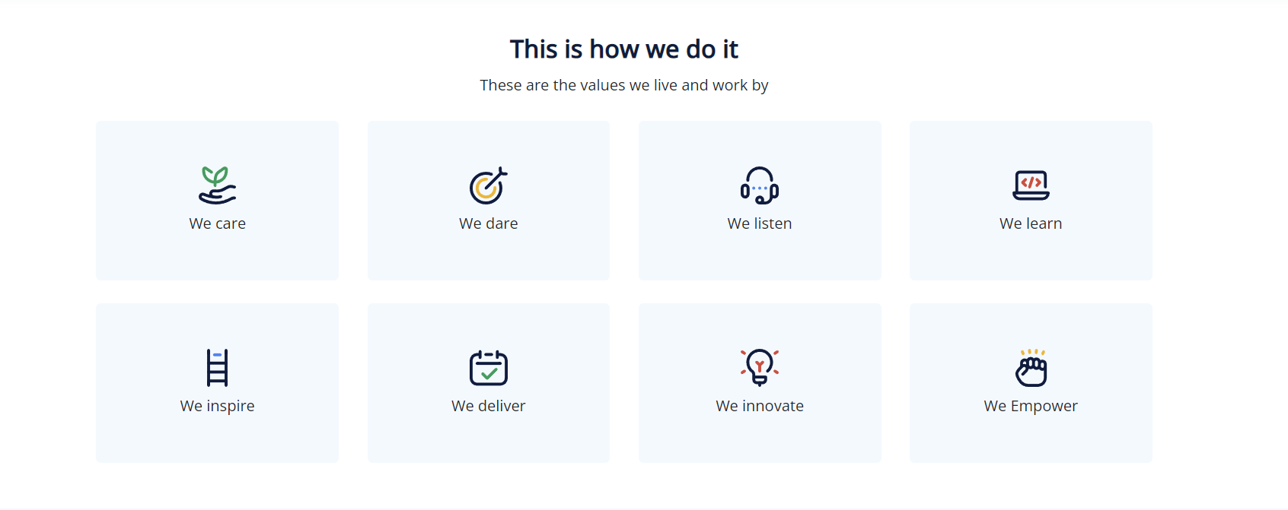

Slide 9





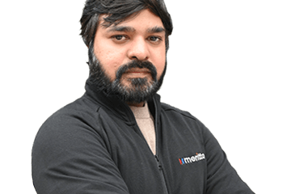

Meet the Leaders
Naveen Goyal
Suraj Sapra
Vikram Shah
Gaurav Singh
Founder & CEO
Co-Founder & CSO
Chief Business Officer
Chief Product Officer
Alok Sharma
Surya Singh
Dheeraj Raj
Sr. Vice President – Product
Vice President – Product
Sr. Vice President – Operations

Slide 10
Thank You.

