Slide 1
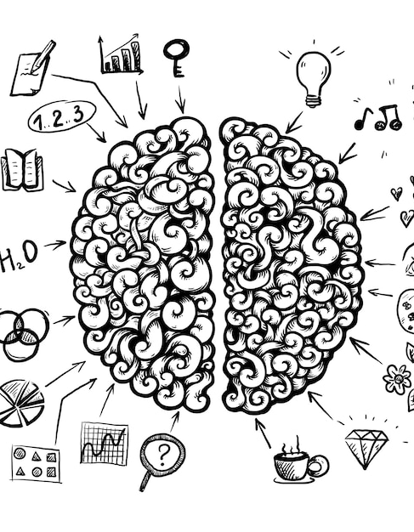
Ourtutors

Slide 2
Agenda
1
2
3
4
5
Introduction
Lack Of Interaction
Social Media
Distraction
Solution
Conclusion

Slide 3

Introduction
Are you maximizing your learning resources, or are you finding yourself constantly distracted by the internet,
Is your health being impacted by extended exposure to mobile screens?
Let's find a balance and make the most of our learning opportunities while also taking care of ourselves."

Slide 4
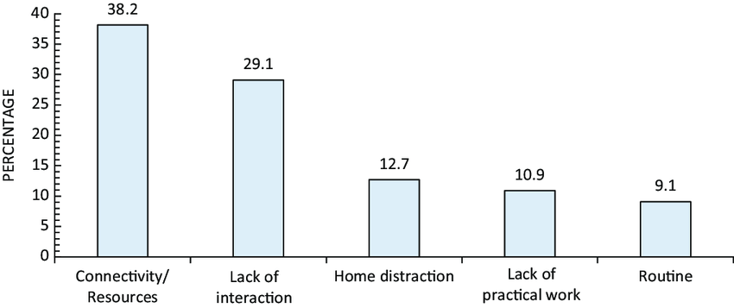
Lack of interaction

Slide 5
40%
Social media distractions can
decrease productivity by
nearly 40%

Slide 6
What’s The Solution?
“
”

Slide 7

We're excited to introduce our latest solution:
a platform that enables you to easily locate the nearest tutors tailored to your specific requirements.
With our innovative technology, you can now explore and connect with tutors who match your preferences seamlessly.
Whether you're looking for academic support, language learning, or skill development, our platform provides a comprehensive database of qualified tutors ready to assist you.
Say goodbye to the hassle of searching for tutors; with our solution, finding the perfect tutor is just a few clicks away.

Slide 8
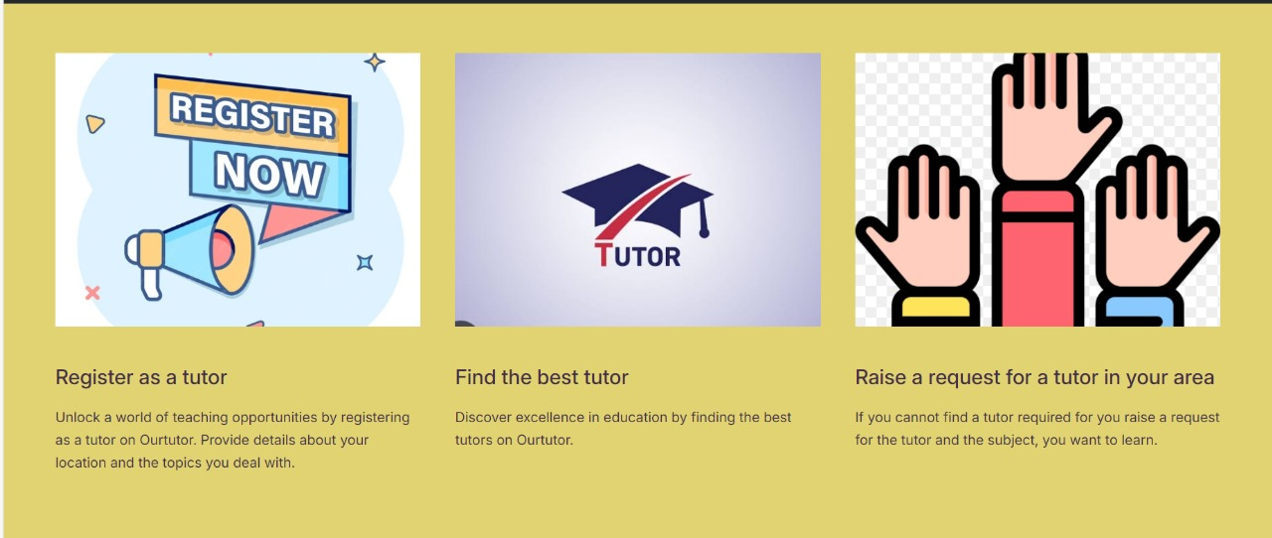
At our website, we prioritize fostering local talent by providing equal opportunities for both tutors and students.
The tutors need to register themselves with their details, location and the subject they deal with.

Slide 9
At our website, we prioritize fostering local talent by providing equal opportunities for both tutors and students.
The tutors need to register themselves with their details, location and the subject they deal with.

Slide 10
Having trouble finding a tutor that meets your specific requirements? Don't worry!
Simply raise a request, and we'll keep an eye out for the perfect match.
Once we find a tutor that fits your needs, we'll notify you right away.

Slide 11

Conclusion
In our digital era, balancing learning and health is vital. Our platform connects students with tailored tutors while prioritizing well-being. With location-based searches, finding the perfect tutor is effortless. Let's seize this opportunity for personalized learning and self-care.

Slide 12

Thank you

