Slide 1
SimpleSEDML
Joseph L. Hellerstein, Lucian P Smith , Herbert M Sauro

Slide 2
Why?
The Simulation Execution Description Markup Language (SED-ML) provides a community standard for describing computational experiments
Key considerations in reproducibility and credibility
Issues
SED-ML is verbose and difficult for humans to generate
Alternatives, such as PhraSED-ML improve matters but adoption is low
No API to help programmers create SED-ML
Access many sources of models (string vs file vs URL, SBML vs Antimony)
Leverage programming environments (datatypes, iteration)
Provide task-oriented abstractions (e.g., simulate a model; compare two models)

Slide 3
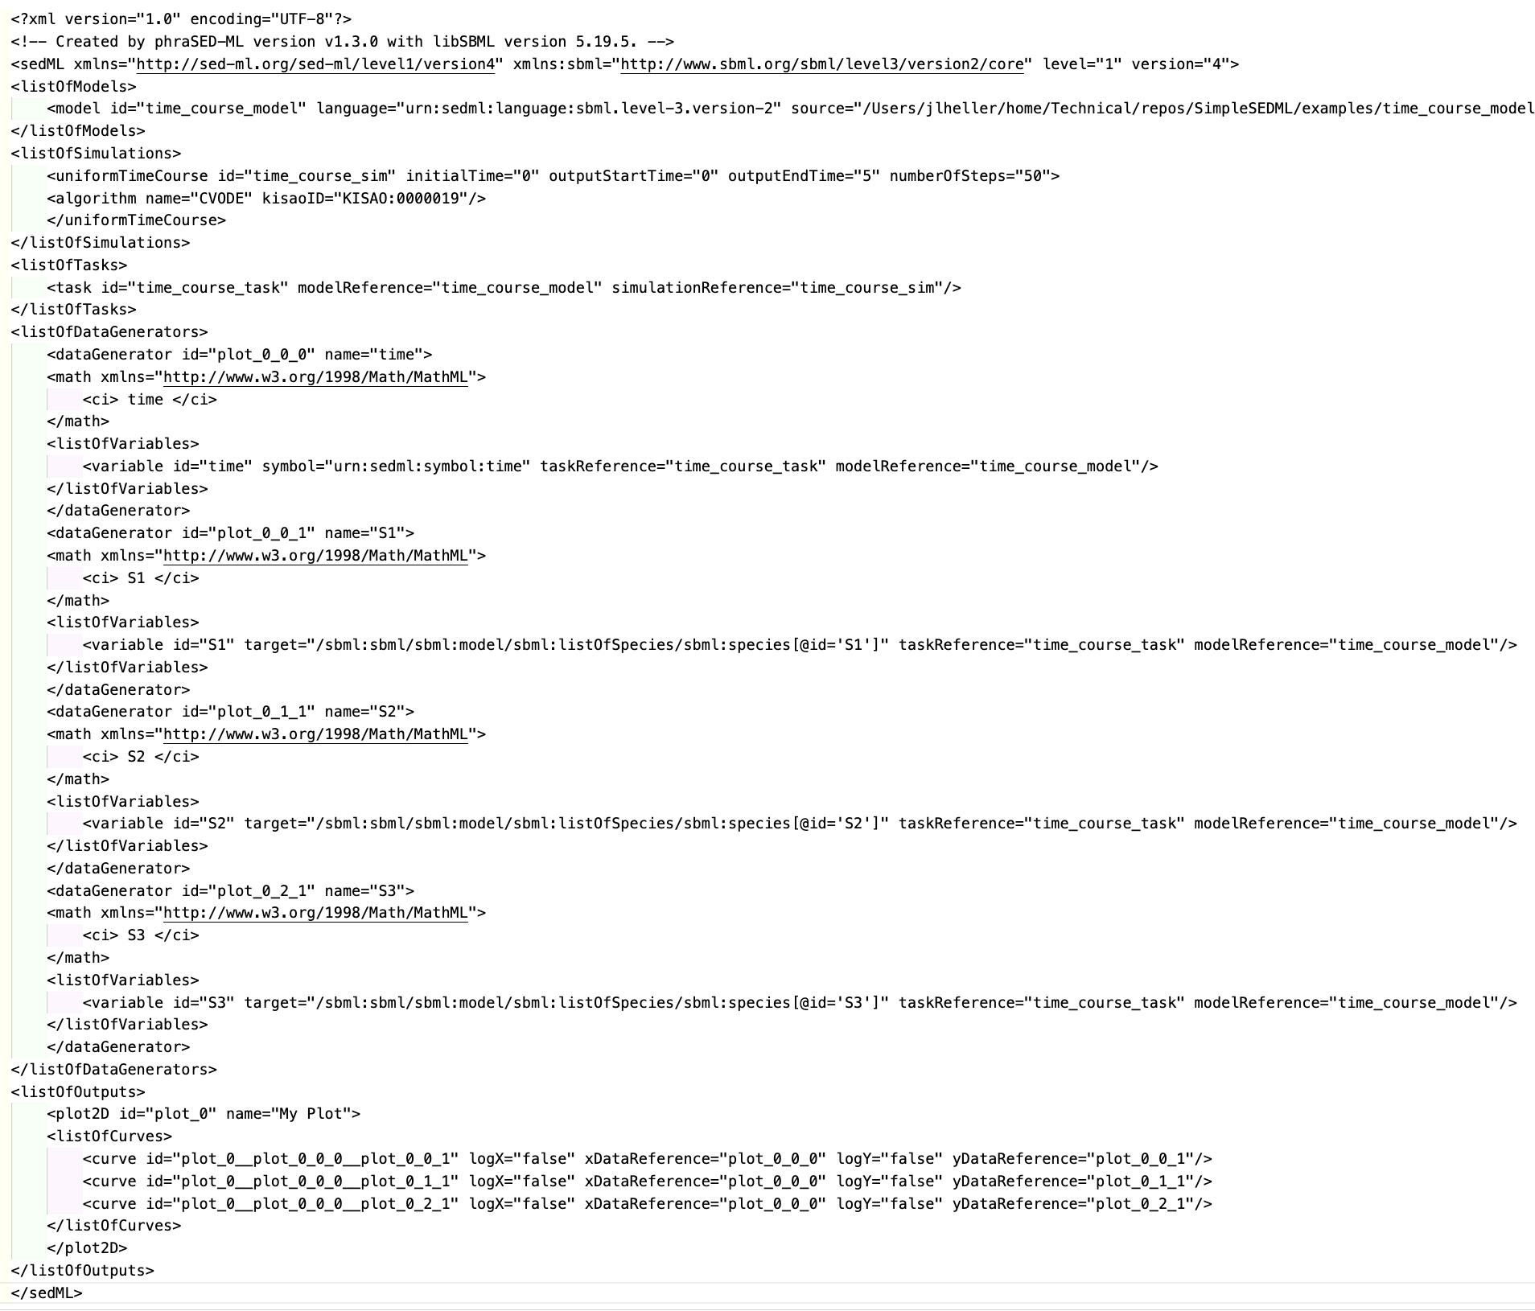
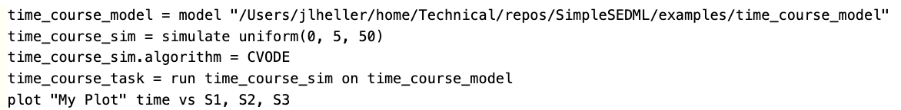
Task: Simulate a single model
SED-ML
PhraSED-ML
Issues
Convert model to SBML
Convert PhraSED-ML to SED-ML
SimpleSEDML
import SimpleSEDML
sedml_str = SimpleSEDML.makeSingleModelTimeCourse(model)

Slide 4
Structure of SimpleSEDML
Task Layer
1 API call, 1 required argument
Singe Model Time Course
Multiple Model Time Course
Specify models (optionally change parameters)
Outputs: reports, plots
66% reduction in statements vs. PhraSED-ML
Virtualization Layer
Base API
Python interface to PhraSED-ML abstractions
Generalize source (File, string, URL, Antimony, SBML)
PhraSED-ML
Tellurium

Slide 5
Example

