Slide 1
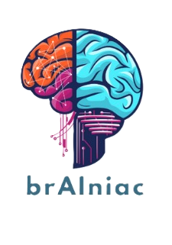
FOUNDERS OF brAIniac
Vushaka
Chidi
Lesego
Tumelo
Tishenia
Angel
Emily
Katlego

Slide 2
The Problem
Diagnosing brain tumors with MRI scans is a very important, yet time and resource intensive task.
In South Africa, there are not enough medical experts to fulfil this task on time with the few experts they are able to spare being overtasked, which can lead to mistakes, delays in treating patients, and even missed findings.
This problem is very critical and should be adequately addressed, as brain tumors can result in death or poor prognosis for untimely interventions.
Early detection of brain tumors and improved accuracy of categorization of tumor type can greatly improve a patient’s prognosis by bringing timely clinical decision-making to them.

Slide 3
Our Solution
brAIniac is an AI-powered decision-support tool that automates the detection and classification of brain tumors from MRI scans.
It leverages the BRISC2025 dataset
Applies deep learning to accurately identify tumor types:
Reduces diagnostic workload
Speeds up the time from diagnosis to medical action
Minimizes the risk of human error.

Slide 4
Our Objectives
To reduce the time required for diagnosis.
To improve the accuracy of brain tumor diagnosis by leveraging the BRISC 2025 dataset.
To improve patients’ prognosis by early detection and allowing for efficient clinical decision-making.
To reduce healthcare costs for both patients and hospitals without sacrificing quality decision-making.
To demonstrate how AI solutions like brAiniac can automate medical processes.
To promote the use and adoption of AI solutions like brAiniac in more remote and low-resource locations in South Africa.

Slide 5
Requirements
FUNCTIONAL
The system will accept brain MRI scans in digital image formats such as JPG.
The system must normalize and pre-process images before analyzing.
The system must predict each MRI image into one of the following classes of [glioma, meningioma, no_tumor, pituitary] as well as return the confidence score.
The system will generate summary reports on test data.
NON-FUNCTIONAL
The system will handle at least 30 MRI scans per hour concurrently.
The system will maintain consistent performance across different MRI scan images.
The system will support expansion to other hospitals in the future.
The system must be highly available about 99.99% of the time.
The system will have a user-friendly dashboard for non-technical users to navigate easily.

Slide 6
Success Criteria
• To achieve more than 80% overall test accuracy when classifying brain MRI scans into the different categories: Glioma, Meningioma, No tumor, and Pituitary.
• To process 1000 test images and generate a confusion matrix and a classification report in less than 5 minutes on limited CPU power (<= 16 GB ram).
• To be able to predict on a single brain MRI scan and classify it while showing a confidence score for each diagnosis in less than 10 seconds.
• To achieve more than 80% user adoption from participating radiologists and neurologists from Chris Hani Hospital

Slide 7
Risks
RISKS | MITIGATION
Misclassification of tumours | Ensure all images are normalized
Over reliance on brainiac | Disclaimer: Decision-support tool Confidence score on all predictions
Privacy data breach | Comply with POPIA act Implement RBAC on deployment
Poor user adoption | 2-week pilot operation on how to use system
Technical failure | Host as cloud based solution

Slide 8
Constraints
• The system analyses brain MRI images only. Other medical imaging, such as PET, CT, and X-rays, as well as other body regions, are out of scope.
• Classification is currently restricted to four classes [glioma, meningioma, no_tumor, pituitary]
• Model performance is validated only on data similar to BRISC2025.
• Testing of the system will be done on a limited compute workstation (less than 16 GB RAM).

Slide 9
Tools and Techniques
The programming language chosen is Python, because it offers machine learning libraries and integrates easily with frameworks such as TensorFlow and Keras.
We applied machine learning and deep learning techniques, including:
Supervised image classification
Convolutional Neural Networks
Normalization
We used Python liabries such as Numpy, sklearn, and matplotlib.
Lastly we used Github, Vs Code and WhatsApp for collaboration and coding.

Slide 10
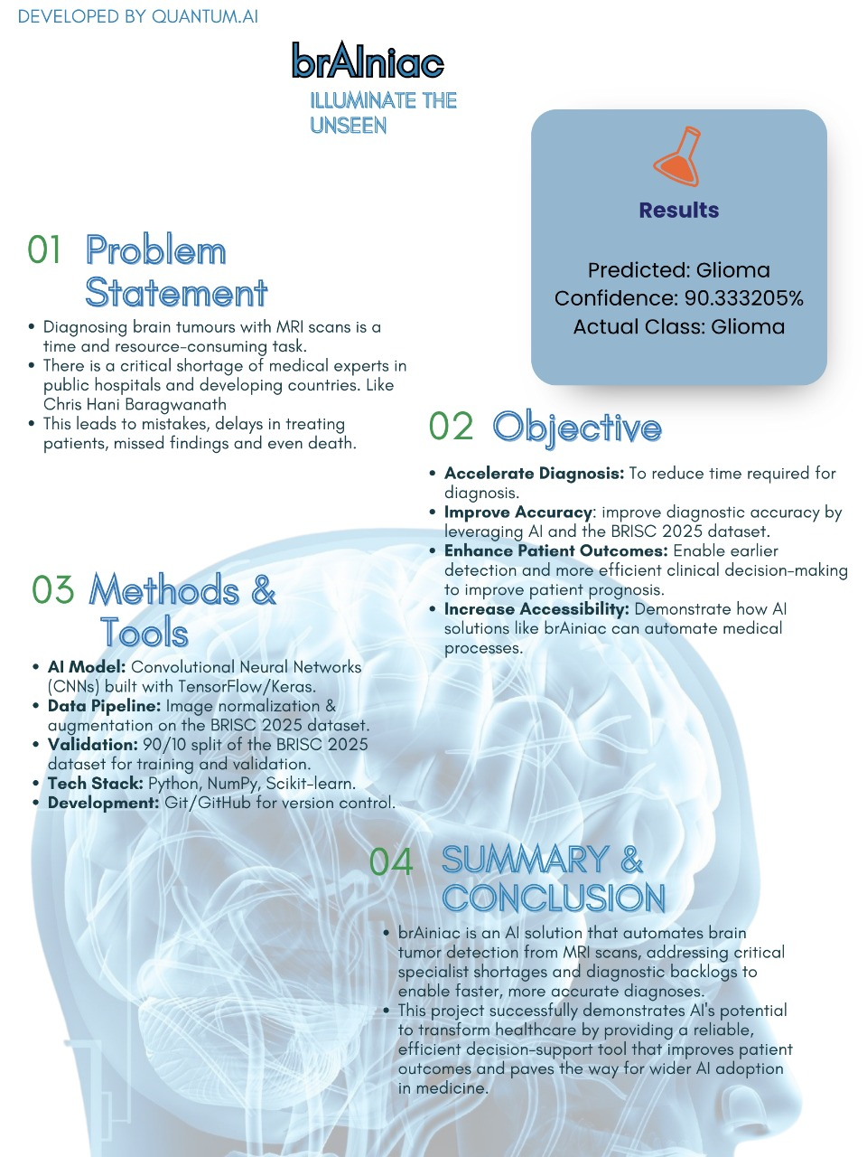
Our Poster

Slide 11
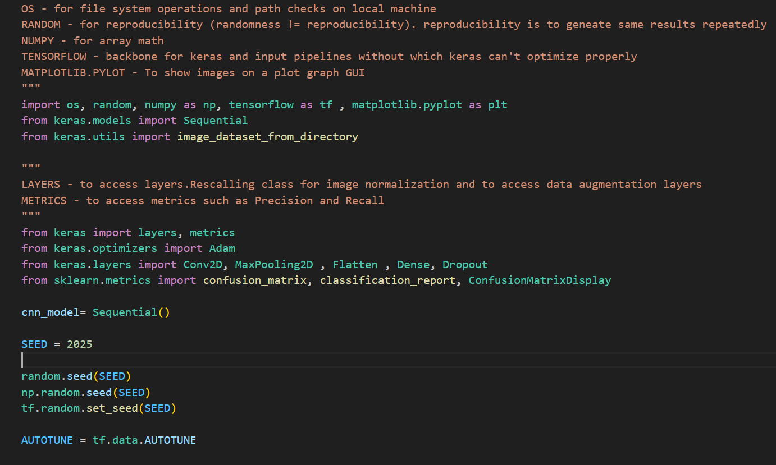
Our Practical solution – Global imports

Slide 12
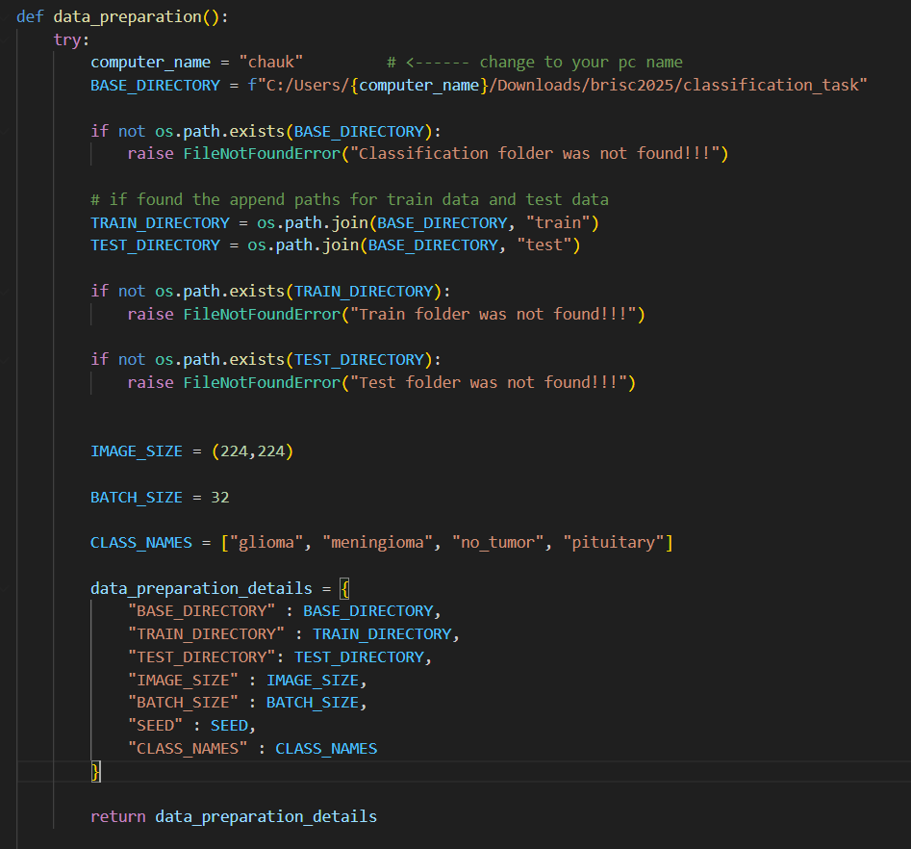
Data Preparation Function

Slide 13
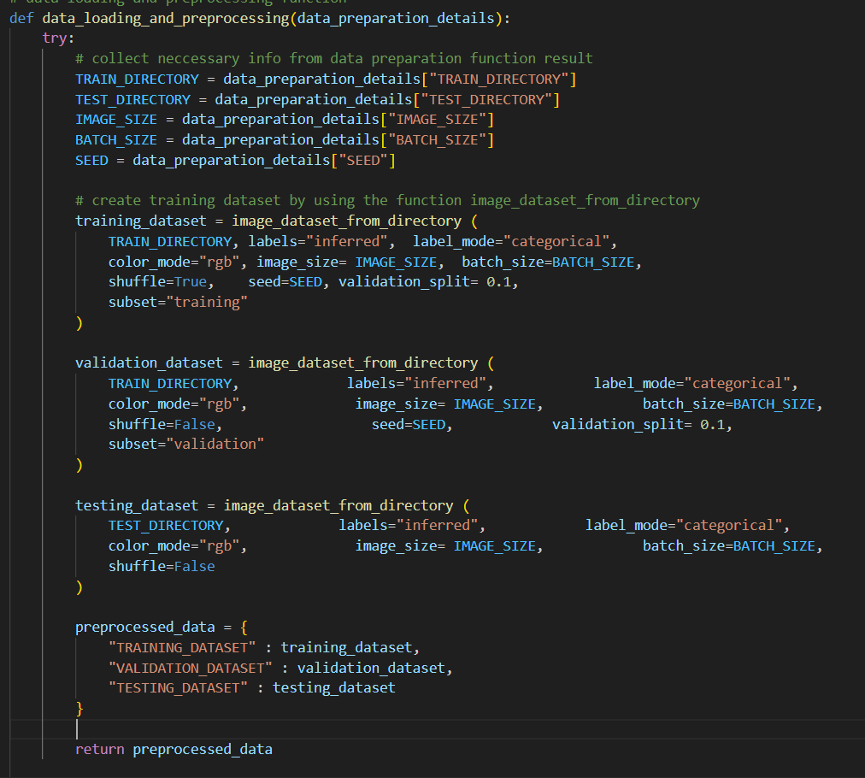
Data Loading and Preprocessing Function

Slide 14
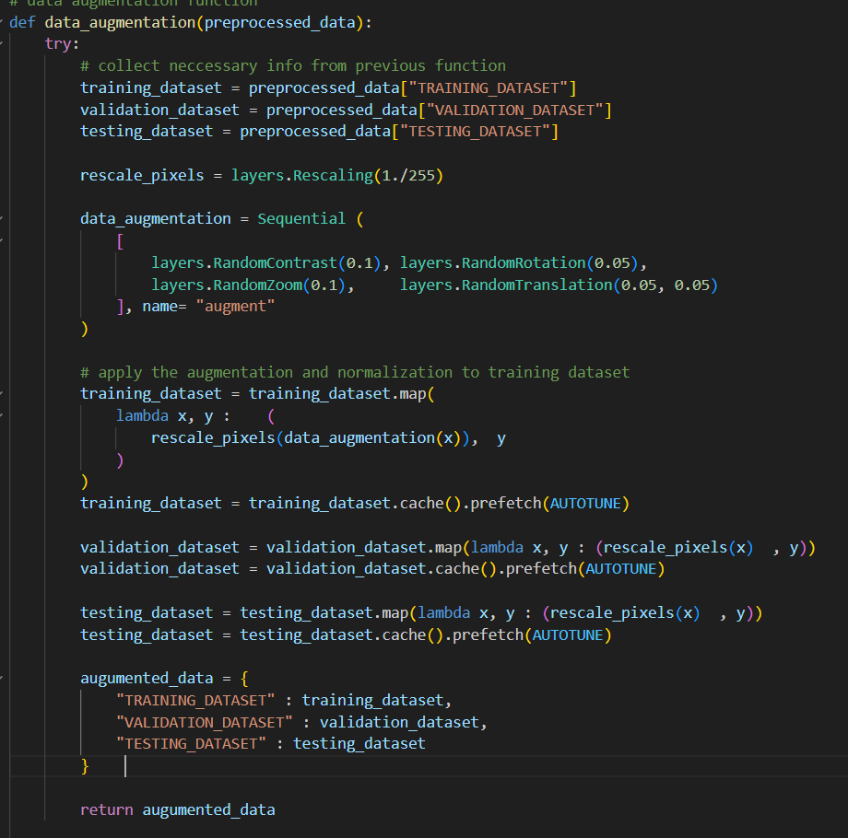
Data Augmentation Function

Slide 15
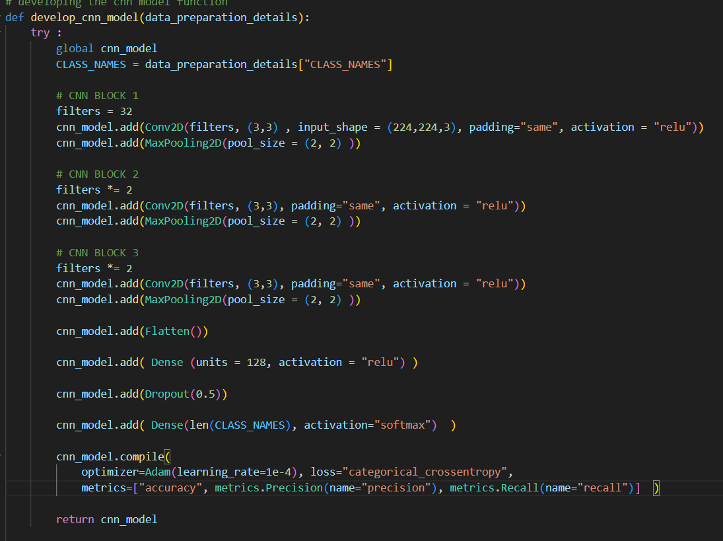
Develop CNN Function

Slide 16
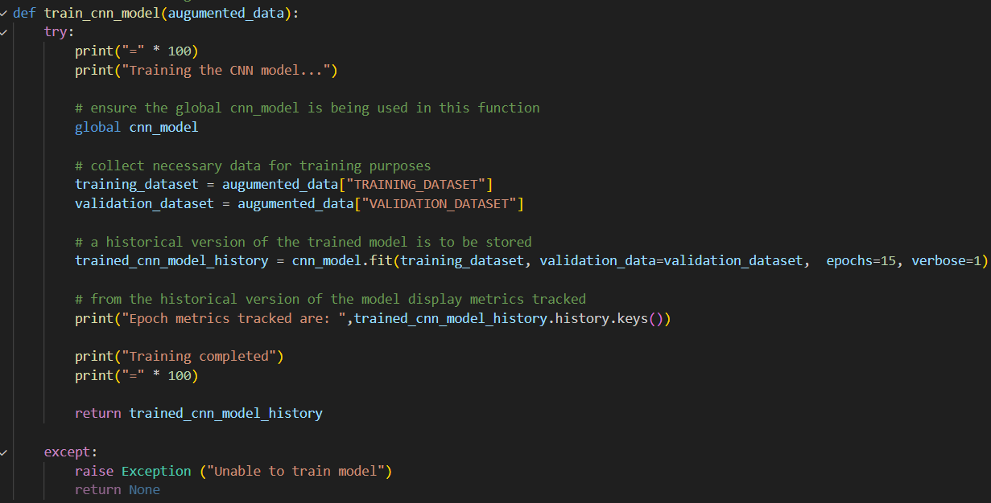
Train CNN Function

Slide 17
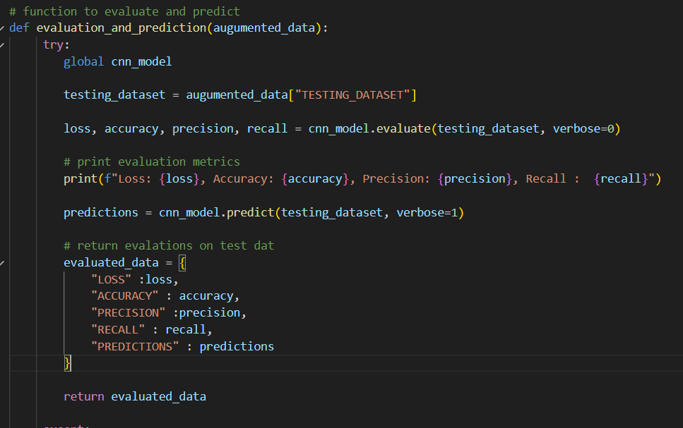
Evaluate and Predict Function

Slide 18
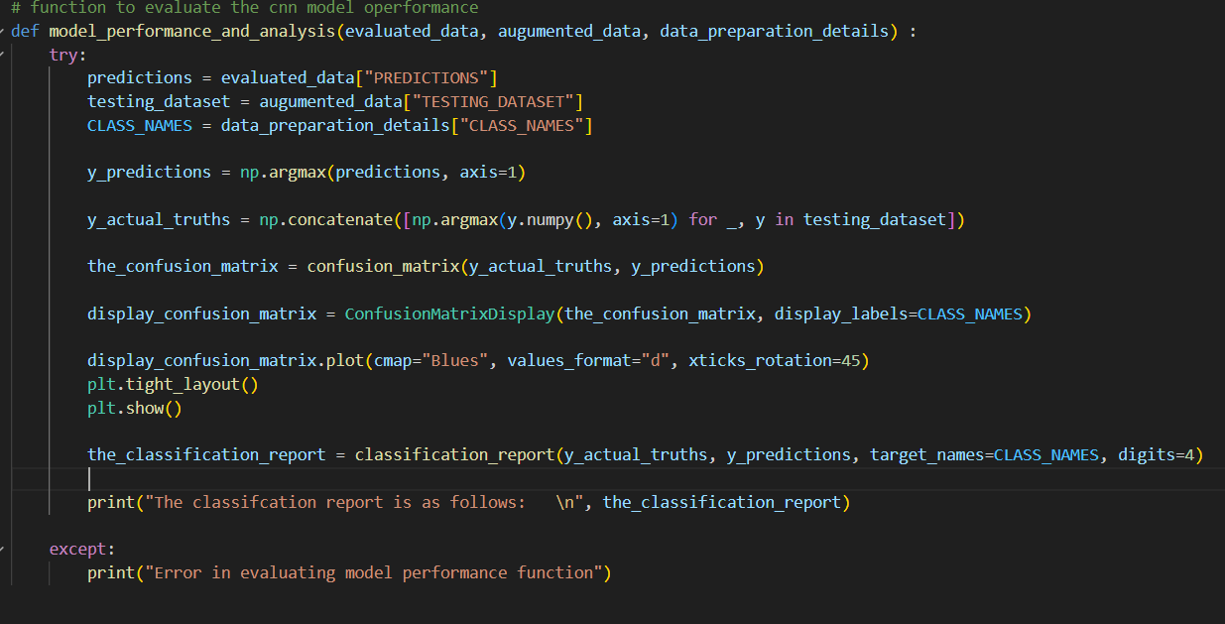
Model Performance and Analysis Function

Slide 19
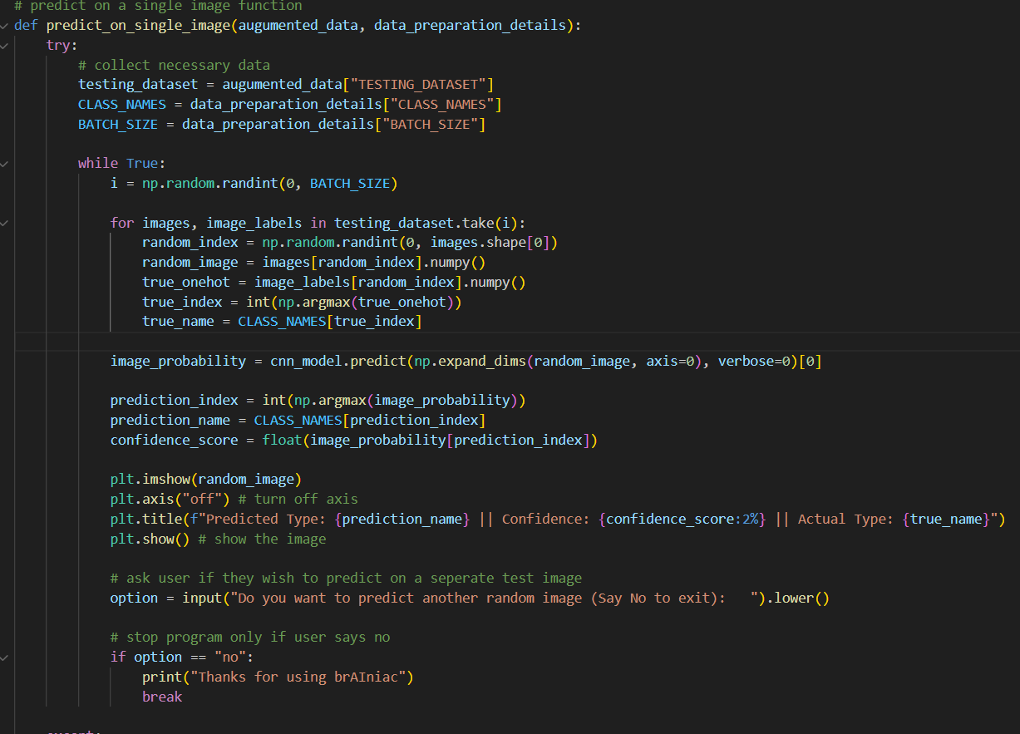
Predict on single image Function

Slide 20
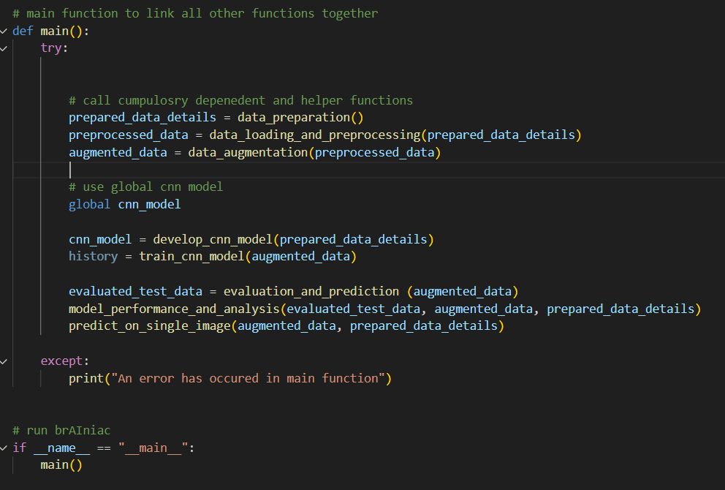
Main Function

