Slide 1


Slide 2
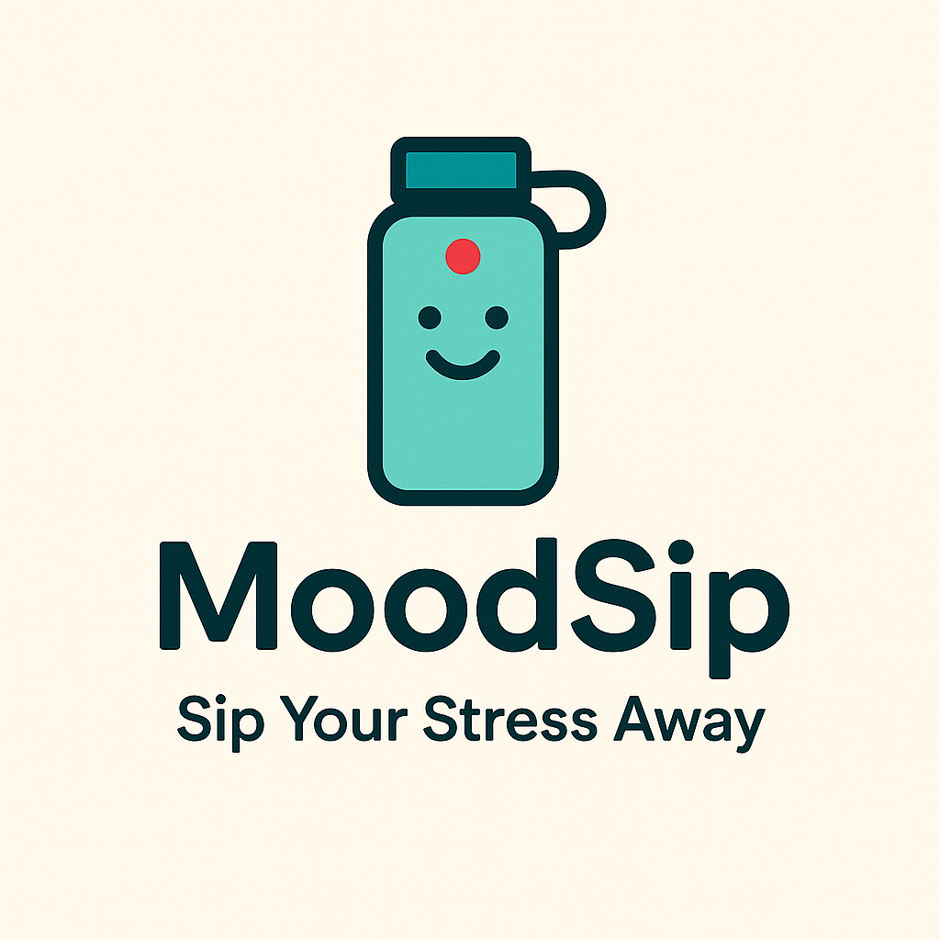
@FrigaZzz
@pitdagosti
@davmacario

Slide 3

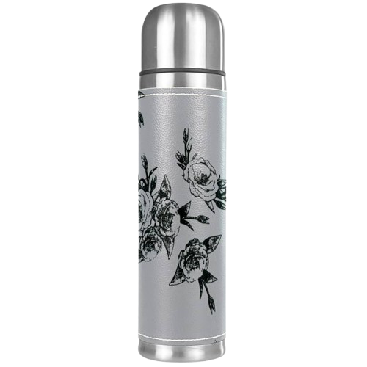
Why Hydration
Matters 💧
Even mild dehydration can reduce concentration and increase irritability
Proper hydration lowers cortisol spikes and improves physical and mental well-being
Effects of dehydration:
Fatigue, confusion, reduced performance 🪫
Higher risk for elderly 🧑‍🦳
Amplifies stress response 💹

Slide 4




The Nicla Vision will watch you and see your mood. Stressed, tired or sad? Nothing that a sip of water will not fix!
Project vision and mission
You’re not only the hot thing here! In these times where the temperatures are rising.. tha same will happen to the level of your thirst!
A timer for your well-being
Damn calm down don’t drown! The longer you drink, the longer you’ll have to wait...

Slide 5
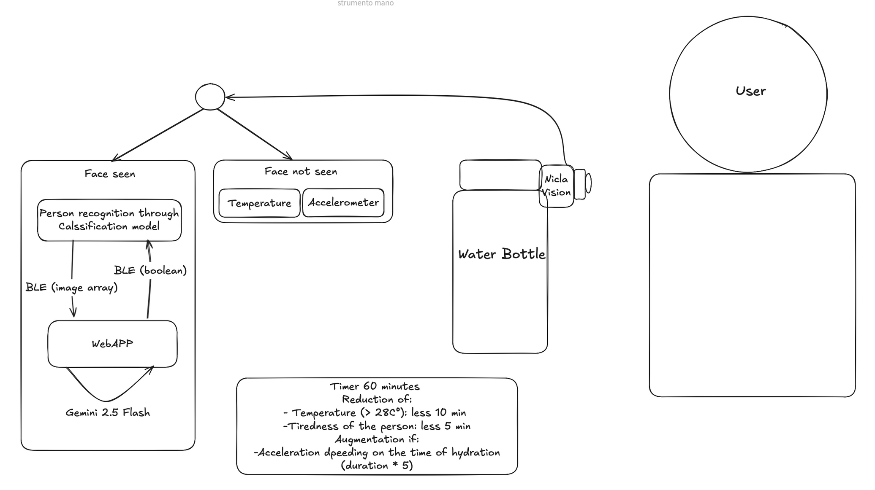
The system architecture

Slide 6
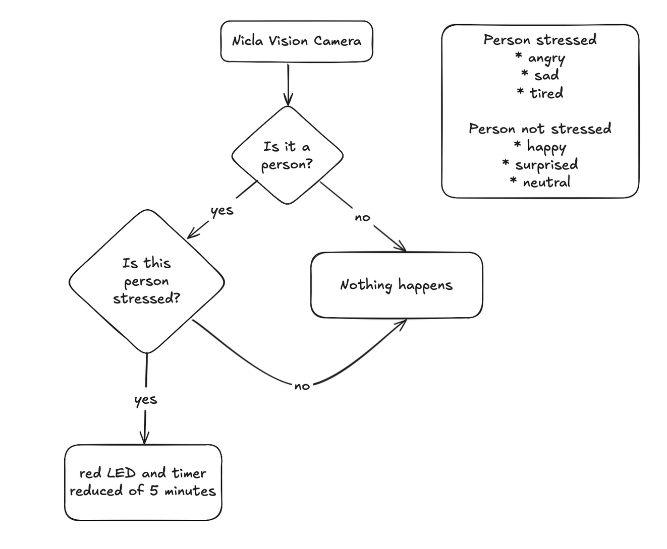
The model architecture

Slide 7
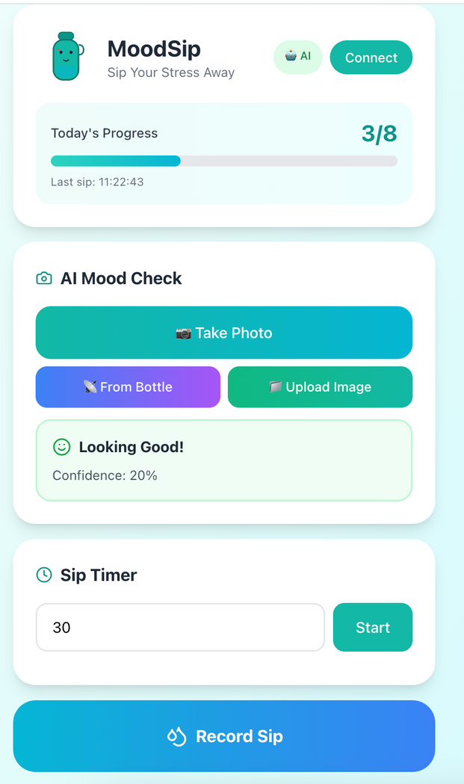
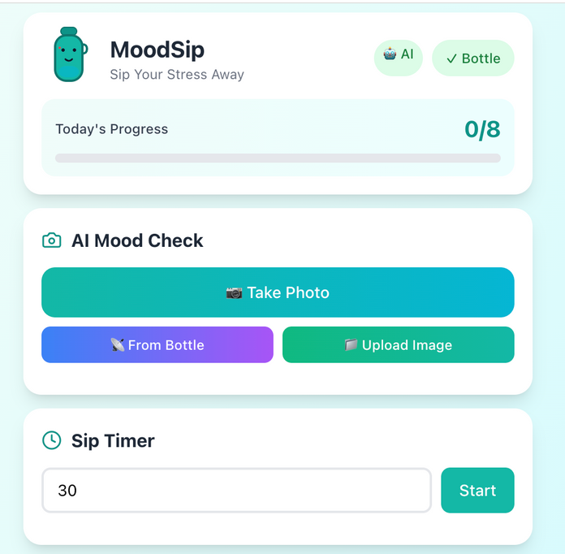
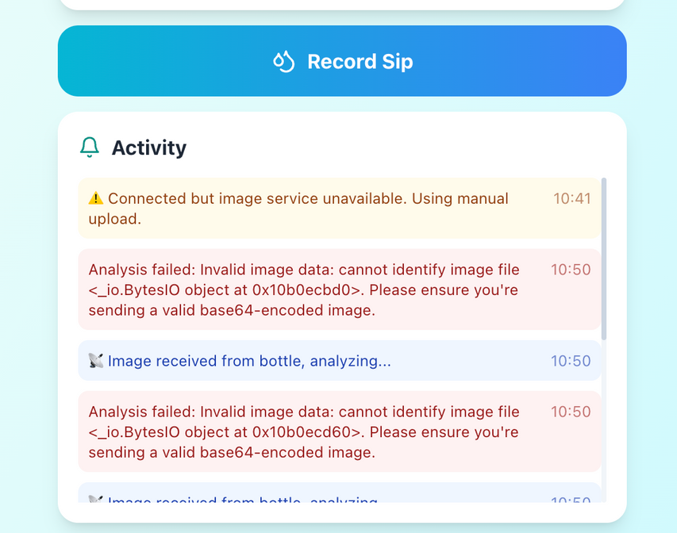
The app
https://10.100.16.79:3000/
http://10.100.16.79:3001/

Slide 8



Thank you very much!

