Slide 1

SREE VIDYANIKETHAN ENGINEERING COLLEGE
TITLE: Breaking Through Color Casts: Enhancing Image Fidelity with Machine Learning-based Correction
Presented by Choppa Jeevan Sai Reddy(20121A0449)
Bavani Akshay(20121A0418)
Bange Bhawane(20121A0416)
Busireddy Srikanth Reddy(20121A0429)
Supervisor
Dr. A. Satish
Associate Professor, Department of ECE.

Slide 2
Contents
ABSTRACT
INTRODUCTION
LITERATURE SURVEY
PROBLEM STATEMENT
OBJECTIVES
SOURCE OF COLOR CAST
EXISTING METHODS
DATASETS OR SOURCES
PROPOSED METHODS
SIMULATION RESULTS
APPLICATIONS
CONCLUSION
FUTURE SCOPE
REFERENCES
CONFERENCE DETAILS
STATUS OF THESIS PREPARATION

Slide 3
ABSTRACT
Color cast poses challenges in various image processing applications, affecting image quality and visual perception. This research investigates diverse methodologies for color cast correction, ranging from traditional algorithms to modern machine learning-based approaches. Leveraging a comprehensive dataset of original and corrected images, the present study evaluates the efficacy of each method using quantitative metrics, including ACMO, BREN, GRAS, LAPM, LAPV, LAPD, and WAVV. Results indicate that while traditional techniques like Gray World Algorithm and White Patch Retinex Algorithm demonstrate moderate effectiveness, the implemented machine learning-based algorithm showcases superior performance across multiple color cast levels. By employing linear regression on RGB values, the method efficiently corrects color cast aberrations, yielding visually appealing and perceptually accurate results. Furthermore, the research highlights the significance of robust color constancy algorithms and their role in mitigating color cast distortions in digital images. This study contributes valuable insights into the field of color cast correction, offering practitioners in image processing and computer vision a comprehensive understanding of effective correction strategies. Future research directions may explore advanced machine learning models and integration with color constancy mechanisms to further enhance color cast correction techniques.

Slide 4
Introduction
Color cast refers to an unwanted tint or hue present in an image, typically caused by variations in lighting conditions or inaccuracies in color reproduction. It manifests as an overall shift in color, often affecting the entire image or specific areas, and can distort the true colors of objects.
Applications such as photography, image processing, computer vision, and remote sensing suffer from color cast issues.
Dehazing, Denoising, low-light correction can be greatly improved by color-cast correction.
In this project, we study and implement classical and advanced color-cast correction techniques.

Slide 5
Literature Survey
Reference | Paper Title | Author(s) | Year | Methodology | Key Findings
[1] | Detection and Reduction of JPEG Color Cast | M. Ni and F. Yang | 2023 | Proposed a method for detecting and reducing color cast in JPEG images. | High effectiveness in reducing color cast artifacts in JPEG images.
[2] | Underwater Image Color Correction Based on Weakly Supervised Color Transfer | C. Li, J. Guo, and C. Guo | 2018 | Introduced a method for color correction in underwater images using weakly supervised learning. | Improved color fidelity in underwater images through weakly supervised color transfer.
[3] | Color Cast Image Enhancement Method Based on Affine Transform | Z. Liang, X. Ding, et al. | 2022 | Presented an image enhancement method based on affine transform for color cast correction. | Effective enhancement of color-casted images through affine transform-based correction.

Slide 6
Literature Survey
Reference | Paper Title | Author(s) | Year | Methodology | Key Findings
[4] | Underwater Image Restoration Based on Color Correction and Red Channel Prior | G. Huo, Z. Wu, and J. Li | 2018 | Proposed a restoration method for underwater images focusing on color correction and utilizing red channel information. | Achieved significant improvement in underwater image restoration by incorporating color correction and red channel priors.
[5] | Image Fusion Based Selective Optimal Restoration of Colors in Single Underwater Images | M. Kanagavel, P. Sivakumar, and S. Bama | 2021 | Introduced a selective optimal restoration method for color enhancement in single underwater images. | Demonstrated effective restoration of colors in single underwater images through selective fusion-based approach.

Slide 7
Problem Statement
Color cast in digital images presents a significant challenge, affecting the accuracy and reliability of image analysis and interpretation across various domains. Addressing this issue is critical for enhancing the quality and reliability of visual data processing and interpretation.

Slide 8
Objectives
Develop an in-depth understanding of color cast phenomena in digital images.
Conduct a comprehensive review of existing literature on color cast detection and correction methods.
Identify key challenges and limitations associated with current color cast correction techniques.
Propose novel methods or enhancements to existing approaches for more effective color cast removal.
Implement and evaluate the proposed methods through rigorous experimentation and comparative analysis.

Slide 9
CRITICAL STUDY AND ANALYSIS OF THE IDENTIFIED PROBLEM
In the critical study and analysis of the identified problem, several key aspects are considered:
Nature of Color Cast: Understanding the underlying mechanisms and characteristics of color cast in digital images, including its causes, variations, and manifestations across different scenarios.
Impact on Image Quality: Analyzing the detrimental effects of color cast on image quality, such as loss of color accuracy, reduced contrast, and overall degradation of visual aesthetics.
Challenges in Correction: Identifying the challenges associated with color cast correction, including the complexity of the problem, variations in lighting conditions, and the need for adaptive algorithms to handle diverse scenarios.
Existing Methods and Limitations: Critically evaluating the effectiveness of current color cast correction methods, considering their strengths, weaknesses, and applicability to real-world scenarios. This involves assessing classic approaches like Gray World Algorithm and Max-RGB, as well as more advanced techniques such as deep learning-based methods.

Slide 10
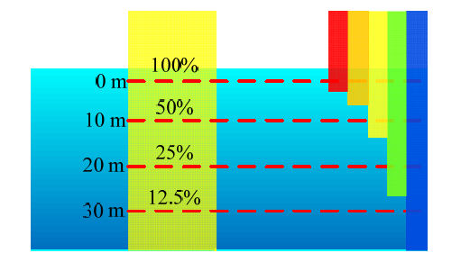
Source of Color Cast

Slide 11
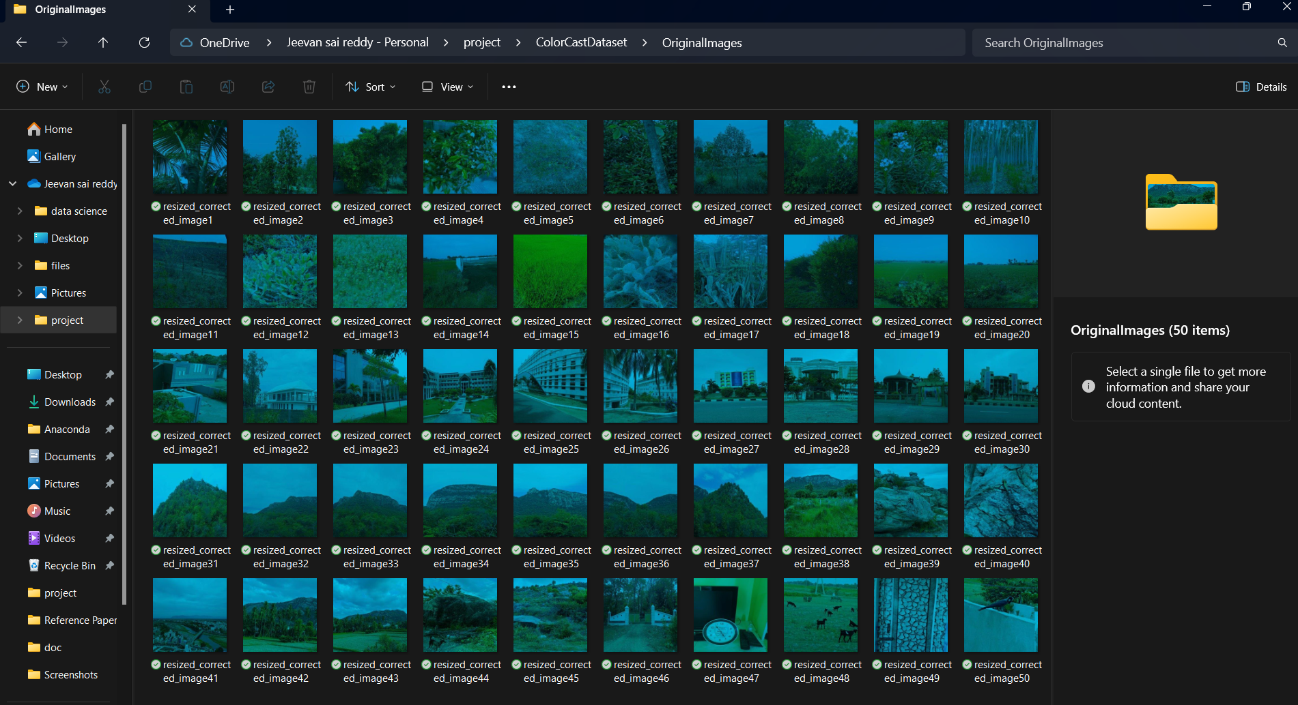
DATASETS OR SOURCES

Slide 12
Existing Methods
Color Correction Methods:
Gray World Algorithm
Max - RGB
Von Kries Hypothesis
White Balance Correction
Gamma Correction
Gray-Scale Enhancement Techniques:
Histogram-Based Method
Grey Edge Algorithm
Gray Pixel World
White Patch Retinex Algorithm

Slide 13

Existing Methods (Cont..)
The Gray World Algorithm assumes that under a neutral light source, the average color in an image should be Gray.
The Max - RGB method enhances intensity values by selecting the maximum among the red, green, and blue channels.
$$R_{corrected}=\frac{1}{R_{avg}}×R$$
$$G_{corrected}=\frac{1}{G_{avg}}×G$$
$$B_{corrected}=\frac{1}{B_{avg}}×B$$
I_{out}​ = max(R,G,B)

Slide 14


Existing Methods (Cont..)
The Von Kries Hypothesis adapts the color space based on luminance values, utilizing an adaptation matrix M_{adapt}​ to scale the color channels.
White balance correction adjusts color channels based on the color temperature of the light source.
$$\left[\begin{matrix}R_{corrected} \\ G_{corrected} \\ B_{corrected}\end{matrix}\right]=M_{adapt}×\left[\begin{matrix}R \\ G \\ B\end{matrix}\right]$$
$$\left[\begin{matrix}R_{corrected} \\ G_{corrected} \\ B_{corrected}\end{matrix}\right]=M×\left[\begin{matrix}R \\ G \\ B\end{matrix}\right]$$

Slide 15

Existing Methods (Cont..)
Histogram-based methods, such as histogram equalization, enhance contrast in grayscale images by redistributing intensity values based on the CDF of the image histogram.
The Grey Edge Algorithm enhances the perceptual quality of grayscale images by emphasizing edges and details.
The Gray Pixel World technique adjusts the intensity of each pixel based on the average intensity of the entire image.
$$I_{corrected}=\frac{\sum{I_{pixels}}}{Number of pixels}$$

Slide 16
Existing Methods (Cont..)
The White Patch Retinex algorithm applies the Retinex algorithm, emphasizing local color changes in an image.
The corrected intensity I_{corrected}​ is computed using the Retinex formula, which involves the logarithm of the ratio of the original intensity to an estimated illumination value.

Slide 17
Proposed Method
The proposed approach is based on the statistical method of regression analysis
Here, the strategy is to identify the coefficients (such as a, b below) to fit the equation below, given the data set of <x, y> values
e is some random element
we need to expand on this to be an n-dimensional formula since our data will consist of elements X = {x₁, x₂, x₃, …, x_{n}}, and y
y = α + βx + ε
There are a variety of ways to do regression including applying using some sort of distribution (e.g., Gaussian), applying the method of least squares, applying Bayesian probabilities, etc
note: neural networks are a form of non-linear regression

Slide 18
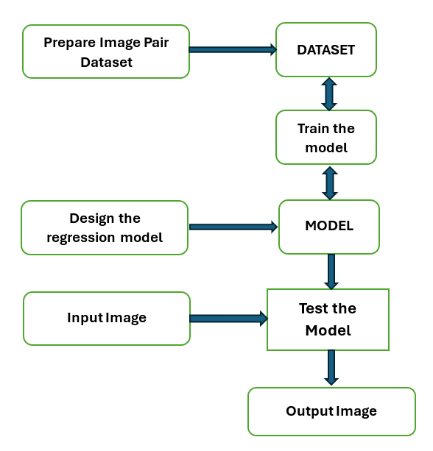
FLOW DIAGRAM

Slide 19
Proposed Method (Cont..)
Setting up file paths:
The code starts by defining paths to folders containing original and corrected images (originalFolderPath and correctedFolderPath).
It lists all JPEG files in these folders using the dir function.
Loading and storing RGB values:
It initializes empty arrays originalRGB and correctedRGB to store RGB values of original and corrected images, respectively.
It reads each original and corrected image using a loop, converts them to double precision, and flattens them to a single row per image.
It concatenates the flattened RGB values of each image to the corresponding array (originalRGB or correctedRGB).
Performing linear regression:
It computes the linear transformation matrix coefficients using the pseudo-inverse (pinv) of original RGB values (originalRGB) and corrected RGB values (correctedRGB).

Slide 20
Proposed Method (Cont..)
4. Loading a test image:
It loads a test image using imread.
It retains a copy of the original test image in testImg1.
5. Applying color cast correction:
It reshapes the test image into a 2D array of RGB values.
It applies the learned transformation matrix coefficients to the RGB values of the test image to perform color cast correction.
It converts the corrected RGB values back to uint8 format and reshapes them to the original image dimensions.
6. Evaluating the corrected image:
It initializes an array fm_deg to store the quality metrics.
It calculates quality metrics for the corrected test image using the fmeasure function for different parameters ('ACMO', 'BREN', 'GRAS', 'LAPM', 'LAPV', 'LAPD', 'WAVV').

Slide 21
Design Metrics
Absolute central moment (ACMO)
Brenner's focus measure (BREN)
Squared gradient (GRAS)
Modified Laplacian (LAPM)
Variance of Laplacian (LAPV)
Diagonal Laplacian (LAPD)
Wavelet variance (WAVV)

Slide 22
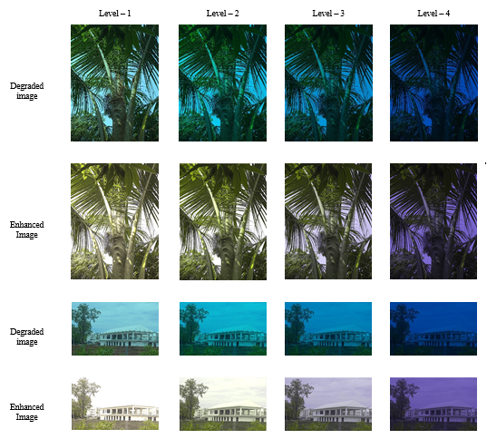
Simulation Results

Slide 23
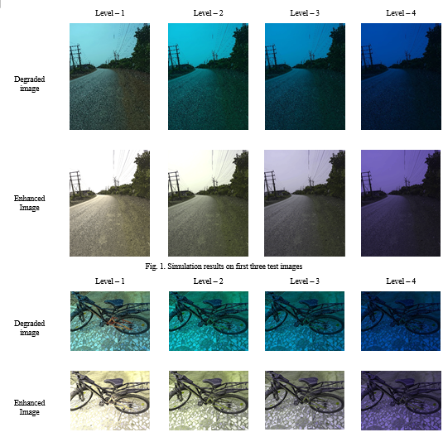
Simulation Results

Slide 24
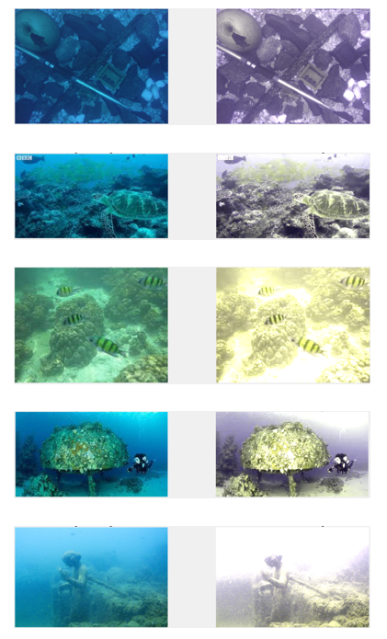
Simulation Results

Slide 25
Simulation Results
on Level-1 degraded images
 | ACMO | BREN | GRAS | LAPM | LAPV | LAPD | WAVV
Im- 1 | 70.77 | 1841 | 39.3 | 15.45 | 1082 | 28.9 | 59.28
Im - 2 | 65.61 | 1045 | 29.9 | 11.42 | 714 | 22.8 | 48.44
Im - 3 | 73.29 | 1489 | 48.5 | 16.79 | 834 | 33.5 | 69.14
Im - 4 | 65.89 | 917 | 30.2 | 10.27 | 483 | 21.1 | 35.12
Im - 5 | 76.52 | 119 | 13.6 | 2.066 | 15.5 | 4.47 | 1.478
Im - 6 | 60.67 | 833 | 27.5 | 8.686 | 475 | 17.8 | 28.89
on Level-2 degraded images
 | ACMO | BREN | GRAS | LAPM | LAPV | LAPD | WAVV
Im-1 | 65.72 | 1269 | 34.26 | 11.40 | 525.3 | 22.89 | 32.875
Im-2 | 72.41 | 690 | 27.18 | 8.860 | 319.1 | 18.61 | 25.528
Im-3 | 74.23 | 756.4 | 38.48 | 11.4 | 328.7 | 23.95 | 32.229
Im-4 | 56.87 | 656.3 | 31.21 | 9.0 | 231.6 | 19.25 | 19.001
Im-5 | 73.9 | 69.28 | 10.24 | 2.04 | 10.08 | 4.296 | 1.1487
Im-6 | 68.2 | 544.1 | 26.91 | 7.13 | 222.5 | 15.17 | 15.652

Slide 26
Simulation Results
on Level-3 degraded images
 | ACMO | BREN | GRAS | LAPM | LAPV | LAPD | WAVV
Im- 1 | 54.646 | 809.68 | 30.79 | 8.8321 | 283.7 | 18.77 | 18.697
Im - 2 | 56.706 | 385.47 | 21.9 | 6.3776 | 159.3 | 13.7 | 14.092
Im - 3 | 58.69 | 406.48 | 29.08 | 8.1385 | 166.9 | 17.43 | 17.653
Im - 4 | 44.065 | 372.89 | 23.35 | 6.5728 | 115.7 | 14.2 | 10.412
Im - 5 | 57.218 | 39.172 | 6.569 | 1.6235 | 6.177 | 3.366 | 0.91
Im - 6 | 60.237 | 304.27 | 20.88 | 5.2481 | 116.5 | 11.32 | 9.0933
on Level-4 degraded images
 | ACMO | BREN | GRAS | LAPM | LAPV | LAPD | WAVV
Im-1 | 35.759 | 321.57 | 21.84 | 5.3622 | 98.03 | 11.72 | 7.5657
Im-2 | 38.733 | 148.75 | 14.46 | 3.8653 | 55.94 | 8.354 | 5.7523
Im-3 | 39.693 | 150.54 | 16.68 | 4.8727 | 60.06 | 10.48 | 6.9835
Im-4 | 30.801 | 146.06 | 13.74 | 4.1174 | 42.95 | 8.879 | 4.3234
Im-5 | 38.064 | 17.737 | 3.237 | 1.2684 | 4.047 | 2.569 | 0.7549
Im-6 | 42.629 | 116.53 | 12.78 | 3.2583 | 42.71 | 7.027 | 4.0789

Slide 27
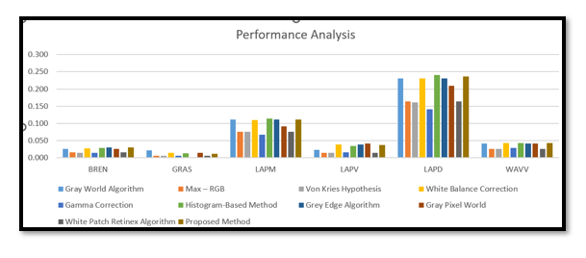
SIMULATION RESULTS

Slide 28
Applications
Photography
Image Editing and Retouching
Medical Imaging
Remote Sensing and Satellite Imagery
Forensic Analysis
Artificial Intelligence and Computer Vision
Archival and Historical Preservation
Agricultural Monitoring
Geological Surveying
Surveillance and Security

Slide 29
Conclusions
The current research highlights the challenges of color cast correction in digital imagery and evaluates traditional methods against a novel machine learning-based approach.
While traditional algorithms show moderate effectiveness, they struggle with complex lighting conditions.
Conversely, the proposed machine learning method demonstrates superior performance.
Simulation results validate its effectiveness across varying levels of color degradation, showcasing significant improvements in color fidelity and image quality.

Slide 30
Future Scope
The proposed method can be extended to video color cast correction.
A more robust dataset can be considered with the highest computational capacity to achieve higher accuracy ranges.
Complex ML-models may be used on the dataset to achieve better results.

Slide 31
References
Rizzi, A., Gatta, C., Marini, D. A new algorithm for unsupervised global and local color correction. Pattern Recognition Letters, Vol 24, No. 11, pp. 1663 - 1677, July. 2003.
Verma, O. P., Kumar, P., Hanmandlu, M., Chhabra, S. High dynamic range optimal fuzzy color image enhancement using Artificial Ant Colony System. Applied Soft Computing, Volume 12, Issue 1, pp. 394 - 404 January 2012.
Sethi, R., Sreedevi, I., Verma, O. P., & Jain, V. (2015, December). An optimal underwater image enhancement based on fuzzy gray world algorithm and Bacterial Foraging algorithm, IEEE Fifth National Conference on Computer Vision, Pattern Recognition, Image Processing and Graphics (NCVPRIPG), pp. 1 - 4 December,2015.
Xie, Z. X., Wang, Z. F. Color Image Quality Assessment Based on Image Quality Parameters Perceived by Human Vision System, International Conference on Multimedia Technology (ICMT), Ningbo 29 - 31 Oct. 2010.
Zhang, X. M., Wandell, B. A. A spatial extension to CIELAB for digital color image reproduction, Symposium Proceedings, 1996.
Finlayson, G.D., Trezzi, E. Shades of gray and color constancy, Proc. of IS&T/SID Color Imaging Conference, Scottsdale, Arizona, USA, pp.37 – 41, 2004.

Slide 32
Thank you

