Slide 1
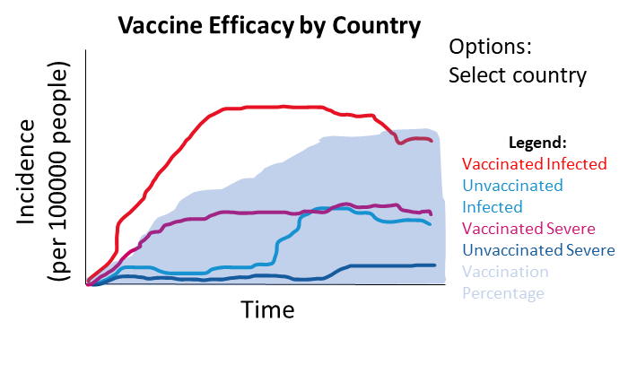
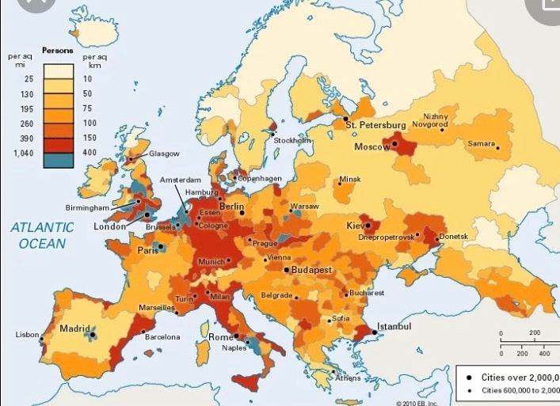
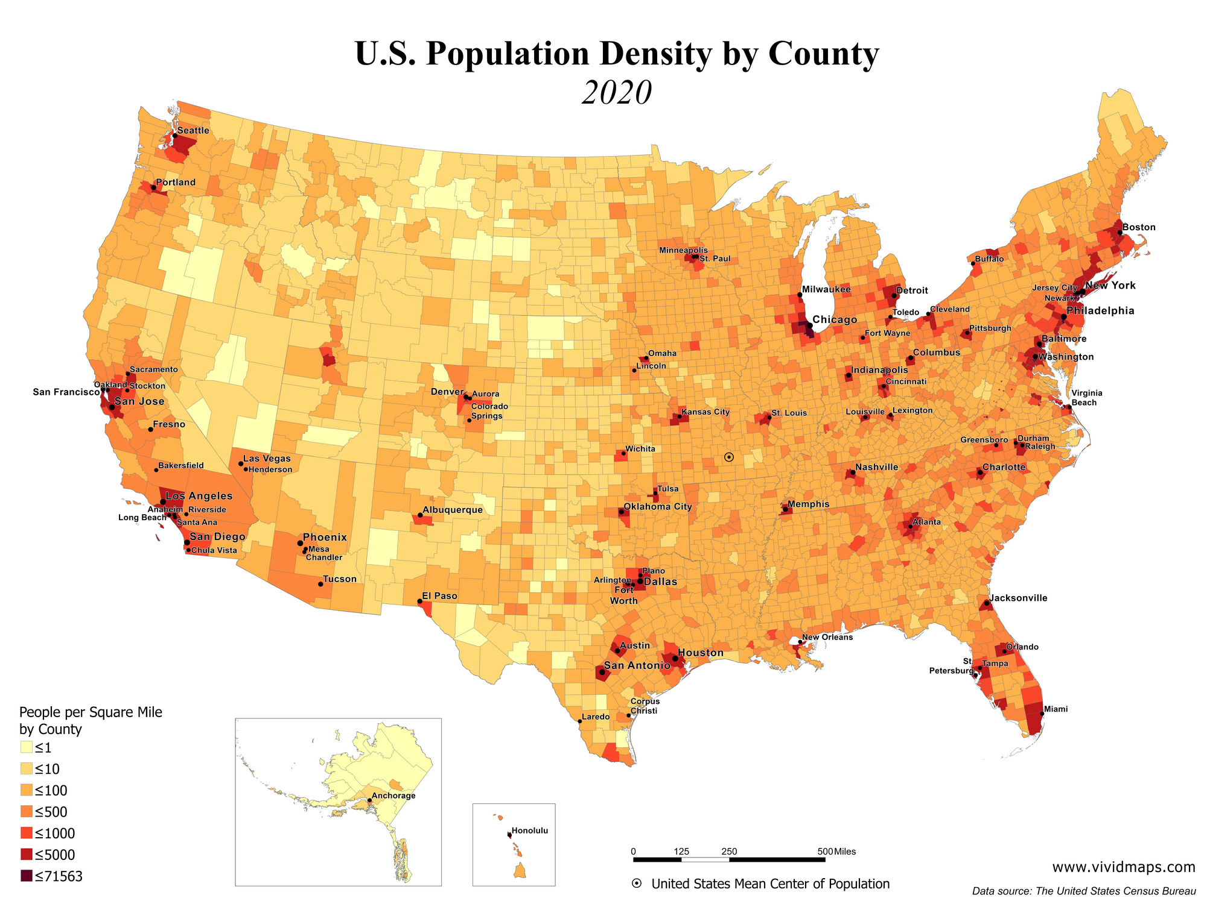
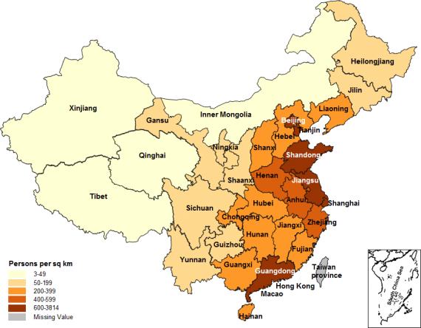



Relationships between COVID-19 and Various Factors:
Vaccination, Population, Tourism, Lockdown Measures
Vaccine Efficacy by Country
Options:
Select country
Incidence
(per 100000 people)
Legend:
Vaccinated Infected
Unvaccinated Infected
Vaccinated Severe
Unvaccinated Severe
Vaccination Percentage
Time
COVID Cases vs Tourism, Population, and Lockdown Measures
Interactive Map
Optional: Inlaid maps of US and China
Date Options:
Several date options (years or important timepoints)
Layer options:
Tourism traffic
Population density
Lockdown measure severity
COVID cases (by country)
Comparison of Lockdown Measures
Country | Measures →
Spain
Italy
Switzerland
Etc

