Slide 1
NASDAQ – AT&T, T-Mobile, Verizon
Andrew, Madi, Seth, Joshua

Slide 2
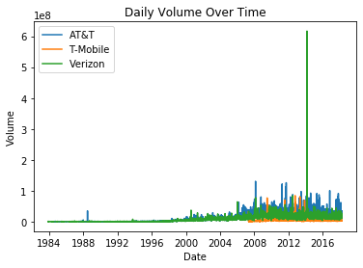
1 - How much did the stock volume fluctuate for each company?

Slide 3
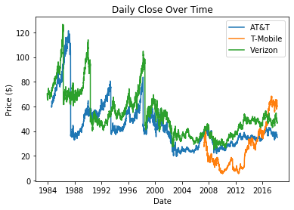
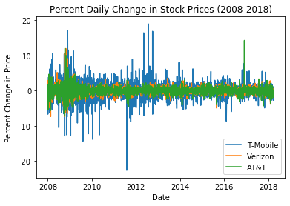
2 - How did Price change over each companies lifetime?

Slide 4
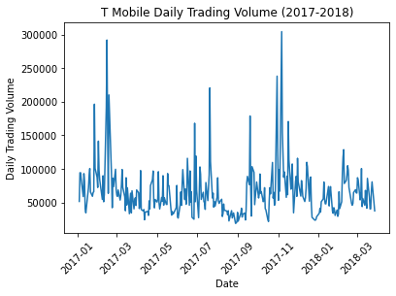
3 - How did stock volume change in the most recent years?

Slide 5
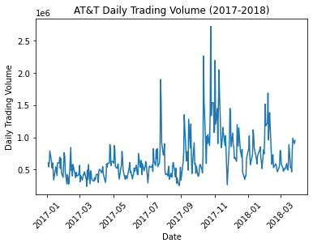

Slide 6
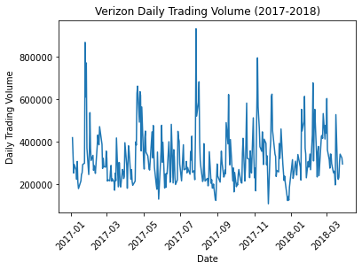

Slide 7
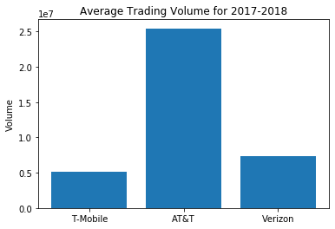

Slide 8
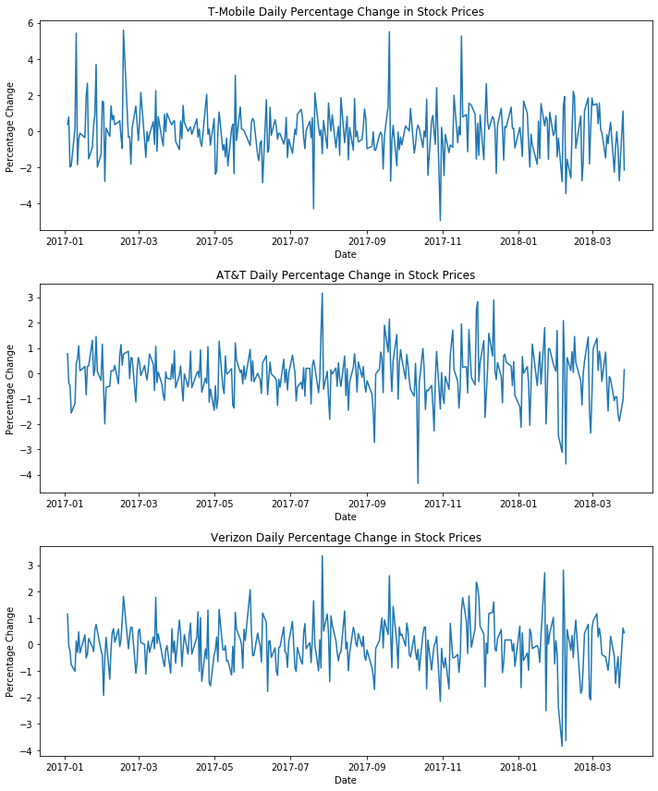
4 - How did Stock Price change in the most recent years?

Slide 9
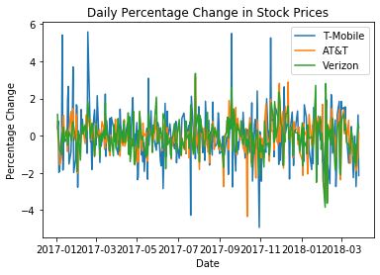

Slide 10
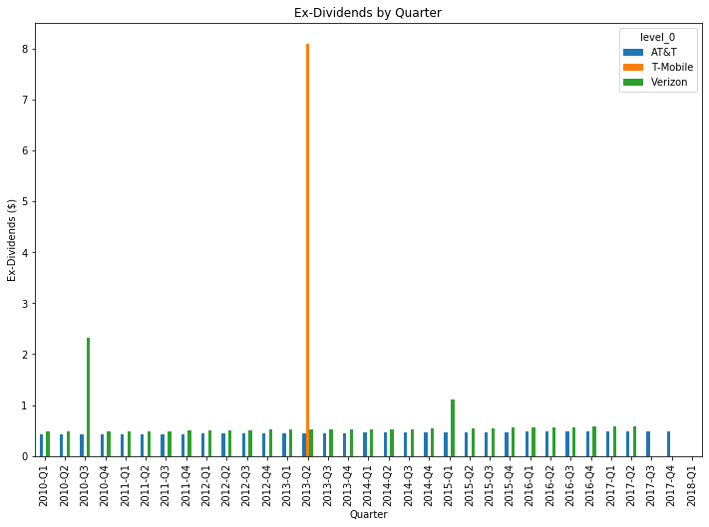
5 - Which company provides the higher and most consistent dividends for our investor?

Slide 11
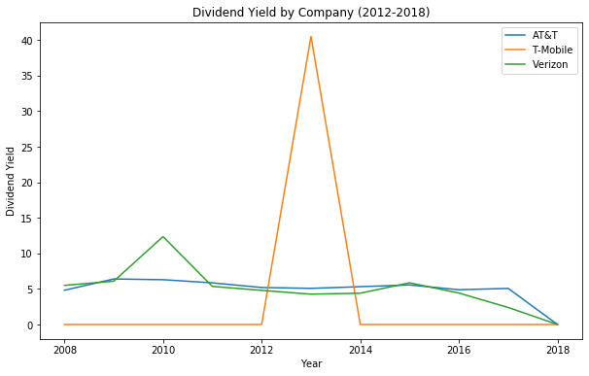

Slide 12
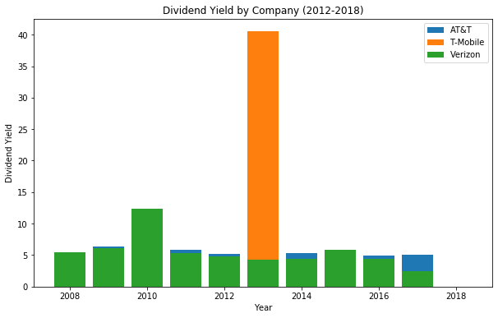

Slide 13
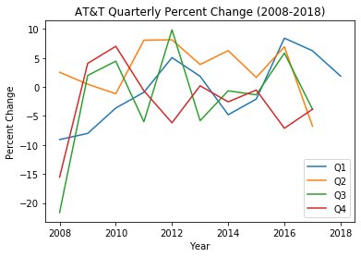
6 - How does the time of year affect the stock value? Are there seasonal trends?

Slide 14
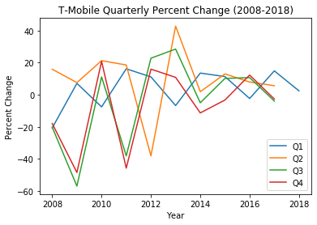

Slide 15
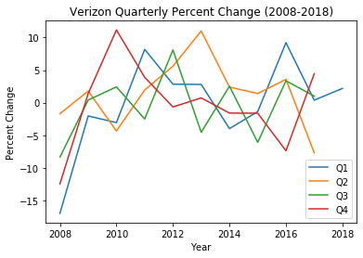

Slide 16
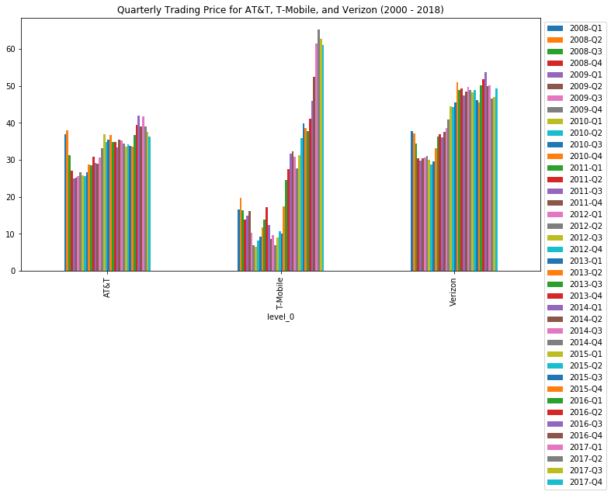

Slide 17
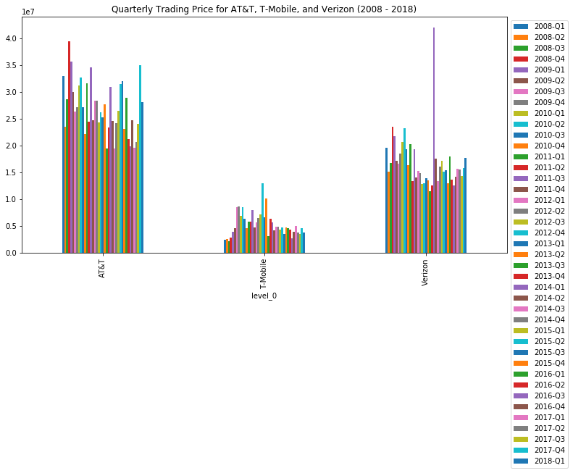

Slide 18
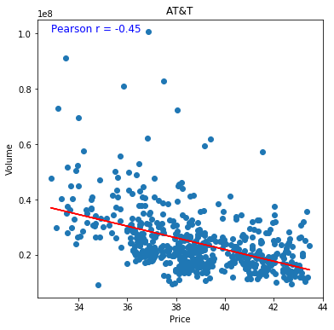
7 - What is the correlation between price and volume for each company
As price increases volume increases there is a moderately stonge negative correlation here.

Slide 19
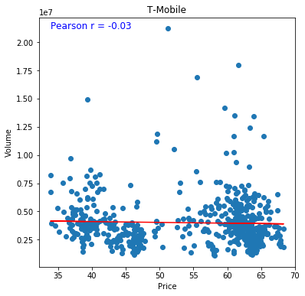
T-Mobile has a very weak correlation between volume and price

Slide 20
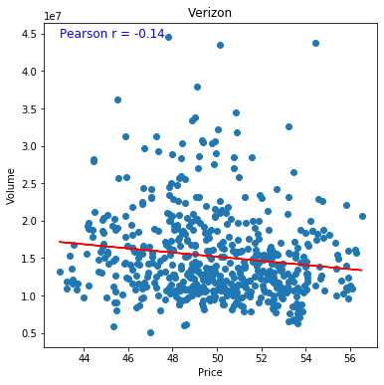
Verizon also has a weak correlation with several outliers.

