Slide 1
NASDAQ – AT&T, T-Mobile, Verizon
Andrew, Madi, Seth, Joshua

Slide 2
1 - How much did the stock volume fluctuate for each company?
Volume is the number of shares transactions between the open and close on a daily basis.
Looking at volume over the lifetime of a company is beneficial because it provides us insight into the growth and health of the business.
We are able to
Identify trends and volume patterns. If there are spikes or dips, it is useful insight to look into events in that time period
Observe the Market liquidity to see how easy it is to sell and buy the stock
Insight into investor sentiments. High volume indicates buying and selling opportunities.

Slide 3
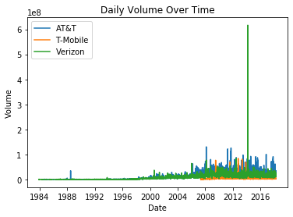
Verizon has a massive spike in 2014 in its daily volume, we will look into this further later in the analysis

Slide 4
2 - How did Price change over each companies lifetime?
Price of stock is the price of a single share. It is determined by calculating the company market capital divided by the number of shares
Stock price varies depending on the companies performance, industry trends and investor behavior.
With this, we are able to
Indicate its current value to buyers and sellers.
Indicate the health of the company compared to others in the industry.
Identify stocks that are currently undervalued by the market.

Slide 5
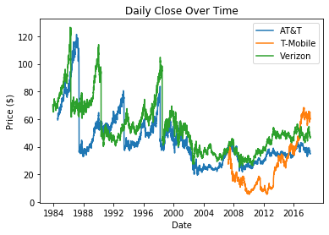
As we can see, T Mobiles data is limited to 2007-2018. Therefore, it is best to focus on the last 10 years of the data

Slide 6
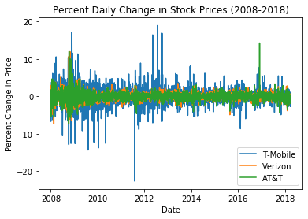
We notice that T Mobile's price change fluctuations are severe. We are looking for a more linear or consistent positive percentage change. This indicates the stock price is increasing or staying at a competitive price in relation to industry.

Slide 7
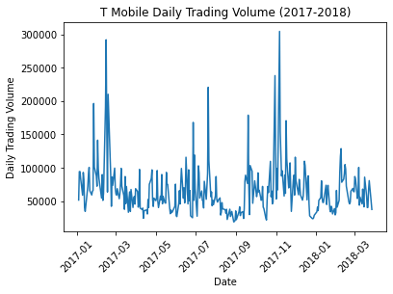
3 - How did stock volume change in the most recent years?
Daily trading volume allows us to see the number of shares of a stock that are traded in a given day. This helps us assess the liquidity of the market for that stock

Slide 8
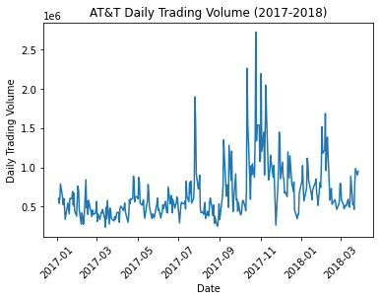
High trading volume: Usually good, meaning there is an active market. Usually beneficial for traders that want to buy/sell shares.

Slide 9
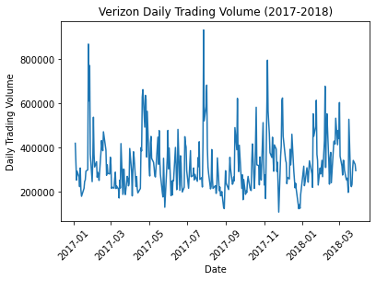
Low trading volume: Not a good indicator. Could be a sign that there's not a lot of interest in the stock or that people are not actively trading; this means shares increasingly more difficult to buy/sell at good prices.

Slide 10
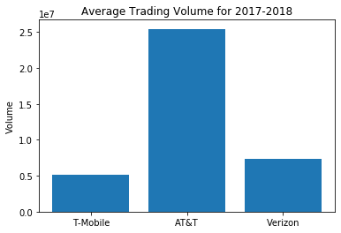
By comparing the average daily trading volume for the three companies, we’ll get an idea of how actively the stock is traded in the market and compare them to see which is being traded at a higher rate
T-Mobile's average daily trading volume for 2017-2018 was 5099418.919753087.
AT&T's average daily trading volume for 2017-2018 was 25438714.100323625.
Verizon's average daily trading volume for 2017-2018 was 7391080.3091938095.
ATT is more liquid than the others. Investors can sell and buy these shares easier than the other two companies for this reason.

Slide 11
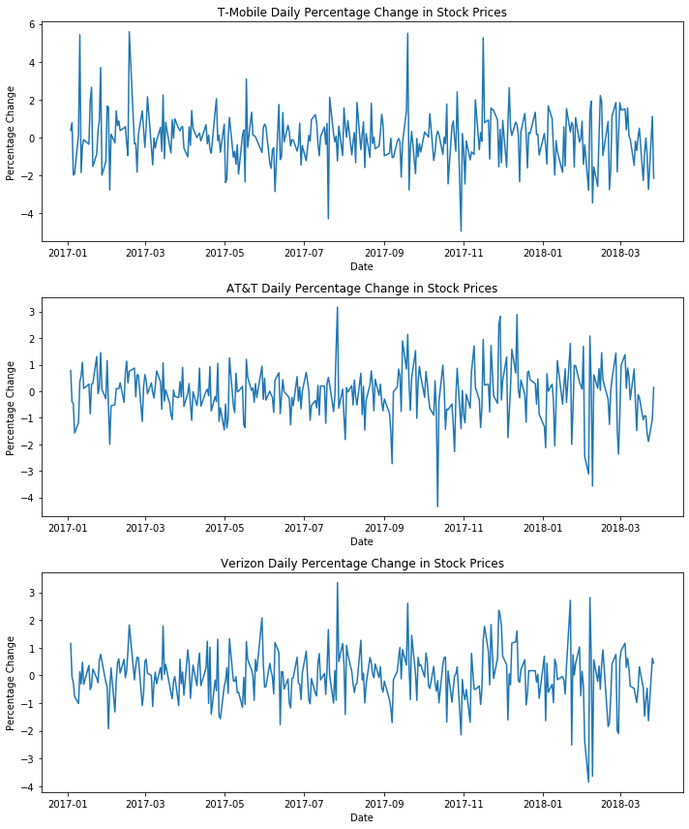
4 - How did Stock Price change in the most recent years?
The daily percent change in stock prices is useful because it gives an idea of how much the stock has moved up or down in a day.
It helps us identify trends, volatility, and trading opportunities. This also helps investors make more informed decisions when buying or selling.

Slide 12
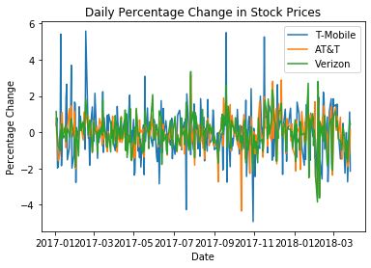
Even zoomed in on the last year we see that T Mobile has more fluctuations, ATT and Verizon are less volatile indicating they are more stable and better investment choices with the given data

Slide 13
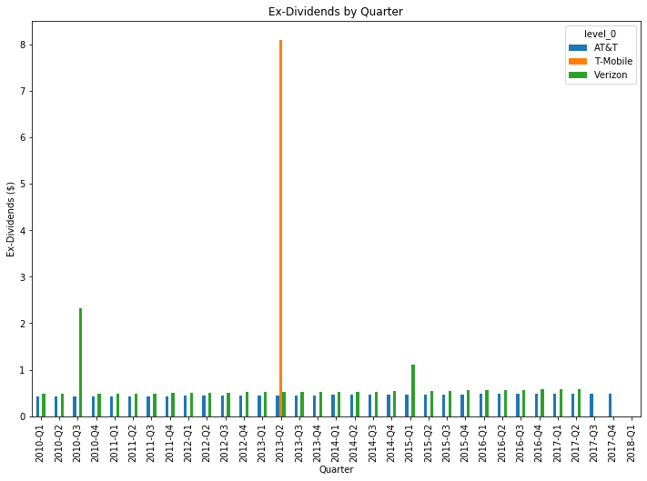
5 - Which company provides the higher and most consistent dividends for our investor?
Quarterly ex-dividends tell investors how much the company gives in dividends to investors.
T Mobile has such a high amount of cash on hand in Q2 2013. This is not a good sign of stability in dividends paid. Verizon seems to be doing well in its overall dividend payments; however, AT&T is the most consistent.

Slide 14
Dividend Yield
To get the Dividend Yield, we sum all the dividends of a given year and divide it by the mean of the stock price of that year.
Dividend Yield gives investors an idea of how much income they can expect to receive for each dollar invested in a particular stock.
Dividend Yield = Total Dividend / Price

Slide 15
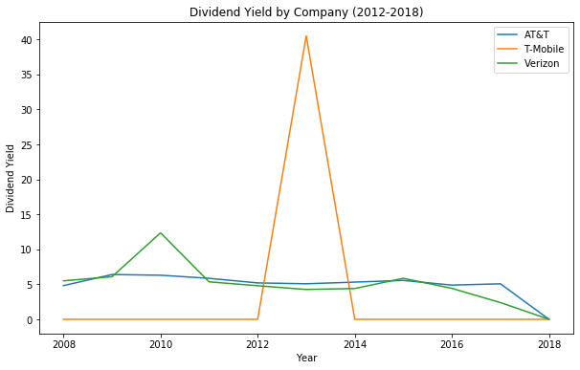
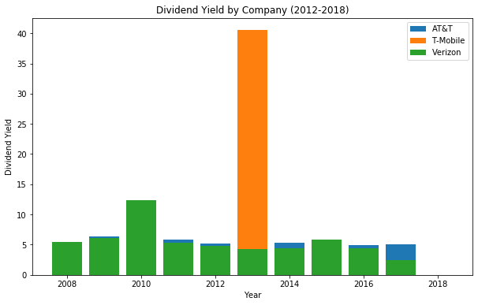
AT&T and Verizon make consistent dividend payments, which is important for an investor seeking to get a steady income from their investments. T Mobile on the other hand only paid their dividends in 2013 in one big lumpsum.

Slide 16
This could mean that T Mobile usually reinvests its profits into the business or that it had a significantly profitably year in 2013 and decided to pay a high dividends payment.
Looking at this alone would not give us much insight into the companies financial state however. It is important to look at the financial reports to get a better idea of how each company is doing.

Slide 17
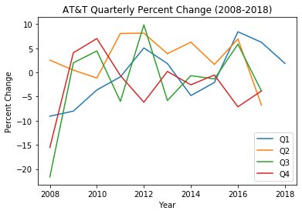
6 - How does the time of year affect the stock value? Are there seasonal trends?
The data show us that there are no quarters that show significant peaks or that lead an investor to make short term investment decisions. The fluctuations in price don't seem to be related to the time of year.
AT&T Quarter 2 seems to have the highest rate throughout the years. It is the only quarter that shows fewer fluctuations.

Slide 18
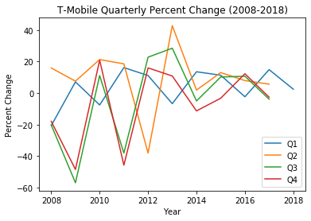
T Mobile shows fewer fluctuations in Quarter 1 but its percent change is severe.

Slide 19
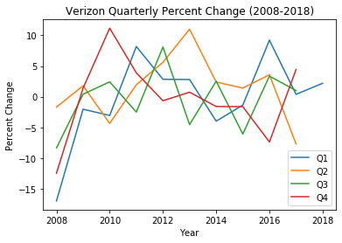
Verizon has no obvious pattern from these graphs.

Slide 20
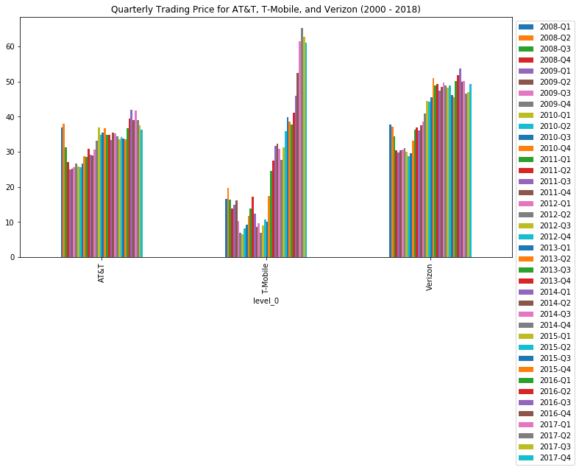
Quarterly Price and Volume

Slide 21
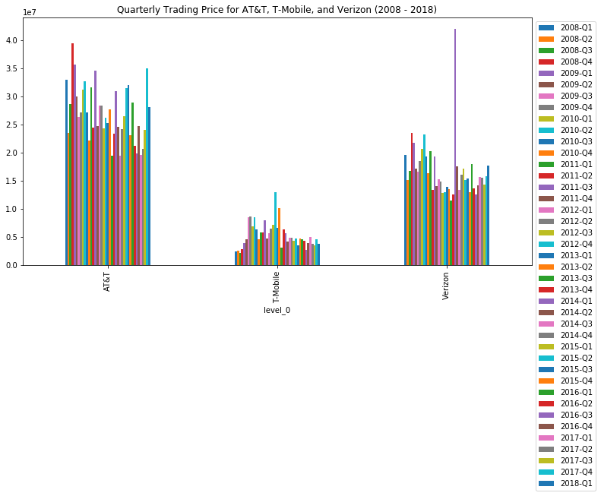

Slide 22
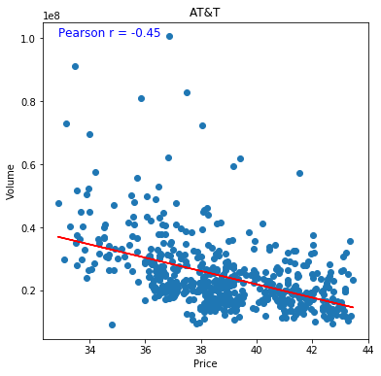
7 - What is the correlation between price and volume for each company
As price increases volume increases there is a moderately stonge negative correlation here.

Slide 23
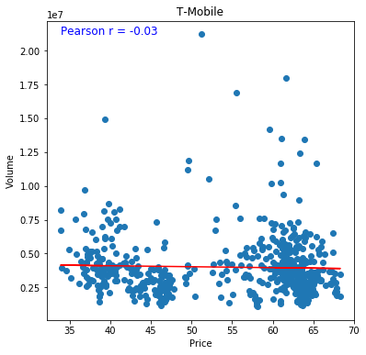
T-Mobile has a very weak correlation between volume and price

Slide 24
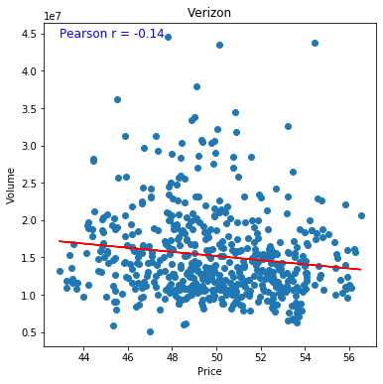
Verizon also has a weak correlation with several outliers.

