Slide 1

B-Ball Brain
Chidubem Arachie
Mahesh Narayanamurthi
Steven Roberts
Patrick Sullivan
Notes:
Everyone

Slide 2
Previous Research
Title | Authors
Prediction of NBA Games based on Machine Learning Methods | Torres, Renator Amorim
Predicting NBA Games using Neural Networks | Loeffelholz, Bernard, Earl Bednar, and Kenneth W. Bauer
Artificial Intelligence in Sports Prediction | McCabe, Alan, and Jarrod Trevathan
Predicting the Outcome of NBA Playoffs Based on the Maximum Entropy Principle | Cheng, Ge, et al
Notes:
Chidubem?

Slide 3
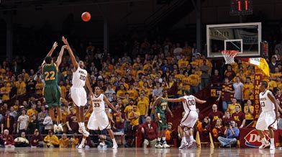
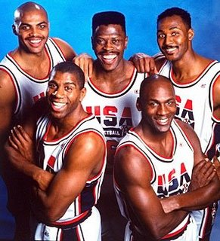
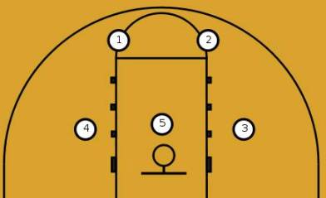
Basketball 101
Positions
5 versus 5
Notes:
Patrick

Slide 4
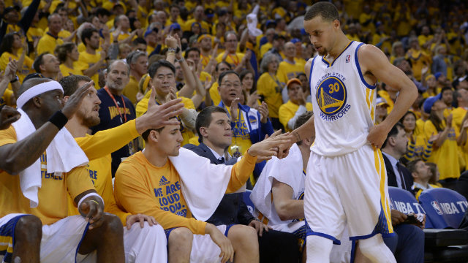
Substitutions
Substitutions make each game more complex than a 5 vs 5 game.
Games have many combinations of two 5-man teams
Notes:
Mahesh

Slide 5
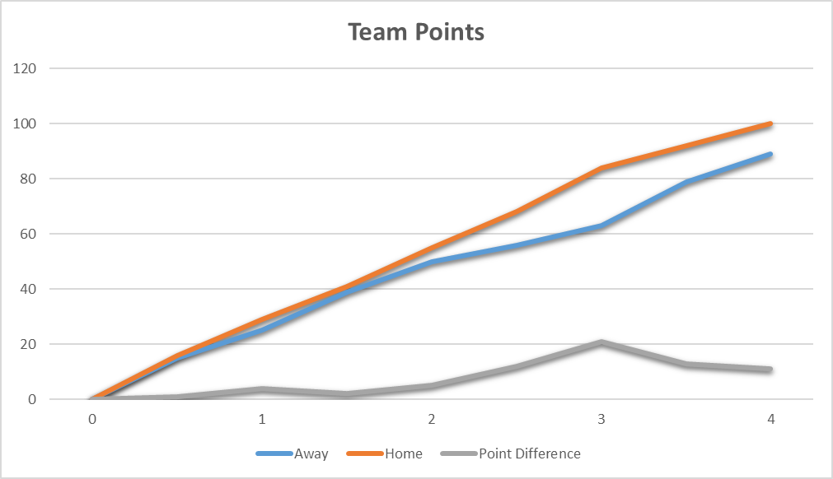
Plus Minus Per Minute
Notes:
Patrick

Slide 6
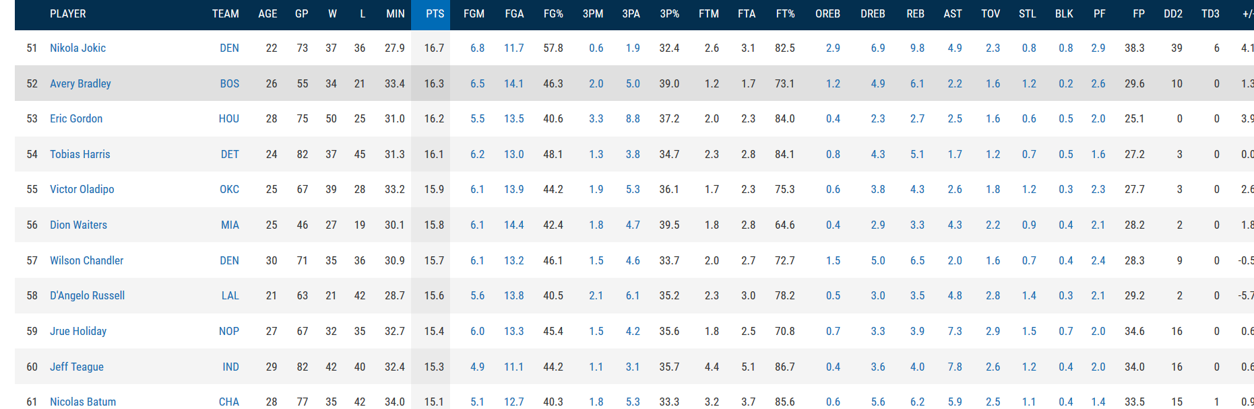
Stats.NBA.com
1,309 Games in 2016-17
486 Players in 2016-17
60 statistics per player
Notes:
Steven?

Slide 7
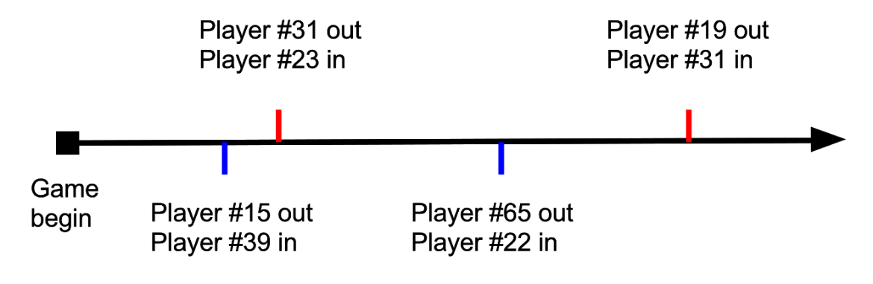
Time Capsules
We break each game down into time capsules: periods where 5 players play against 5 opponents an no substitutions between
Throw away invalid time capsules that occasionally occur due to errors in the game’s play-by-play (6 players on a team)
Minimum time capsule duration of 30 seconds
Notes:
Mahesh

Slide 8
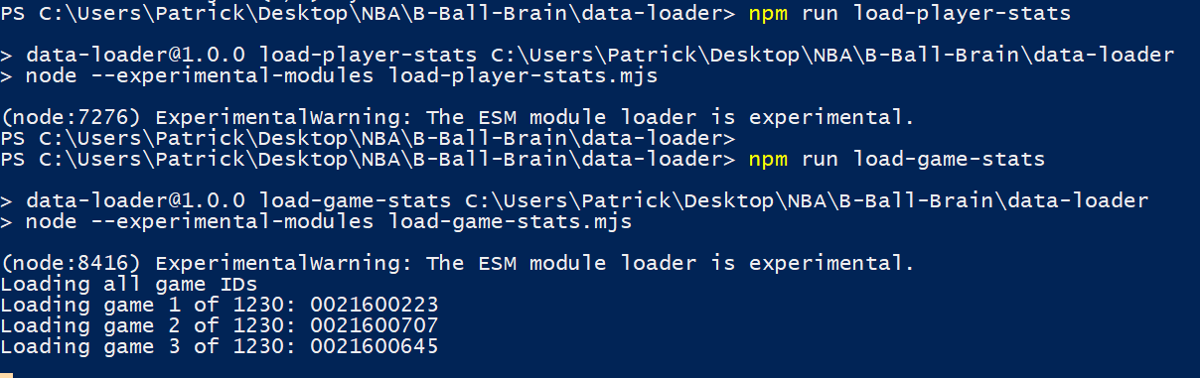
NBA API and Data fetching
Player data is gathered with season average stats
Game data given is play-by-play of events within a game
Game is then segmented when substitutions occur in game
Notes:
We use a Node

Slide 9
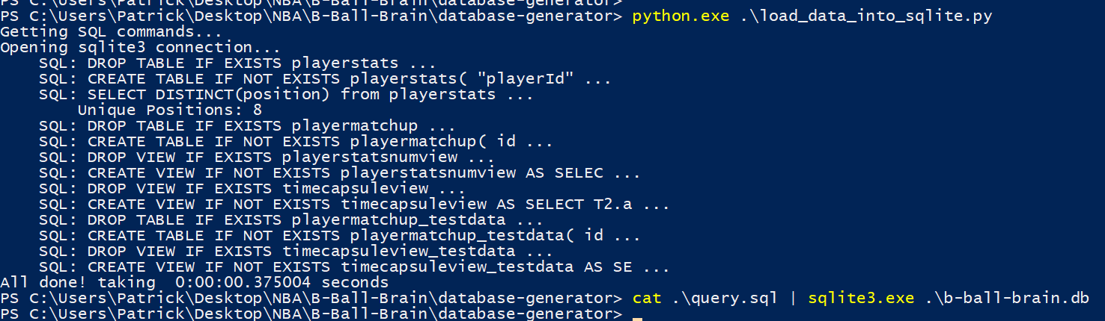
Database Generation
JSON data is then validated and loaded into SQLite Database
Views are created on the tables to combine each player’s season statistics with the 5 vs 5 outcome for a given time capsule
Notes:
Patrick?

Slide 10
Training and Testing Data
Training data size was 29,090 examples (time capsules)
From 1,230 games
The 2016-17 regular season
Testing size was 1,877 examples (time capsules)
From 79 games
The 2016-17 playoff games

Slide 11
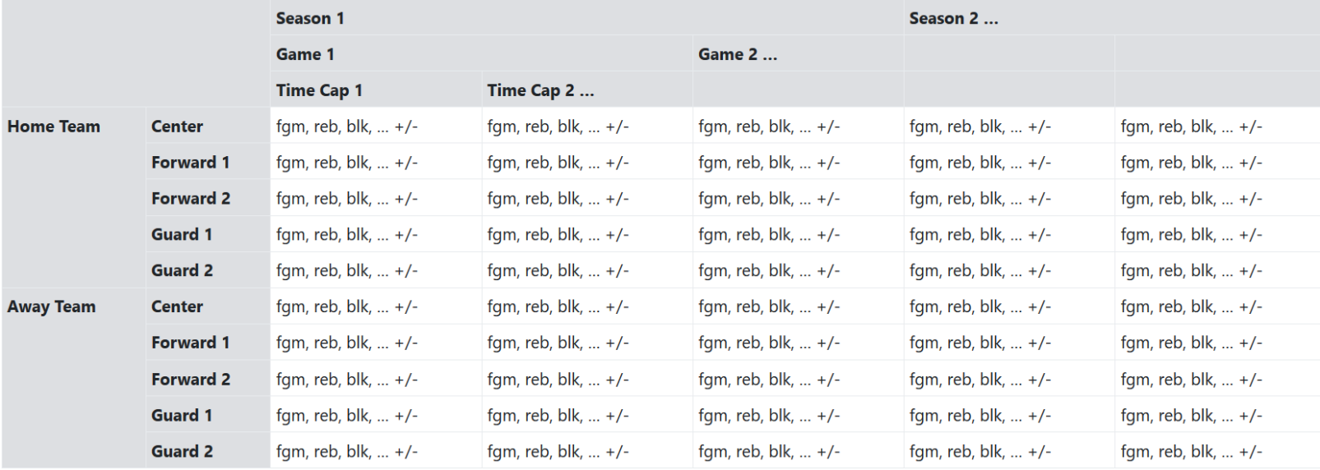
Data Representation
Flattened data is 600 features and 29,000+ examples (time capsules)
Target column is Plus Minus Per Minute
Notes:
Patrick?

Slide 12
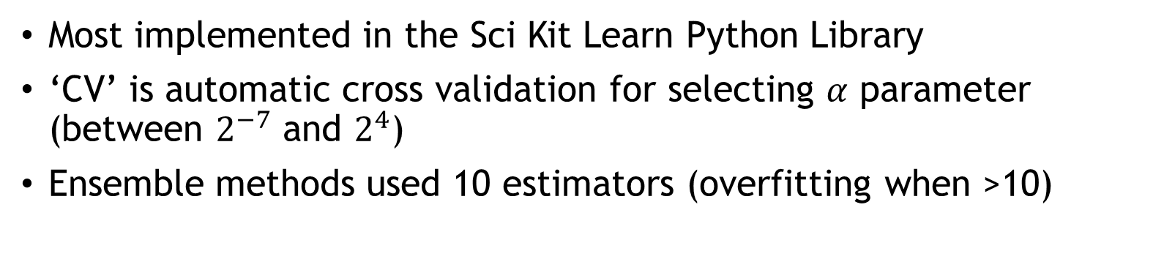
Regression Models
Linear Regression
Bayesian Ridge Regression
RidgeCV Regression
ElasticNetCV Regression
LassoCV Regression
GradientBoostingRegressor
AdaBoostRegressor
ExtraTreesRegressor
RandomForestRegressor
Most implemented in the Sci Kit Learn Python Library
‘CV’ is automatic cross validation for selecting $α$ parameter (between $2^{−7}$ and $2^{4}$)
Ensemble methods used 10 estimators (overfitting when >10)

Slide 13
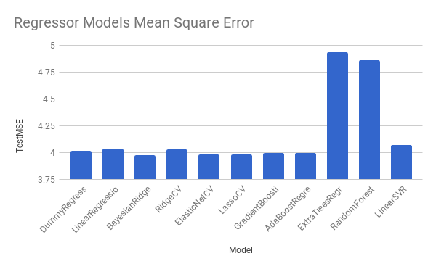
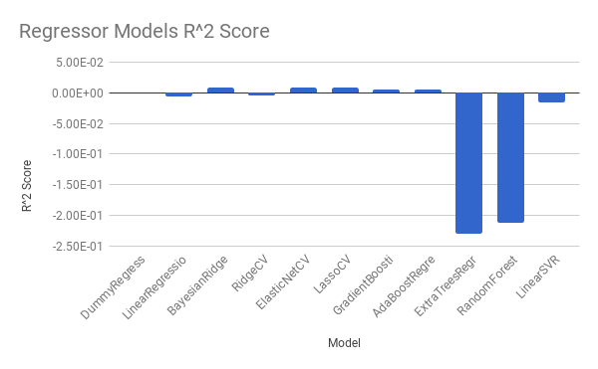
Regression Results

Slide 14
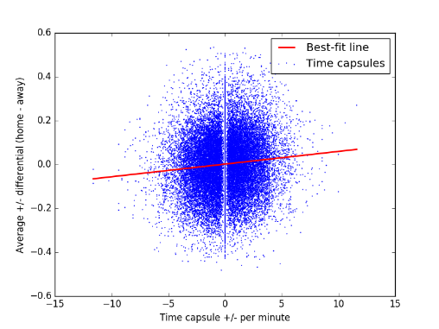
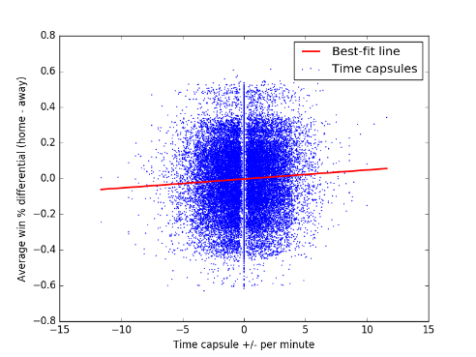
Regression Results Retrospective
Amount of noise in the data is quite high
Exact scores can be messy since end-of-game events happen very rapidly.
Binary Win-Loss is the simplified approach.

Slide 15
Classification Models
LogisticRegression
LinearDiscriminantAnalysis
KNeighborsClassifier
GaussianNB
SVC (linear kernel)
SVC (RBF kernel)
GradientBoostingClassifier
RandomForestClassifier
Feedforward Neural Network (FNN) with dropout
Ensemble methods (GradientBoostingClassifier) use 400 estimators
The FNN has one hidden layer with 50 neurons, sigmoid for activation, and p = 0.5 for dropouts
The LogisticRegression constant C=0.0005 (L2 regularization multiplier)

Slide 16
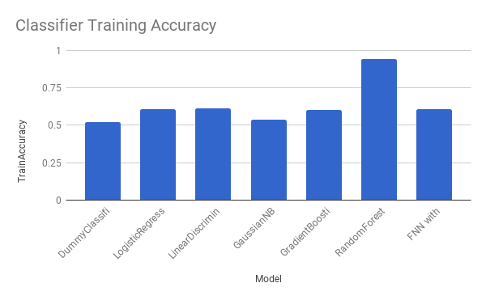
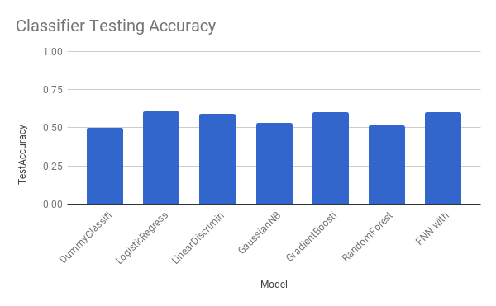
Classification Results
Unfinished Models: KNeighborsClassifier, SVC(linear kernel), SVC(RBF kernel)

Slide 17
Comparison to Previous Research
We can compare the difference between using player data instead of team data by comparing results to work from Torres
Model | Torres Accuracy | Our Accuracy
Naïve Classifier (baseline) | 63.98% | 49.71%
Logistic Regression Classifier | 67.44% | 60.58%
Increase from dumb to smart model: | 3.46% | 10.87%
Notes:
Chidubem?

Slide 18
Final Thoughts
More training can be done using several previous seasons. Stats.NBA.com has 20 years of data. We used 1.
Testing on the playoff games has some testing sample bias (playoffs are composed of the best teams from the regular season)
The minimum duration for a time capsule can be adjusted for even more data (but could add more unnecessary noise)
Notes:
Anyone?

