Slide 1

Scraping and Analyzing Independent House Rentals in Hyderabad
By
Bharath Reddy Bollu

Slide 2
Problem Statement
Rental house seekers face difficulty accessing consolidated, clean, and insightful data.
Websites like Housing.com have rich information but do not allow direct download or aggregation.
Need to extract, organize, and analyze rental listings to uncover trends and assist decision-making.

Slide 3
Project Objectives
To collect rental listing data (location, rent, BHK, size, etc.) from Housing.com
for Hyderabad.
To perform data cleaning and preprocessing on the extracted information.
To uncover patterns, trends, and anomalies through univariate and bivariate analysis.
To derive actionable insights on rent pricing and housing trends.

Slide 4
Web Scraping – Details
Website Source
Website Scraped: housing.com
Target Section: Rental listings for independent houses/villas in Hyderabad
Scraping Process Followed
Collected Listing URLs
Scraped 32 pages
Each page contains ~30 listings
Total house links collected: ~800
Extracted Details from Each House Link
Address, BHK, Bathrooms, Rent, Area (sqft), Furnishing Status, Parking Availability, etc.
Tools & Libraries Used
requests, Beautifulsoup, pandas, matplotlib, seaborn, numpy and regex

Slide 5
Dataset Summary
Total Records: ~[e.g., 800] house listings collected from 32 pages.
Features Extracted: Address, BHK, Bathrooms, Area (sqft), Rent, Furnishing Status, Parking, Posted Date.
Categorical Features: Furnishing Status, Parking Availability, Facing, Property Type etc.
Numerical Features: BHK, Bathrooms, Area (sqft), Rent.
Date Field: Posted Date (used to analyze listing trends over time)
Target Variable: Rent (Continuos Variable)

Slide 6
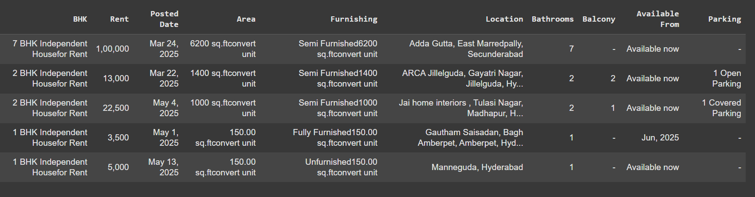
Raw Data

Slide 7
Exploratory Data Analysis
Data Cleaning and Preprocessing Steps
Feature Extraction:
Extracted BHK using regex from titles like “7 BHK Independent House for Rent”.
Extracted area_sqft using regex from titles like “6200 sq.ftconvert unit”.
Furnishing and Structure Details:
Separated furnishing_status (e.g., "Semi Furnished") from area string.
Replaced inconsistent values (“-”) in furnished, parking and balcony features with “Not Mentioned”.
Location Engineering:
Split address to create new columns: primary_location and city
Rent Cleaning:
Converted rent from string format (e.g., “1,00,000”) to integer by removing commas.

Slide 8
Date Handling:
Converted posted_date from string to datetime.
Created new time-based features:
posted_month
day_name
is_weekend
Deduplication & Column Management:
Removed 5 duplicate records.
Dropped intermediate columns: BHK, Posted Date, Area, Furnishing, Location.
Renamed and rearranged columns for better clarity.
Outlier Investigation:
Checked outliers in bhk, rent, and bathrooms.
Retained all values as valid based on contextual evidence (e.g., high area or location).

Slide 9
Univariate Analysis
Objective: To understand the distribution and characteristics of individual features in the dataset.
Analyzed numerical features using:
Histograms & Boxplots (e.g., rent, area_sqft, bhk, bathrooms)
Summary statistics (mean, median, min, max, quartiles)
Analyzed categorical features using:
Countplots (e.g., furnishing_status, parking, primary_location)
Frequency tables and bar plots
Checked for outliers in:
bhk, bathrooms, and rent using boxplots
No removal applied since values were meaningful and justified

Slide 10
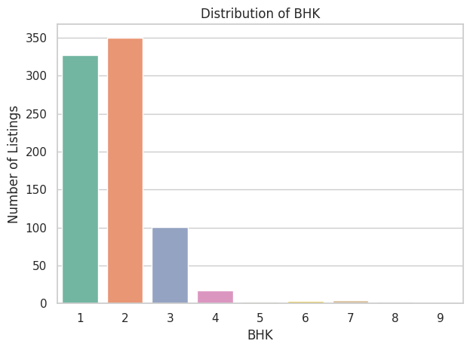
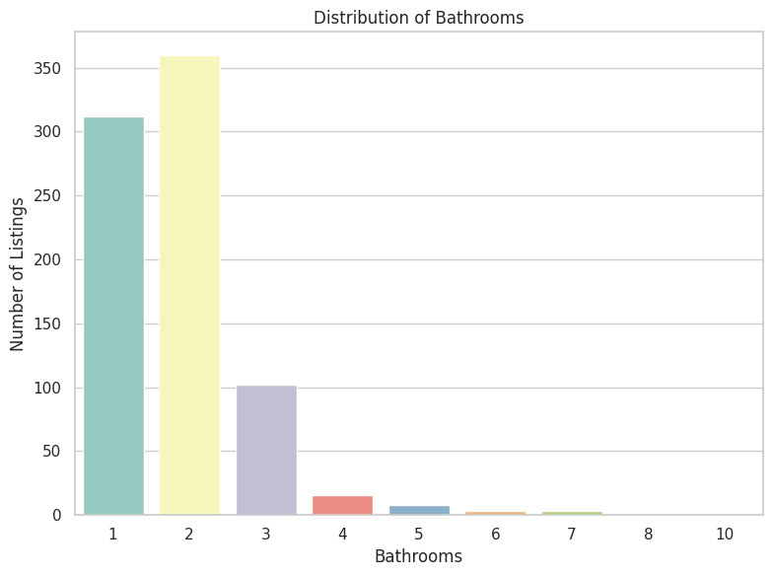
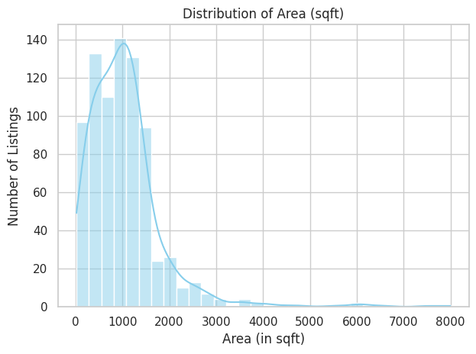
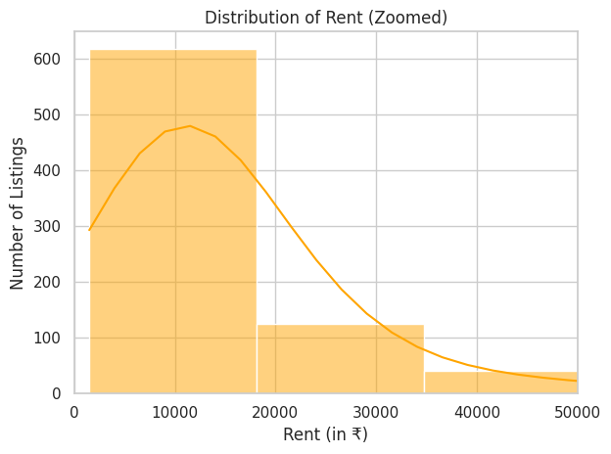
Visual Plots (Univariate Analysis)

Slide 11
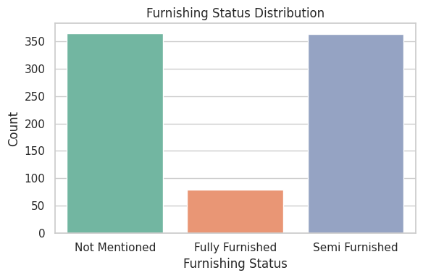
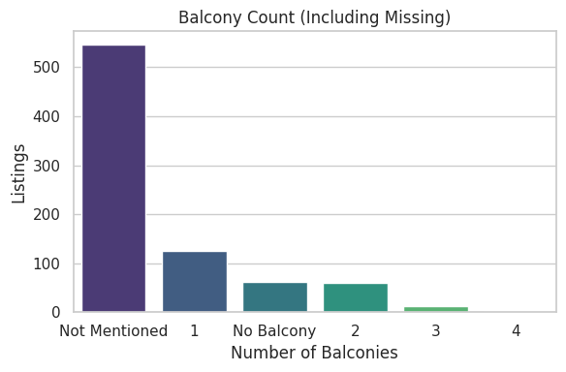
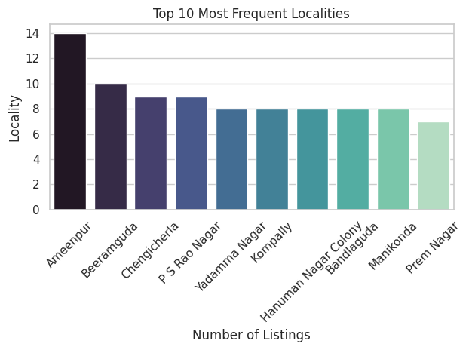
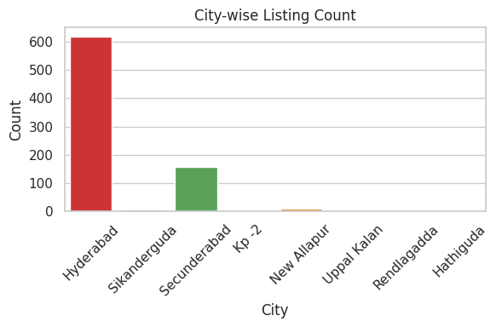
Visual Plots (Univariate Analysis)

Slide 12
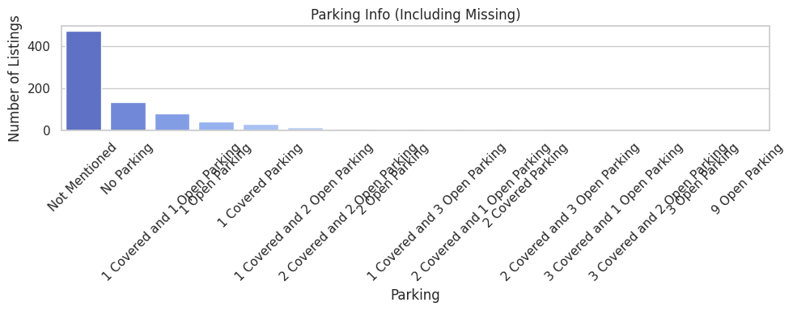
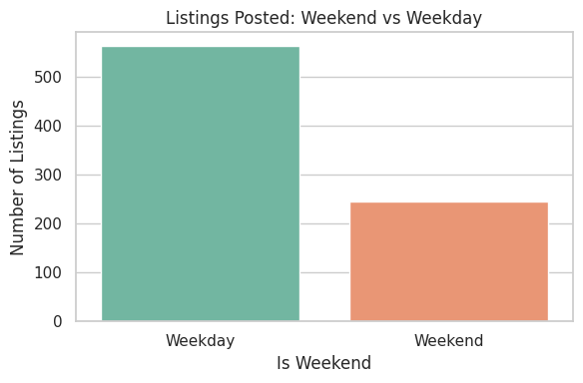
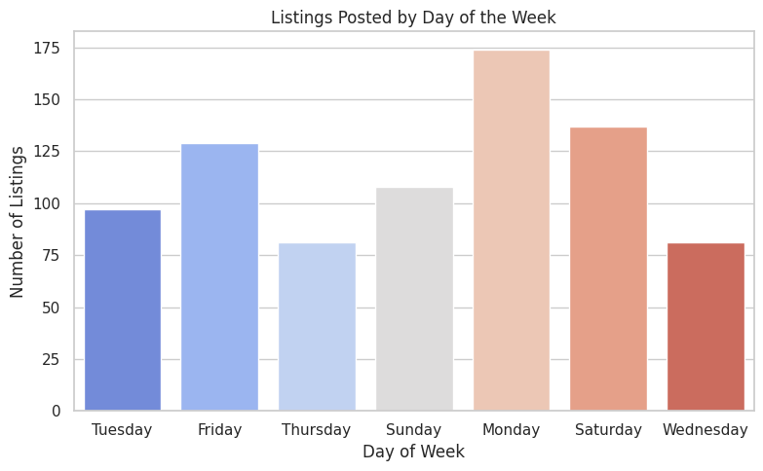

Slide 13
Univariate Analysis – Key Insights
Most listings are 2 BHK with 2 bathrooms, typically 500–1300 sqft in area.
Over 95% of listings have 1–4 BHKs and 1–4 bathrooms.
A few premium listings feature 9–10 BHKs and bathrooms with areas up to 8000 sqft.
Majority of rents fall between 8,000 – 18,000.
High-end rentals reach up to ₹5,00,000/month, corresponding to large luxurious properties.
45% are semi-furnished.
Parking info missing in 471 out of 799 listings; limited listings offer 1 open/covered slot.
547 listings (≈75%) have no balcony info.
Among the rest, most homes feature 1–2 balconies.
Most listings are from Hyderabad (614), followed by Secunderabad.
Ameenpur is the most frequently listed locality.
693 listings are available now (immediate occupancy).
174 listings posted on Mondays; 556 on weekdays.
Most posts: April 20 – May 11, 2025 and Latest post: May 20, 2025

Slide 14
Bivariate & Multivariate Analysis – Steps
Numerical Features vs Rent
Scatter plots for:
BHK vs Rent
Bathrooms vs Rent
Sqft vs Rent
Used pivot tables to compute:
Average, Minimum, and Maximum Rent by BHK and Bathrooms
Visualized using heatmaps for clear comparison.
Categorical Features vs Rent
Balconies vs Rent – Bar plot & Box plot
Furnishing Status vs Rent – Violin plot & Bar plot
Parking vs Rent – Bar plot
City vs Rent – Bar plot

Slide 15
Bivariate & Multivariate Analysis – Steps
Posted Date/Month/Weekend vs Rent
Analyzed average rent over time
Primary Location vs Rent
Created pivot table, visualized Top 10 high-rent localities and Low-rent or rarely listed localities.
Multivariate Analysis (MVA)
Plotted Pairplot for numerical features: Rent, BHK, Bathrooms, Sqft
Created Correlation Matrix and visualized using heatmap to understand feature relationships

Slide 16
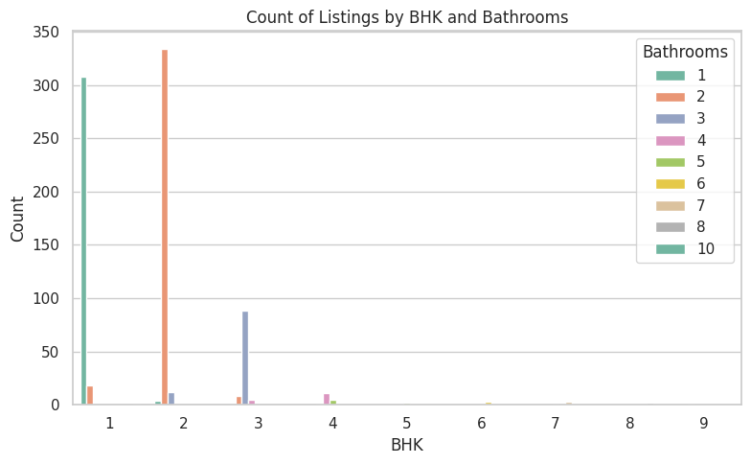
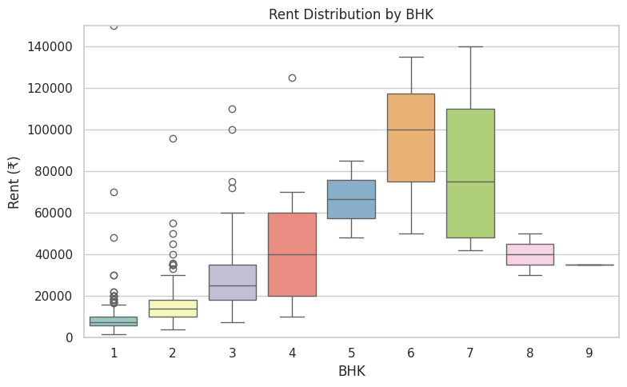
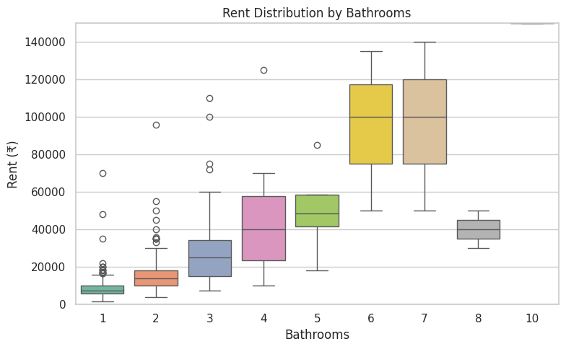
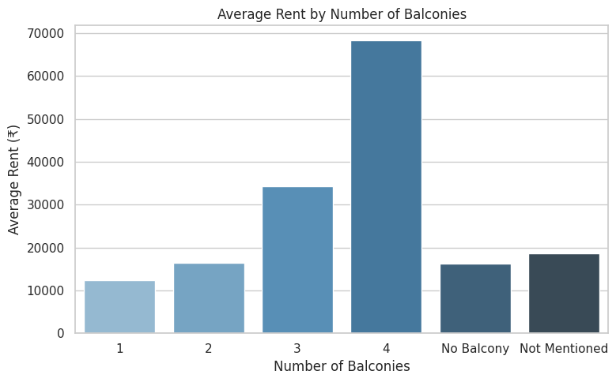
Visual Plots (Bivariate and Multivariate Analysis)

Slide 17
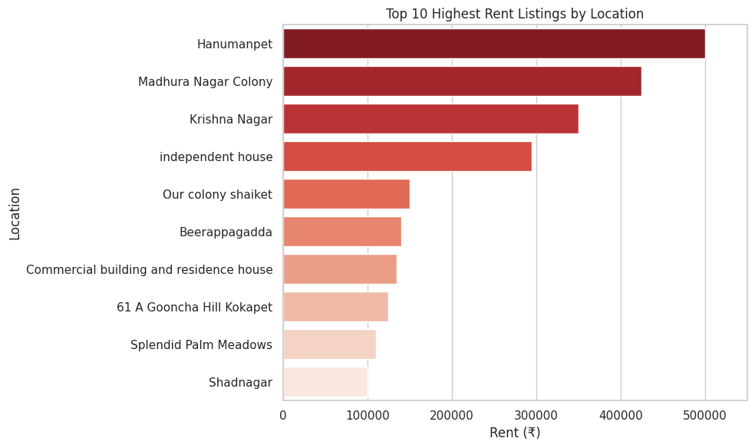
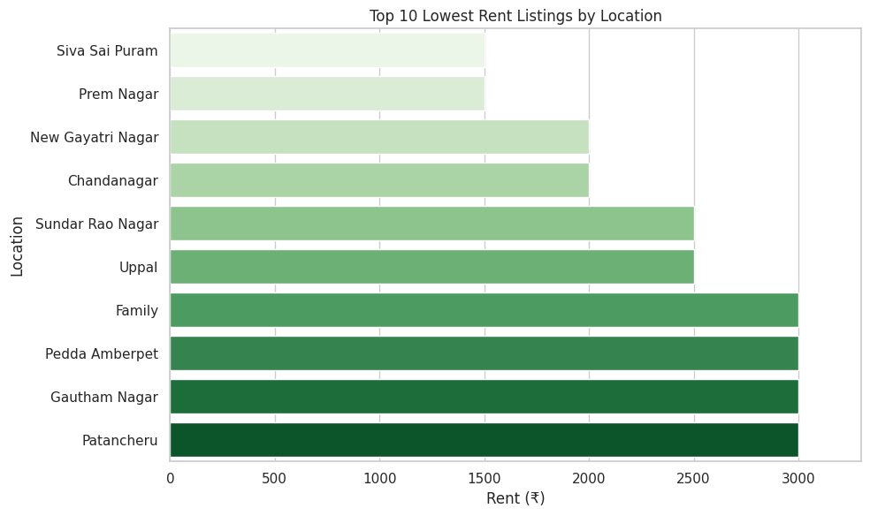
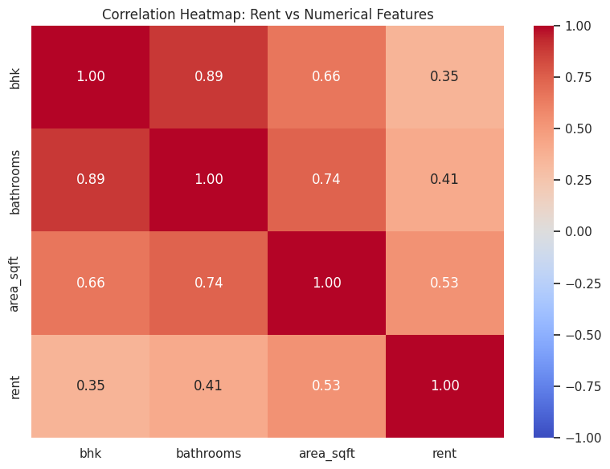
Visual Plots (Bivariate and Multivariate Analysis)

Slide 18
Overall Insights & Conclusion
House Trends
Most listings are 1–2 BHK homes with 1–2 bathrooms, commonly 500–1300 sqft in area.
Majority of rents range from 8K–18K, but luxury outliers go up to 5L/month.
Semi-furnished is the most common furnishing status (~45%).
Rent Distribution Insights
1 BHK + 1 Bath: Most common (305 listings), median rent 7.1K, max 4.25L.
2 BHK + 2 Bath: Common with wide rent range 4K–96K.
High BHK & bath combinations show premium listings, e.g., 6 BHK avg rent 95K.
Feature Influence on Rent
More balconies, covered parking, and better furnishing → higher rents.
Fully furnished homes have the highest avg rent (29.6K), followed by semi-furnished (21.6K).
Balcony count positively impacts rent: 12.2K (1) → 68.3K (4).

Slide 19
Overall Insights & Conclusion
Location Impact
Most listings are from Hyderabad (614/799).
Ameenpur has the most listings; Manikonda shows the highest avg rent (~21.3K).
Prem Nagar has the lowest recorded rent at 5,500.
Hanumanpet and Madhura Nagar Colony has the highest rent listing at 5,00,000 per month.
Affordable zones: Chengicherla (8.4K), Kallakal (5K); high variability in Bayanna Nagar.
Correlation Summary
Strong correlation: BHK ↔ Bathrooms (0.89)
Rent is more correlated with Area (0.53) than BHK (0.35) or Bathrooms (0.41).
Suggests area influences rent more than room count.
Posting Patterns
Most listings posted on weekdays, especially Mondays.
Majority marked as "Available Now" (693/799), indicating an active market.

Slide 20
Experience & Challenges Faced
Experience Gained
Learned end-to-end data workflow: Web Scraping → Cleaning → Analysis → Insights
Gained hands-on experience with BeautifulSoup for extracting real estate listings
Applied Regex & operations for parsing complex text fields (BHK info, rent, area)
Performed Feature Engineering, e.g., deriving city, location, day of week, etc.
Built strong foundation in Exploratory Data Analysis (EDA) using pandas, matplotlib, and seaborn
Challenges Faced
Irregular formats in scraped text (e.g., BHK + area + furnishing in one string)
Missing/incomplete values for features like parking, balcony, etc.
Dealing with dynamic content loading on the website while scraping

Slide 21
Q & A
Any questions or clarifications?

Slide 22

THANK YOU

