Slide 1







Analysis of Technology trends
Erik D. Brumoen
6th October 2024

Slide 2



OUTLINE
Executive Summary
Introduction
Methodology
Results
Visualization – Charts
Dashboard
Discussion
Findings & Implications
Conclusion
Appendix

Slide 3

EXECUTIVE SUMMARY
Context of data and analysis goals.
Methodology description
Data gathering
Data analysis
Data presentation & visualizations
Future Technology Trends
Implications in relations to the overall findings highlighted
Key-take-aways related to analysis, and presented data

Slide 4

INTRODUCTION
Analyze and present findings in relation the technology trends in software- and web development among developers around the world
Analyzed data from Stack Overflow’s annual developer survey covers extensively what the current programming languages are, and which future trends are to be expected.
Purpose of analysis:
Highlight current- and future soft (or eventual hard) requirements, for future jobs related to understanding of tech. languages.
Highlight demographical factors, related to tech. (country, gender)
This analysis hold relevancy to;
Programmers
IT industry leaders
Comp. science students

Slide 5

METHODOLOGY
Collecting survey data and gaining an understanding of given data.
Web scraping
APIs
Request libraries
Data Wrangling
Data cleaning
Data Vizualization
IBM Cognos (dashboards)
Presenting our findings

Slide 6

RESULTS
R

Slide 7
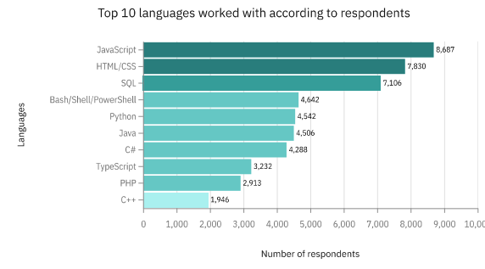
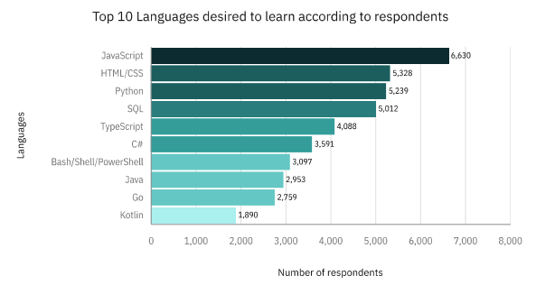
PROGRAMMING LANGUAGE TRENDS
Current Year
Next Year
<Bar chart of top 10 programming languages for the current year goes here.>
< Bar chart of top 10 programming languages for the next year goes here.>

Slide 8
PROGRAMMING LANGUAGE TRENDS - FINDINGS & IMPLICATIONS
Findings
JavaScript and HTML-CSS leading tech. languages.
Interest in Python increasing
Increasing interest in TypeScript And Kotlin
Implications
Favor of status quo. JavaScript/HTML-CSS leads as the languages the most desire to learn.
Pythons increase in popularity is in accordance to assumptions, as it is a leading language used for AI

Slide 9
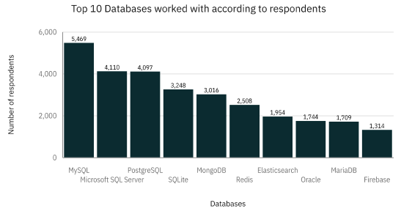
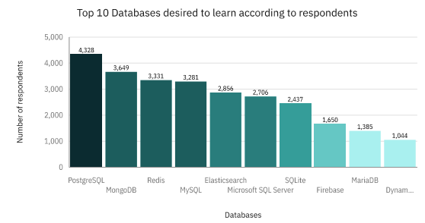
DATABASE TRENDS
Current Year
Next Year
< Bar chart of top 10 databases for the current year goes here >
< Bar chart of top 10 databases for the next year goes here.>

Slide 10
DATABASE TRENDS - FINDINGS & IMPLICATIONS
Findings
MySQL leads as the most frequent used database
PostgreSQL retains fairly high levels of use
Decline in popularity and use in Microsoft SQL
Implications
Favor of status-quo. Open sourced databases preferred.
Increased interested in NoSQL databases like MongoDB and Redis.
PostgreSQL has a fairly high interest comparatively to use

Slide 11
DASHBOARD
Link to the read-only view of the Cognos dashboard:
https://us1.ca.analytics.ibm.com/bi/?perspective=dashboard&pathRef=.my_folders%2FIBM%2BCapstone%2BProject%2B-%2BModule%2B5&action=view&mode=dashboard&subView=model0000019262183625_00000000
https://github.com/B-D-E1804/IBM-Data-Analyst-Capstone-Project/blob/main/IBM%20Cognos%20-%20Capstone%20Project%20pdf.pdf

Slide 12
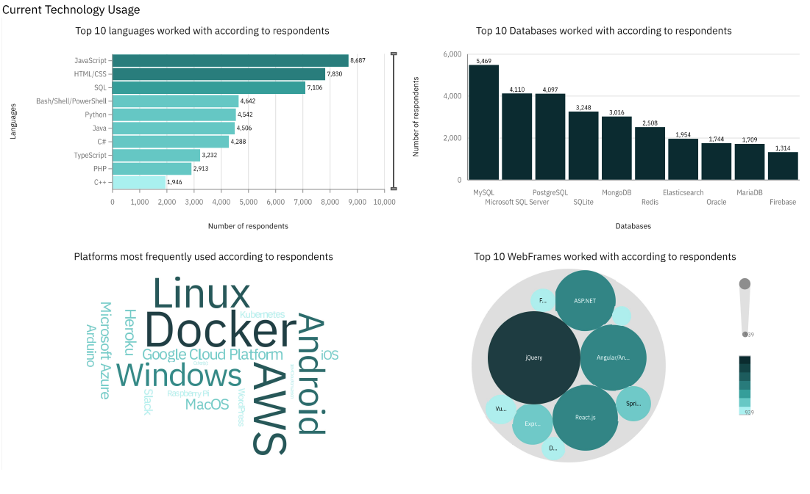
DASHBOARD TAB 1
Screenshot of dashboard tab 1 goes here

Slide 13
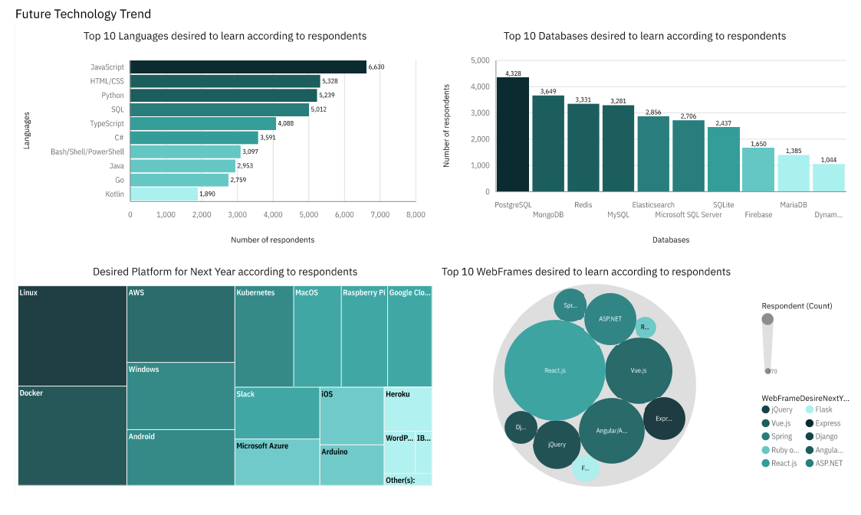
DASHBOARD TAB 2
Screenshot of dashboard tab 2 goes here

Slide 14
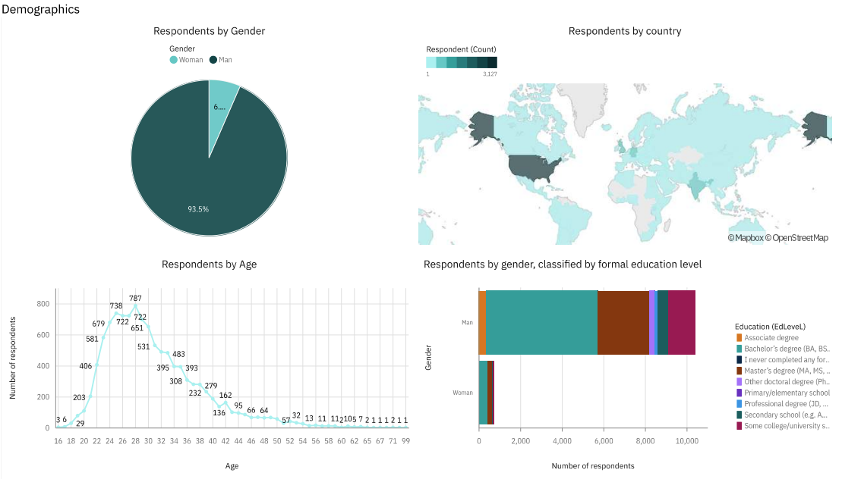
DASHBOARD TAB 3
Screenshot of dashboard tab 3 goes here

Slide 15
DISCUSSION
Impact and overall value of tech popularity- and usage in emerging countries and economies
Lack of females represented in demographics of analyzed data
A real concern in terms of discrimination, or statistical bias due to survey data?

Slide 16
OVERALL FINDINGS & IMPLICATIONS
Findings
JavaScript retains it’s popularity, and is overall desired to be learnt
Male dominated field
Users- or people highly interested in developing usually come from more established countries (USA, Western Europe)
Implications
Little changes annually, although noSQL databases have seen an significant boost in desire to learn/popularity
Majority of developers, have a formal education
Need for higher degree of inclusion; lack of females

Slide 17

CONCLUSION
Technology trends
On par with previous years, with some slight changes in popularity related to a few key programming languages and databases.
On-going development and need of IT/ in emerging economies/countries.
Underlying demographical trends
Age, gender, country

Slide 18

APPENDIX

Slide 19
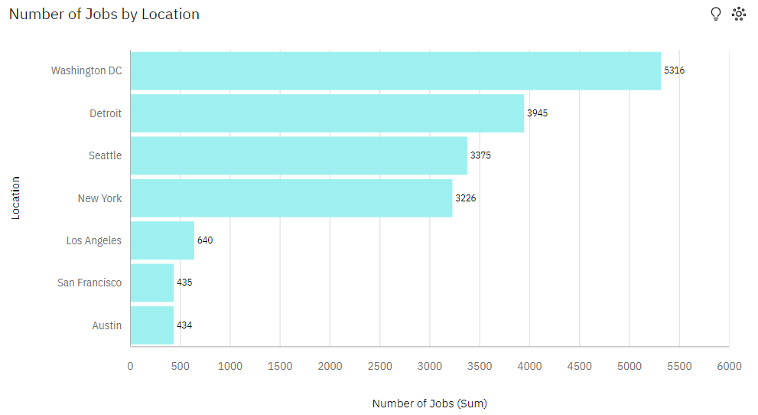
JOB POSTINGS
In Module 1 you have collected the job posting data using Job API in a file named “job-postings.xlsx”. Present that data using a bar chart here. Order the bar chart in the descending order of the number of job postings.

Slide 20
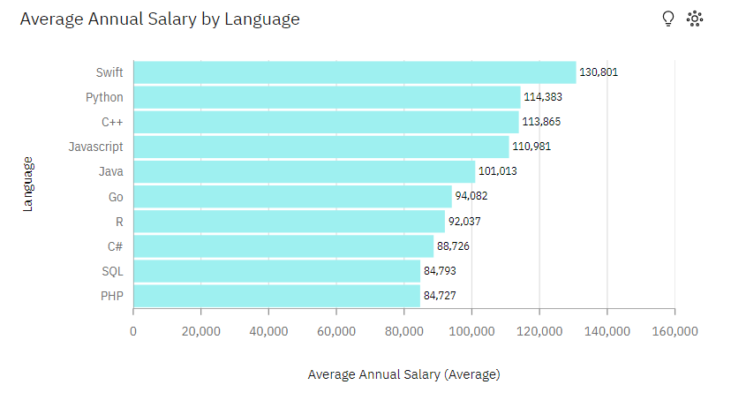
POPULAR LANGUAGES
In Module 1 you have collected the job postings data using web scraping in a file named “popular-languages.csv”. Present that data using a bar chart here. Order the bar chart in the descending order of salary.

