Slide 1
B-FERL: BLOCKCHAIN BASED FRAMEWORK FOR SECURING SMART VEHICLES
- TEAM 3
2019506010
2019506008
2019506083
2019506087
2019506097

Slide 2
OBJECTIVE AND SCOPE
Objective:
To produce a framework for in-vehicle network security that exposes threats in smart vehicles (CAVs) by ascertaining the state of the vehicles internal controls.
Scope of the project:
To build a decentralized security framework for in-vehicle networks
To evaluate the resilience of the proposed framework to identified attacks
To detect Distributed Denial of Service (DDoS) attack using Machine Learning

Slide 3
BLOCKCHAIN IMPLEMENTATION
Blockchains are immutable and decentralized ledgers that help us store data and the transactions in a series of blocks.
Ethereum is a decentralized open-sourced platform that allows us to build other blockchain applications on it using smart contract. An Ethereum blockchain account is created using the Ethereum cryptocurrency wallet. The Ethereum cryptocurrency wallet allows us to interact with the Ethereum blockchain and decentralized applications.
Here, Metamask wallet is used to interact with the Ethereum blockchain. It provides unique account address, public key and private key that ensures a secure interaction with the Ethereum blockchain.
SOFTWARE TOOLS USED:
Remix Ethereum IDE, Metamask wallet, Rinkeby Test Network
PROGRAMMING LANGUAGE:
Solidity (Ethereum)

Slide 4
SMART CONTRACTS
A smart contract is a computer program or a transaction protocol that run on the blockchain when predetermined conditions are met.
They are used to automate the execution of an agreement according to the terms of a contract.
Solidity is an object-oriented programming language for writing smart contracts. It is used to implement smart contracts on various blockchain platforms like Ethereum.
Here, Remix Ethereum IDE is used to create, compile and debug smart contracts and Rinkeby Test Network is used to test smart contracts before deployment.
Sample smart contract
pragma solidity ^0.5.0;
contract Sample
{
constructor() public{ }
function getResult() public view returns(uint)
{
uint a = 1; uint b = 2;
uint result = a + b;
return result;
}
}

Slide 5
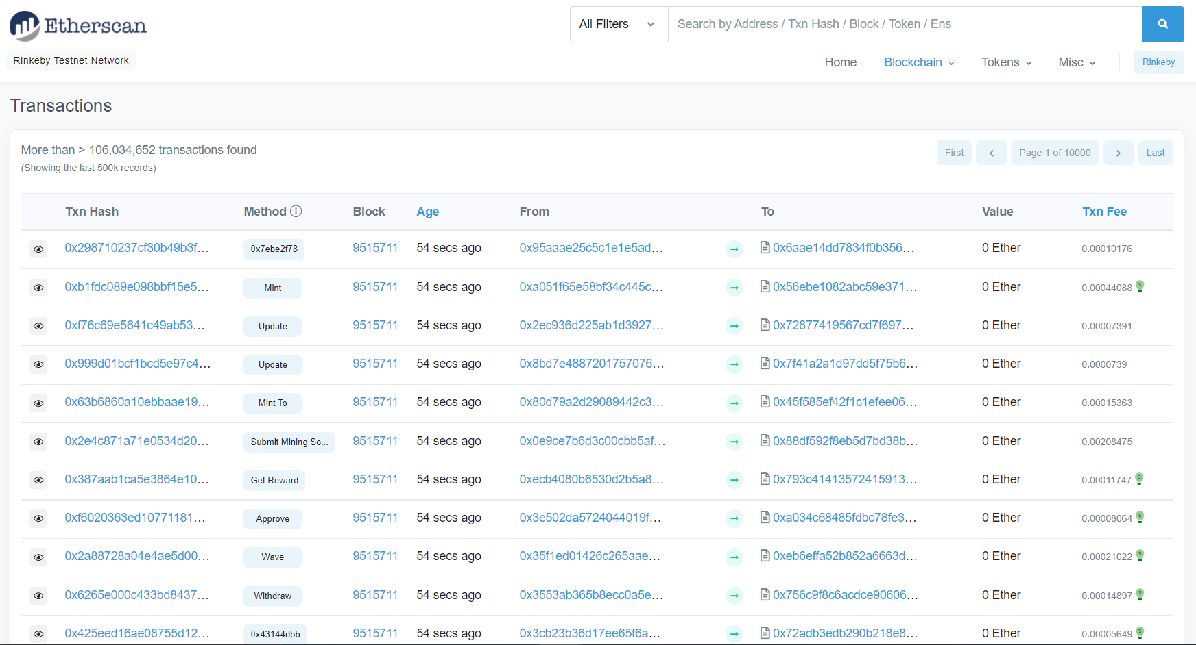
TRANSACTIONS IN BLOCKCHAIN

Slide 6
REGISTRATION OF CAV
Registration of a CAV by vehicle manufacturer when it is assembled creates a block called the genesis block for the CAV and this transaction is termed as genesis transaction.
A genesis block consists of
A public key/id
Firmware hashes of all ECUs (Electronic Control Units)
SS_{ID} – Merkle tree root from all firmware hashes
Timestamp of block
This block becomes a permanent block in the blockchain after the authenticity of the transaction is verified by the transport and legal authorities. This block is used for validate the CAV in the lower tier until a further update
Source Code Link:
https://drive.google.com/drive/folders/17IHNmS1bxdY6qyUsF0uPnqmRt0zUNq-8?usp=sharing

Slide 7
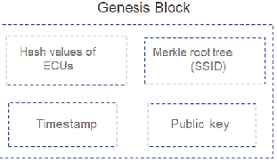
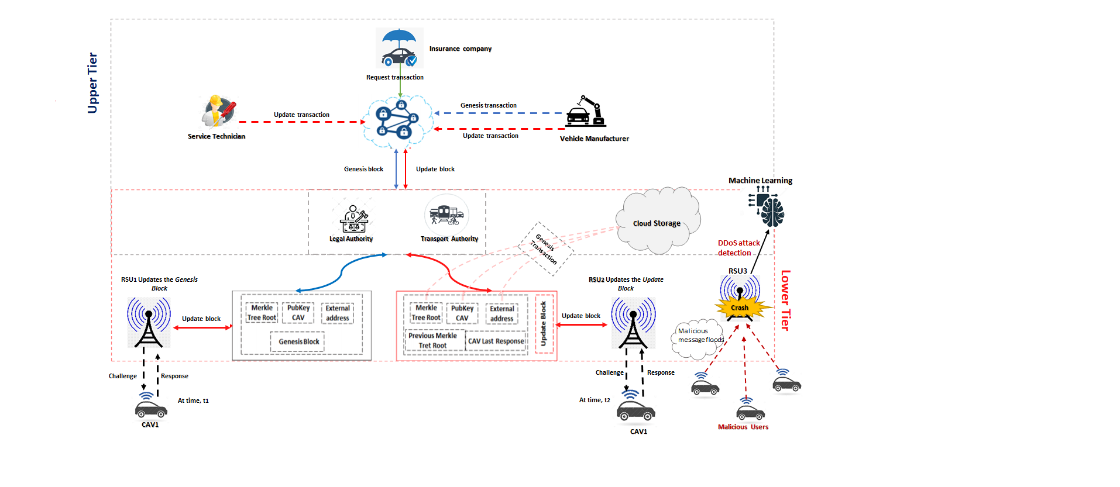

Slide 8
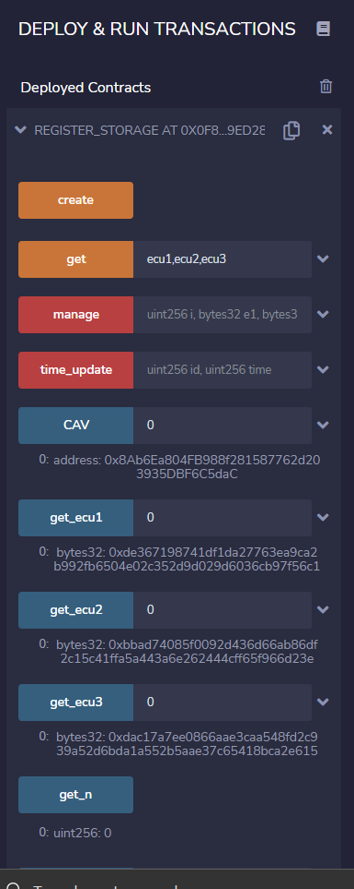
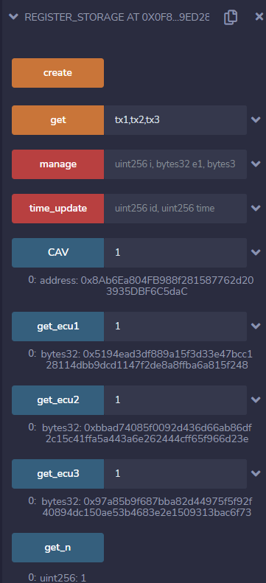
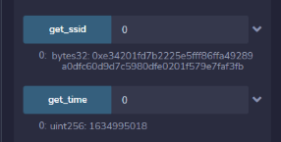
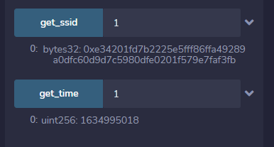
OUTPUT

Slide 9
CHALLENGE RESPONSE MECHANISM
When CAV approaches a RSU ,the RSU sends challenge request CAV to prove the integrity of its ECUs.
CAV computes the SSID and hash values of the selected ECUs including its signature, time stamp and public key to as a response to the RSU for the verification.
The RSU first checks the validity of CAV by checking the Blockchain for the block of that CAV. If no block found it reports the malicious CAV.
If the validation succeeds, RSU compares the SSID in response received from CAV with the SSID in the block. When SSID is verified it checks the hash value of a random ECU. When verification is successful updation in the lower tier occurs. If the CAV fails to prove its integrity, RSU reports the malicious CAV.
When the same CAV encounters the another RSU , challenge and response activity begins again . It follows the same step as above but in-addition ton those, the RSU compares the time stamp on the response data to the immediate previous record stored on the lower tier blockchain to prevent any reply attack.
The time stamp value is expected to continuously increase as the vehicle travels, in this is the case, RSU updates the CAVs block

Slide 10
Source code link:https://drive.google.com/drive/folders/1Jpa-syjMaH2uRHR8MiLJ3Q881LI5aWTF?usp=sharing

Slide 11
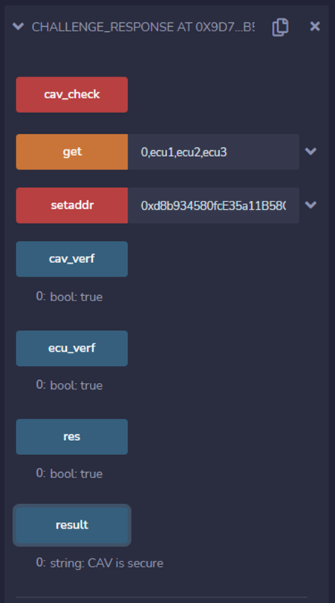
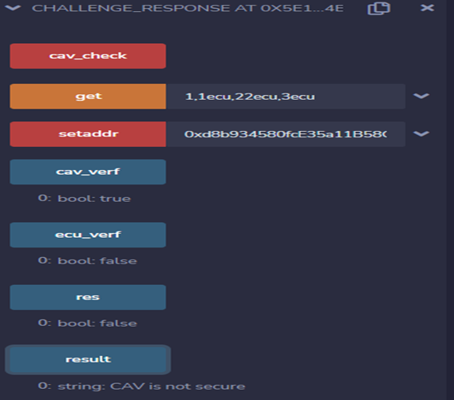
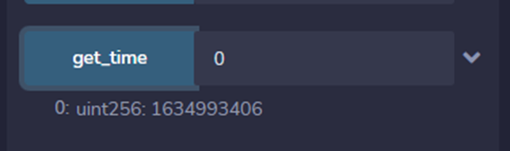
OUTPUT
Valid CAV Malicious CAV

Slide 12
UPDATION OF CAV
The Updation transaction is initiated by a service technician or by the vehicle manufacturer. When an ECU in the CAV is updated, the update transaction is initiated and this is done during the process of scheduled maintenance or diagnostics.
An updation leads to the change in SSID value.
This updation occurs in the upper or lower tier and when it is initiated in the upper tier, the transaction updates the record in the upper tier.
In the lower tier, it occurs when a CAV provides a response to the challenge request initiated by an RSU
Source code link: https://drive.google.com/drive/folders/1c3MVrFcqPpDBb6v5ykW0-e6C9hxLU5ns?usp=sharing

Slide 13
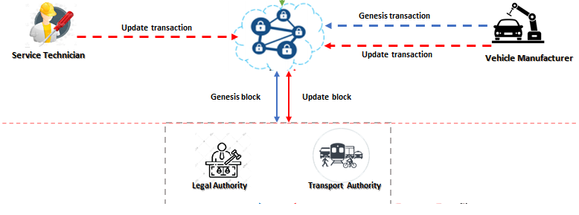

Slide 14
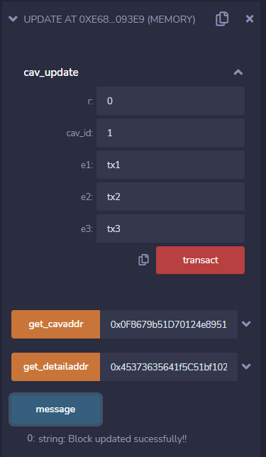
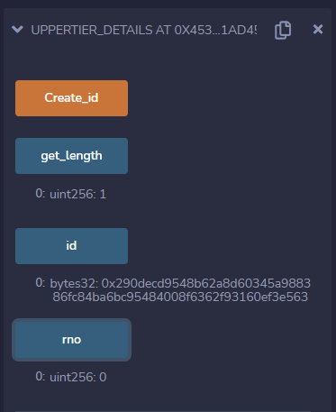
OUTPUT

Slide 15
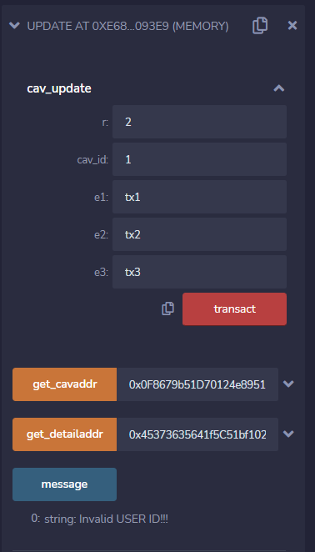
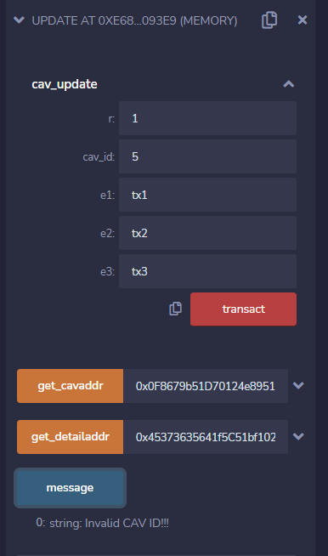

Slide 16
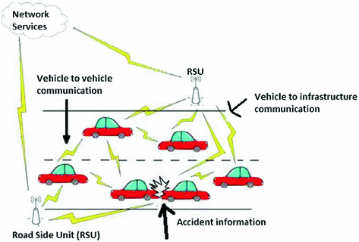
DDoS ATTACKS IN VANETs
Distributed denial of service (DDoS) attacks are a subclass of denial of service (DoS) attacks. It involves multiple connected online devices, which are used to overwhelm a target website with fake traffic.
DDoS attacks aim to make your website and servers unavailable to legitimate users. DDoS can also be used as a smokescreen for other malicious activities and to take down security appliances, breaching the target’s security perimeter.
From a high level, a DDoS attack is like an unexpected traffic jam clogging up the highway, preventing regular traffic from arriving at its destination.

Slide 17
DATASET USED:
CIC-IDS 2017 :
Canadian Institute of Cybersecurity IDS 2017 dataset is used for detection of DDoS attacks.
PYTHON LIBRARIES USED :
NumPy
Pandas
Matplotlib
Seaborn
Scikit-Learn
Source code link: https://colab.research.google.com/drive/15m4568mYjrMT6PnNiTm7tSPNXPoqDvAX

Slide 18
DATA PRE-PROCESSING
Import the python libraries like numpy, pandas, matplotlib, seaborn and scikit-learn.
Import the dataset using the pandas library.
View the imported dataset.
Replace zeros with NaN values.
Convert the data type of certain columns into float values to compute accurate mean values.
Replace the NaN values with the mean values of their respective columns.
Provide the aggregate functions for the dataset for statistical use.
Removed the infinity float values of the dataset.

Slide 19
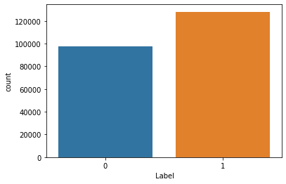
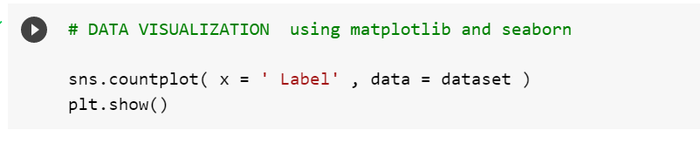
DATA VISUALIZATION
With the use of seaborn and matplotlib libraries, the data visualization of the dataset has been done.
The graph has been plotted using the ‘Label’ column in the dataset.
As the imported dataset is considered to be an unbalanced one, Recall Scores is chosen as a metric to calculate the performance of the model.

Slide 20
FEATURE SCALING
Data Scaling is a data preprocessing step for numerical features. Many machine learning algorithms like Gradient descent methods, KNN algorithm, linear and logistic regression, etc. require data scaling to produce good results. Various scalers are defined for this purpose.
In this data scaling, where the minimum of features is made equal to zero and the maximum of features equal to one. MinMax Scaler shrinks the data within the given range, usually of 0 to 1. It transforms data by scaling features to a given range. It scales the values to a specific value range without changing the shape of the original distribution.
The mathematical formulation for Min-Max Scaler:
X(scaled) = x-min(x)/max(x) – min(x)
For code, the collaboration link is: https://colab.research.google.com/drive/1DnzxgVuHsJIx0Zly-nUTP1RZebg0P3kC?usp=sharing

Slide 21
ALGORITHMS
Objective
To detect DDoS Detection, we use a dataset to evaluate and identify the right algorithm. We apply Machine learning algorithms on preprocessed Dataset to find the best algorithm of them all.
DATASET USED:
CIC-IDS 2017 :
Canadian Institute of Cybersecurity IDS 2017 dataset is used
for detection of DDoS attacks.
ALGORITHMS:
Random Forest
Logistic Regression
K-Nearest Neighbour
Decision Tree
XG Boost

Slide 22
MACHINE LEARNING ALGORITHMS
Here we have applied five ML algorithms namely Logistic Regression, KNN, Random forest, Decision Tree, XgBoost.
Logistic Regression
Logistic regression is a machine learning algorithm, which comes below the Supervised Learning approach used for fixing classification problems. It is used for predicting the categorical dependent variable with a given set of unbiased variables.
K-Nearest Neighbor
K-Nearest Neighbor is one of the least complex Machine Learning calculations dependent on Supervised Learning procedure utilized for classification problems. KNN calculation accepts the comparability between the new data and previously present cases and put the new case into the classification that is generally alike the available classes.

Slide 23
Random Forest
Random Forest is an machine learning algorithm that has a place with the regulated learning strategy utilized for both Classification and Regression issues in ML. It depends on the idea of ensemble learning, which is a course of consolidating various classifiers to take care of a complex problem and to work on the result of the model.
Decision Tree
Decision Tree is a supervised learning strategy utilized predominantly for classification. It is a tree-structured classifier, where internal nodes address the characteristics of a dataset, branches address the decision rules and each leaf node addresses the result.
XGBoost
XGBoost stands for “Extreme Gradient Boosting”. XGBoost is an optimized distributed gradient boosting library.It implements Machine Learning algorithms under the Gradient Boosting framework. It provides a parallel tree boosting to solve many data science problems in a fast and accurate way.

Slide 24
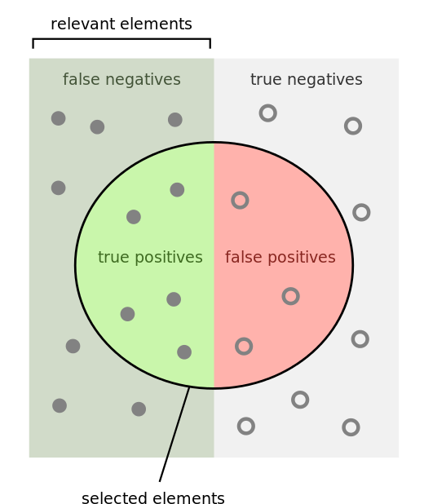
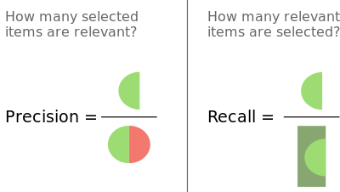
PRECISION AND RECALL SCORE
Now we proceed to estimate the precision and recall score of each of the five algorithms. Precision score quantifies the number of positive class predictions that actually belong to the positive class. Recall score quantifies the number of positive class predictions made out of all positive examples in the dataset.

Slide 25
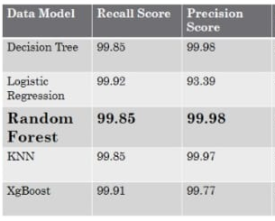
COMPARATIVE ANALYSIS

Slide 26
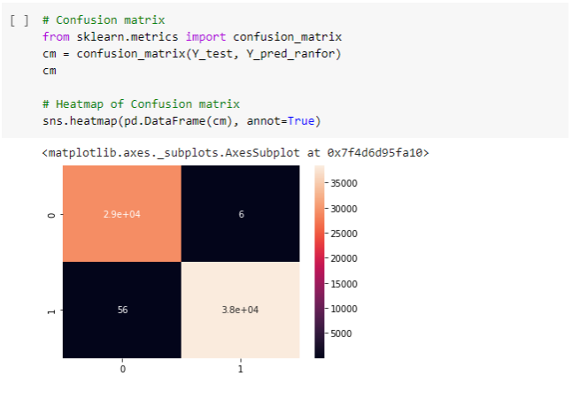
CONFUSION MATRIX FOR RANDOM FOREST
From the recall and the precision scores of the algorithms used Random Forest algorithm performs better.

Slide 27
THANK YOU

