Slide 1

CS 5/7320 Artificial Intelligence Making Simple Decisions AIMA Chapter 16
Introduction slides by Michael Hahsler
Decision network slides by Dan Klein and Pieter Abbeel
This work is licensed under a Creative Commons Attribution-ShareAlike 4.0 International License.

Slide 2
Decision theory = Probability theory (evidence & belief) + Utility theory (want)

Slide 3
Decision-theoretic agents
Logical agents
Uncertainty
Conflicting goals
Goal-based agents
Can only assign goal/not goal to states and find goal states.
Decision-theoretic agents
Assign a utility value to each state.
Cannot deal with:
A rational agent optimizes the expected utility.
Utility is related to the external performance measure (see PEAS).

Slide 4


Utility
A utility function $U\left(s\right)$ expresses the desirability of a state.
Utility functions are derived from rational preferences:
$U\left(A\right)>U\left(B\right)\overset{⇔}{}A≻B$ and $$U\left(A\right)=U\left(B\right)\overset{⇔}{}A\sim B$$
Therefore, often it is enough to know the utility ranking of states.

Slide 5



Expected Utility
We need:
A utility function $U\left(s\right).$
The probability to currently be in every state $P\left(s\right).$
The probability that an action will get us to different states s’ $P\left(Result\left(a\right)=s^{′}\right)=\sum_{s}{P\left(s\right)P(s^{′}|s,a)}$
Expected utility of an action: $$EU\left(a\right)=\sum_{s′}{P\left(Result\left(s\right)=s^{′}\right)U(s^{′})}$$

Slide 6
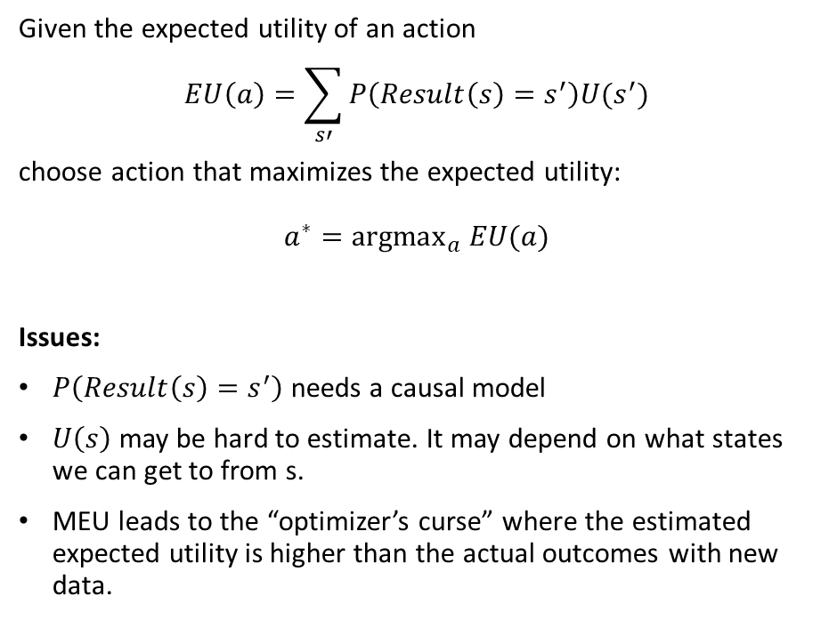
Principle of Maximum Expected Utility (MEU)
Action
Given the expected utility of an action $$EU\left(a\right)=\sum_{s′}{P\left(Result\left(s\right)=s^{′}\right)U(s^{′})}$$
choose action that maximizes the expected utility: $$a^{∗}={argmax}_{a} EU(a)$$
Issues:
$P\left(Result\left(s\right)=s^{′}\right)$ needs a causal model
$U\left(s\right)$ may be hard to estimate. It may depend on what states we can get to from s.
MEU leads to the “optimizer’s curse” where the estimated expected utility is higher than the actual outcomes with new data.

Slide 7
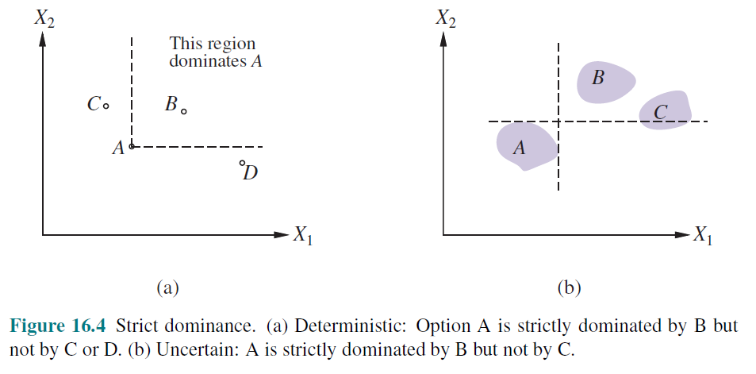
Multi-attribute Utility Theory

Slide 8
Decision Networks
These slides were created by Dan Klein, Pieter Abbeel, Sergey Levine, with some materials from A. Farhadi. All CS188 materials are at http://ai.berkeley.edu

Slide 9

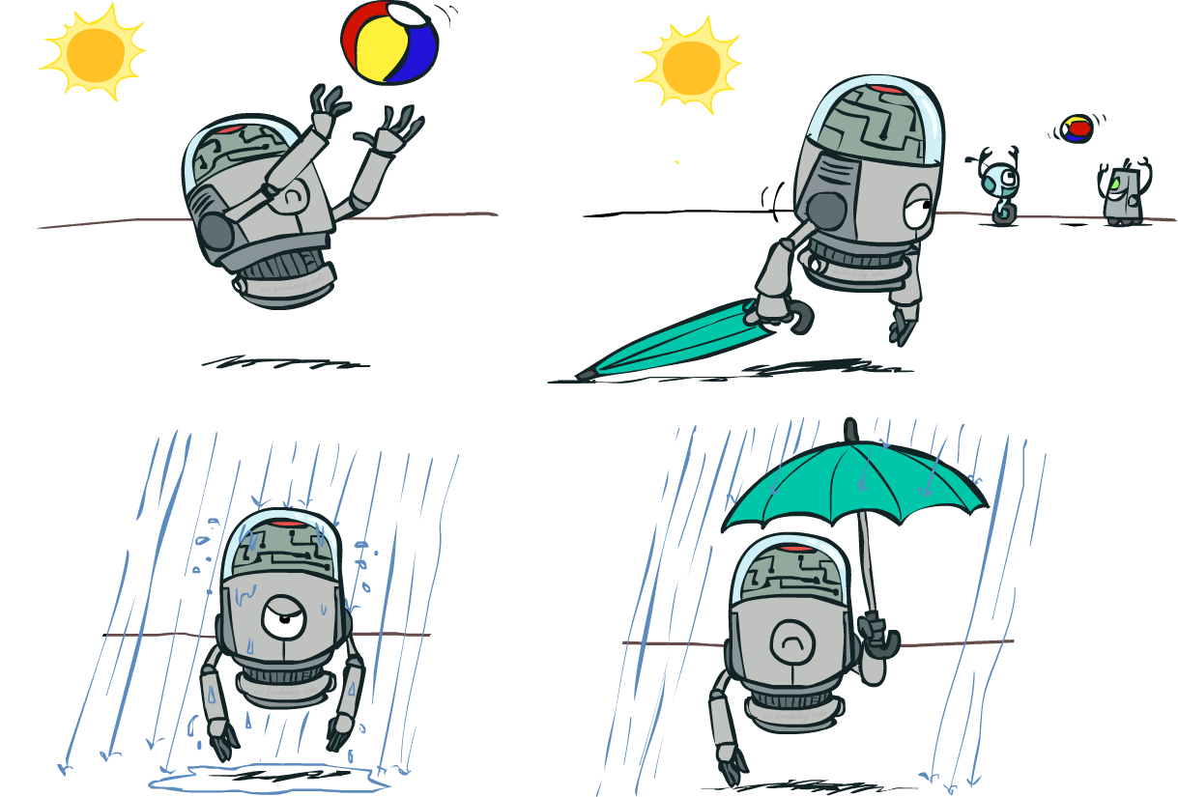

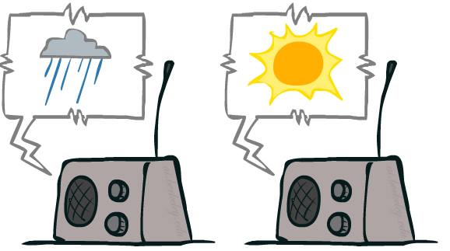
Decision Networks
Umbrella
U
Weather
Forecast
Notes:
There exists a ghostbusters demo

Slide 10
Decision Networks
MEU: choose the action which maximizes the expected utility given the evidence
Can directly operationalize this with decision networks
Bayes nets with nodes for utility and actions
Let's us calculate the expected utility for each action
New node types:
Chance nodes (just like BNs)
Actions (rectangles, cannot have parents, act as observed evidence)
Utility node (diamond, depends on action and chance nodes)
Umbrella
U
Weather
Forecast
Notes:
There exists a ghostbusters demo

Slide 11
Decision Networks
Action selection
Instantiate all evidence
Set action node(s) each possible way
Calculate posterior for all parents of utility node, given the evidence
Calculate expected utility for each action
Choose maximizing action
Umbrella
U
Weather
Forecast
Notes:
There exists a ghostbusters demo

Slide 12
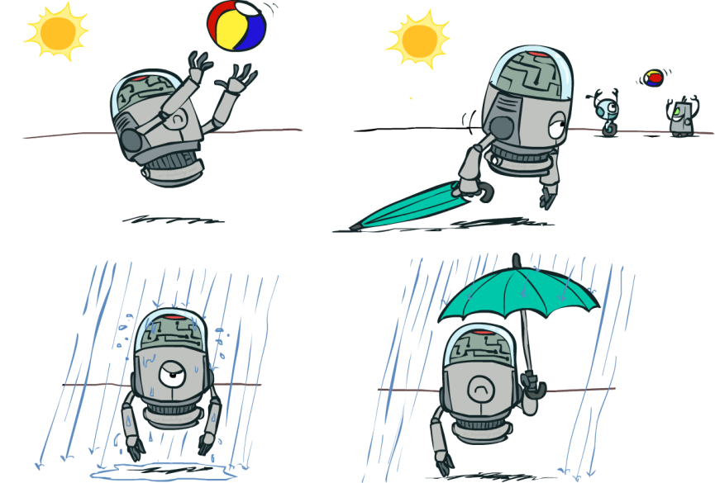
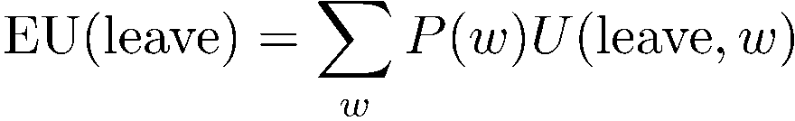
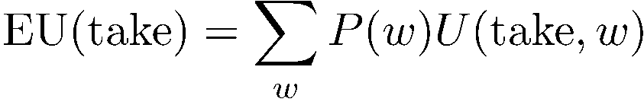

Decision Networks
Umbrella = leave
Umbrella
U
Umbrella = take
Weather
A | W | U(A,W)
leave | sun | 100
leave | rain | 0
take | sun | 20
take | rain | 70
W | P(W)
sun | 0.7
rain | 0.3
Optimal decision = leave
Notes:
There exists a ghostbusters demo

Slide 13
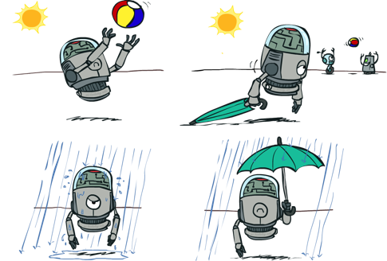





Decisions as Outcome Trees
{}
take
leave
Umbrella
Weather | {}
Weather | {}
U
Weather
sun
sun
rain
rain
U(t,s)
U(t,r)
U(l,s)
U(l,r)
Almost exactly like expectimax / MDPs
What’s changed?

Slide 14
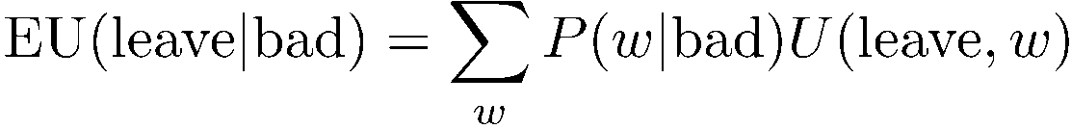


Example: Decision Networks
Umbrella = leave
A | W | U(A,W)
leave | sun | 100
leave | rain | 0
take | sun | 20
take | rain | 70
Umbrella
U
Umbrella = take
Weather
W | P(W|F=bad)
sun | 0.34
rain | 0.66
Optimal decision = take
Forecast
=bad

Slide 15

Decisions as Outcome Trees
Umbrella
{b}
take
leave
U
W | {b}
W | {b}
Weather
sun
sun
rain
rain
U(t,s)
U(t,r)
U(l,s)
U(l,r)
Forecast
=bad

