Slide 1
Employees Data Analysis with Excel
Student Name : Jaya Prakash B
User ID : asunm110312201038
29D4A4CAEB3C3CABA474C3A0B0A2AC56
Department : III B. COM ( A&F )
College : DRBCCC Hindu College

Slide 2
Project Title
Employee FTE using FUNNEL, CHART AND HISTOGRAM

Slide 3

Agenda
Problem Statement
Project Overview
End Users
Our Solution and Proposition
Dataset Description
Modelling Approach
Results and Discussion
Conclusion

Slide 4
Problem Statement
“Despite having a large workforce, our organization struggles with inefficient resource allocation, leading to increased costs and decreased productivity.” “Current workforce planning processes are manual, time-consuming, and lack data-driven insights, hindering our ability to make informed decisions.” “Our organization faces challenges in optimizing employee FTE, resulting in skill gaps, underutilization, and missed opportunities for growth.” “Inefficient management of employee FTE leads to unnecessary

Slide 5
Project Overview
“This project aims to analyze employee Full-Time Equivalents (FTE) to inform strategic workforce planning, optimize resource allocation, and drive business growth.” “Project Overview: Leveraging Excel to analyze employee FTE data, identifying trends, and providing actionable insights for organizational improvement.” “Our project seeks to provide a comprehensive analysis of employee FTE, enabling data-driven decisions on talent management, workforce planning, and organizational design.” “This initiative focuses on examining employee FTE data to uncover opportunities for cost savings, productivity enhancements, and improved workforce utilization.”

Slide 6
Who are the End Users?
"The primary end users of this analysis are HR leaders, talent managers, and organizational planners seeking data-driven insights to inform workforce decisions.”
"Our target audience includes business stakeholders, department heads, and operations teams who will benefit from optimized employee FTE and improved resource allocation.“
"The end users of this solution are executives, managers, and analysts responsible for strategic workforce planning, talent management, and organizational design."

Slide 7
Our Solution and Proposition
“Our solution leverages data-driven insights from employee FTE analysis to optimize workforce planning, reduce costs, and improve productivity.” “We propose a tailored approach to managing employee FTE, enabling organizations to right-size their workforce, enhance efficiency, and drive business growth.” “Our proposition: Unlock the full potential of your workforce by harnessing the power of employee FTE data, informing strategic decisions, and driving operational excellence.” “Our solution helps organizations make informed decisions about employee FTE, ensuring optimal resource allocation, improved talent management, and increased competitiveness.” “We offer a data-informed solution to optimize employee FTE, reducing waste, improving agility, and aligning workforce capacity with business objectives.”

Slide 8
Dataset Description
“The dataset comprises employee FTE data, encompassing [number] records and [number] attributes, providing a comprehensive view of our workforce.” “Our dataset consists of employee FTE information, including [list specific attributes, e.g., department, job title, location], enabling detailed analysis and insights.” “The employee FTE dataset used in this analysis contains [number] data points, offering a robust foundation for examining workforce trends and patterns.” “This dataset describes employee FTE across [specific dimensions, e.g., business units, regions, job functions], facilitating informed decision-making.” “The dataset includes employee FTE data for [specific time period or snapshot], providing a snapshot of our workforce at [specific point in time].”

Slide 9
Modelling Approach
"We employed a data-driven approach, utilizing Excel to analyze employee FTE and uncover insights into workforce dynamics.“
"Our modelling approach involved a detailed examination of employee FTE data to identify trends, patterns, and correlations.“
"Using Excel, we developed a comprehensive model to analyze employee FTE, enabling us to inform strategic workforce decisions.“
"Our approach leveraged Excel's analytical capabilities to explore employee FTE data, revealing opportunities for optimization and improvement.”

Slide 10
Results of Employee FTE

Slide 11
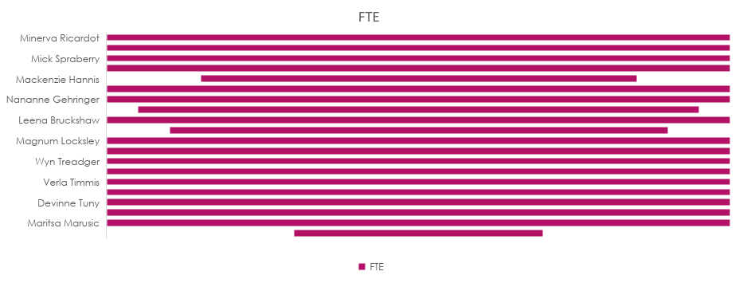
Employee FTE Using Funnel

Slide 12
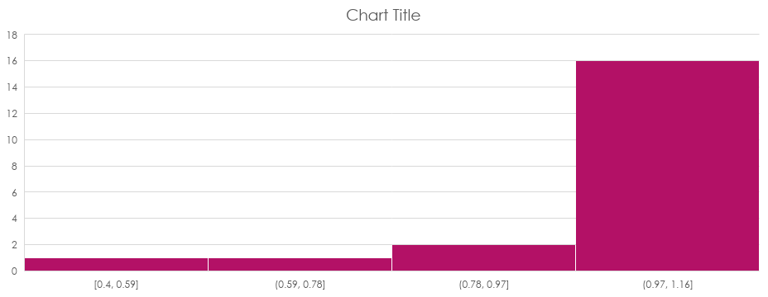
Employee FTE Using Histogram

Slide 13
Conclusion
“Our analysis of employee FTE reveals opportunities to optimize workforce planning and improve organizational efficiency.” 2. “By examining employee FTE, we can inform strategic decisions on staffing, resource allocation, and talent management.” 3. “This analysis provides valuable insights into employee FTE, enabling us to make data-driven decisions and drive business growth.” 4. “Our findings on employee FTE highlight areas for improvement in workforce utilization and productivity.” 5. “By understanding employee FTE, we can better align our workforce with business objectives and achieve operational excellence.”

